Slide 1
Planned Production of Electricity in BD
Md. Rakibur Rahman
GID:

Slide 2
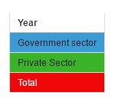
Production of Electricity
Production Sources
2 Types
Government Sector
Private Sector

Slide 3
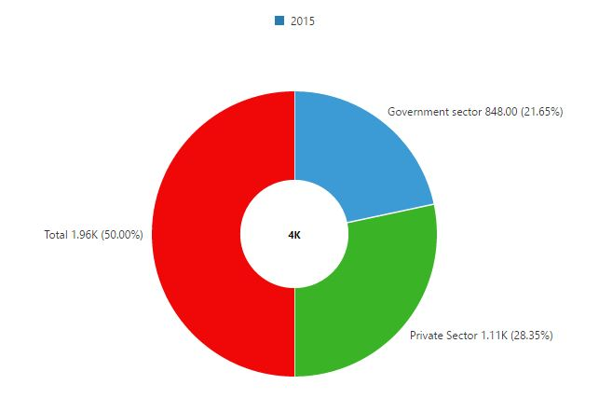
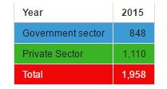
Production of Electricity
Production in 2015

Slide 4
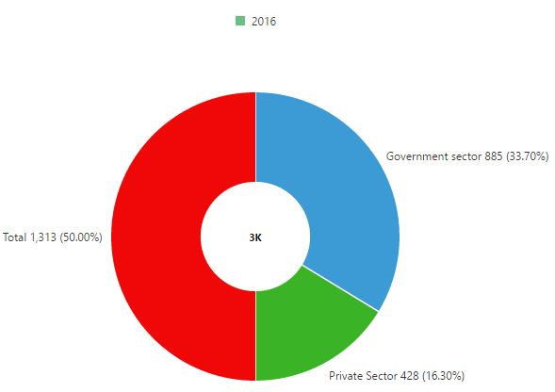
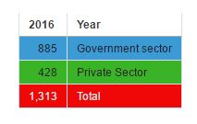
Production of Electricity
Production 2016

Slide 5
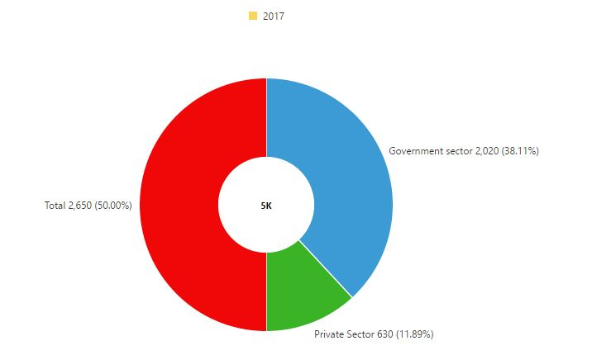
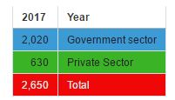
Production of Electricity
Production in 2017

Slide 6
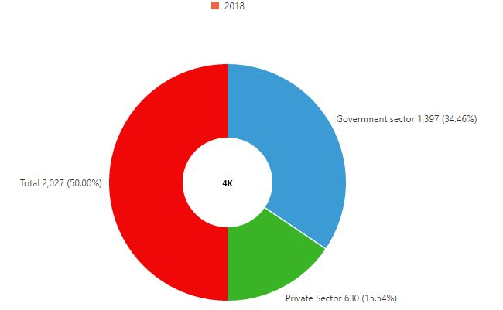
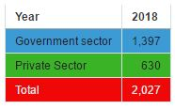
Production of Electricity
Production in 2018

Slide 7
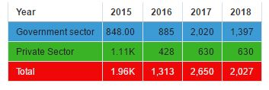
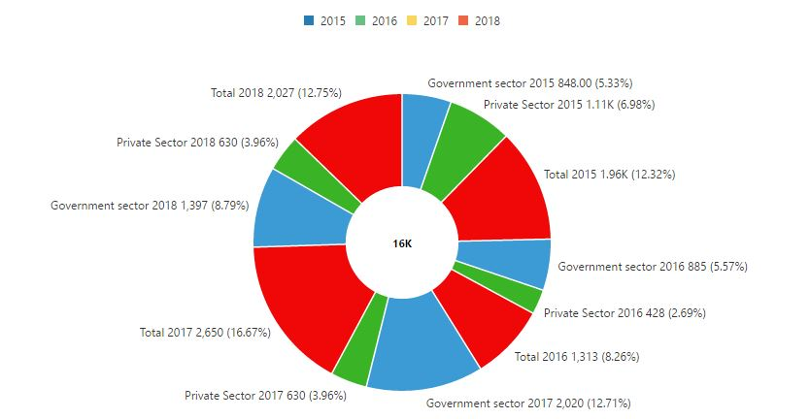
Production of Electricity
Production 2015-2018

Slide 8
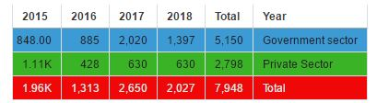
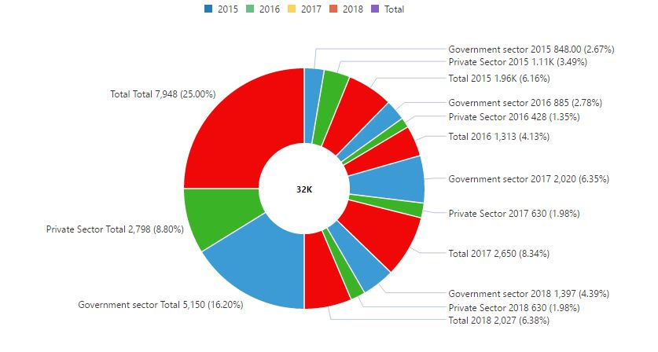
Production of Electricity
Production Total (2015-2018)

Slide 9
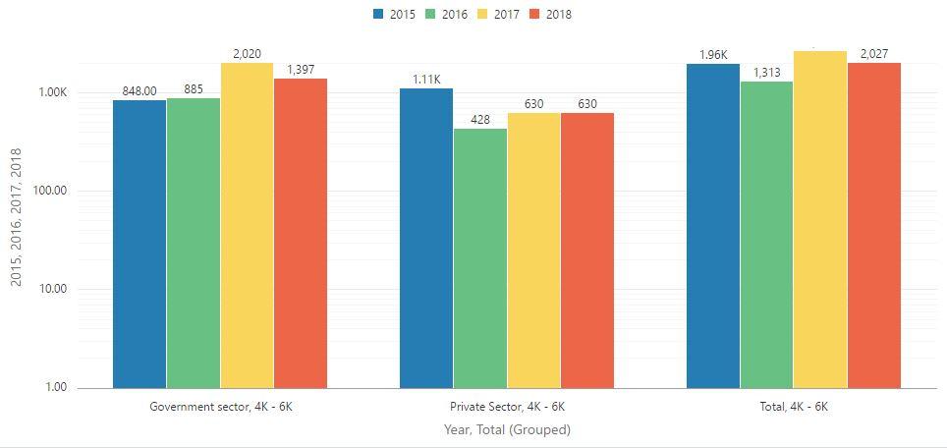
Production of Electricity
Production Bar Diagram (Sector by Year)

