Slide 1

Household Power Consumption & Prediction
Raikibul Hasan, Rukhsar Ahmed

Slide 2
Outline
01
Overview
Why this topic is interest.
02
Data
Data description /visualization.
03
Model
04
Discussion & Conclusion

Slide 3
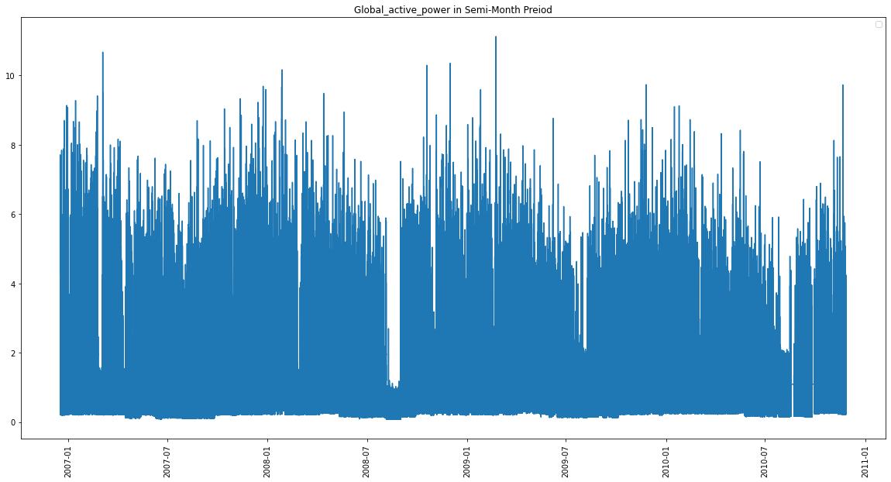
With the advent of new gadgets and a push towards greater electrification projects globally, power consumption is rising globally.
Thus, we can also expect that household or residential power consumption is so on the rise. With greater access to global power consumption data, forecasting power consumption is an emerging challenge.
Household Power Consumption

Slide 4


Why prediction is important?
An accurate forecast can help both the consumer as well as the supplier side
For the consumer, a power forecast helps in financial planning as making more green choices overall
For the supplier, an accurate forecast will definitely help in supply regulation.
Such a forcasting models can help to optimize the overall supply chain of the household power industry.

Slide 5
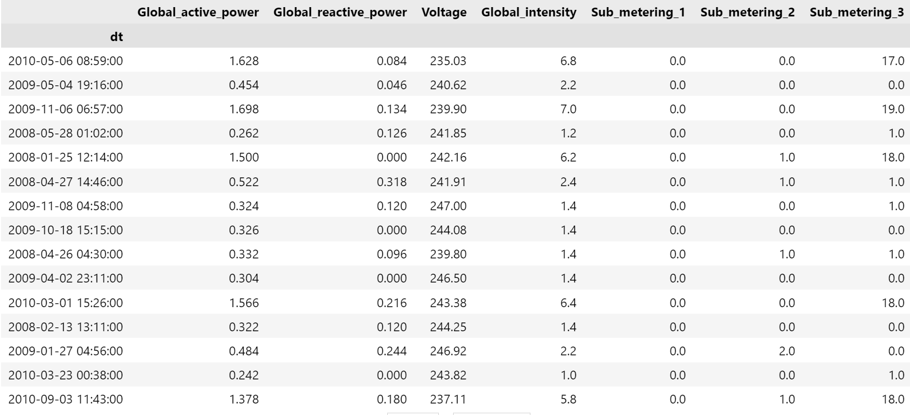
Data

Slide 6
ML
Machine Learning
Section Break

Slide 7
Closing Price of Apple

Slide 8
Sales volume History

Slide 9
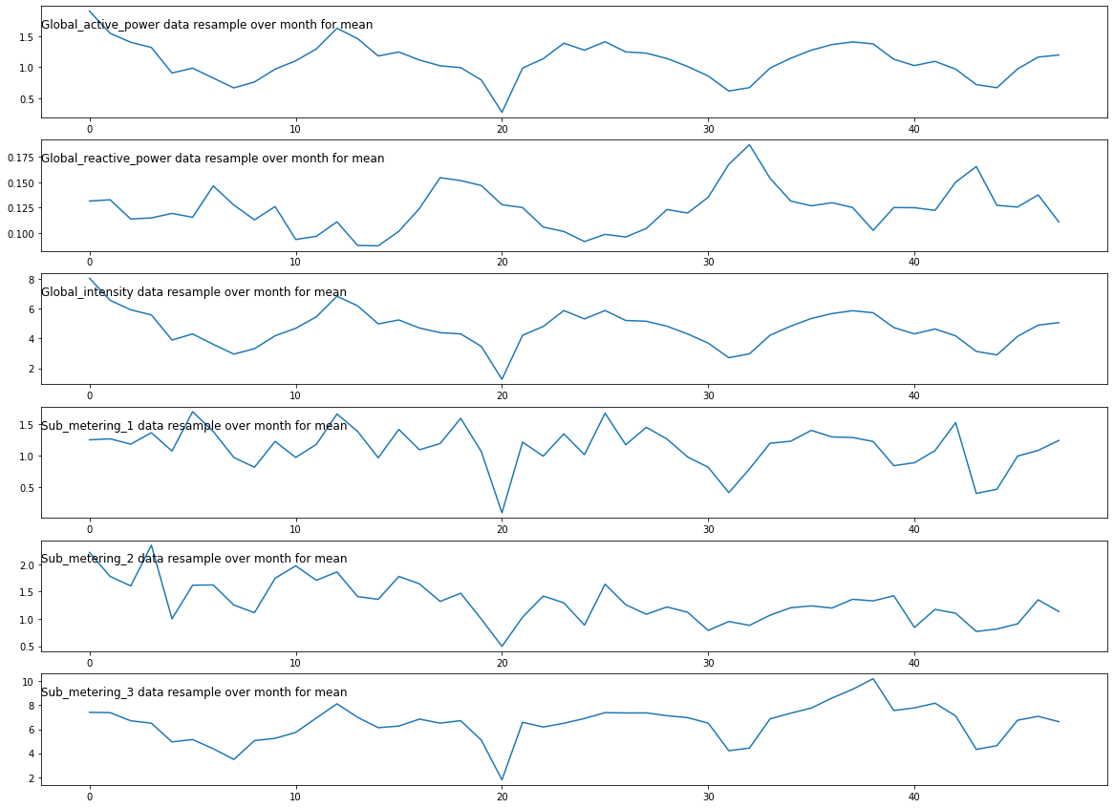
Moving Average of the various Stocks

Slide 10
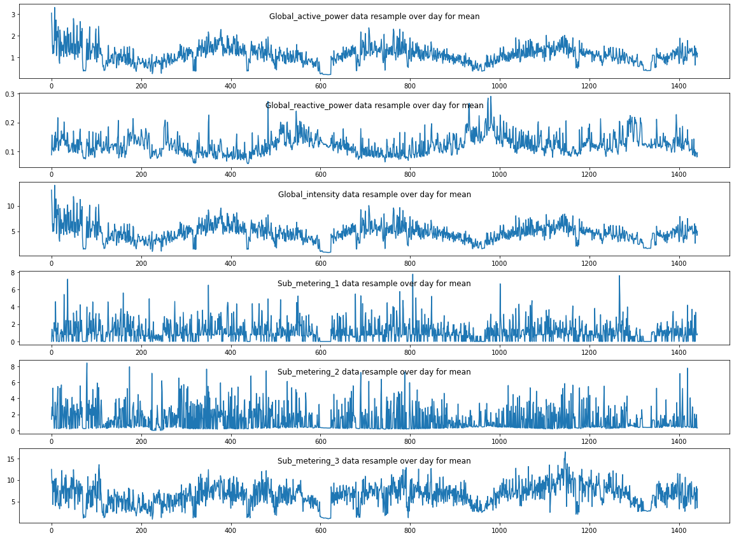
Average daily return using a histogram

Slide 11
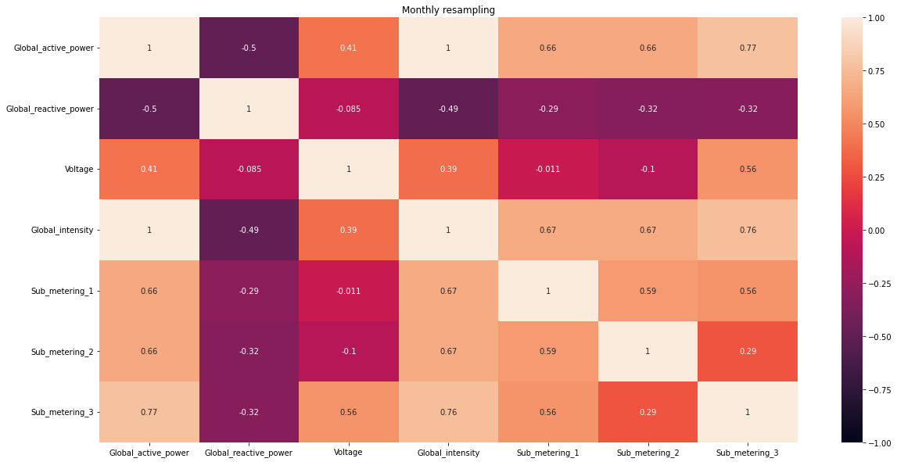
Correlation of

Slide 12
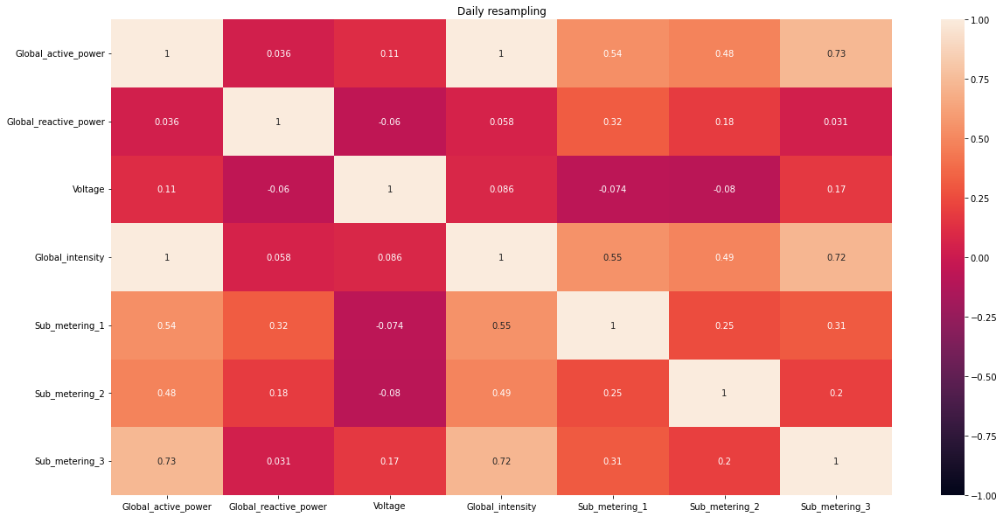
Correlation of

Slide 13
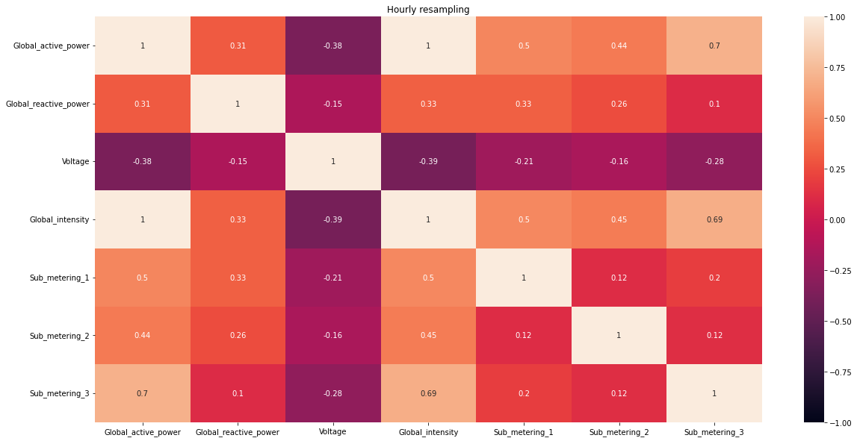
Correlation of

Slide 14
Why LSTM?
The reason they work so well is that LSTM can store past important information and forget the information that is not. LSTM has three gates:
The input gate: The input gate adds information to the cell state,
The forget gate: It removes the information that is no longer required by the model,
The output gate: Output Gate at LSTM selects the information to be shown as output.

Slide 15
Section
Break

Slide 16
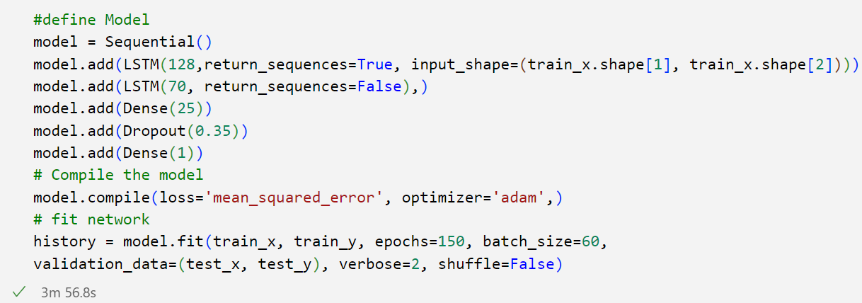
Model

Slide 17
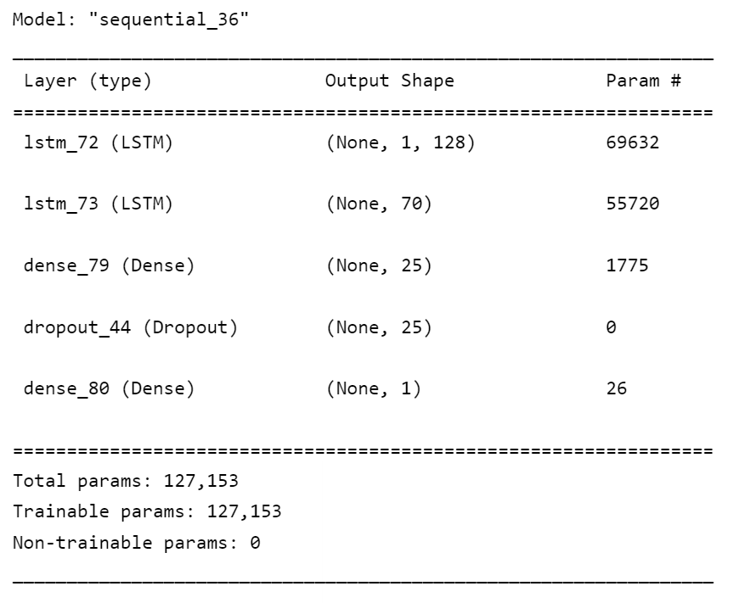
Model

Slide 18
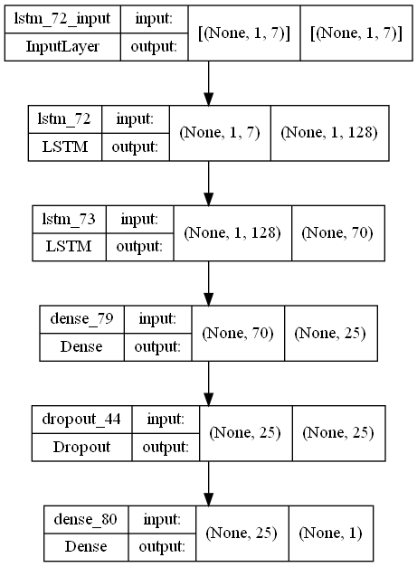
Model Layer
Notes:
We try to create a network model with two LSTM layers
and 2 dense layers that make the model try to find the closing
value for the next day. Sequential methods are used because of
the advantages of finding patterns of similarities. it helps in
finding the next event for that particular X data. Model
Compile defines the loss function, the optimizer, and the
metrics. That's all. It has nothing to do with the weights and
you can compile a model as many times as you want without
causing any problem to pretrained weights. LSTM. The
compiler has optimizer Adam that makes the network learn
the value. We use the loss as have a mean squared error than
try to reduce the loss that has accrued at the time of learning.
epochs are used to make the model learn the same data
repeated times. At epochs 2 is apply for that we got the nearest
value for the next day closing value. Batch size is 1 because
each value is individual and it is independent that makes the
prediction accuracy.
Then we create x train and y train to predict the accuracy of
the model and predict the values for x train and get the y to
predict value. We compare both y train and y predict values.

Slide 19
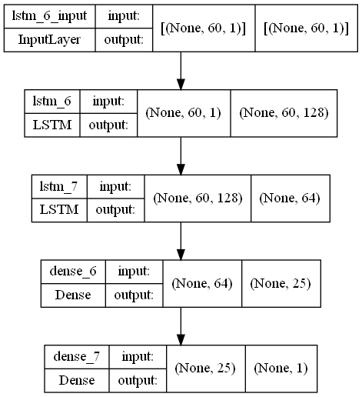
Model Layer

Slide 20
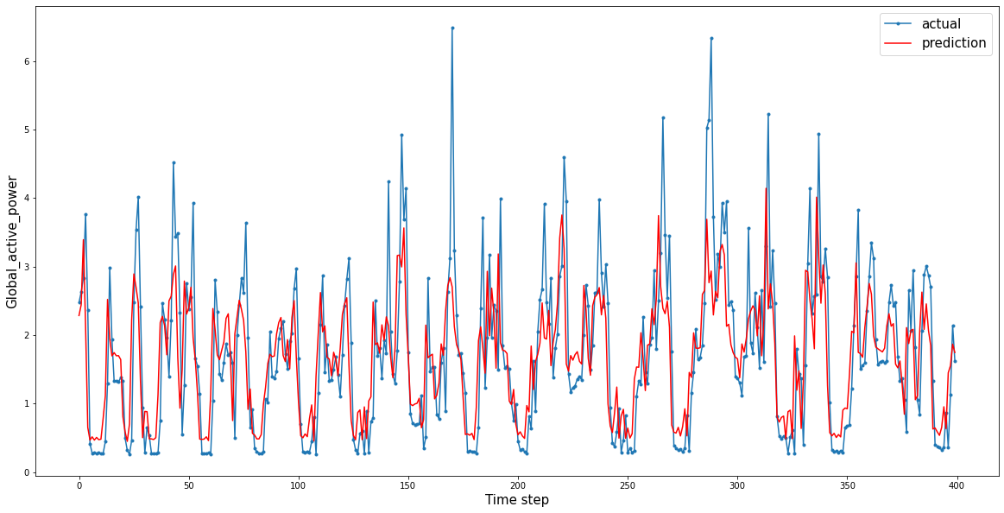
Prediction

Slide 21
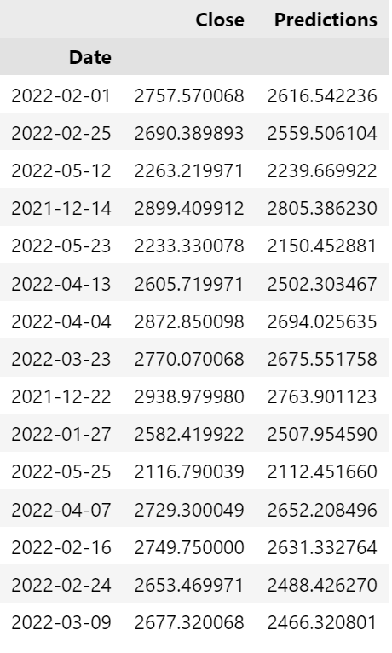
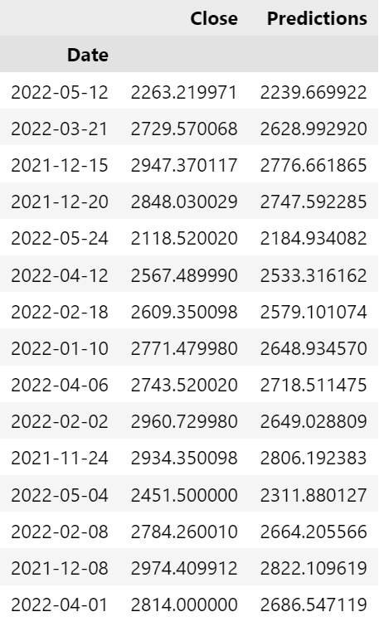

Slide 22
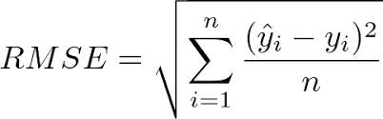
Discussion & Conclusion
By using LSTM we get a good accuracy on our forecasting.
Here we only considered the closing price of each day and created the model and get the closest predicted value
Root-mean-square error (RMSE) is :68.614559

Slide 23
Code: https://github.com/rakiiibul/stock-market-analysis_ML-Project
Reference: https://www.tutorialspoint.com/time_series/time_series_lstm_model.htm
https://towardsdatascience.com/time-series-forecasting-with-recurrent-neural-networks-74674e289816

Slide 24
Thank you for your attention

