Slide 1

Household Power Consumption & Prediction
Raikibul Hasan, Rukhsar Ahmed
Code: https://github.com/rakiiibul/House-hold-electrice-power-consumptiuon_LSTM

Slide 2
Outline
01
Overview
Why this topic is interest.
02
Data
Data description /visualization.
03
Model
04
Discussion & Conclusion

Slide 3
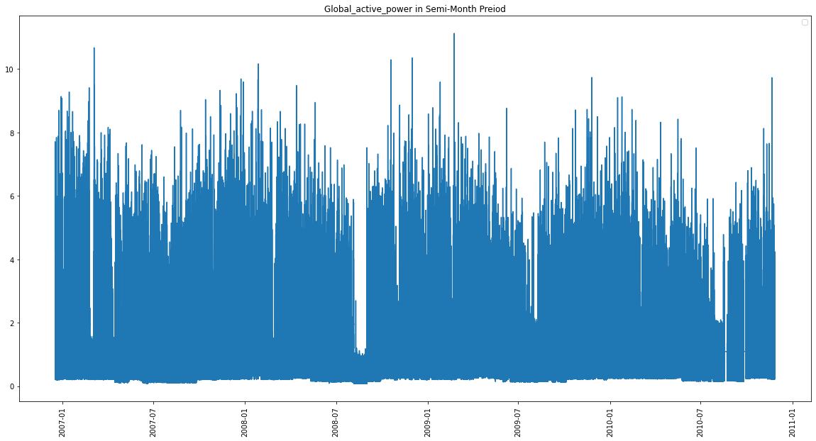
With the advent of new gadgets and a push towards greater electrification projects globally, power consumption is rising globally.
Thus, we can also expect that household or residential power consumption is so on the rise. With greater access to global power consumption data, forecasting power consumption is an emerging challenge.
Household Power Consumption

Slide 4


Why prediction is important?
An accurate forecast can help both the consumer as well as the supplier side
For the consumer, a power forecast helps in financial planning as making more green choices overall
For the supplier, an accurate forecast will definitely help in supply regulation.
Such a forcasting models can help to optimize the overall supply chain of the household power industry.

Slide 5
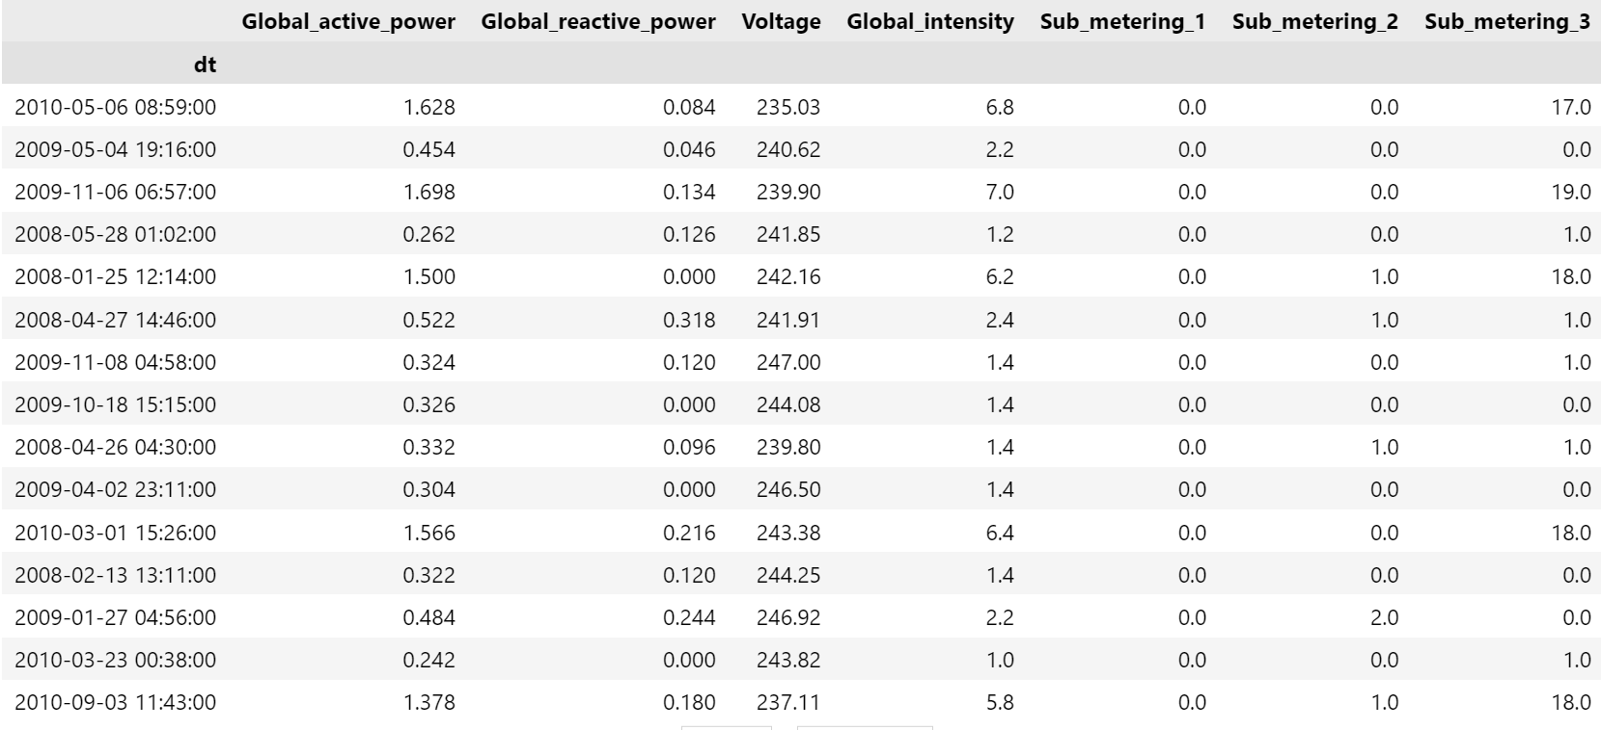
Data

Slide 6
ML
Machine Learning
Section Break

Slide 7
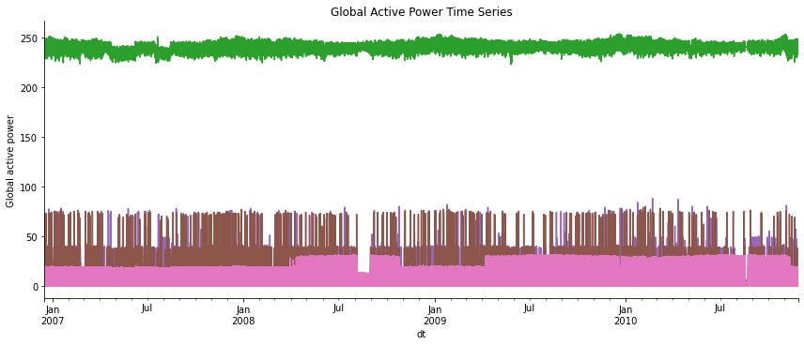
Global active power History

Slide 8
Global active power Plot

Slide 9
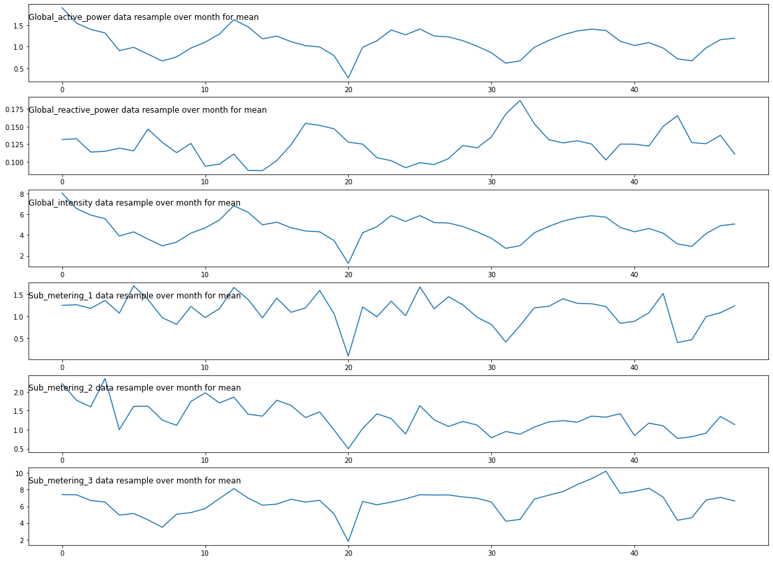
Monthly Power Data resampling

Slide 10
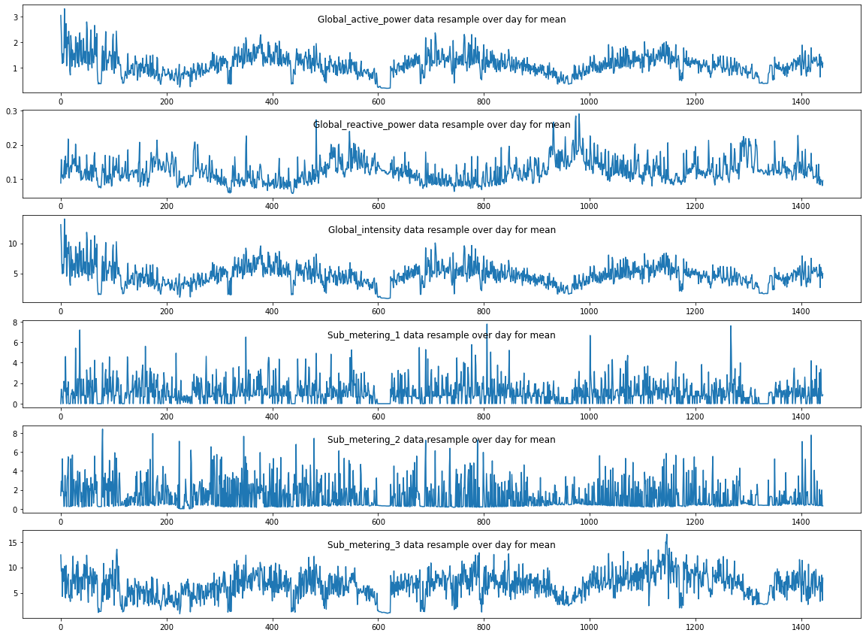
Daily Power Data resampling

Slide 11
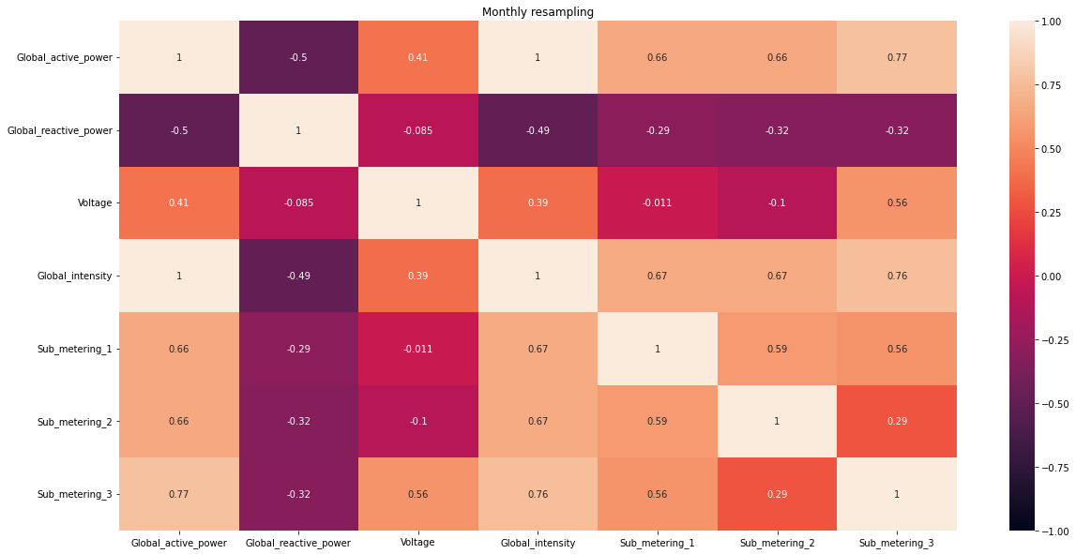
Monthly Correlation of power consumption

Slide 12
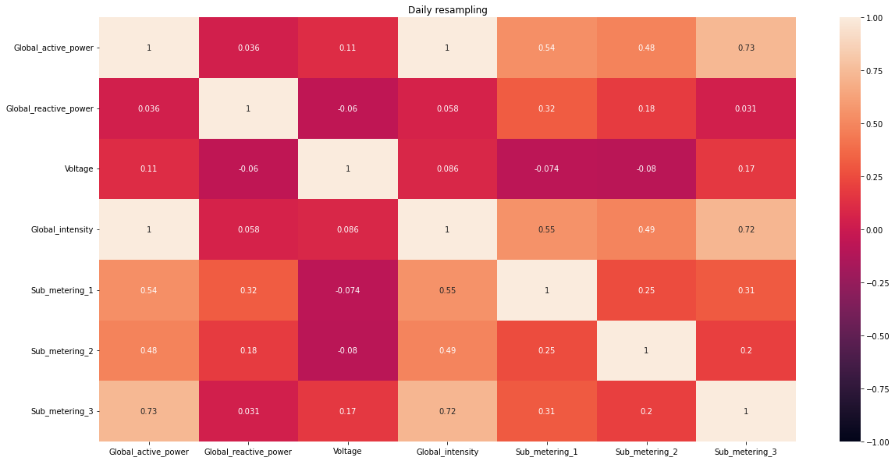
Daily Correlation of power consumption

Slide 13
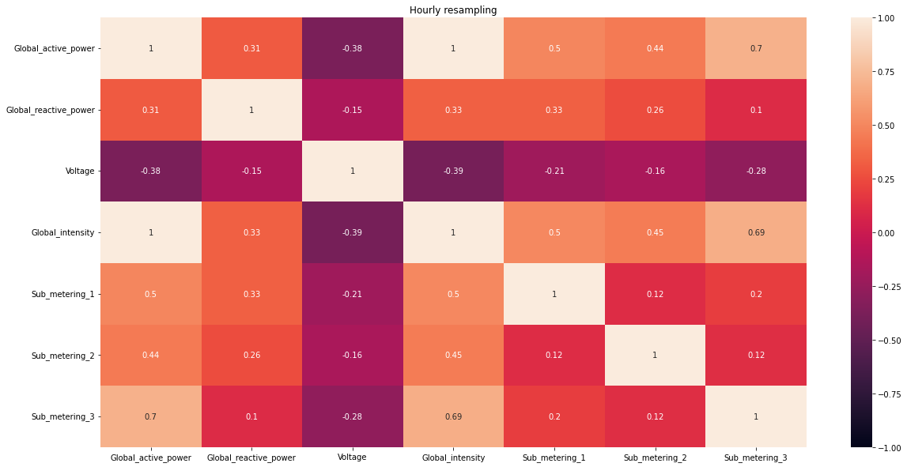
Hourly Correlation of power consumption

Slide 14
Why LSTM?
The reason they work so well is that LSTM can store past important information and forget the information that is not. LSTM has three gates:
The input gate: The input gate adds information to the cell state,
The forget gate: It removes the information that is no longer required by the model,
The output gate: Output Gate at LSTM selects the information to be shown as output.

Slide 15
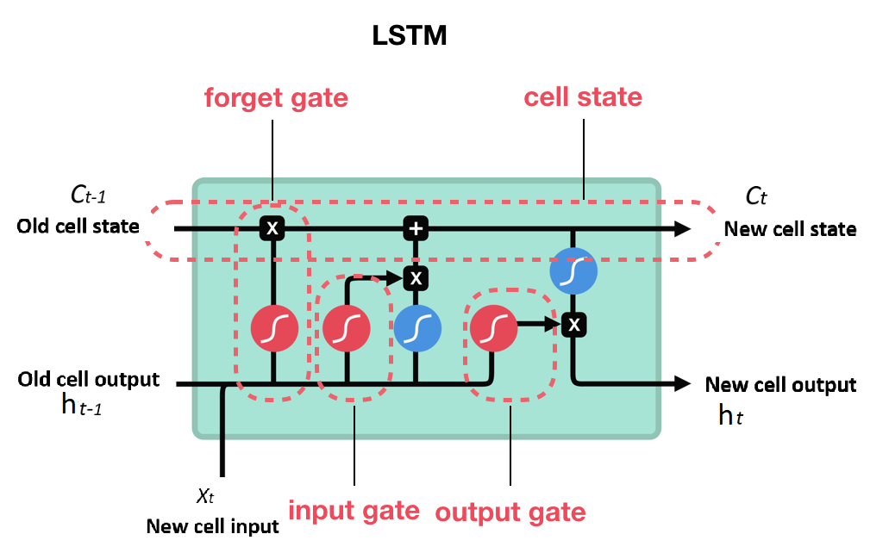
LSTM
The key to LSTMs is the cell state (cell memory), the horizontal line running through the top of the diagram, through which the information flows along and the internal mechanism called gates that can regulate the flow of information. The cell state is kind of like a conveyor belt. It runs straight down the entire chain, with only some minor linear interactions.

Slide 16
Section
Break

Slide 17
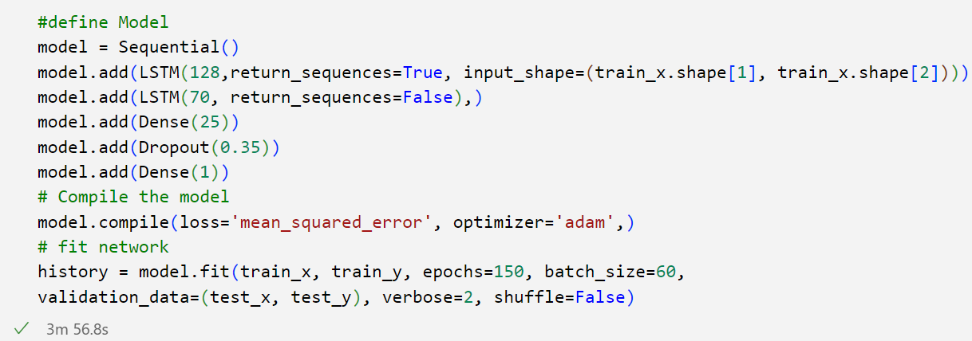
Model

Slide 18
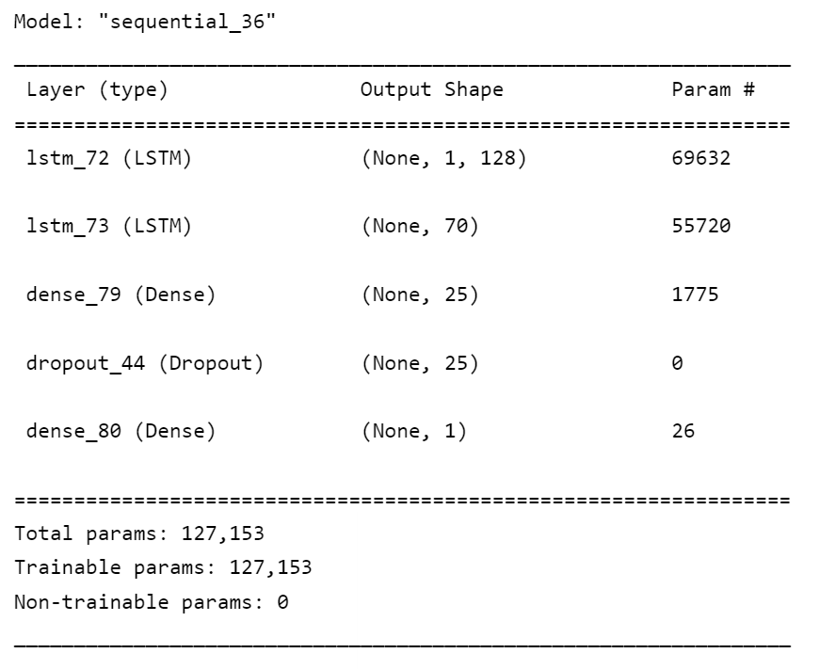
Model

Slide 19
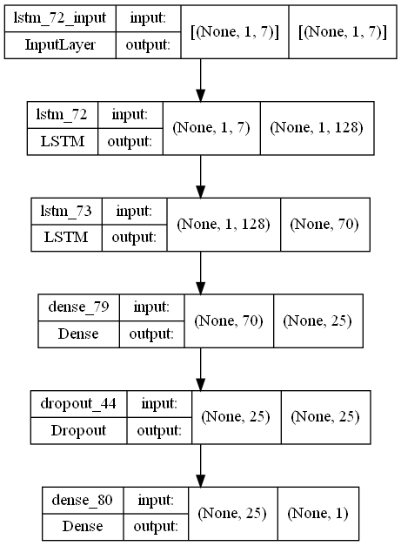
Model Layer
Notes:
We try to create a network model with two LSTM layers
and 2 dense layers that make the model try to find the closing
value for the next day. Sequential methods are used because of
the advantages of finding patterns of similarities. it helps in
finding the next event for that particular X data. Model
Compile defines the loss function, the optimizer, and the
metrics. That's all. It has nothing to do with the weights and
you can compile a model as many times as you want without
causing any problem to pretrained weights. LSTM. The
compiler has optimizer Adam that makes the network learn
the value. We use the loss as have a mean squared error than
try to reduce the loss that has accrued at the time of learning.
epochs are used to make the model learn the same data
repeated times. At epochs 2 is apply for that we got the nearest
value for the next day closing value. Batch size is 1 because
each value is individual and it is independent that makes the
prediction accuracy.
Then we create x train and y train to predict the accuracy of
the model and predict the values for x train and get the y to
predict value. We compare both y train and y predict values.

Slide 20
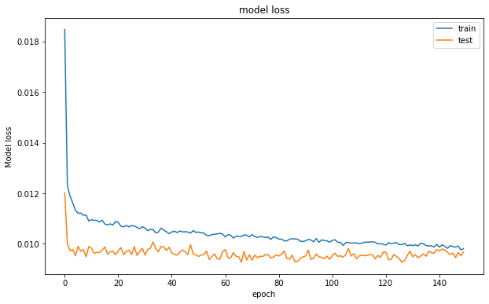
Model Loss curve

Slide 21
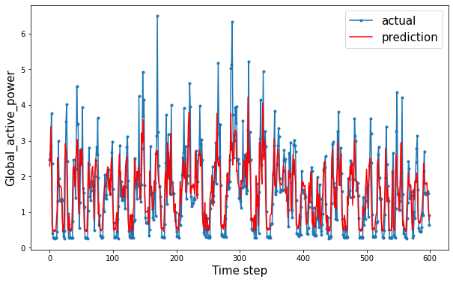
Prediction

Slide 22
Discussion & Conclusion
Our model is highly flexible.
Our model is highly usable in predictions where there's time lag between input features and target signals, and can capture long-term temporal dependencies without suffering optimization challenges
Model suitable for predictions involving large volume datasets -- our model used over 2M data entries.
Model has the ability to figure out or understand hidden pattern in the given dataset.
Our Model is good for time series modeling because of its recurrent nature(RNN)

Slide 23
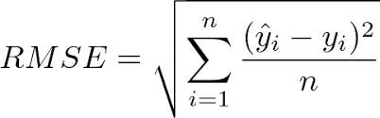
Discussion & Conclusion
By using LSTM we get a good accuracy on our forecasting.
Model limitation: Most of the case it can not predict the peak value.
Root-mean-square error (RMSE) is :0.63

Slide 24
Code: https://github.com/rakiiibul/House-hold-electrice-power-consumptiuon_LSTM
Reference:
Dataset: https://archive.ics.uci.edu/ml/datasets/individual%2Bhousehold%2Belectric%2Bpower%2Bconsumption

Slide 25
Thank you for your attention

