Slide 1
ISIC24 Highlights

Slide 2
Deck Goals
Discuss key points of competition
Outline main points of competition
Repository for valuable images, screenshots, etc
…

Slide 3
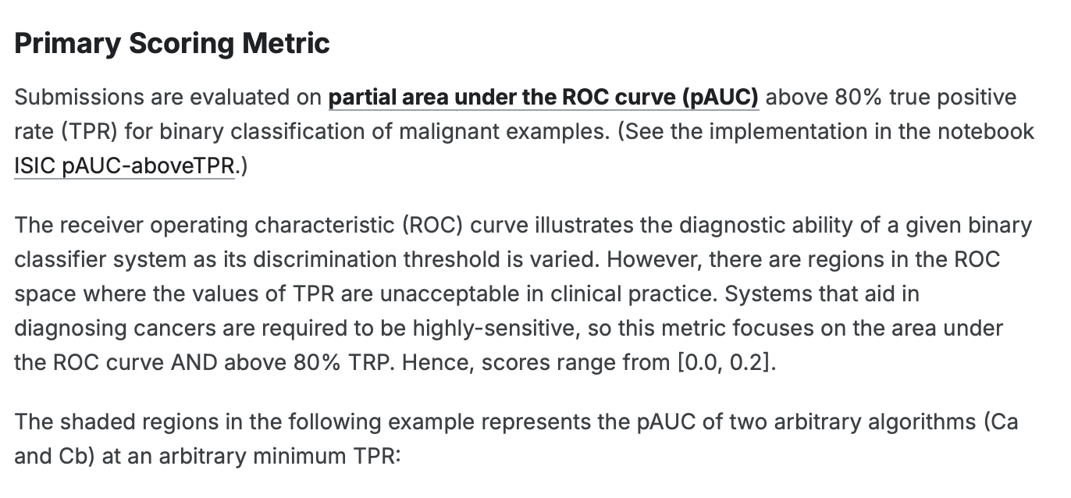
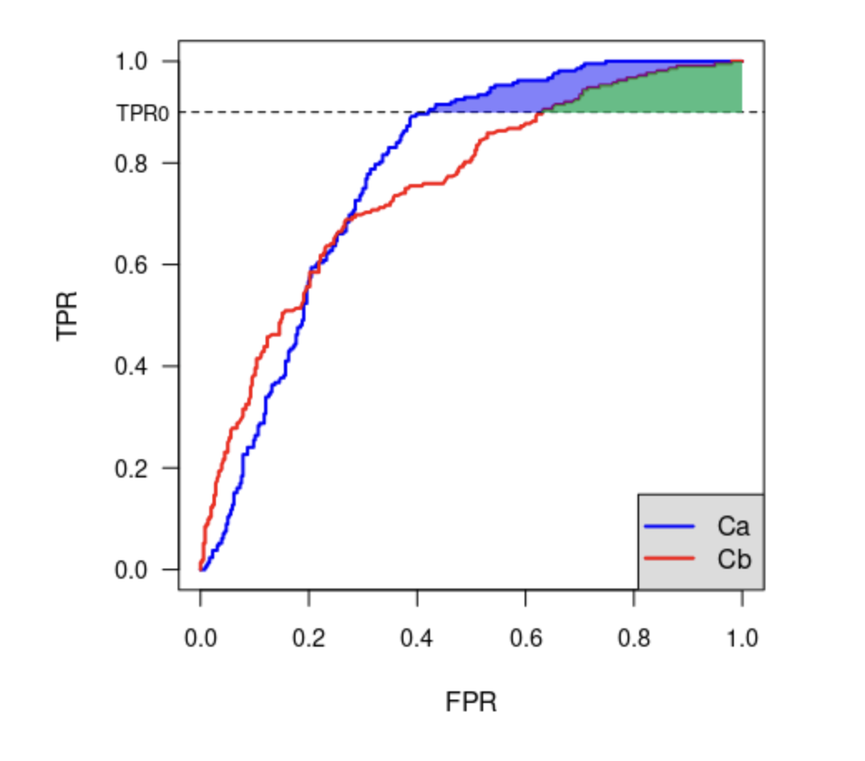
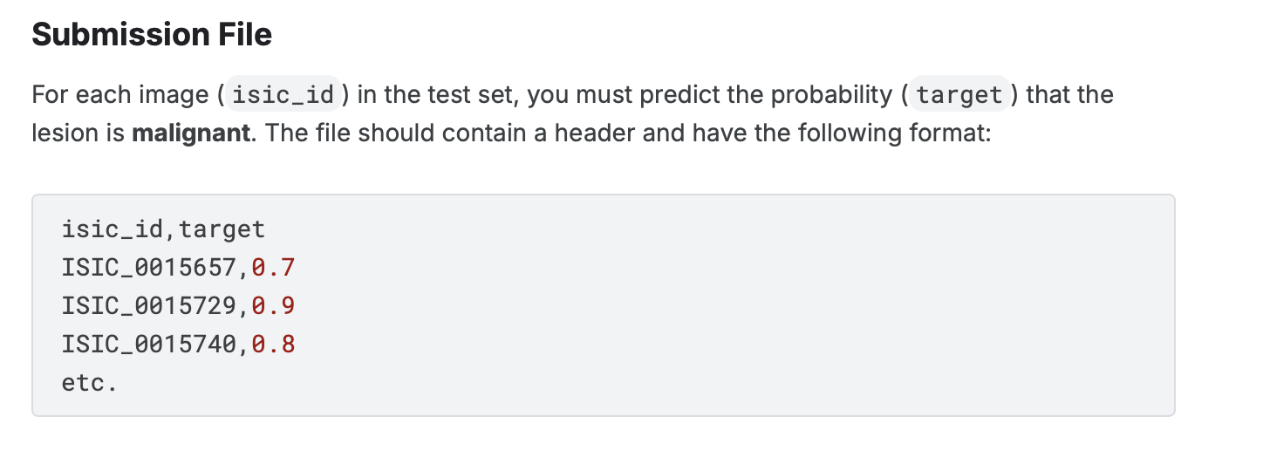
Scoring Metric
Notes:
The important part here is that the area under the ROC curve above 80% is what we’re trying to maximize.

