Slide 1
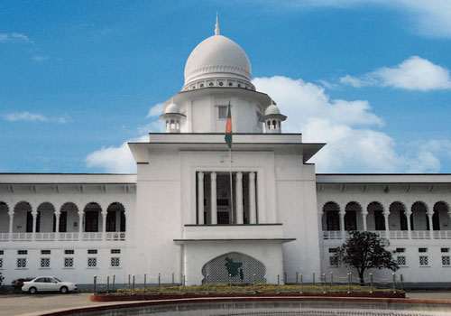
Judicial Management System
Chowdhury Md Rakin Haider, 1005009
Shakil Ahmed, 1005014
Md Touhiduzzaman, 1005018
Shohan Al Jannat, 1005023
Tanzeer Hossain, 1005029
CSE , BUET
Notes:
Good Morning everyone. I am Rakin , proposing our project for Information System development sessional course. Ours is the project “Judicial Management System” .

Slide 2
Scenario
Police stations have to convey all the filed cases to the court.
Then one of the magistrate have to entry these cases in a list.
Both of these are prone to error and tedious for the person assigned to it.
Notes:
Before describing the exact system we want to shed some light into some real life scenerio that are natobale in the present system. From the administrative point of view we should refer to the problem that the existing system is error prone and causes unnessecary manual labour.

Slide 3
Scenario
Mr. Kashem filed a case
He didn’t get any notice about the hearing date
As a result he ended up losing his property because of his absence in the hearing.
Notes:
Now, lets have a look at what type of harassments people face due to the existing low user friendly system. We often see people having issues with their property . It is also quite common that this issue turns up to the court. Then the owner has to rush to the court frequently because if he fails gather information about the progress of the case he might end up loosing hid property. And there is very little scope to collect information without visiting the court.

Slide 4
Existing System
Police Station
Court
People
Interaction Between Active Elements
Notes:
In the existing system there are actully three active element in the lifecycle of a case. These are the police station the court and the people who are the users of this system. The police station passes information to the court. People interact with both of these elements in different phases of the proceedings.

Slide 5
Existing System : Flow of Execution
Police Station Phase:
Plaintiff
Duty Officer
FIR
CMM Court
CMM Court Phase:
CMM
Magistrate
Notes:
To elaborate the flow of execution some diagrams will be helpful. The first of many stages of a case is a plaintiff filing a case with the help of a duty officer at a police station. Then F.I.R ,the complete description of the information required for a case, is formed and forwarded to Chief Metropolitan Court. CMM court then forwards it to corresponding magistrate.

Slide 6
Existing System : Flow of Execution
The Court Phase:
Magistrate
Bench
Cause List
Notes:
In the court a magistrate assigns this case under a judge and entries the informations in a cause list. This is actually a hand written book which is the only source for people to know about the update of the case.

Slide 7
Existing System : Flow of Execution
At The Trial Phase:
Framing of Charge
State witness
Witness on behalf of accused (Optional-342)
Argument
Judgment:
Acquittal
Sentenced
Notes:
There are several other steps of trial like introducing witnesses of both side , presenting arguments and finally a judgment.

Slide 8
Existing System: Summery
A case is first filed in either police station or court.
In both of the cases it is forwarded to the Chief Metropolitan Magistrate (CMM) court.
Then CMM forwards this case to corresponding magistrate, tribunal or court.
Then it is sent for trial under a judge.
Then the judge takes appropriate action and thus proceed towards judgement.
After judgement the plaintiff and defendant may or may not wish to appeal in higher court.
Notes:
Here is a summery of the overall process.

Slide 9
Existing System : Problems
Lengthy
Time consuming
Complex flow of information
Manual
Error prone
Huge workload
Wastage
Repetition of collecting same papers
Lack of co-ordination between phases
Scope of corruption
Notes:
Now we want to emphasis on the problems in the existing process. First of all the process is quiet Lengthy and time consuming. As there is no proper database lawyers have to collect same papers again and again . Collecting these papers repeatedly causes wastage of time and their money .
In addition to these problems the flow is quite complex to be handled manually . If we do some calculation on average 11200 cases are filed everyday which is a huge data to handle manually without error.

Slide 10
Our Approach Towards Solution
Problems | Solutions
1. Huge workload at the police station consuming time & manual labor. | Sending FIR via web in between Police stations and CMM court.
2. Manually inserting data to the cause list. | Automatically update cause list
3. Lack of ease of access in searching the cause list manually for case details | Building a web service allowing searching for required information .
4. Collecting same document repeatedly causing lots of money for the people | Unified viewing system for all
Notes:
The goal of our project is to solve the existing problems by replacing the manual system with a better computerized system. We are planning to do that by implementing several web services.The load of conveying f.i.r.’s to the courts everyday can be reduced using a web service for every police stations. Whenever a case is filed its fir is send to the CMM court immediately.
Secondly data entry problem in the courts can be solved by building an application for updating cause list automatically.
And lastly a web application for the users end can solve the problems related to searching viewing and collecting information .

Slide 11
Thank You
Notes:
Thank you all for patiently listening to our project proposal.

