Slide 1

NATURAL LANGUAGE PROCESSING [NLP]
MCA473b UNIT 2
INSTRUCTOR: Dr Rohini V
MISSION
CHRIST is a nurturing ground for an individual’s holistic development to make effective contribution to the society in a dynamic environment
VISION
Excellence and Service
CORE VALUES
Faith in God | Moral Uprightness Love of Fellow Beings
Social Responsibility | Pursuit of Excellence

Slide 2
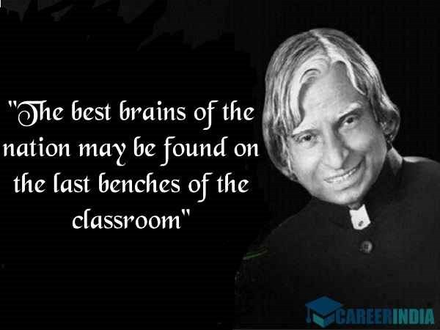
CHRIST
Deemed to be University

Slide 3
UNIT2 -Syllabus
CHRIST
Deemed to be University
PARSING AND SYNTAX
Word Level Analysis: Regular Expressions, Text Normalization, Edit Distance, Parsing and Syntax- Spelling, Error Detection and correction-Words and Word classes- Part-of Speech Tagging, Naive Bayes and Sentiment Classification: Case study

Slide 4
Outline
CHRIST
Deemed to be University
Activity
Regular Expressions
Text Normalization
Edit Distance

Slide 5
ACTIVITY
CHRIST
Deemed to be University
User: I am unhappy.
ELIZA: DO YOU THINK COMING HERE WILL HELP YOU NOT TO BE UNHAPPY
User: I need some help, that much seems certain.
ELIZA: WHAT WOULD IT MEAN TO YOU IF YOU GOT SOME HELP
User: Perhaps I could learn to get along with my mother. ELIZA: TELL ME MORE ABOUT YOUR FAMILY
User: My mother takes care of me.
ELIZA: WHO ELSE IN YOU FAMILY TAKES CARE OF YOU
User: My father.
ELIZA: YOUR FATHER
User: You are like my father in some ways. Weizenbaum (1966)

Slide 6

ELIZA !
CHRIST
Deemed to be University

Slide 7
Regular Expressions
Deemed to be University
The most important tool for describing text patterns: the regular expression.
Regular expressions can be used to specify strings we might want to extract
from a document, from transforming “I need X” in Eliza (example –Activity),
To defining strings like $199 or $24.99 for extracting tables of prices from a document.
We’ll then turn to a set of tasks collectively called text normalization.
Normalizing text means converting it to a more convenient, standard form.

Slide 8

Text Normalization
CHRIST
Deemed to be University
Tokenization -New York- rock ‘n’ roll -Tweets #nlp
sing – sang- sung and sings
Lemmatization
Stemming
Sentence segmentation
Edit distance- metric -

Slide 9
Regular Expressions
CHRIST
Deemed to be University
Regular Expression- regex, regexp or RE
A formal language for specifying text strings
Regular expressions are case sensitive.
The simplest kind of regular expression is a sequence of simple characters.

Slide 10

Regular Expressions
CHRIST
Deemed to be University
How can we search for any of these?
woodchuck
woodchucks
Woodchuck
Woodchucks
Image source: Slide adapted from Dan Jurafsky
To search for woodchuck, If I type /woodchuck/ ?
The pattern /woodchucks/ will not match the string Woodchucks.
How to solve this?

Slide 11
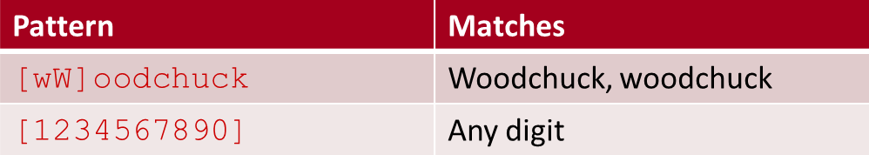
Letters inside square brackets []
CHRIST
Deemed to be University
the pattern /[wW]/ matches patterns containing either w or W.
The string of characters inside the braces specifies a disjunction of characters to match.
The regular expression /[1234567890]/ specified any single digit. Is this ok?
/[ABCDEFGHIJKLMNOPQRSTUVWXYZ]/ Is this ok? ➔

Slide 12
Ranges [A-Z]
CHRIST
Deemed to be University
Cases where there is a well-defined sequence associated with a set of characters, the brackets can be used with the dash (-) to specify range any one character in a range.
The pattern /[2-5]/ specifies any one of the characters 2, 3, 4, or 5.
The pattern /[b-g]/ specifies one of the characters b, c, d, e, f, or g.

Slide 13
Exercise- RE Match Example Patterns Matched
CHRIST
Deemed to be University
Find the match here !
/[A-Z]/
an upper case letter
“ we should call it ‘Drenched Blossoms’ ”
/[a-z]/
a lower case letter
“my ”
/[0-9]/
a single digit
“Chapter 1: Down the Rabbit Hole”

Slide 14
The caret ^ -Negation in Disjunction
CHRIST
Deemed to be University
The square braces can also be used to specify what a single character cannot be, by use of the caret ^.
If the caret ^ is the first symbol after the open square brace [,the resulting pattern is negated.
For example, the pattern /[^a]/ matches any single character (including special characters) except a.
This is only true when the caret is the first symbol after the open square brace. If it occurs anywhere else, it usually stands for a caret.

Slide 15
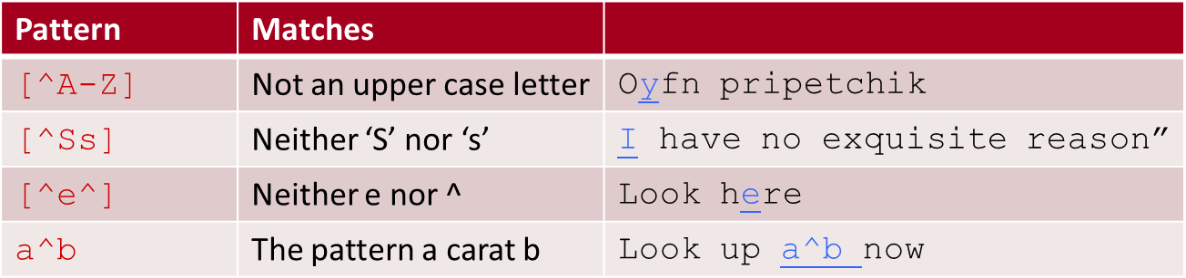
CHRIST
Deemed to be University

Slide 16

Regular Expressions: More Disjunction
CHRIST
Deemed to be University
Woodchucks is another name for groundhog!
The pipe | for disjunction

Slide 17
CHRIST
Deemed to be University
[gG]roundhog|[Ww]oodchuck
Pattern | Matches
groundhog|woodchuck
yours|mine | yours mine
a|b|c | = [abc]
[gG]roundhog|[Ww]oodchuck

Slide 18
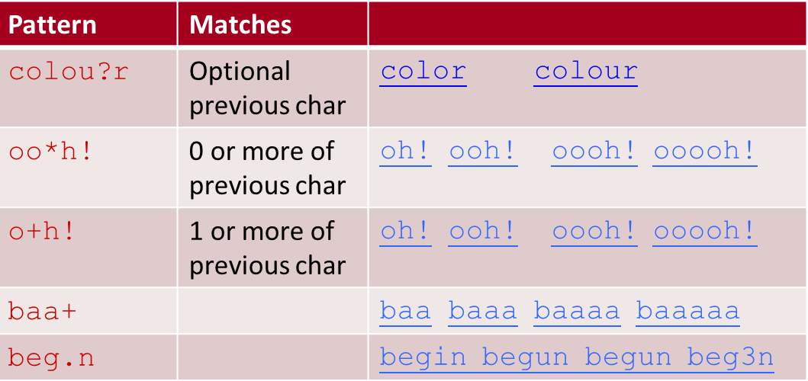
Regular Expressions: ? * + .
CHRIST
Deemed to be University

Slide 19
CHRIST
Deemed to be University
For example, consider the language of certain sheep, which consists of strings that look like the following:
baa!
baaa!
baaaa!
baaaaa!
.

Slide 20
OUTLINE
CHRIST
Deemed to be University
More operators
Substitution ,Capture groups and ELIZA
Word and Corpora
Text Normalization

Slide 21
Find me all instances of the word “the” in a text.
CHRIST
Deemed to be University
/the/ [tT]he
Misses capitalized examples Incorrectly returns other or theology

Slide 22
CHRIST
Deemed to be University
[^a-zA-Z][tT]he[^a-zA-Z]
However, there is still one more problem with this pattern:?

Slide 23
CHRIST
Deemed to be University
it won’t find the word the when it begins a line. This is because the regular expression [^a-zA-Z], which is used to avoid embedded instances of the, implies that there must be some single character before the the

Slide 24
Errors
CHRIST
Deemed to be University
The process we just went through was based on fixing two kinds of errors
Matching strings that we should not have matched (there, then, other)
False positives (Type I)
Not matching things that we should have matched (The)
False negatives (Type II)

Slide 25
CHRIST
Deemed to be University
In NLP we are always dealing with these kinds of errors.
Reducing the error rate for an application often involves two antagonistic efforts:
Increasing accuracy or precision (minimizing false positives)
Increasing coverage or recall (minimizing false negatives).

Slide 26
More Operators
CHRIST
Deemed to be University
We can also use explicit numbers as counters, by enclosing them in curly brackets.
The regular expression /{3}/ means “exactly 3 occurrences of the previous character or expression”.
A range of numbers can also be specified. So /{n,m}/ specifies from n to m occurrences of the previous char or expression.

Slide 27
Substitution, Capture Groups, and ELIZA
CHRIST
Deemed to be University
An important use of regular expressions is substitutions
The use of parentheses to store a pattern in memory is called a capture group.
Every time a capture group is used (i.e., parentheses surround a pattern), the register resulting match is stored in a numbered register.
To use parentheses for grouping, but don’t want to capture the resulting
pattern in a register.
Substitutions and capture groups are very useful in implementing simple chatbots like ELIZA

Slide 28

Interpret the pattern
CHRIST
Deemed to be University
User1: Men are all alike. ELIZA1: IN WHAT WAY
User2: They’re always bugging us about something or other.
ELIZA2: CAN YOU THINK OF A SPECIFIC EXAMPLE
User3: Well, my boyfriend made me come here.
ELIZA3: YOUR BOYFRIEND MADE YOU COME HERE
User4: He says I’m depressed much of the time.
ELIZA4: I AM SORRY TO HEAR YOU ARE DEPRESSED

Slide 29

CHRIST
Deemed to be University
ELIZA works by having a series or cascade of regular expression substitutions each of which matches and changes some part of the input lines.
Input lines are first uppercased. The first substitutions then change all
instances of MY to YOUR, and I’M to YOU ARE, and so on.
The next set of substitutions matches and replaces other patterns in the input.

Slide 30
CHRIST
Deemed to be University
Regular expressions play a surprisingly large role
Sophisticated sequences of regular expressions are often the first model for any text processing text
For many hard tasks, we use machine learning classifiers
But regular expressions are used as features in the classifiers
Can be very useful in capturing generalizations

Slide 31
Words
CHRIST
Deemed to be University
Corpus (plural corpora)
He stepped out into the hall, was delighted to encounter a water brother.
How many words are there?

Slide 32
CHRIST
Deemed to be University
Q& A
This sentence has 13 words if we don’t count punctuation marks as words, 15
if we count punctuation.
Whether we treat period (“.”), comma (“,”), and so on as words depends on
the task.
part-of-speech tagging or parsing or speech synthesis, we sometimes treat punctuation marks as if they were separate words.

Slide 33
Switchboard
CHRIST
Deemed to be University
The Switchboard corpus of American English telephone conversations between strangers
I do uh main- mainly business data processing
Utterance
- This utterance has two kinds of disfluencies.
The broken-off word main- is fragment ---- called a fragment.
Words like uh and um are called fillers or filled pauses.

Slide 34
Few more:
CHRIST
Deemed to be University
Lemma
Wordform
Word Type
Word Tokens

Slide 35
NATURAL LANGUAGE PROCESSING [NLP]
MCA473BUNIT 2
INSTRUCTOR: Dr Rohini V
MISSION
CHRIST is a nurturing ground for an individual’s holistic development to make effective contribution to the society in a dynamic environment
VISION
Excellence and Service
CORE VALUES
Faith in God | Moral Uprightness Love of Fellow Beings
Social Responsibility | Pursuit of Excellence

Slide 36

CHRIST
Deemed to be University
Your dreams are what define your individuality. They have the power to give you wings and make you fly high.

Slide 37
OUTLINE
CHRIST
Deemed to be University
Code Switching
Text Normalization
Word Tokenization
Word Normalization, Lemmatization and Stemming
Sentence Segmentation

Slide 38

Corpora
CHRIST
Deemed to be University

Slide 39
Hint:
CHRIST
Deemed to be University
dost tha or ra- hega ... dont wory ... but dherya rakhe

Slide 40
CHRIST
Deemed to be University
[“he was and will remain a friend ... don’t worry ... but have faith”]
The text that our algorithms must process might come from newswire, fiction or non-fiction books, scientific articles, Wikipedia, or religious texts.
It might come from spoken genres like telephone conversations, business
meetings, medical interviews, or transcripts of television shows or movies.
Text also reflects the demographic characteristics of the writer (or speaker): their age, gender, race, socioeconomic class can all influence the linguistic properties of the text we are processing.
And finally, time matters too.
To ensure that the models are fit to the data.

Slide 41
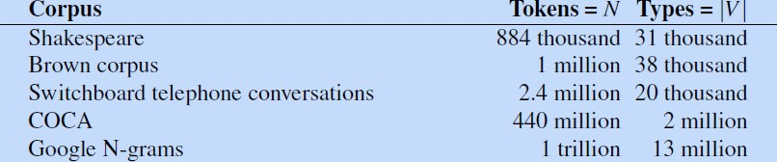
CHRIST
Deemed to be University
When we speak about the number of words in the language, we are generally
referring to word types

Slide 42
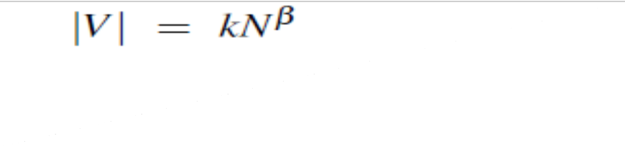
CHRIST
Deemed to be University
The larger the corpora we look at, the more word types we find, and in fact this relationship between the number of types |V| and number of tokens N is called Herdan’s Law (Herdan, 1960) or Heaps’ Law (Heaps, 1978)

Slide 43
TEXT NORMALIZATION
CHRIST
Deemed to be University

Slide 44
Basic Text Processing
CHRIST
Deemed to be University
Every NLP task needs to do text normalization:
Segmenting/tokenizing words in running text
Normalizing word formats
Segmenting sentences in running text

Slide 45
Tokenization
CHRIST
Deemed to be University
We often want to break off punctuation as a separate token;
commas are a useful piece of information for parsers,
periods help indicate sentence boundaries.
But we’ll often want to keep the punctuation that occurs word internally.
Ph.D., M.Phil Dr. Mr.

Slide 46
CHRIST
Deemed to be University
Special characters and numbers to be kept in prices ($45.55) and dates (01/02/06);
we don’t want to segment that price into separate tokens of “45” and “55”.
There are URLs (http://www.stanford.edu), Twitter hashtags (#nlproc), or email addresses (someone@cs.colorado.edu).

Slide 47
Word Tokenizer
CHRIST
Deemed to be University
A tokenizer can also be used to expand clitic contractions that are marked by apostrophes,
A clitic is a part of a word that can’t stand on its own, and can only occur
when it is attached to another word.
Example:
Converting what're to the two tokens what are, and we're to we are.

Slide 48
Word Tokenizer
CHRIST
Deemed to be University
Depending on the application, tokenization algorithms may also tokenize multiword expressions like New York or rock 'n' roll as a single token, which requires a multiword expression dictionary of some sort.
Tokenization is thus intimately tied up with named entity detection, the task of detecting names, dates, and organization.
https://towardsdatascience.com/tokenization-for-natural-language-processing-a179a891bad4

Slide 49
Word Tokenizer
CHRIST
Deemed to be University
One commonly used tokenization standard is known as the Penn Treebank to PennTreebank Tokenization standard, used for the parsed corpora (treebanks) released by the Linguistic Data Consortium (LDC).
This standard separates out clitics (doesn’t becomes does plus n’t), keeps hyphenated words together, and separates out all punctuation.
List the different tokenizers!
tokenizer = TreebankWordTokenizer()

Slide 50
Word Tokenizer
CHRIST
Deemed to be University
The standard method for tokenization is therefore to use deterministic algorithms based on regular expressions compiled into very efficient finite state automata.
Carefully designed deterministic algorithms can deal with the ambiguities that arise, such as the fact that the apostrophe needs to be tokenized differently when used as a genitive marker (as in the book’s cover), a quotative as in ‘The other class’, she said, or in clitics like they’re.

Slide 51
Tokenization: language issues
CHRIST
Deemed to be University
Word tokenization is more complex in languages like written Chinese, Japanese, and Thai, which do not use spaces to mark potential word- boundaries
Word Tokenization in Chinese
Also called Word Segmentation
Chinese words are composed of characters [hanzi in Chinese]
Characters are generally 1 syllable and 1 morpheme.
Average word is 2.4 characters long.
Standard baseline segmentation algorithm:
Maximum Matching (also called Greedy)

Slide 52
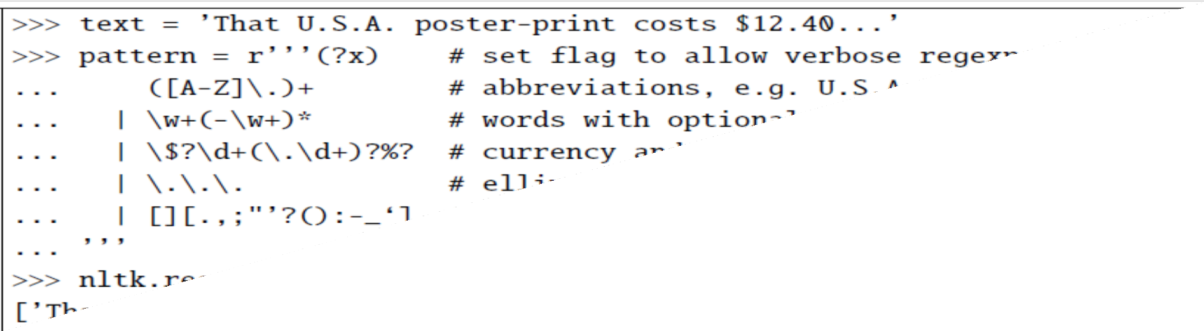
CHRIST
Deemed to be University

Slide 53
Maximum Matching Word Segmentation Algorithm
CHRIST
Deemed to be University
Given a wordlist of Chinese, and a string.
Start a pointer at the beginning of the string
Find the longest word in dictionary that matches the string starting at
pointer
Move the pointer over the word in string
Go to 2

Slide 54
CHRIST
Deemed to be University
Thetabledownthere
theta bled own there
Doesn’t generally work in English!
But works astonishingly well in Chinese

Slide 55

CHRIST
Deemed to be University
Where are the words?
莎拉波娃现在居住在美国东南部的佛罗里达
莎拉波娃 现在 居住 在 美国 东南部 的 佛罗里达

Slide 56
Translation
CHRIST
Deemed to be University
Shā lā bō wá xiànzài jūzhù zài měiguó dōngnán bù de fóluólǐdá.

Slide 57
CHRIST
Deemed to be University
Sharapova now lives in Florida in the southeastern United States.
word segmentation -Japanese and Thai the character is too small a
unit.
https://towardsdatascience.com/tokenization-for-natural-language-processing-a179a891bad4

Slide 58
Byte-Pair Encoding for Tokenization
CHRIST
Deemed to be University
The intuition of the algorithm is to iteratively merge frequent pairs of characters.
The algorithm begins with the set of symbols equal to the set of
characters.
Each word is represented as a sequence of characters plus a special end-of-word symbol . AB .
At each step of the algorithm, we count the number of symbol pairs, find the most frequent pair (‘A’, ‘B’), and replace it with the new merged symbol (‘AB’).

Slide 59
Byte-Pair Encoding for Tokenization
CHRIST
Deemed to be University
We continue to count and merge, creating new longer and longer character strings, until we’ve done k merges; k is a parameter of the algorithm.
The resulting symbol set will consist of the original set of characters plus k new symbols.

Slide 60
Word Normalization, Lemmatization and Stemming
CHRIST
Deemed to be University
Word normalization is the task of putting words/tokens in a standard format, choosing a single normal form for words with multiple forms like USA and US or uh-huh and uhhuh .
This standardization may be valuable, despite the spelling information that is lost in the normalization process.
Need to “normalize” terms
Information Retrieval: indexed text & query terms must have same form.
We want to match U.S.A. and USA

Slide 61
CHRIST
Deemed to be University
Enter: window
Enter: windows
Enter: Windows
Search: window, windows
Search: Windows, windows, window
Search: Windows
Potentially more powerful, but less efficient
[Ww] oodchucks

Slide 62
Case folding
CHRIST
Deemed to be University
Case folding is another kind of normalization.
Mapping everything to lower case means that Woodchuck and woodchuck are represented identically, which is very helpful for generalization in many tasks, such as information retrieval or speech recognition.
For sentiment analysis and other text classification tasks, information extraction, and machine translation, by contrast, case can be quite helpful and case folding is generally not done
Reason? US ➔us

Slide 63
OUTLINE
CHRIST
Deemed to be University
Announcements-
Review of previous session- {Code Switching, Word Tokenization, Text Normalization, Word Normalization}
Activity
Word Normalization, Lemmatization and Stemming
Sentence Segmentation
Edit Distance Algorithm

Slide 64
Example
CHRIST
Deemed to be University
US the country and us the pronoun can outweigh the advantage in generalization that case folding. [Phonetics ] [Optional]
However in NLP we want
we also want two morphologically different forms
of a word to behave similarly
This is especially common in morphologically complex languages like Russian, where for example the word Moscow has different endings in the phrases Moscow, of Moscow, to Moscow, and so on.

Slide 65

Activity
CHRIST
Deemed to be University

Slide 66
Lemmatization
CHRIST
Deemed to be University
Reduce inflections or variant forms to base form
am, are, is → be
car, cars, car's, cars' → car
The most sophisticated methods for lemmatization involve complete morphological parsing of the word.
Morphology is the study of morpheme the way words are built up from smaller meaning-bearing units called morphemes.

Slide 67
CHRIST
Deemed to be University
Two broad classes of morphemes can be distinguished:
Stems—the central morpheme of the word, supplying the main meaning— and
affixes—adding “additional” meanings of various kinds
Example? cat s

Slide 68
Stemming
CHRIST
Deemed to be University
Lemmatization algorithms can be complex.
Stemming
Reduce terms to their stems in information retrieval
Stemming is crude chopping of affixes
language dependent
The Porter stemmer

Slide 69
The Porter stemmer - I/p & O/p
CHRIST
Deemed to be University
This was not the map we found in Billy Bones’s chest, but an accurate copy, complete in all things-names and heights and soundings-with the single exception of the red crosses and the written notes.
Thi wa not the map we found in Billi Bone s chest but an accur copi complet in all thing name and height and sound with the singl except of the red cross and the written note
https://tartarus.org/martin/PorterStemmer/

Slide 70
Stemmers
CHRIST
Deemed to be University
Stemmers can be useful
However they do tend to commit errors of both over- and under-generalizing, as shown in the table
Errors of Commission
organization organ
Errors of Omission
European Europe
doing doe , analysis analyses, numerical numerous ?

Slide 71
Sentence Segmentation
CHRIST
Deemed to be University
!, ? are relatively unambiguous
Period “.” is quite ambiguous
Sentence boundary
Abbreviations like Inc. or Dr.
Numbers like .02% or 4.3
Build a binary classifier
Looks at a “.”
Decides EndOfSentence/NotEndOfSentence
Classifiers: hand-written rules, regular expressions, or machine- learning

Slide 72
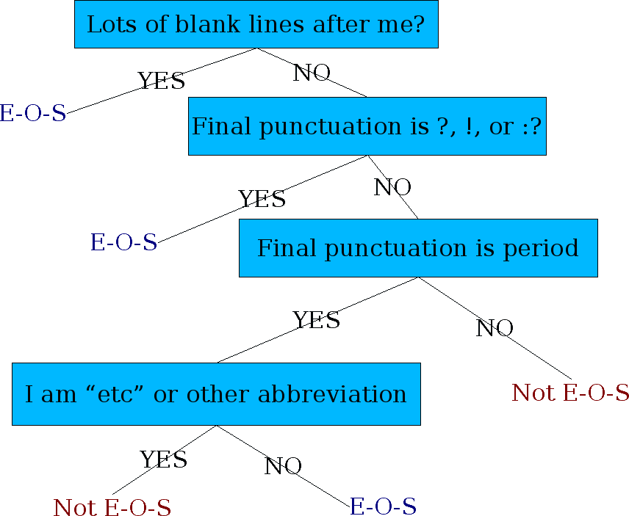
Determining if a word is end-of-sentence: a Decision Tree
CHRIST
Deemed to be University

Slide 73
Implementing Decision Trees
CHRIST
Deemed to be University
A decision tree is just an if-then-else statement
The interesting research is choosing the features
Setting up the structure is often too hard to do by hand
Hand-building only possible for very simple features, domains
For numeric features, it’s too hard to pick each threshold
Instead, structure usually learned by machine learning from a training corpus

Slide 74
Minimum Edit Distance
CHRIST
Deemed to be University

Slide 75
Minimum Edit Distance
CHRIST
Deemed to be University
Much of natural language processing is concerned with measuring how similar two strings are.
Spell correction
The user typed “graffe”

Slide 76
How similar are two strings?
CHRIST
Deemed to be University
Which is closest?
graf
graft
grail
giraffe
Also for Machine Translation, Information Extraction, Speech Recognition

Slide 77
CHRIST
Deemed to be University
Another example comes from coreference, the task of deciding whether two strings such as the following refer to the same entity:
Stanford President John Hennessy
Stanford University President John Hennessy

Slide 78

Visual Representation
CHRIST
Deemed to be University
Alignment :Two strings and their alignment:
A series of symbols expressing an operation list

Slide 79
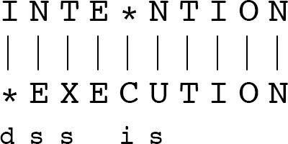
Levenshtein Distance – 2 concepts
CHRIST
Deemed to be University
If each operation has cost of 1
Distance between these is 5
If substitutions cost 2 (Levenshtein)
Distance between them is 8

Slide 80
CHRIST
Deemed to be University
The Levenshtein distance between two sequences is the simplest weighting factor in which each of the three operations has a cost of 1.
Levenshtein also proposed an alternative version of his metric in which each
insertion or deletion has a cost of 1 and substitutions are not allowed.
This is equivalent to allowing substitution, but giving each substitution a cost of 2_ since any substitution can be represented by one insertion and one deletion).
Using this version, the Levenshtein distance between intention and execution is _8 .

Slide 81
The Minimum Edit Distance Algorithm
CHRIST
Deemed to be University

Slide 82
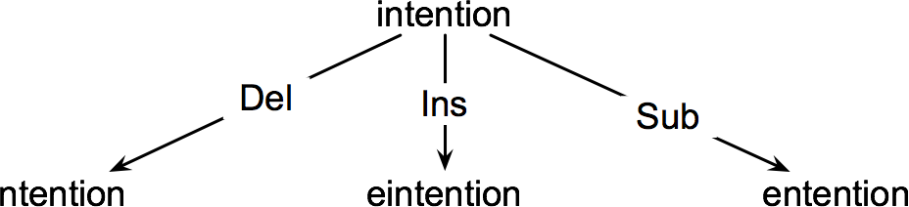
How to find the Min Edit Distance?
CHRIST
Deemed to be University
Searching for a path (sequence of edits) from the start string to the final string:
Initial state: the word we’re transforming
Operators: insert, delete, substitute
Goal state: the word we’re trying to get to
Path cost: what we want to minimize: the number of edits

Slide 83
Minimum Edit as Search
CHRIST
Deemed to be University
But the space of all edit sequences is huge!
We can’t afford to navigate naïvely
Lots of distinct paths wind up at the same state.
We don’t have to keep track of all of them
Just the shortest path to each of those revisited states.
We can do this by using dynamic programming,(Bellman 1957)
Solving problems by combining solutions to subproblems.
Examples/Algorithms for dynamic programming in NLP.

Slide 84
Activity
CHRIST
Deemed to be University
Consider the shortest path of transformed words that represents the minimum edit distance between the strings intention and execution
i n t e n t i o n
n t e n t i o n
e t e n t i o n
e x e n t i o n
e x e n u t i o n
e x e c u t i o n

Slide 85
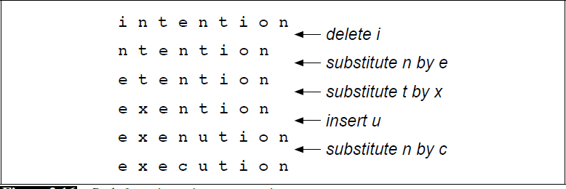
Path from Intention to Execution
CHRIST
Deemed to be University

Slide 86
Defining Min Edit Distance
CHRIST
Deemed to be University
For two strings
X of length n
Y of length m
We define D(i,j)
the edit distance between X[1..i] and Y[1..j]
i.e., the first i characters of X and the first j characters of Y
The edit distance between X and Y is thus D(n,m)

Slide 87
Dynamic Programming for Minimum Edit Distance
CHRIST
Deemed to be University
Dynamic programming: A tabular computation of D(n,m)
Solving problems by combining solutions to subproblems.
Bottom-up
We compute D(i,j) for small i,j
And compute larger D(i,j) based on previously computed smaller values
i.e., compute D(i,j) for all i (0 < i < n) and j (0 < j < m)

Slide 88

CHRIST
Deemed to be University
The value of D[i; j] is computed by taking the minimum of the three possible paths through the matrix which arrive

Slide 89
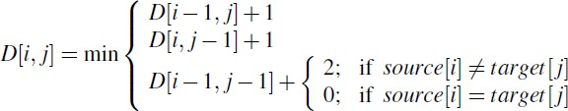
CHRIST
Deemed to be University
If we assume the version of Levenshtein distance in which the insertions and deletions each have a cost of 1 (ins-cost() = del-cost() = 1), and substitutions have a cost of 2 (except substitution of identical letters have zero cost), the computation for D[i; j] becomes:

Slide 90
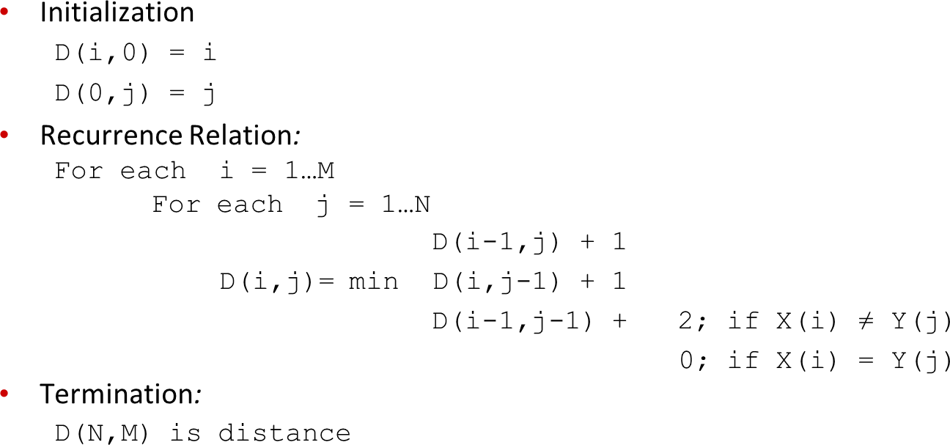
Defining Min Edit Distance (Levenshtein)
CHRIST
Deemed to be University

Slide 91
The Minimum Edit Distance Algorithm
CHRIST
Deemed to be University
How to find the Minimum Edit Distance, Explain in 4 steps

Slide 92
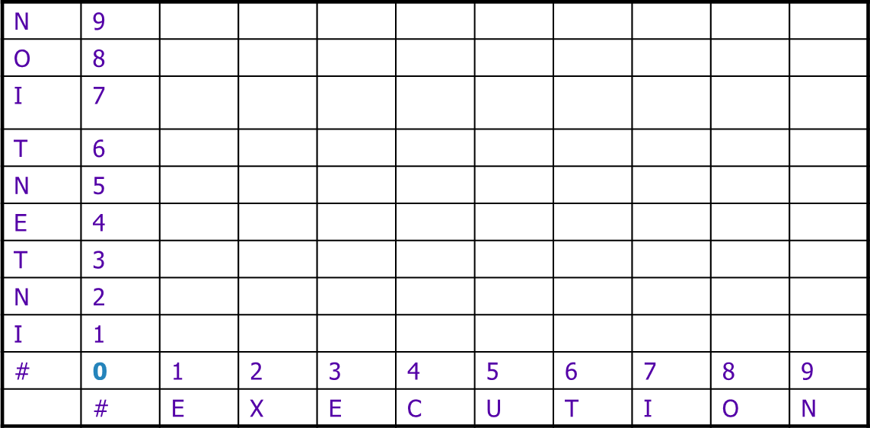
The Edit Distance Table
CHRIST
Deemed to be University

Slide 93
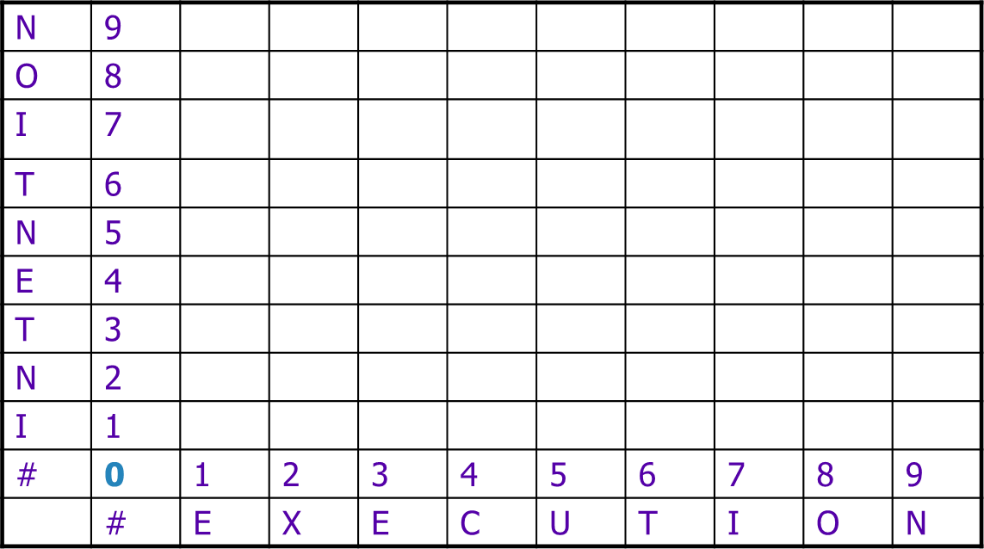
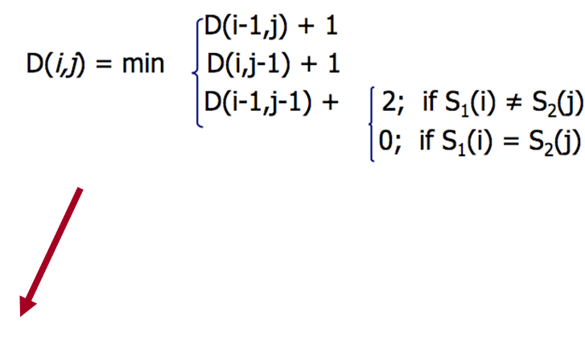
The Edit Distance Table
CHRIST
Deemed to be University

Slide 94
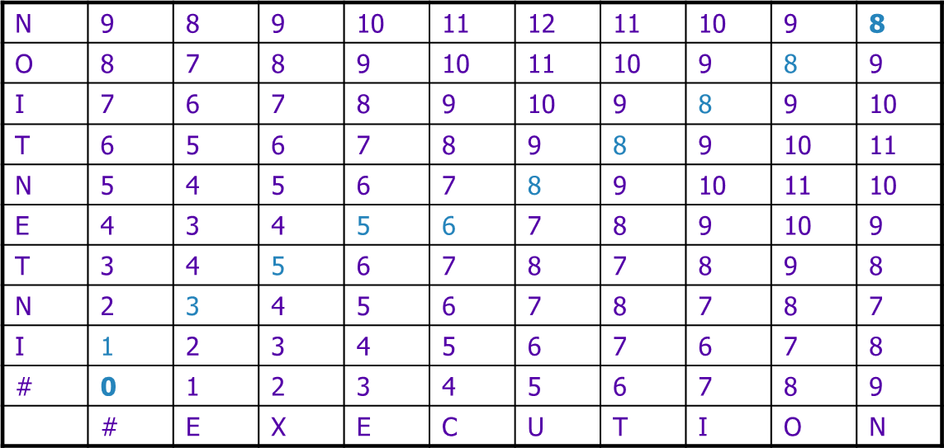
The Edit Distance Table –for Asynchronous mode
CHRIST
Deemed to be University

Slide 95
Backtrace for Computing Alignments
CHRIST
Deemed to be University
Edit distance isn’t sufficient
We often need to align each character of the two strings to each other
We do this by keeping a “backtrace”
Every time we enter a cell, remember where we came from
When we reach the end,
Trace back the path from the upper right corner to read off the alignment

Slide 96
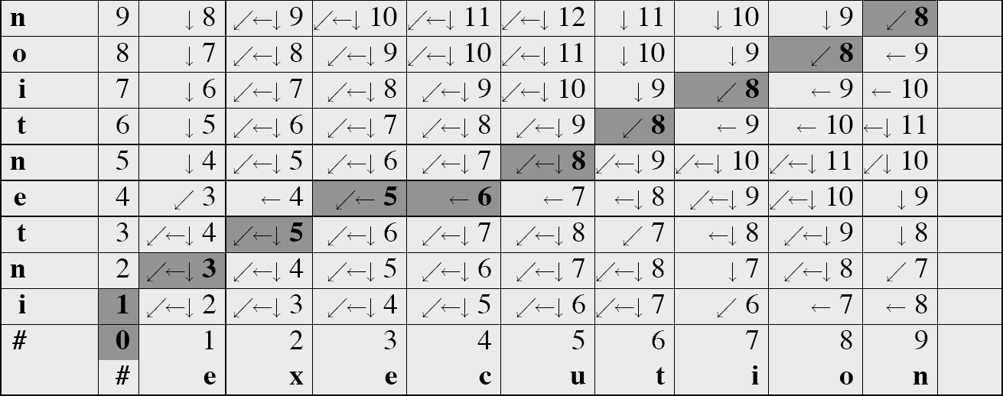
MinEdit with Backtrace
CHRIST
Deemed to be University

Slide 97
Adding Backtrace to Minimum Edit Distance
CHRIST
Deemed to be University
Base conditions:
D(i,0) = i D(0,j) = j
Recurrence Relation:
Termination:
D(N,M) is distance
For each i = 1…M
For each j = 1…N
D(i-1,j) + 1
D(i,j)= min D(i,j-1) + 1
D(i-1,j-1) + 2; if X(i) ≠ Y(j)
0; if X(i) = Y(j)
LEFT
ptr(i,j)= DOWN
DIAG

Slide 98
Complexity –Time/Space O(m,n) O(m+n)
CHRIST
Deemed to be University

