Slide 1
Digital Portfolio
STUDENT NAME:SHIHABUTHEEN.M
REGISTER NO:2422k0125
NMID:asbru4e2422k0125
DEPARTMENT:||-B.Sc (COMPUTER SCIENCE)
COLLEGE:TEXCITY ARTS AND SCIENCE
UNIVERSITY:BHARATHIAR UNIVERSITY

Slide 2

PROJECT TITLE
Interactive Portfolio Website
using HTML, CSS, and JavaScript

Slide 3


AGENDA
Problem Statement
Project Overview
End Users
Tools and Technologies
Portfolio design and Layout
Features and Functionality
Results and Screenshots
Conclusion
Github Link
3/21/2024 Annual Review

Slide 4

PROBLEM STATEMENT
In today’s competitive IT industry, job seekers and developers often struggle to present their skills, achievements, and projects in an engaging way. Traditional resumes are static and fail to showcase creativity, interactivity, and real-world coding skills

Slide 5

PROJECT OVERVIEW
This project is a personal portfolio website designed and developed using HTML, CSS, and JavaScript. It highlights my profile, skills, certificates, resume, and contact details in an interactive and responsive way. The website also includes animations, a modal popup system, and a clean UI/UX to ensure recruiters and clients can easily explore my work

Slide 6

WHO ARE THE END USERS?
1Recruiters & Hiring Managers → To evaluate my skills, projects, and certifications. 2.Clients / Companies → To contact me for freelance or job opportunities. 3.Peers & Developers → To get inspired or collaborate on projects. 4.Myself → To maintain a digital identity showcasing my career journey

Slide 7

TOOLS AND TECHNIQUES
Frontend: HTML5, CSS3, JavaScript (Vanilla JS). Design: Responsive layout, animations, modal popups. Hosting: Online platforms (GitHub Pages / Netlify / Vercel). Assets: Postimages for certificates, resume, and profile images

Slide 8
POTFOLIO DESIGN AND LAYOUT
Navigation Bar (Fixed): Smooth scrolling to all sections. HomeSection: Profile photo, name, role, and tagline. About Section: A brief introduction and background. Skills Section: Interactive cards listing my skills. Certificates & Resume Section: Modal popups to view documents. Contact Section: Contact info + form for clients to reach me. Responsive Design: Works across desktop, tablet, and mobile
8

Slide 9
FEATURES AND FUNCTIONALITY
✅Responsive design with mobile-first approach. ✅Modalpopupfor certificates and resume. ✅Hoveranimations on skills and profile image. ✅Contactform with name, email, phone, and project details. ✅Fixednavigation bar with smooth scrolling. ✅Darkmodernthemewith glowing accentcolors

Slide 10
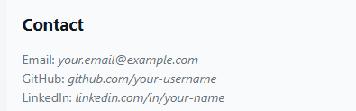

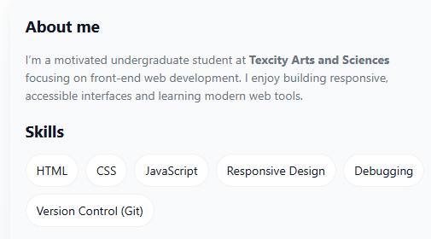
RESULTS AND SCREENSHOTS
3/21/2024 Annual Review
10

Slide 11
CONCLUSION
The portfolio website solved the challenge of presenting my
skills
and achievements dynamically. It reflects my knowledge of
frontend
technologies (HTML, CSS, JavaScript) and provides
recruiters with a
user-friendly way to explore my profile.
This project improved my skills in UI/UX design, responsive
layouts,
and JavaScript interactivity
11

