Slide 1
EXECUTIVE PROJECT REPORT
Insurance Premium
Prediction App
01
INPUT
Profile
02
CALCULATE
A machine-learning web application for estimating insurance premiums from user-provided profile inputs.
BMI
03
PREDICT
Estimate
PREPARED FOR
Rakesh Ranjan
LOCAL PROTOTYPE | FLASK + SCIKIT-LEARN
Executive overview • Current app design • Validation • Next steps

Slide 2
01 / PROJECT AT A GLANCE
Executive summary
A lightweight web interface connects user inputs to a pre-trained regression model and returns a premium estimate.
The need
The solution
The outcome
Make a model-based insurance-cost estimate accessible through a simple form.
Flask serves the form, validates inputs, optionally calculates BMI, and calls the trained model.
A browser-based local prototype returns a prediction or a clear input-validation message.
EXECUTIVE TAKEAWAY
The core user journey is implemented end-to-end. Treat output as an estimate, not an insurer quote; production readiness needs additional hardening.
INSURANCE PREMIUM PREDICTION | RAKESH RANJAN
02

Slide 3
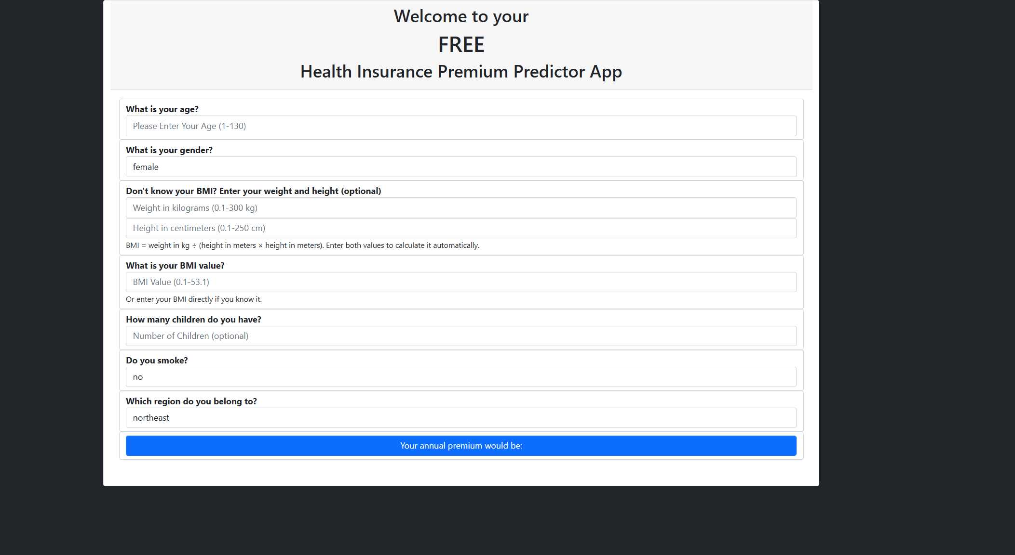
02 / USER EXPERIENCE
A simpler path from profile to estimate
WHAT THE USER CAN DO
• Enter age and select gender, smoker status, and region.
• Provide BMI directly, or enter both weight (kg) and height (cm).
• See BMI calculated automatically using weight / height².
• Leave children blank to use zero; submit to request the estimate.
BMI FORMULA
BMI = kg ÷ (height in meters)²
INSURANCE PREMIUM PREDICTION | RAKESH RANJAN
03

Slide 4
03 / HOW IT WORKS
End-to-end prediction workflow
01
02
03
04
05
Collect
›
Validate
›
Derive BMI
›
Predict
›
Respond
Form captures profile
and category inputs
Browser feedback;
server checks again
Use weight + height,
or manual BMI
Pandas feature row
sent to sklearn model
Show estimate or
HTTP 400 message
MODEL INPUT ORDER
age → sex → BMI → children → smoker → region
INSURANCE PREMIUM PREDICTION | RAKESH RANJAN
04

Slide 5
04 / TRUSTWORTHY INPUTS
Input safeguards and data boundaries
SERVER-ENFORCED INPUT RULES
Age
1–130, whole years
INTERPRETATION NOTE
Cleaned-data ranges inspected:
Age 1–130 • BMI 16.0–53.1 • Children 0–10
Weight + height
Both or neither; 0–300 kg / 0–250 cm
Accepted age and children limits are broader than observed training ranges. Predictions outside the data range may be extrapolations. BMI is capped at the observed maximum.
BMI
Greater than 0; maximum 53.1
Children
Blank → 0; otherwise 0–10, whole number
Client-side checks improve usability; Flask revalidates submitted values before inference.
INSURANCE PREMIUM PREDICTION | RAKESH RANJAN
05

Slide 6
05 / SOLUTION DESIGN
Architecture and technology
PRESENTATION
Browser • HTML / Bootstrap • JavaScript • CSS
RUNTIME SNAPSHOT
↓
• Python + Flask local web app
• Prediction endpoint: POST /predict
• Local port: 1947
• Model pickle recorded with scikit-learn 1.2.0
• No database or user-history storage
APPLICATION
Flask routes • parsing • validation • BMI derivation
↓
INFERENCE
pandas feature row • scikit-learn Gradient Boosting model
↓
LOCAL ASSETS
clean_data.csv dropdowns • trusted model pickle
Production note: disable debug mode, use a production WSGI server, and pin the model-compatible runtime.
INSURANCE PREMIUM PREDICTION | RAKESH RANJAN
06

Slide 7
06 / EXECUTIVE CLOSE
Project status and recommended next steps
Delivered
Current boundary
Recommended next
Interactive Flask prototype, BMI helper, backend validation, packaged model/data, and design documentation.
Local development server; no authentication, persistence, monitoring, or model confidence interval.
Harden deployment, add automated tests and logging, and evaluate predictions on held-out data.
PRIORITY ROADMAP
1
Operational readiness
2
Quality assurance
3
Model governance
Production server, debug off, dependency/model version pinning
Automated validation and prediction tests; user-friendly error UX
Document evaluation metrics and monitor input/model drift
The app demonstrates a complete local inference journey; estimates should be presented as informational, not binding.
INSURANCE PREMIUM PREDICTION | RAKESH RANJAN
07

