Slide 1

Application Decommissioning Summary Report
Notes:
---

Slide 2
Overall Application Readiness Summary
Notes:
High-level readiness analysis across applications, Readiness distribution interpretation

Slide 3

High-level readiness analysis across applications
Overview of Application Readiness
  Seventy-four applications assessed show an average readiness of 83.84%, indicating strong data alignment for decommissioning.
High-Readiness Applications
  Fifty-one applications with 90% or higher readiness have near-complete must-have inputs and minimal gaps.
Medium-Readiness Applications
  Nine applications fall into 60-89% readiness, needing additional details to complete technical and operational metadata.
Low-Readiness Applications
  Thirteen applications under 60% readiness require targeted workshops and follow-ups for critical data gaps.
Notes:
This slide provides a consolidated view of the overall application readiness derived from the complete dataset of seventy-four applications analyzed for decommissioning assessment. The purpose of this content is to offer executives and decision-makers a quick understanding of where the portfolio stands in terms of readiness completeness, coverage of required parameters, and identification of areas needing immediate action. The total number of applications assessed, seventy-four, reflects a broad technology landscape with varying levels of operational complexity and dependency across systems. A significant insight is that the average readiness across all these applications stands at 83.84 percent, indicating relatively strong alignment between the information received from client stakeholders and the essential data required for decommissioning feasibility evaluation. This average, however, also reflects the presence of both well‑documented and poorly‑documented applications within the ecosystem.
A closer breakdown of readiness percentages shows that fifty-one applications fall into the high‑readiness category, which includes systems with ninety percent or higher readiness. These applications generally have complete or near‑complete Must‑Have inputs and minimal gaps in Good‑to‑Have attributes, positioning them well for subsequent phases such as dependency verification, compliance review, and archival requirements assessment. Nine applications fall into the moderate or medium‑readiness group (sixty to seventy‑nine percent), indicating that while foundational parameters have been captured, additional details are needed to finalize the assessment. These systems typically exhibit minor gaps in technical or operational metadata. Lastly, thirteen applications fall below sixty percent readiness, representing the highest‑risk group that will require structured stakeholder workshops, targeted deep dives, and focused follow‑ups before decommissioning strategies can be meaningfully developed. These applications often miss critical Must‑Have information such as data retention policies, interface mappings, archival dependencies, or business owner validations. Collectively, this slide helps teams prioritize their engagement approach while ensuring maximum efficiency in the overall decommissioning roadmap.

Slide 4
Readiness distribution interpretation
Readiness Tier | Percentage Range | Number of Applications
High Readiness | ≥ 90% | 51 🟢
Medium Readiness | 60–89% | 9 🟡
Low Readiness | < 60% | 13 🔴

Slide 5

Top & Bottom Readiness Highlights
Notes:
Evaluation of Must‑Have and Good‑to‑Have completeness, Heatmap completeness table

Slide 6
Top 10 Ready Applications
# | Application | Readiness %
1 | Mainframe Commercial Property | 100.00
2 | Commercial Mainframe COI | 100.00
3 | Mainframe Policy Entry | 100.00
4 | HV - eForms Generation App | 98.68
5 | HV-COGNOS | 98.68
6 | HV-ACE - Premium Audit | 98.68
7 | HV-ImageRight | 98.68
8 | HV-Hazard Grade Matrix (HGM) | 98.68
9 | Mainframe General Liability (GLS) | 97.37
10 | HV-U279 Processing Form | 97.37

Slide 7
Bottom 10 - Need Inputs
# | Application | Readiness %
1 | Pathway (DSM) | 34.21
2 | Error Message | 35.53
3 | Commercial Underwriting DB | 39.47
4 | Commercial Renewal Reporting DB | 39.47
5 | Policy Expirations | 40.79
6 | Policy Reload | 42.11
7 | Allied Endorsements | 43.42
8 | Alpha Search | 44.74
9 | HV-AQS | 56.58
10 | HV-AQS Batch Print | 57.89

Slide 8
Readiness Categories with Visual Indicator
Notes:
Categorization using readiness thresholds, Readiness category summary table

Slide 9
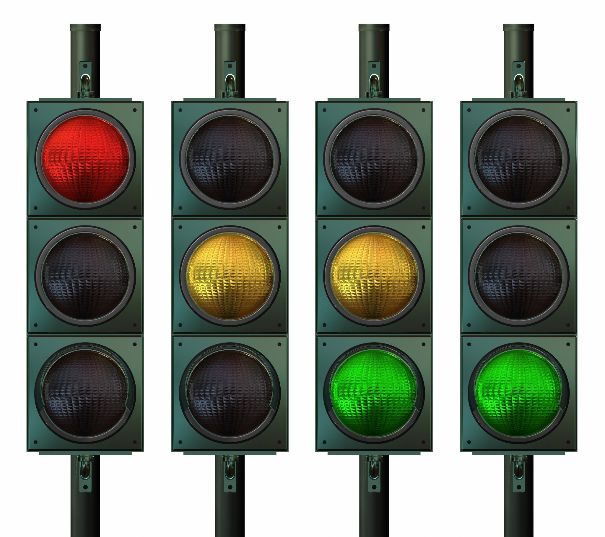
Categorization using readiness thresholds
Green Readiness Category
  Fifty-one applications are in green with over ninety percent readiness, indicating strong documentation and minor gaps.
Amber Readiness Category
  Eighteen applications fall in amber, showing moderate readiness with foundational documentation but needing more information.
Red Readiness Category
  Thirteen applications are in red, exhibiting critical gaps requiring immediate focus and deep-dive workshops.
Notes:
This slide utilizes the traffic‑light‑style readiness category visual (as provided by the user) to enhance interpretability of application readiness across the portfolio. Based on the thresholds communicated—green for ninety percent and above, amber for seventy to ninety percent, and red for below seventy percent—the dataset reveals a clear concentration of applications in the green zone. Specifically, fifty‑one applications qualify as high‑readiness systems and are strong candidates for advancing into decommissioning decision cycles. The green categorization typically reflects well‑documented systems where both Must‑Have and Good‑to‑Have data points are either fully completed or exhibit only minor, non‑blocking gaps.
The amber range, covering seventy to ninety percent readiness, includes approximately eighteen applications when taking into account that nine fall within the sixty to seventy‑nine percent bucket and the remaining nine between eighty and eighty‑nine percent. This group represents systems where the foundational structure of required documentation is present but supplementary information must still be acquired to reach a state of readiness suitable for validation. Amber‑category applications often include heritage systems, moderately complex integrations, or tools with shared dependencies that require further elaboration from business or technology owners.
Thirteen applications fall into the red category, defined as systems below seventy percent readiness. These applications pose the greatest risk to program timelines and require immediate attention. Systems in this tier frequently exhibit missing Must‑Have parameters such as compliance mandates, archival rules, functional criticality, interface maps, or end‑state business validation. Red‑category applications may also include legacy or poorly documented environments where information gaps stem from system age, personnel turnover, or lack of authoritative documentation repositories. Prioritizing deep‑dive workshops for these applications is essential to eliminate bottlenecks in the decommissioning lifecycle. By leveraging the readiness categorization alongside the provided image visual, decision‑makers can easily segment applications, ensuring that efforts and resources align with priority areas.

Slide 10
Readiness category summary table
Category | Definition | Application Count
Green | ≥ 90% Ready | 51 🟢
Amber | 70–90% Ready | 18 🟡
Red | < 70% Ready | 13 🔴

Slide 11
Input Completeness Heatmap Summary
Notes:
Evaluation of Must‑Have and Good‑to‑Have completeness, Heatmap completeness table

Slide 12

Evaluation of Must‑Have and Good‑to‑Have completeness
Fully Complete Applications
  Three applications have full Must-Have and Good-to-Have completion, enabling smooth decommissioning without extra input.
Must-Have Complete Only
  Fourteen applications completed Must-Have inputs with some Good-to-Have gaps, remaining close to full readiness.
Good-to-Have Complete Only
  Nine applications completed Good-to-Have fields but lack some Must-Have items, posing compliance and risk issues.
Least Complete Applications
  Forty-eight applications lack significant Must-Have and Good-to-Have data, requiring targeted efforts to improve readiness.
Notes:
This slide provides a deeper analysis of the completeness of Must‑Have and Good‑to‑Have parameters across all applications in the assessment scope. Unlike percentage‑based readiness scoring, which gives a high‑level view, this input‑completeness heatmap reveals structural documentation gaps that directly affect decommissioning feasibility and sequencing. Only three applications have achieved full completion across both Must‑Have and Good‑to‑Have inputs, indicating that these systems possess clear data coverage and can advance through the decommissioning workflow without dependency on additional stakeholder input. These applications typically include strongly governed platforms or recently modernized systems that follow standardized documentation practices.
Fourteen applications have completed all Must‑Have inputs but retain gaps in Good‑to‑Have fields. This group remains close to full readiness, as Must‑Have inputs form the core evaluation criteria. Good‑to‑Have gaps often relate to optional metadata such as secondary integrations, environment‑level nuances, or ancillary business owner considerations. Nine applications complete all Good‑to‑Have fields yet lack certain Must‑Have items—these represent structurally risky systems because gaps in Must‑Have parameters directly impact compliance, archival, technical dependency analysis, or risk scoring models. The presence of missing Must‑Have items requires immediate escalation to relevant stakeholders.
Finally, forty‑eight applications fall into the least‑complete quadrant, lacking significant portions of both Must‑Have and Good‑to‑Have inputs. This distribution indicates a substantial dependency on business and technical SMEs for clarification and represents the largest barrier to program acceleration. These applications may involve outdated documentation, complex integration landscapes, or distributed ownership across multiple teams. Addressing this group through targeted working sessions, structured questionnaire reviews, or documentation mining exercises will be essential to elevate overall readiness. Presenting this breakdown to leadership helps set expectations on required resource bandwidth and timeline impact.

Slide 13
Heatmap completeness table
Must-Have Status | Good-to-Have Status | Application Count
Complete | Complete | 3
Complete | Not Complete | 14
Not Complete | Complete | 9
Not Complete | Not Complete | 48

