Slide 1
Smart Technologies
Self-driving car
Ewan Rakotoanosy - D00243375

Slide 2
Data Generation
Generated with joystick
Multiples data set :
first_track_8lap | 8 laps in each direction on track 1
first_track_15lap | 15 laps in each direction on track 1
first_track_15lap_track2_2lap | 15 laps in each direction on track 1 and 2 laps in 1 direction on track2

Slide 3
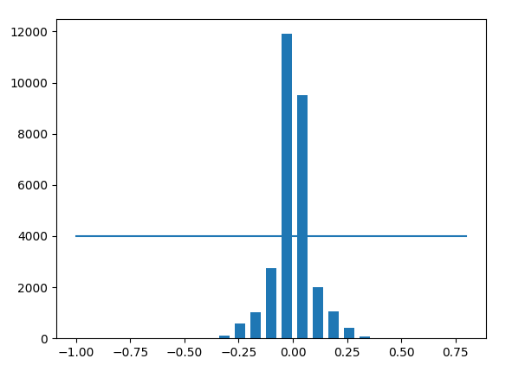
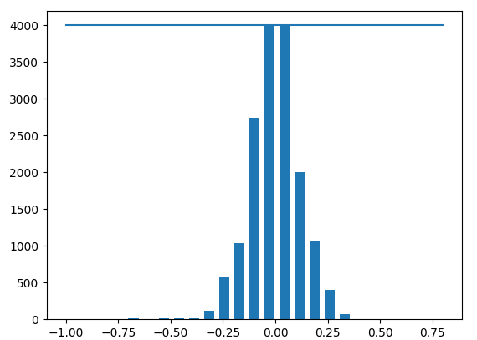
Data exploration

Slide 4
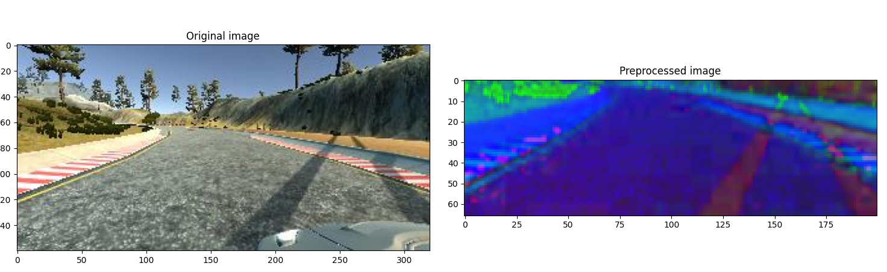
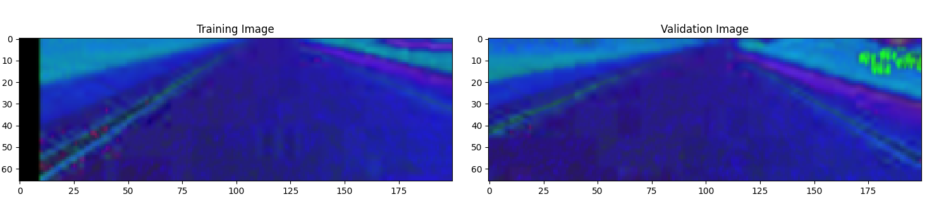
Data pre-processing

Slide 5
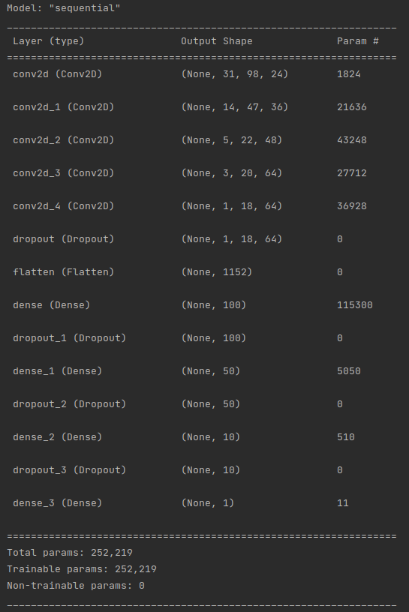
Model

Slide 6
Model tested and result
model_1track_8lap_yuv.h5
Colour representation | YUV
Dataset | first_track_8lap
Shadow augmentation | No
Result Track 1 | Completes multiple laps
Result Track 2 | crashes directly on the right

Slide 7
Model tested and result
model_1track_8lap.h5
Colour representation | HUV
Dataset | first_track_8lap
Shadow augmentation | No
Result Track 1 | Completes multiple laps
Result Track 2 | Drive until the first turn and crashes

Slide 8
Model tested and result
model_1track_8lap_shadow.h5
Colour representation | HUV
Dataset | first_track_8lap
Shadow augmentation | Yes
Result Track 1 | Completes multiple laps
Result Track 2 | Drive until the first shadow and crashes

Slide 9
Model tested and result
model_1track_15lap_shadow.h5
Colour representation | HUV
Dataset | first_track_15lap
Shadow augmentation | Yes
Result Track 1 | Completes multiple laps perfectly
Result Track 2 | Crashes immediately in the left sign

Slide 10
Model tested and result
model_1track_15lap_track2.h5
Colour representation | HUV
Dataset | first_track_15lap_track2_2lap
Shadow augmentation | No
Result Track 1 | Drive until the bridge and then exit the road
Result Track 2 | Drive until the first shadow and crashes

Slide 11
Model tested and result
model_1track_15lap_track2_shadow.h5
Colour representation | HUV
Dataset | first_track_15lap_track2_2lap
Shadow augmentation | Yes
Result Track 1 | Drive until the bridge and then exit the road
Result Track 2 | Complete multiple laps

