Slide 1
EL1
3D NAND Throughput Scaling
Area-Law Confirmed in Public Benchmark Data
CDT–CCDR–TN Engineering · April 2026

Slide 2
The Question
Volume Scaling Hypothesis
Area Scaling Hypothesis
Throughput ~ L^{1.5}
More layers = more cells = proportionally more data flow through the 3D volume
Throughput ~ L^{1.0}
Throughput limited by the interfacial surface area, not bulk volume — a holographic constraint
Which one does the data support?

Slide 3
Dataset: 32 – 300 Layers
Layers | Throughput (MB/s) | Capacity (GB)
32 | 40 | 256
48 | 50 | 512
64 | 60 | 512
96 | 80 | 1024
128 | 100 | 2048
176 | 130 | 2048
232 | 160 | 4096
300 | 200 | 4096
8 public benchmark-style data points
Spans early 3D NAND to 300+ layer stacks
Sequential read throughput, advertised capacity

Slide 4
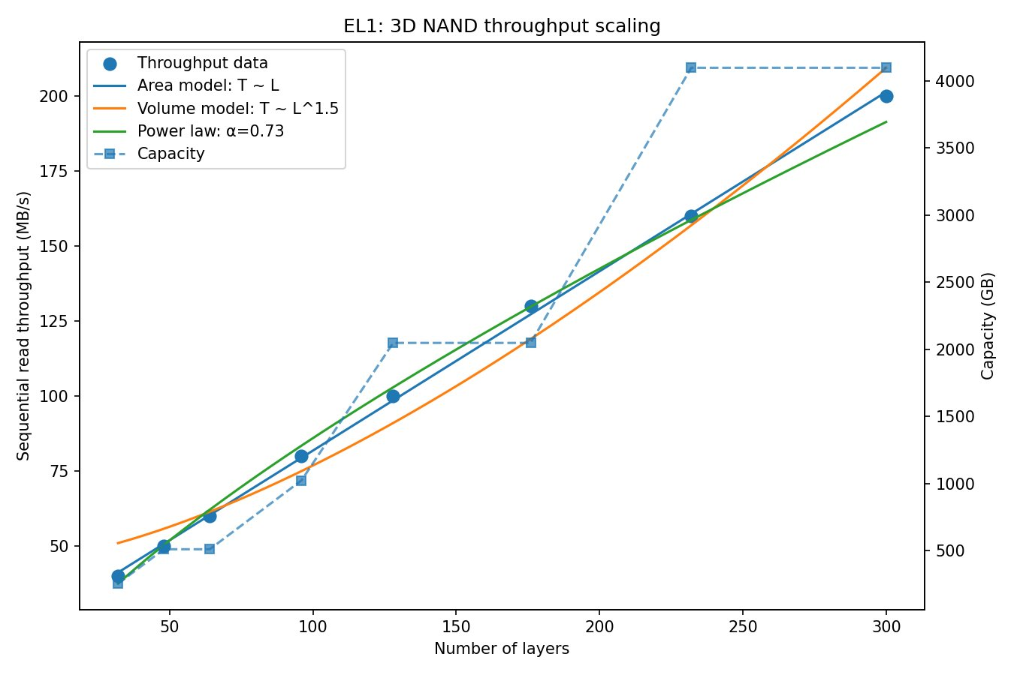
Three-Model Comparison
Area model (blue) tracks data almost perfectly; volume model (orange) diverges above 100 layers

Slide 5
Results: Area Law Wins Decisively
0.9994
33×
0.73
R² Area Model
SSE Ratio
Power-Law α
vs 0.9787 volume
lower than volume
sub-linear, not 1.5
Metric | Area | Volume | Power Law
AIC | 8.68 | 36.77 | 24.79
BIC | 8.84 | 36.92 | 24.95
Lower AIC/BIC = better model. Area model wins by 16–28 points (decisive).

Slide 6
Why Area, Not Volume?
CDT–CCDR Interpretation
3D NAND is a physical crystal. The Ryu–Takayanagi minimal surface sets an information-theoretic ceiling on data flow through any cross-section of the stack. The throughput bottleneck is the 2D interfacial boundary between the bit-line array and the control-gate stack — not the 3D volume of cells.
α < 1 explained: Each additional layer contributes less marginal throughput because the boundary-area bottleneck tightens as the stack grows.
Volume scaling (α = 1.5) refuted: Would require information propagating through the entire 3D volume simultaneously — violates the holographic bound.

Slide 7
Engineering Implications
Optimise die area, not layer count
Wider bit-line pitch or parallel channels increase holographic surface area and throughput without deeper etching penalties.
Yield improvement
Shorter stacks with wider dies are easier to manufacture. 200-layer wide die ≈ 300-layer narrow die throughput.
Lower power and thermal
Fewer layers reduce vertical RC delay and thermal resistance at the same throughput.
Roadmap warning
α = 0.73 means 400+ layer stacks will hit severe throughput plateaus. First-movers to area-optimised architecture gain a competitive window.

Slide 8
Next Steps
1
Validate with proprietary data — run the script against internal throughput measurements across your product line
2
Simulate next-gen die geometries — area-optimised vs layer-count-optimised at 200, 300, 400 layers
3
Joint workshop or NDA discussion — bring the CCDR framework to your architecture team
4
Co-publish — industry paper confirming the area law on production data
Script, data, and full analysis available — no proprietary dependencies

