Slide 1
Sierra Speakers Toastmasters Meeting Tools
A Step-by-Step Guide
1 / 26

Slide 2
What These Tools Do
Three macros built into your schedule spreadsheet that handle meeting prep.
1
2
3
Send Role Confirmations
Generate Meeting Agenda
Draft Club Meeting Email
Email members assigned to roles and track who confirms, who declines, and who still needs to reply.
Build a polished Google Doc agenda from the schedule, complete with speakers, evaluators, and Word of the Day.
Create a weekly reminder email as a Gmail draft, ready for your review before sending.
Any club member can use these tools. Everything runs from the Toastmasters menu in your spreadsheet.
2 / 26

Slide 3
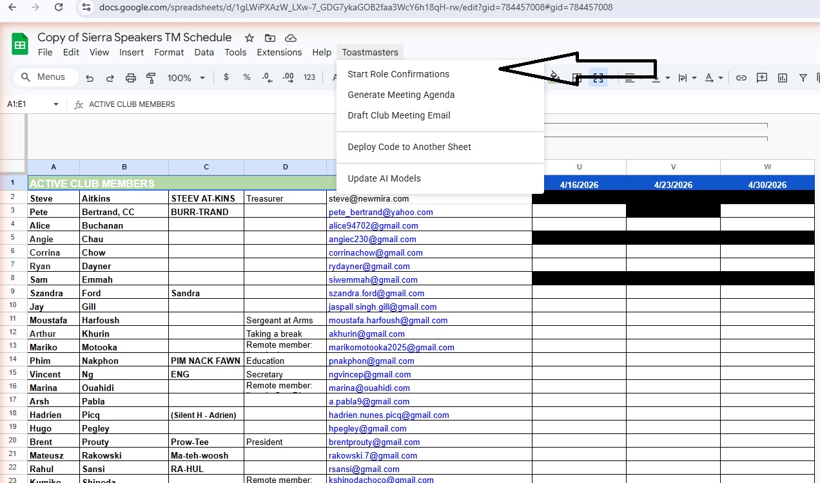
First Time Setup
Google Permissions (one-time authorization)
1
Google shows an "This app isn't verified" warning. This is normal.
2
Click "Advanced" (small link at the bottom-left).
3
Click "Go to [project name] (unsafe)".
4
Review the permissions and click "Allow".
The script needs access to your spreadsheet, permission to send email on your behalf, and permission to create Google Docs. After you approve once, Google remembers your choice.
3 / 26

Slide 4
Role Confirmations
Select "Start Role Confirmations" from the Toastmasters menu

Slide 5
Role Confirmations
Open the Toastmasters Menu
Click Toastmasters in the menu bar, then select Start Role Confirmations.
5 / 26

Slide 6
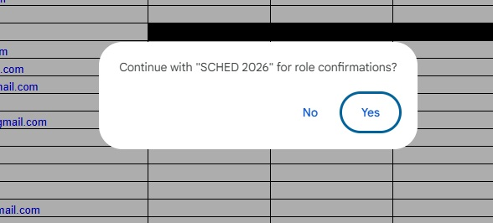
Role Confirmations
Confirm the Schedule Sheet
A dialog asks whether to continue with the current schedule tab (for example, "SCHED 2026"). Click Yes if that is the correct schedule.
6 / 26

Slide 7
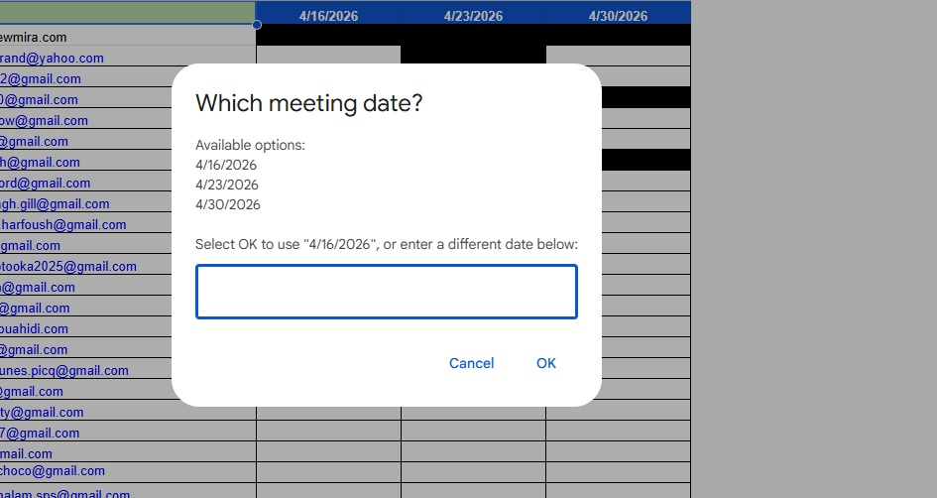
Role Confirmations
Pick the Meeting Date
Select the meeting date from the list of upcoming dates. The default is the next meeting. Click OK to accept it, or pick a different date.
7 / 26

Slide 8
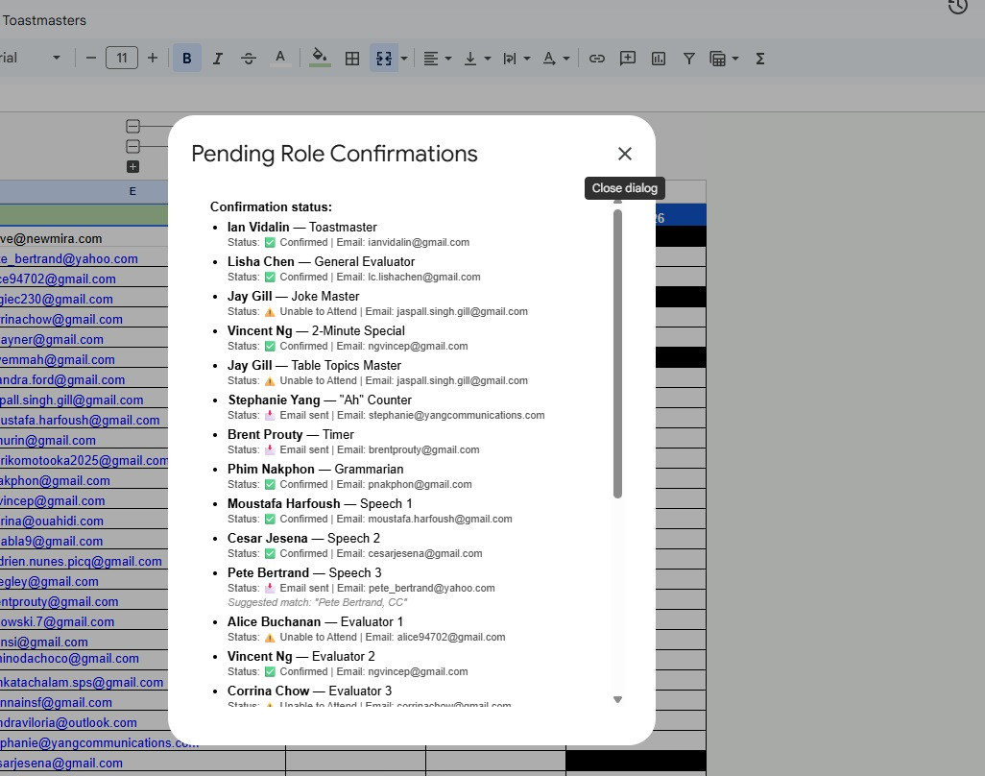
Role Confirmations
Review Pending Roles
The macro opens a Pending Role Confirmations panel. Each role shows the member's name and a color-coded status: Confirmed, Email sent, or Unable to Attend.
8 / 26

Slide 9
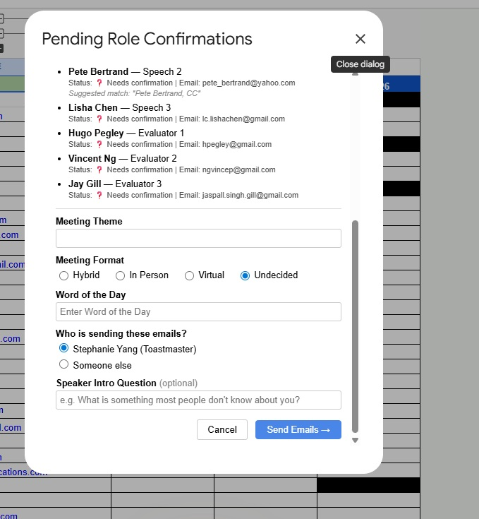
Role Confirmations
Fill in Details and Send
Set the meeting theme, format, Word of the Day, and sender. Click Send Emails to create Gmail drafts. The macro never sends directly; you review drafts first.
9 / 26

Slide 10
Generate Meeting Agenda
Select "Generate Meeting Agenda" from the Toastmasters menu

Slide 11
Generate Agenda
Open Generate Meeting Agenda
Click Toastmasters, then select Generate Meeting Agenda.
11 / 26

Slide 12
Generate Agenda
Pick the Meeting Date
The same date picker appears. Select the meeting date and click OK.
12 / 26

Slide 13
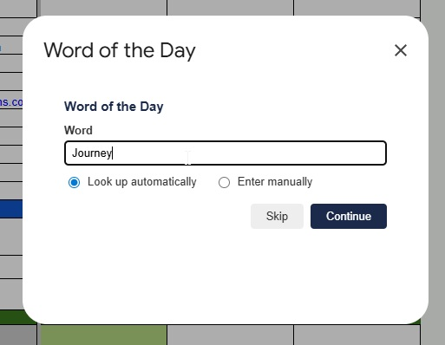
Generate Agenda
Enter the Word of the Day
A dialog asks you to type in the Word of the Day.
13 / 26

Slide 14
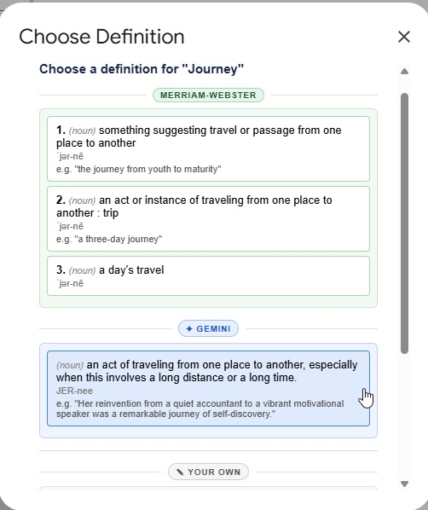
Generate Agenda
Pick a Definition
The macro looks up your word and offers definition options. Pick the one you like best.
14 / 26

Slide 15
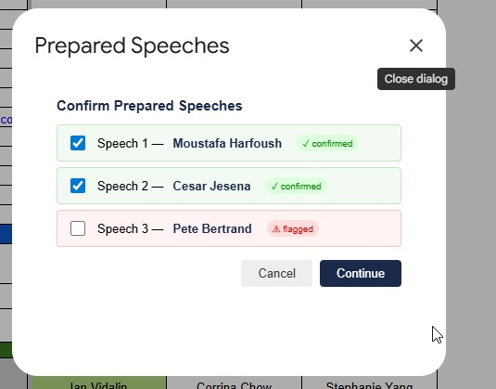
Generate Agenda
Confirm Prepared Speeches
The macro shows speakers for this meeting. Uncheck any speech that is not happening, then click Continue.
15 / 26

Slide 16
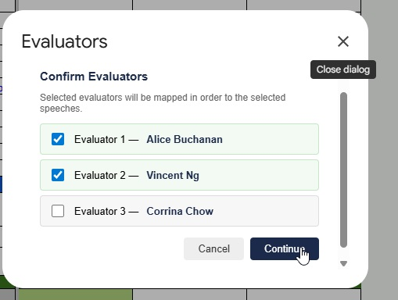
Generate Agenda
Confirm Evaluators
Confirm the evaluator assignments. The macro pairs each speaker with their assigned evaluator.
16 / 26

Slide 17
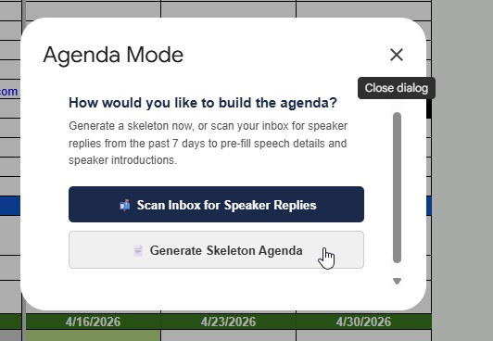
Generate Agenda
Agenda Generation in Progress
The macro builds the agenda document. Before generating, it can scan your Gmail inbox for emails from speakers about their upcoming speeches.
This helps auto-populate speech titles, pathway levels, and other details so you do not have to type them in manually.
If no relevant emails are found, the macro simply proceeds with whatever information is already in the schedule sheet.
This step saves time compared to manually entering each speaker's details before generating the agenda.
17 / 26

Slide 18
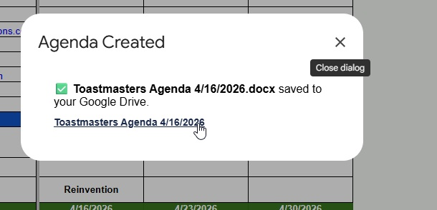
Generate Agenda
Get the Agenda Link
When the agenda is ready, a popup shows you the link. Click it to review your agenda. The link is automatically saved and will pre-fill in the club email dialog later.
18 / 26

Slide 19
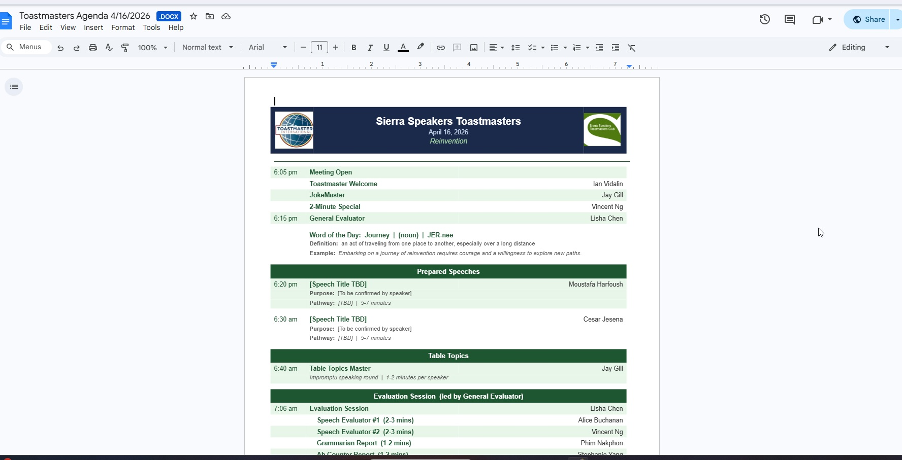
Generate Agenda
Your Generated Agenda
Here is an example of the generated meeting agenda document. The agenda pulls speakers, evaluators, Word of the Day, and other details directly from your schedule.
19 / 26

Slide 20
Draft Club Meeting Email
Select "Draft Club Meeting Email" from the Toastmasters menu

Slide 21
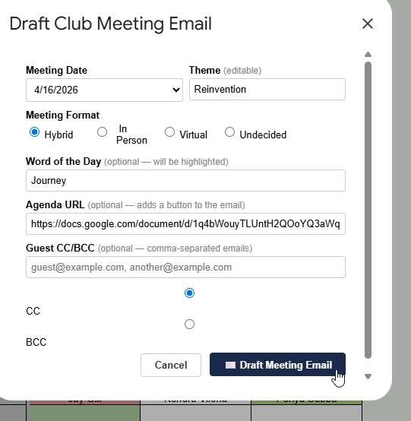
Club Email
Draft Club Meeting Email
Click Toastmasters, then Draft Club Meeting Email. The dialog fields come pre-populated from your earlier choices (theme, Word of the Day, agenda URL, and meeting format from when you ran Role Confirmations or Generate Agenda). You can overwrite any field before drafting. No need to re-enter everything.
21 / 26

Slide 22
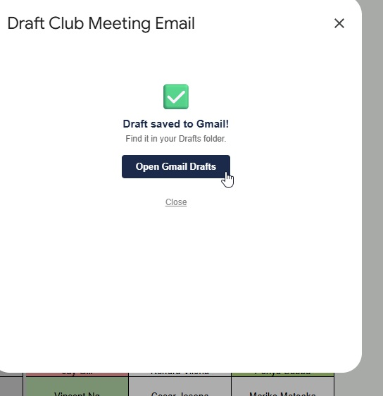
Club Email
Draft Saved to Gmail
After you click Draft Meeting Email, a confirmation dialog appears. Click Open Gmail Drafts to jump straight to your drafts folder and review the email.
22 / 26

Slide 23
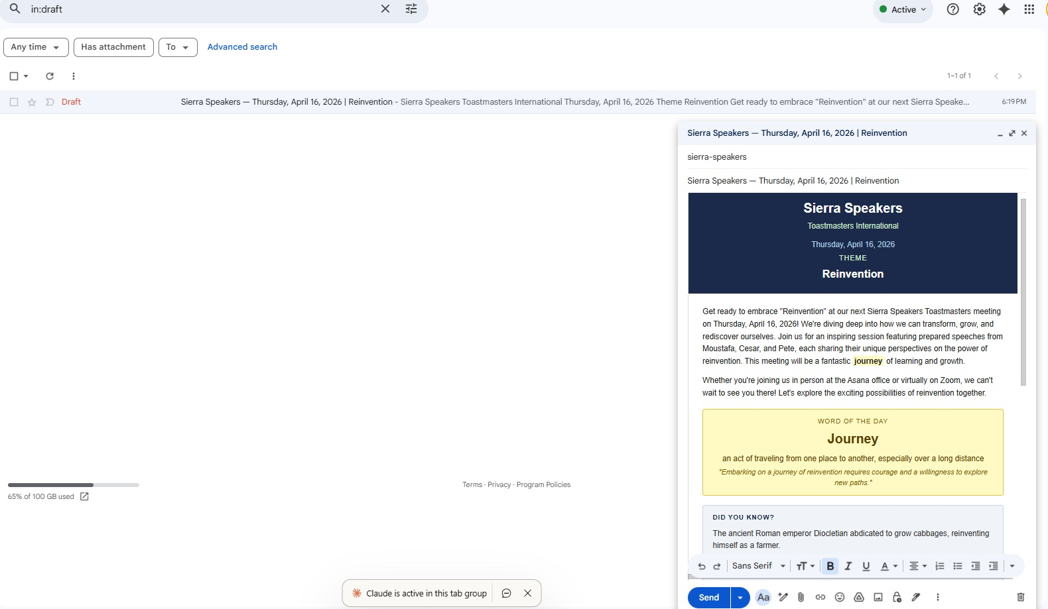
Club Email
Review and Send from Gmail
Click Draft Meeting Email to save the email as a Gmail draft. Open Gmail, find it under Drafts, read it over, and click Send. The macro never sends on its own.
23 / 26

Slide 24
Appendix
Additional reference material

Slide 25
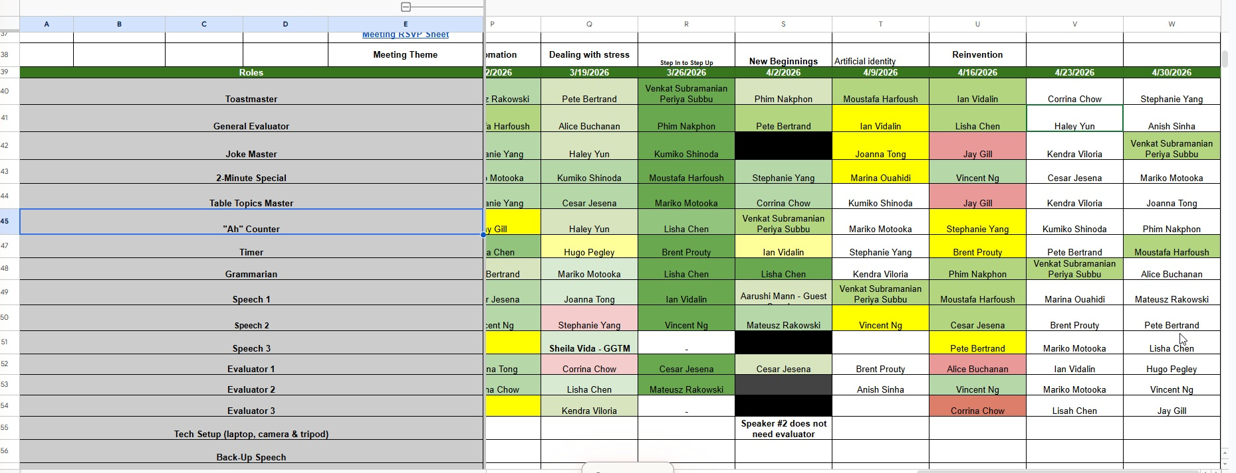
Reference
Understanding the Color Coding
Green
The member has confirmed their role.
Yellow
The member has been contacted but has not replied yet.
Red
This role needs reassignment.
Colors update automatically when you run Start Role Confirmations.
25 / 26

Slide 26
Tips and Reminders
Always review drafts before sending. The macros create Gmail drafts, never send directly.
Run confirmations early in the week. This gives members time to reply and lets you handle swaps before the meeting.
Generate the agenda before drafting the club email. The agenda URL can be auto-filled into the email form.
Re-run Role Confirmations as needed. It only emails people who have not already been contacted.
If you see a "Running script" banner at the top of the spreadsheet, just wait until it finishes.
The Toastmasters menu only appears once the spreadsheet has fully loaded. If you don't see it right away, wait a few seconds.
Need help? Ask your VP of Education or the member who set up the spreadsheet.
26 / 26

