Slide 1
Scheduling with Outliers
Ravishankar Krishnaswamy
(Carnegie Mellon University)
Joint work with Anupam Gupta, Amit Kumar and Danny Segev

Slide 2
Introduction
Classical Scheduling Problems
  Given jobs and machines
  Find best schedule according to some objective
Simple Example
  N jobs, M machines.
  Job j has a processing time of p_{j}
  Find schedule of minimum makespan
    Minimize maximal load on any machine.

Slide 3
A possible issue
What if there are some rogue jobs?
  They dominate objective value
  Algorithms focus on handling these
  Ignore effects of others
For example,
  Straggler job might slow down response time of all jobs
  If we discard that job, other jobs finish much faster
  Commonly seen in computers

Slide 4
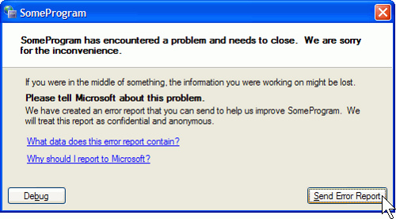
Overcoming this..
Ignore these rogue jobs
Scheduling with outliers
  Or possibly, scheduling without liars? ☺
More Formally
  Each job comes with a penalty if we discard it
  Discard a total penalty of R
  Schedule the others to optimize given objective

Slide 5
Outliers vs “Prize-Collecting”
Prize-Collecting Model
  Penalty of jobs left out figures in objective function
  Minimize objective of scheduled jobs + penalty of outliers
Outlier Model
  Hard bound on penalty
  leave out some jobs, while scheduling the others
Both model similar concept
  Prize-Collecting combines two different measures
  Can solve PC if we solve outlier problem.

Slide 6
Problems Studied
Makespan/Generalized Assignment
  n jobs and m unrelated machines
  Job j has processing time p_{ij} and cost c_{ij} on machine i
  Job j also has penalty r_{j}
  Goal is to minimize makespan
    while leaving out jobs of total penalty R
Non-Outlier Setting: (C,2T)-approximation algorithm

Slide 7
Problems Studied
Weighted Sum of Completion Times
  n jobs and m unrelated machines
  Job j has processing time p_{ij} on machine i
  Job j also has penalty r_{j}
  Goal is to minimize average completion time of the jobs
    while leaving out jobs of total penalty R
Non-Outlier Setting: 2-approximation algorithm

Slide 8
Problems Studied
Average Flow Time
  n jobs and m identical machines
  Job j has processing time p_{j} and arrival time a_{j}
  Goal is to minimize average flow time of the jobs
    F_{j} = C_{j} – a_{j} or the time for which j is present in the system
    while leaving out jobs of total penalty R
Non-Outlier Setting: O(log P)-approximation algorithm

Slide 9
Our Results
Generalized Assignment / Makespan
A deterministic [C(1+є), 3T] approximation algorithm
Weighted Sum of Completion Times
A randomized constant factor approximation algorithm for the general case
An FPTAS in the case of single machine sum of completion times
Average Flow Time (Preemptive)
A deterministic O(log P) approximation algorithm when all penalties are unit

Slide 10
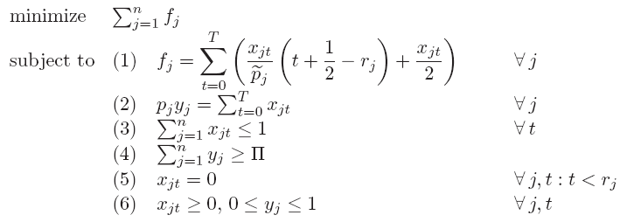
An LP Formulation
Adapted from Garg and Kumar [ICALP 06]
x_{jt} :: extent of job j is scheduled in time slot [t,t+1]
y_{j} :: fraction of j scheduled
f_{j} :: fractional flow time of j

Slide 11
Rounding: Some Obstacles
For sum of completion times and makespan
  We can use ½ point of any job effectively
Does not quite work for flow time
  (α C_{j} – a_{j} ) >> α (C_{j} – a_{j} )
Such techniques need “speed-up” of α
Without speed-up, we really need to work inside LP schedule

Slide 12
How can the LP cheat?
M
2^{k}
2^{k-1}
2^{k-2}
…
2¹
1
…
1
1
…
1
1
1
2^{k+1}
2^{k}
2^{k-1}
2²
Requirement: k/2 + M jobs
LP Schedule:
fraction ½ of each large job in the corresponding gray intervals
fraction 1 of each small job in the blue intervals
LP Cost is roughly 2^{k} + M

Slide 13
How can the LP cheat?
M
2^{k}
2^{k-1}
2^{k-2}
…
2¹
1
…
1
1
…
1
1
1
2^{k+1}
2^{k}
2^{k-1}
2²
Requirement: k/2 + M jobs
Integral Schedule:
once jobs M + k/2 jobs are chosen, SRPT is optimal
all small jobs will be chosen
k/2 large jobs all wait for period of M
Give up globally; Work locally
Integral Cost is (M.k)

Slide 14
Rounding 1: Local Swap
Consider two jobs of processing times 2^{k}
Let y₁ and y₂ denote their fractional extents in LP
To make the schedule integral, suppose we swap
  Δ fraction of J₂ with equal fraction of J₁
J₁
J₂
a₁
a₂
Δ
Observation: LP cost increase is roughly Δ (a₂ – a₁)

Slide 15
Local Swap Continued
Can perform such swaps and ensure that
  Each time instant t is charged at most 1 in total
Good if job sizes are powers of two
  Any point charged is not empty time
  Total charge is upper bounded by LP_{OPT}
  Can get desired O(log P)-approximation algorithm
How do we handle fact that all jobs are not 2^{k} ?

Slide 16
Handling General Sizes
Group jobs into buckets. Look at one such bucket
If j₂ has larger processing time
  There is sufficient space to replace it by equal fraction of j₁
  Same argument as in previous slide
If j₂ has smaller processing time
  Not enough space
  Schedule j₂ over j₁ !
  Might violate the release date of j₂
Still no good.. ☹
J₁
J₂
a₁
a₂

Slide 17
A Not-so-local Swap
What’s the Problem?
  Grow j for long time charging intervals till fraction 2/3
  Then j sees smaller job j’ scheduled to 2/3
  j’ eats j, but we’re still left with 1/3 of j
  Cycle repeats…
A Fix
  Don’t be local -- Look Ahead
  Avoid such issues
  More complex charging argument

Slide 18
Ingredient 2: A Local Shift
To fix the release date issue
  Look at any job class
  Consider all the time intervals where we schedule that class jobs
  Shift the schedule by 2^{k} entirely within this interval
Total extra cost: O(log P) LP_{OPT}
Unfinished jobs increase by 2 per class

Slide 19
Wrapping Up
O(log P) approximation algorithm
  flow-time on single machine with unit penalties
  can be extended to identical machines
Other results
  O(1) for weighted completion times and makespan
What about flow time with non-uniform penalties?
Outlier versions of other problems?

Slide 20
Thank You!

