Slide 1
Approximation Algorithms for Capacitated Set Cover
Ravishankar Krishnaswamy
(joint work with Nikhil Bansal and Barna Saha)

Slide 2
Approximating Set Cover
Given m sets, n elements
Find minimum cost collection of sets
to cover all elements
Greedy: ln n approximation
[Feige]: ln n hardness of approximation

Slide 3
Not the end of story
Several set systems (X,S) admit much better approximations
e.g. geometric covering,
totally unimodular systems,
small hereditary discrepancy,
small VC-dimension, etc.
What about the capacitated versions?
Can solve these either exactly or upto O(1) factors

Slide 4
Capacitated Set Cover
Instance: Sets and Elements
Sets have capacities and costs
Elements have demands
Find minimum cost collection of sets
    total capacity of sets covering an element is at least its demand
eg: capacitated network design, flowtime, and many more applications

Slide 5
Capacitated Set Cover
In general, O(log n)-approximation is known
Can we obtain improved approximations for special cases like TU matrices?
Initiated by Chakrabarty, Grant, and Konemann [2010]
Meta: Is it only the structure of the set system that determines the approximability?

Slide 6
Results of Chakrabarty et al.
MC is often as easy as 0/1 Problem
Multi Cover
Integrality Gap
Capacitated Set Cover
Integrality Gap
Priority Cover
Integrality Gap
[CGK] conjecture
CSC has same approximability as 0-1 problem

Slide 7
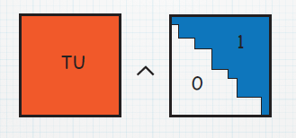
Priority Cover Problem
Input: Sets (costs) and Elements
both have priorities
  Min cost collection of sets to “cover” elements
  element is only covered by sets of higher priority
[CGK]: there are log c_{max} priorities
A

Slide 8
Priority Covering
Good News: remains a 0-1 problem
Bad News: alters the structure of matrix
  anding with triangular matrix of 1s
  e.g. original matrix could be totally unimodular
  but not any more…
How well can we approximate this problem?
k: no. of priorities
Theorem: O(α log² k) approximation
where α is integrality gap of 0/1 problem
Corollary: O(α log log² C) approximation for CSC
where α is integrality gap of 0/1 problem

Slide 9
Roadmap
Introduction
Problem Definition
Priority Covering Problems
Approximating PCPs
Lower Bounds
Conclusion

Slide 10
Our Rounding Algorithm
determinant of any submatrix is 0,1, -1
Fact 1: Each subdivision is also TU
Fact 2: There are log k subdivisions in total
Very simple: divide and conquer
  for simplicity, assume the original matrix is TU
S
T
e
f

Slide 11
What we have done…
Each set appears in log k copies
Each elements fractionally covered to extent 1/ log k in some copy
  Each copy is TU and therefore integral polytope
Gives O(log² k) approximation for TU matrices
Also works if hereditary int. gap is α

Slide 12
Hereditary Systems?
Given set system (X,S)
if all subsystems (X’, S’) have int. gap α
then hereditary int. gap is α
TU systems,
geometric instances,
bounded hereditary discrepancy, etc.
steiner tree cut system

Slide 13
Hereditary Discrepancy
generalizes Total Unimodularity
A matrix M has Herdisc α
if for any subset of columns
there exists a {1,-1} coloring
s.t. any row sums to at most α

Slide 14
HerDisc to Her. Integrality Gap
consider fractional solution (scale it by α)
think of fractional assignment in bits
x_{i} = 0.10110010
let S: all sets for which lsb is 1
obtain {1,-1} coloring for variables in S
increase or decrease according to coloring
end up with integer solution
total loss of coverage in each row < α; solution feasible ☺

Slide 15
Roadmap
Introduction
Problem Definition
Priority Covering Problems
Approximating PCPs: O(log² k)
Sample Application
Lower Bounds
Conclusion

Slide 16
Flow Time Scheduling
  Jobs with different processing times and weights arrive over time
  Schedule them on single processor
  minimize “weighted flow time” of the jobs
  can preempt jobs

Slide 17
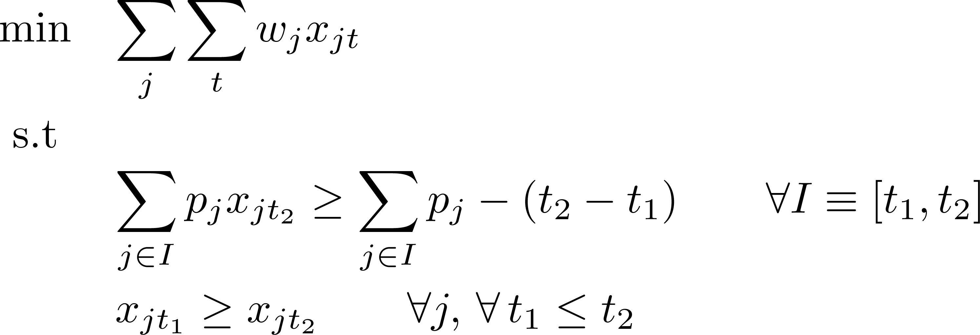
Relaxation in [BP10]
t₁
t₂
(r_{1,}w_{1,}p₁)
(r_{2,}w_{2,}p₂)
(r_{3,}w_{3,}p₃)

Slide 18
Structure of 0/1 Set System
Elements are intervals
Sets are also intervals, but must overlap
t₁
t₂
Bansal and Pruhs used powerful result about weighted geometric set covering [Varadarajan] to get O(log k) approximation
This gives very simple O(log² k)
Can encode it as priority line cover problem!
our theorem
We need to solve priority version of this problem

Slide 19
Roadmap
Introduction
Problem Definition
Priority Covering Problems
Approximating PCPs: O(log² k)
Sample Application: Flowtime
Lower Bounds
Conclusion

Slide 20
Lower Bounds
O(log² k) loss in approximating PSC
Is it necessary?
Don’t know, but log k loss is unavoidable
There exist set systems with
hereditary int. gap of 2
but the priority version has log k gap
use connections to recent lower bounds of ϵ-net in geometric graphs of low dimension
In particular, 1/ϵ log 1/ϵ bound for 2-D Rectangle Covers
[Pach Tardos 10]

Slide 21
Lower Bound Reduction
2-Dimension RC = Priority P
2-Dimension RC with = P
rectangles fixed at X-axis
(just Priority Line Cover in disguise)
  integrality gap of 2 is known

Slide 22
To Conclude…
Capacitated Set Cover
Priority Covering
Approximating PCPs: O(α log² k)
If 0/1 problem has O(α) hereditary int. gap.
e.g., if 0/1 problem has O(α) her. disc.
Lower Bounds: Ω(α log k)
Can we close this gap?
Thanks!

Slide 23
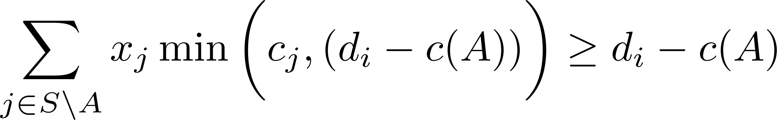
LP relaxation
Naïve: bad
Integrality Gap of Knapsack
high capacity set, high cost
element of low demand
  LP cheats by picking this set to a very tiny extent
Fix: add “Knapsack Cover” inequalities!

