Slide 1
An O(1) Approximation Algorithm for Generalized Min-Sum Set Cover
Ravishankar Krishnaswamy
Carnegie Mellon University
joint work with Nikhil Bansal (IBM) and Anupam Gupta (CMU)

Slide 2
elgooG: A Hypothetical Search Engine
Given a search query Q
Identify relevant webpages and order them
Main Issues
Different users looking for different things with same query
(cricket: game, mobile company, insect, movie, etc.)
Different link requirements
(not all users click first relevant link they like)
Our ordering should capture these varying needs and keep all clients happy

Slide 3
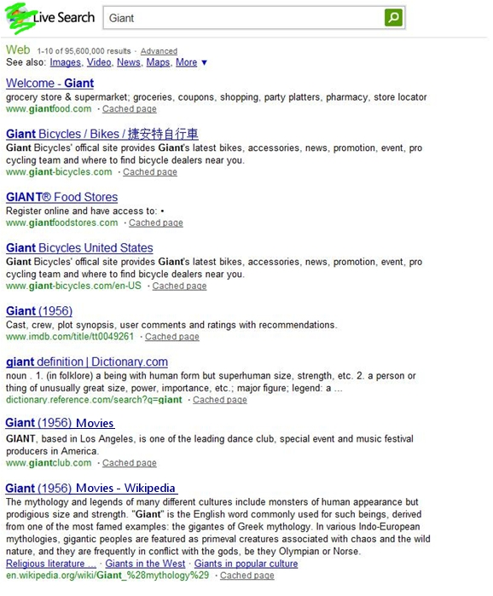


A Small Example [AGY09]
Query is “giant”, 3 users in system
User 1 needs groceries
User 2 wants bikes
User 3 searches for the movie
User Happiness
Users 1,2 most likely click on the
first relevant link itself
User 3 considers two relavent links
before deciding on one

Slide 4

Example Continued..
One Possible Ordering
gianteagle.com
gianteagle.com/welcome
giantbikes.com
imdb.com/giant(1956)
gianteagle.com/fools
gianteagle.com/your
gianteagle.com/search_engine
movies.yahoo.com/giant
A Better Ordering
giantfoods.com
giantbikes.com
imdb.com/giant(1956)
movies.yahoo.com/giant
User 1 happy
User 1 happy
User 2 happy
User 2 happy
User 3 happy
Average Happiness Time
= (1 + 2 + 4)/3
= 2.33
User 3 happy
Average Happiness Time
= (1 + 3 + 8)/3
= 4

Slide 5

More Formally
P
p₄
n pages/elements
p₂
p₆
p₉
p₁
p₈
p₅
P_{n-1}
p₁₀
p_{n}
p₇
Order these pages to minimize average “happiness time” of the users.
A user u is happy the first time he sees K_{u} pages from his set S_{u}
S_{u}
u
m users/sets
K_{u}
2
1
3
2
1

Slide 6
Special Cases
When K_{u} is 1 for all users
Min-Sum Set Cover Problem
4-Approximation Algorithm [FLT02]
NP-Hard to get (4-є)-approximation
When K_{u} is |S_{u}| for each user
Min-Latency Set Cover Problem
2-Approximation Algorithm [HL05]
(can be thought of as special case of precedence constrained scheduling)
(2- є)-Inapproximability Result (assuming UGC variant) [BK09]

Slide 7
The Generalized Problem
O(log n)-Approximation Algorithm [AGY09]
This Talk: Constant factor randomized approximation algorithm for
Generalized Min-Sum Set Cover (Gen-MSSC)

Slide 8
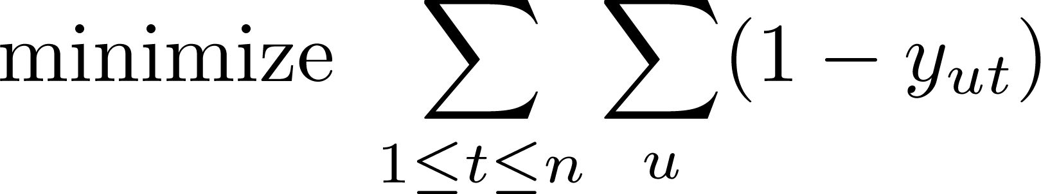
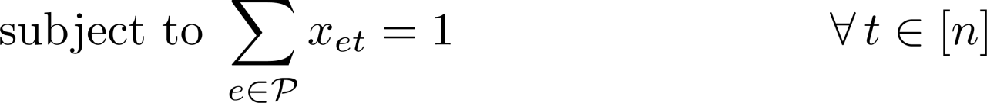
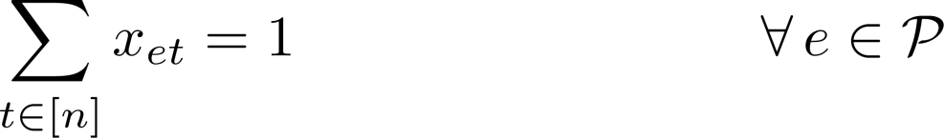
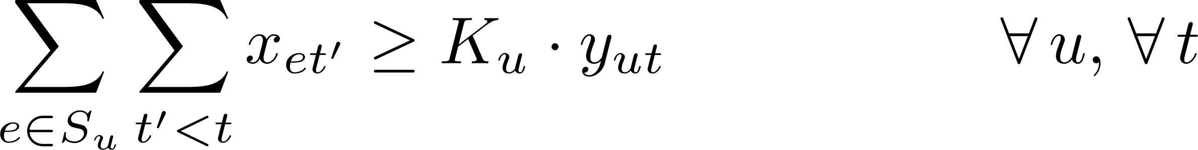
An IP Formulation of Gen-MSSC
Bad Integrality Gap
8
Notes:
8

Slide 9
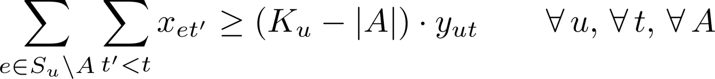
1. Fixing the LP
e_{n+2}
Knapsack Cover Inequalities [Carr et al. SODA 2000]
e_{n+1}
e_{n+k}
e_{n-1}
e_{n}
e₁
e₂
e₅
e₃
e₄
9
9

Slide 10
The Rounding Algorithm
Optimal LP
solution
First Attempt: Randomized Rounding
For each time t and element e,
tentatively place element e at time t with probability x_{et}
o.2
o.5
o.8
o.3
Time t

Slide 11
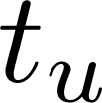
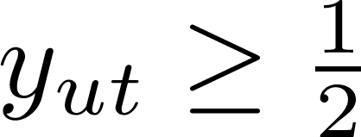


The Rounding Algorithm
What we know
At each time t, the expected number of elements scheduled is 1.
For any user u, let denote the first time when
Then, the LP constraint ensures that
With constant probability p_{u}, user u is “constant-happy” by time t_{u}.
The user u incurred happiness time at least in LP solution!
Can get O(log n)-approximation algorithm
Time t

Slide 12
An O(log n) Approximation Algorithm
Time t
By a time of t_{u}, the user u is happy with very high probability
The expected number of elements we select until t_{u} is O(log n) t_{u}
The happiness time of user u is at most O(log n) LP_{u}
Average happiness time is O(log n) LP_{cost}
Time t
Time t

Slide 13
Breaking the O(log n) Barrier
Problem with rounding strategy
selection probabilities were uniform
users which the LP made happy early need to be given priority
users which got happy later in the LP can afford to wait more

Slide 14


Breaking the O(log n) Barrier
Consider a time interval [1, 2^{i}]
If is more than ¼, include e in a set O_{i}
Else include e in O_{i} with probability
Expected number of elements rounded: 4.2^{i}
Consider a set/user such that y_{u,2}^{i} is at least ½
Good Elements: All |G| elements included with probability 1.
Bad Elements:
Therefore,
User u is “completely covered” with constant probability.

Slide 15
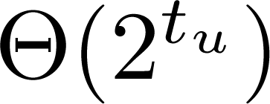


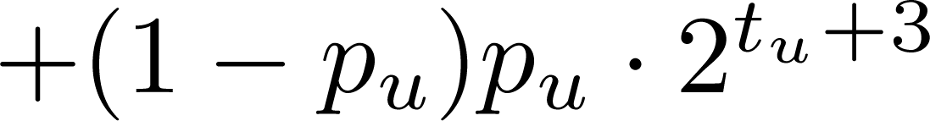
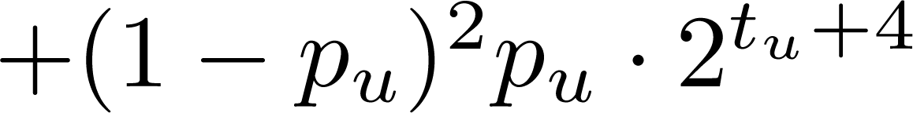

The Non-Uniform Rounding
Let O_{i} denote the selected elements when we randomly round the LP solution restricted to the interval [1, 2^{i}]
The final ordering is O₁ O₂ O₃ … O _{log n}
How much does a user pay? (if the LP “½-covered” it at time 2^{tu})
…
O(1) Approximation!
2^{tu+1}
2^{tu+2}
2^{tu+3}

Slide 16
Summary
Generalized Min-Sum Set Cover
Constant Factor Approximation Algorithm
Non-uniform randomized rounding by looking at prefixes
Open Question
Better constants, anyone?
Thanks a lot! Questions?

