Slide 1
Online and Stochastic Survivable Network Design
Ravishankar Krishnaswamy
Carnegie Mellon University
joint work with Anupam Gupta and R. Ravi

Slide 2

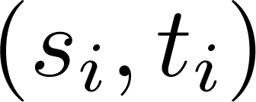
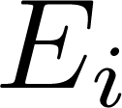
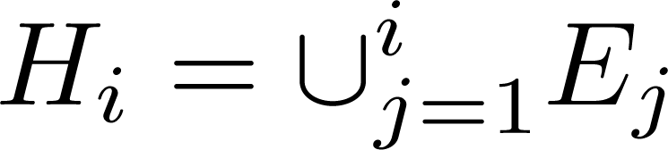


Online k-edge-connectivity (k-EC)
Given a graph G, and edge costs .
Demand sequence arrives online.
When vertices arrive, need to “buy” set of edges s.t
The subgraph k-edge-connects with
Competitive Ratio

Slide 3
A Toy Example
Each s_{i} needs 2 edge disjoint paths to t_{i.}
t₂
t₁
s₁
Algo cost = 10+5+3 = 18
s₃
OPT = 12
s₂
t₃

Slide 4
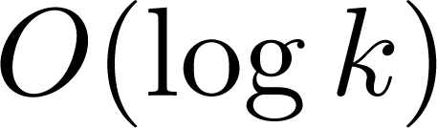
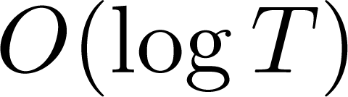
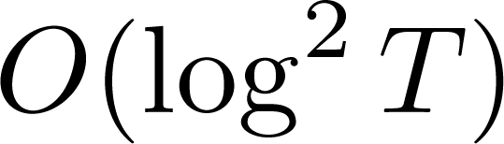
Related Work
Offline k-edge-connectivity
Primal-Dual Algorithm: -approximation [Goemans+ 94]
Iterative Rounding: 2-approximation [Jain 98]
Online k-edge-connectivity
For Steiner Forest (k=1), -competitive algorithm [AAB 04, BC 97]
Greedy algorithm is -competitive.
(T is number of terminals which arrive)
What about higher k?
Notes:
Awerbuch Azar Bartal, Berman Coulston

Slide 5

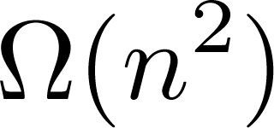
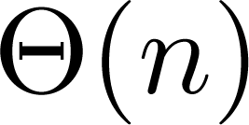
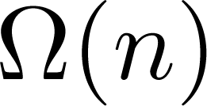
How good is greedy?
Consider the case k=2.
All demand pairs are of the form
Total Cost of Greedy
Optimal Cost
Competitive Ratio
Greedy is not very good ☹
Can get Ω(T)-lowerbound for T = O(log n)

Slide 6



Our Results
Theorem 1: Online k-EC
-competitive randomized online algorithm.
Theorem 2: Online Metric k-EC
-competitive online algorithm on complete metric graphs.
Theorem 3: 2-Stage Stochastic k-EC
-approximation algorithm on general graphs.
-approximation algorithm on complete metrics.

Slide 7
Our High-level Approach
Incrementally build a k-edge-connected solution.
Cast connectivity augmentation as a set cover problem: “in j^{th} round, cover all size j-cuts”
Good News: good algorithms for online set cover.
[AAABN03] is an O(log E log S)-competitive algorithm.
Bad News: exponentially many cuts to cover.
Challenge: getting a “compact” set covering problem
Size S should be polynomial in n, as set cover has a polylog(S)-guarantee.
Use random embeddings into subtrees to get more structure on the edge costs

Slide 8


For this talk
Assume that k = 2, and the problem is rooted.
Assume graph is “backboned”
Theorem 1: Online k-EC
-competitive randomized online algorithm for k-EC.
Theorem 1: Online 2-EC
-competitive randomized online algorithm for rooted 2-EC.
Theorem 1: Online 2-EC on Backboned Graphs
-competitive randomized online algorithm for rooted 2-EC
on backboned graphs.

Slide 9
Backboned Graphs
There is a spanning subtree T called the base tree.
Any non-tree edge has cost equal to the cost of the base-tree path.
[ABN08]: a random backboned graph with low expected stretch.
r
b
c
a
d
l = a+b+c+d
x
l
y
Notation: P_{T}(x,y) denotes the base tree path between x and y

Slide 10
2-Edge-Connectivity on Backboned Graphs
Consider a set of vertices {v₁, v₂, …, v_{j}} which require 2-connectivity to r.
Let OPT be an optimal offline solution.
Can imagine OPT to contain base tree path P_{T}(v_{i},r) for all i
with O(1) blow-up in cost.
Online 1-connectivity on Backboned Graphs
Easy. Just buy the base tree path.
Can we augment edges to this path to get 2-connectivity?

Slide 11
2-Edge-Connectivity on Backboned Graphs
Consider a backboned graph with base tree T (the red edges).
Let vertex v_{i} arrive needing 2-edge connectivity to the root r.
Best way to 1-connect v_{i} with r:
buy the r-v_{i} base tree path.
Consider a cut-edge on this path.
Look at the cut this induces on the base tree.
Some edge of OPT (an offline optimal solution)
must cross this cut.
Get a covering cycle of twice the cost!
r
v_{i}

Slide 12
A Compact Set Cover Instance
Think of non-tree edges to be sets, and tree edges to be the elements.
Any cut edge on the tree path has a “cover” from OPT.
A non-tree edge (x,y) covers all the tree edges on path P_{T}(x,y).
If all edges on path P_{T}(r,v_{i}) are covered, then v_{i} is 2-edge-connected to r.
The min-cost set of covering cycles has cost at most 2c(OPT).
r
v₁

Slide 13
Online 2-Connectivity Algorithm
Algorithm 2-Conn(D)
Set-up Online Set Cover instance:
Elements are tree edges (at most n).
Sets are non-tree edges (at most n²).
Element e is covered by set f=(u,v) if e lies on P_{T}(u,v).
When vertex v_{i} arrives:
Buy the base tree path P_{T}(r,v_{i} ).
Feed each cut-edge on P_{T}(r,v_{i}) to the online set cover algorithm.
For each edge (x,y) the set cover algorithm buys,
-- buy the entire cycle P_{T}(x,y) U (x,y).

Slide 14
Analysis
When vertex v_{i} arrives:
Buy the base tree path P_{T}(r,v_{i} ).
Feed each cut-edge on P_{T}(r,v_{i}) to the online set cover algorithm.
For each edge (x,y) the set cover algorithm buys,
-- buy the entire cycle P_{T}(x,y) U (x,y).
Total base tree cost is at most c(OPT).
Optimal offline set cover cost to cover all cut-edges is c(OPT).
Online Set Cover Algo[AAABN03]: O(log E log S)-competitve
Total cost of online 2-EC Algo: O(log² n) c(OPT)

Slide 15
The General Case: k-Connectivity
Basic Idea: Augment connectivity incrementally.
When new terminal v arrives,
Buy base tree path P_{T}(r,v)
Feed all “1-cuts” to the online set cover algorithm: make the vertex v to be 2-edge-connected to r.
Feed all “2-cuts” to online set cover algorithm.
Proceed in this fashion.
Need to show:
A compact (and low cost) set covering instance can model the augmentation problem.

Slide 16
From 2 to 3-Connectivity
Consider a subgraph H that 2-edge-connects a terminal v to r.
Let P₁ and P₂ denote 2 edge disjoint paths from v to r.
Suppose H also contains the base tree path P_{T}(v,r).
Consider a 2-cut Q = {e₁, e₂} separating v and r.
The end vertices of e₁ and e₂ must be reachable from v or r in H \ Q.
Vertices reachable from v are R-vertices
Vertices reachable from r are L-vertices
e₁
P₁
R
L
v
r
R
P₂
L
e₂

Slide 17
Covering Lemma
For any such cut Q, there is an edge (x,y) in OPT such that
P_{T}(x,y) U (x,y) \ Q connects an L-vertex to an R-vertex.
Therefore, v and r are connected in H \ Q U P_{T}(x,y) U (x,y)
y
x
e₁
P₁
L
R
r
v
L
R
P₂
e₂
Adding that cycle to H will eliminate Q as a cut

Slide 18

Connectivity Augmentation
Create the following set cover system (upfront):
Elements: l-cuts along with L and R labels for end vertices.
Sets: non-tree edges m
A cut Q is covered by a non-tree edge (x,y) if
the cycle P_{T}(x,y) U (x,y) \ Q connects an L-vertex to an R-vertex.
Online Set Cover: O(log E log S)-competitive
( E = ; S = m)
Online k-EC algorithm: O(k log²m)-competitive

Slide 19
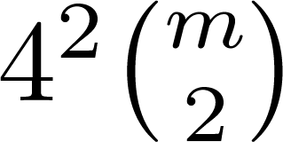

To Finish: The Algorithm
We create the following set cover system
Elements are the 2-cuts, along with L and R labels for end vertices of cut edges
At most elements.
Sets are the non-tree edges
At most m sets.
A cut Q is covered by a non-tree edge (x,y) if the cycle P_{T}(x,y) U (x,y) \ Q connects an L-vertex to an R-vertex.
When a new terminal v arrives,
We 2-edge connect v to r.
Identify a 2-cut, and feed the edges along with the L and R labels to the online set cover algorithm.
For any edge (x,y) it buys, buy the entire cycle P_{T}(x,y) U (x,y).
From the guarantees of the online set cover algorithm, this is a
-competitive online algorithm on backboned graphs

Slide 20
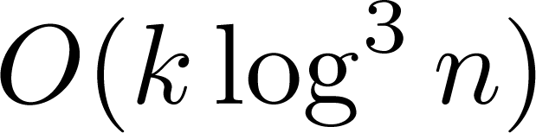

Summary
Presented randomized online algorithms for k-EC
Competitive Ratio:
Augment connectivity with small and cheap set cover instance.
Can’t avoid the term
Gives approximation algorithms for
Stochastic and Rent or Buy k-EC
Open Questions:
Improve guarantees. (getting rid of k?)
Online Vertex Connectivity?

Slide 21
Thank You!
Questions?

Slide 22
2nd Attempt: Online LP Rounding
Solve the LP relaxation for the k-edge-connected subgraph problem online.
Can do this with polylog(n)-competitiveness.
Roadblock: Rounding the fractional solution online
Not known even for the online Steiner forest problem.

Slide 23
Corollary
Two Stage Stochastic k-EC
Each vertex appears as demand with a probability p_{v}.
Need to buy first stage edges and recourse edges to k-edge connect the vertices which appear.
Minimize total expected cost.
Theorem 3: Stochastic k-EC
We get -approximation algorithms for this problem on general graphs, and an -approximation algorithm on complete metrics.

