Slide 1
Approximation Algorithms for Generalized Min-Sum Set Cover
Ravishankar Krishnaswamy
Carnegie Mellon University
joint work with Nikhil Bansal and Anupam Gupta

Slide 2
elgooG: A Hypothetical Search Engine
Given a search query Q
Identify relevant webpages and order them
Main Issues
Different users looking for different things with same query
(cricket: game, mobile company, insect, movie, etc.)
Different link requirements
(not all users click first relevant link they like)
Our ordering should capture these varying needs and keep all clients happy

Slide 3
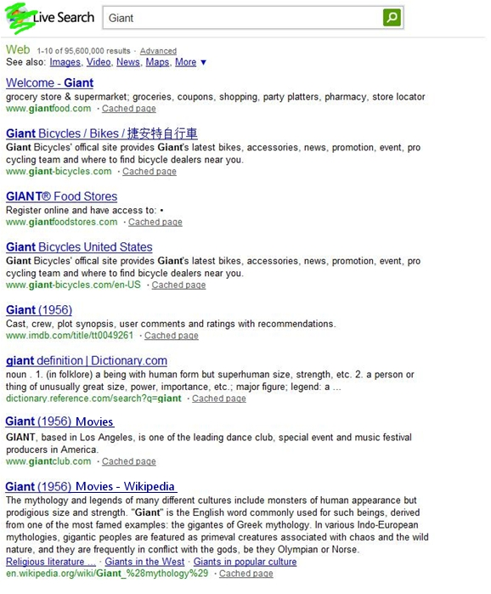


A Small Example
Query is “giant”, 3 users in system
User 1 needs groceries
User 2 wants bikes
User 3 searches for the movie
User Happiness
Users 1,2 most likely click on the
first relevant link itself
User 3 considers two relavent links
before deciding on one
Want to find an order which is good on average

Slide 4

Example Continued..
One Possible Ordering
gianteagle.com
gianteagle.com/welcome
giantbikes.com
imdb.com/giant(1956)
gianteagle.com/fools
gianteagle.com/your
gianteagle.com/search_engine
movies.yahoo.com/giant
A Better Ordering
gianteagle.com
giantbikes.com
imdb.com/giant(1956)
movies.yahoo.com/giant
User 1 happy
User 1 happy
User 2 happy
User 2 happy
User 3 happy
Average Happiness Time
= (1 + 2 + 4)/3
= 2.33
User 3 happy
Average Happiness Time
= (1 + 3 + 8)/3
= 4

Slide 5

More Formally
P
p₄
n pages/elements
p₂
p₆
p₉
p₁
p₈
p₅
P_{n-1}
p₁₀
p_{n}
p₇
Order these pages to minimize average “happiness time” of the users.
A user u is happy the first time he sees K_{u} pages from his set S_{u}
S_{u}
u
m users/sets
K_{u}
2
1
3
2
1

Slide 6
Problem Statement
Input
A collection of n pages, denote by set P
A set of m users, user u associated with a set of relevant pages S_{u} ⊆ P
User u also associated with an interest threshold of K_{u}
Output
An ordering of the pages
Average happiness time is minimized
User u happy the first time K_{u} pages are displayed from his wish-list S_{u}
Generalized Min-Sum Set Cover

Slide 7
Special Cases
When K_{u} is 1 for all users
Min-Sum Set Cover Problem
4-Approximation Algorithm [FLT02]
NP-Hard to get (4-є)-approximation
When K_{u} is |S_{u}| for each user
Min-Latency Set Cover Problem
2-Approximation Algorithm [HL05]
(can be thought of as special case of precedence constrained scheduling)

Slide 8
The Generalized Problem
O(log n)-Approximation Algorithm [AGY09]
This Talk: Constant factor randomized approximation algorithm for
Generalized Min-Sum Set Cover (Gen-MSSC)

Slide 9

Talk Outline
Motivation
Problem Statement and Results
Strawman Attempts
Our Algorithm
Extensions

Slide 10
Take 1: Greedy
(choose the element which belongs to most uncovered sets)
Good News
- When k_{u} is 1 for all sets
The greedy algorithm is a 4-approximation.
Bad News
The same strategy is arbitrarily bad for our problem.
Will not cover bad example. Explained in [AGY09].
10
Notes:
10

Slide 11

Take 1: Greedy
(choose the element which belongs to most uncovered sets)
Good News
- When k_{u} is 1 for all users
- The greedy algorithm is a 4-approximation.
How about generalizing this idea for larger k_{u}?
Choose the set of elements maximizing
Finding this maximizer seems to be computationally hard.
11
Notes:
11

Slide 12
Talk Outline
Motivation
Problem Statement and Results
Strawman Attempts
Our Algorithm
Extensions

Slide 13
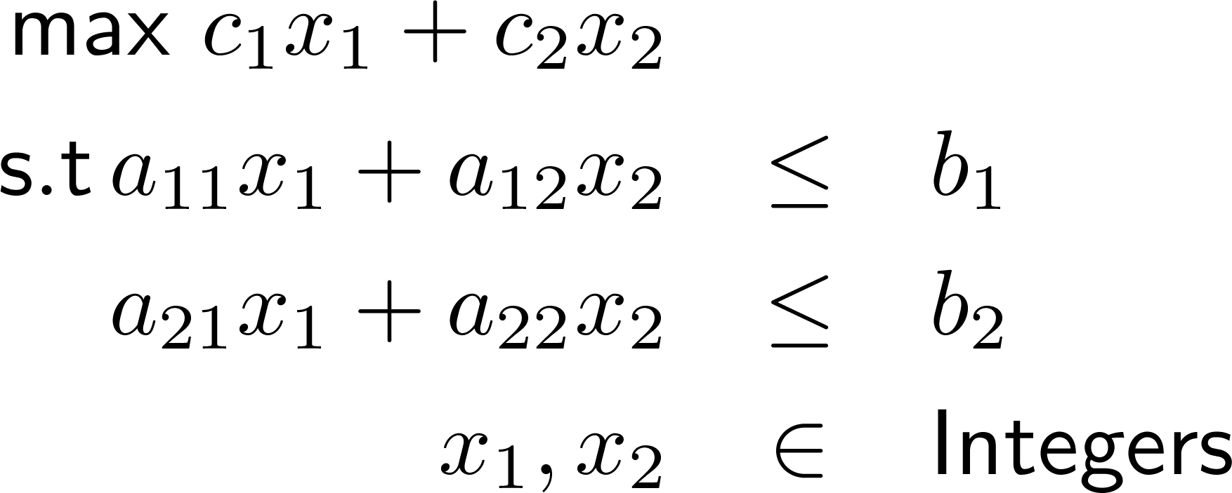



When Greed Fails, Try Linear Programming
Formulate the problem as an “Integer Program”
13
Notes:
13

Slide 14
Approx Algos via Linear Programming
Formulate the problem as an Integer Program
Relax the Integer Program to get a Linear problem
Remap optimal LP solutions to get solutions to original problem
formulate IP
Computationally Intractable
Generalized Min-Sum Set Cover Problem Instance
Linear Programming Relaxation
“round” LP solution
14
Notes:
14

Slide 15
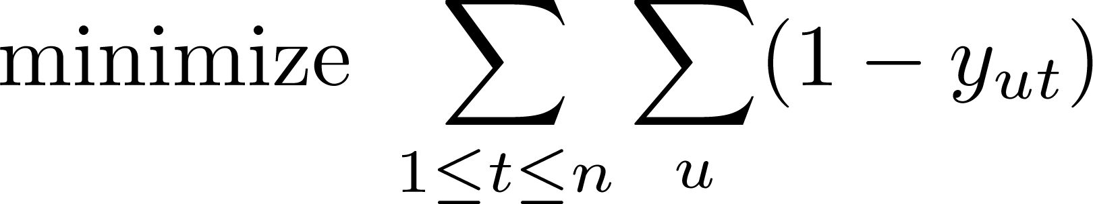
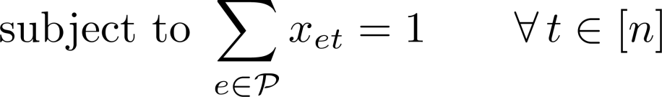
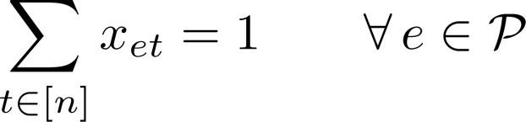
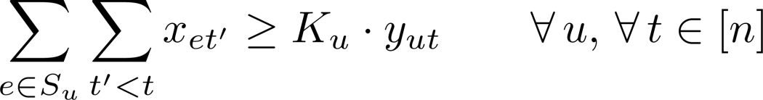
An IP Formulation of Gen-MSSC
15
Notes:
15

Slide 16
An IP Formulation of MSSC
16
Notes:
16

Slide 17
The Rounding Algorithm
Optimal LP
solution
First Attempt: Randomized Rounding
For each time t and element e,
tentatively place element e at time t with probability x_{et}
o.2
o.5
o.8
o.3
Time t

Slide 18

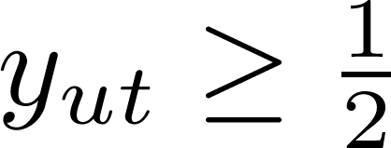
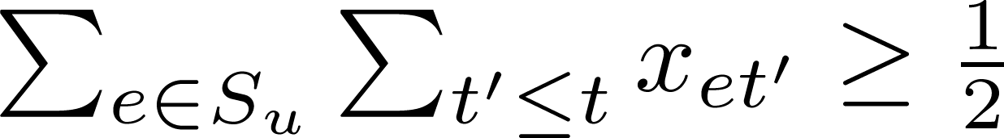

The Rounding Algorithm
What we know
At each time t, the expected number of elements scheduled is 1.
For any user u, let denote the first time when
Then, the LP constraint ensures that
With constant probability p_{u}, user u is happy by time t_{u}.
The user u incurred happiness time at least in LP solution!
Chernoff bound on tossing independent coins with expectation ½
Time t

Slide 19
An O(log n) Approximation Algorithm
Time t
By a time of t_{u}, the user u is happy with very high probability
The expected number of elements we select until t_{u} is O(log n) t_{u}
The happiness time of user u is at most O(log n) LP_{u}
Average happiness time is O(log n) LP_{cost}
Time t
Time t

Slide 20
Breaking the O(log n) Barrier
Problem with rounding strategy
selection probabilities were uniform
users which the LP made happy early need to be given more priority
Use non-uniform rounding
know that users which got happy later in the LP can afford to wait more!

Slide 21


Breaking the O(log n) Barrier
Consider a time interval [1, 2^{i}]
If is more than ¼, include e in O_{i}
Else include e in O_{i} with probability
Expected number of elements rounded: 4.2^{i}
Consider a set such that y_{S,2}^{i} is ½
The good elements are included with probability 1.
Any set that is fractionally ½ covered, is “happy” with constant probability.

Slide 22
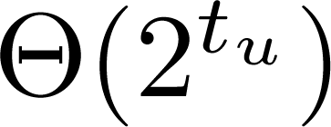


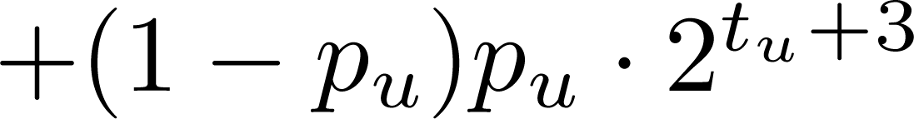
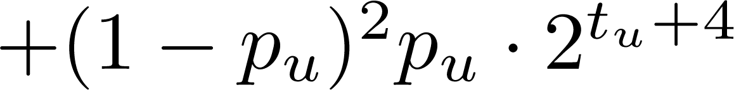

Breaking the O(log n) Barrier
Let O_{i} denote the selected elements when we randomly round the LP solution restricted to the interval [1, 2^{i}]
Say the final ordering is O₁ O₂ O₃ … O _{log n}
How much does a user pay? (if the LP made it happy at time 2^{tu})
…
O(1) Approximation!
2^{tu+1}
2^{tu+2}
2^{tu+3}

Slide 23
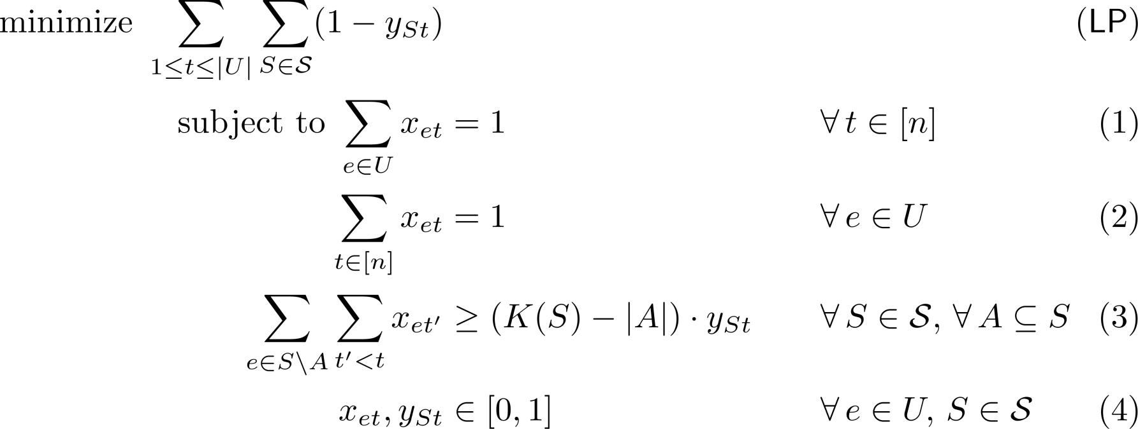
On to the generalized problem
Knapsack Cover Inequalities

Slide 24
Summary
Generalized Min-Sum Set Cover
Constant Factor Approximation Algorithm
Non-uniform randomized rounding by looking at prefixes
Open Questions
Our constant (400) is too large to be useful. Better constants, anyone?
Can we handle non-identical pages?
(some pages are more relevant than others)
Thanks a lot! Questions?

