Slide 1
Approximation Algorithms for Generalized Scheduling Problems
Ravishankar Krishnaswamy
Carnegie Mellon University
joint work with Nikhil Bansal, Anupam Gupta and Viswanath Nagarajan

Slide 2
Introduction and Outline
In this talk
  We consider the following problems
a) Generalized Min-Sum Set Cover/Web-Search Re-Ranking
b) Online Broadcast Scheduling
Explain these two problems
  Our results
Get into details
  For Gen-MSSC

Slide 3
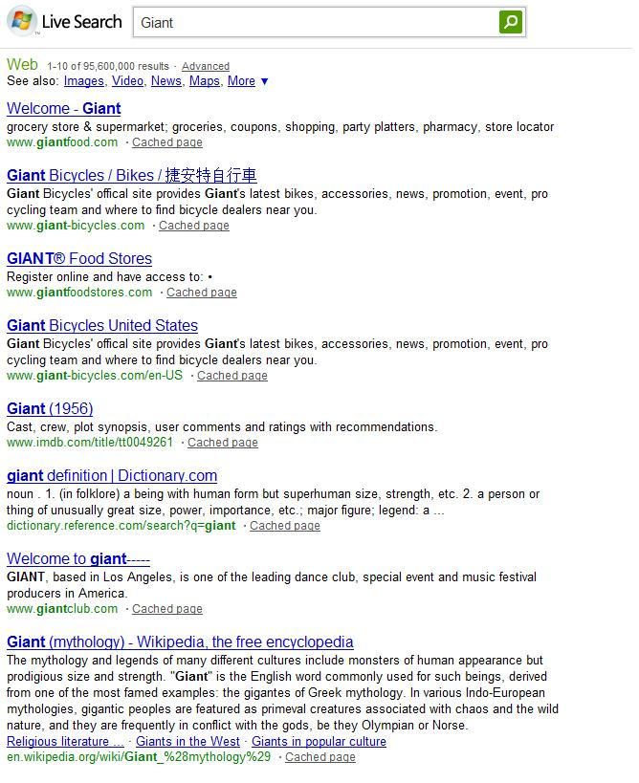



Web Search Re-Ranking
Consider a search query to Google
  Page Rank has an ordering
  Different Users “mean” different things
  (U1 looking for Groceries,
  U2 for bikes, and
  U3 for the movie)
Google needs to capture this
  Produce global ordering s.t
  All users are happy
It has history and logs
  Knows when each user is happy
1
2
3

Slide 4
Web Search Re-Ranking
Query has n results
Each user is interested in subset of them
User not necessarily happy after
seeing first item from his list
Nor can he see all of them
  List too long ☹
Has individual threshold
  Google knows this from logs
1
2
3

Slide 5
More Formally
Input
  A collection of n pages
  A set of m users
    Each user/set interested in subset of the pages
    Has an interest threshold k_{u}
Output
  An ordering of the pages
  Average happiness time is minimized
    User u happy the first time k_{u} pages are displayed from his wish-list.
Can look at pages as elements; users as sets
  Generalized Min-Sum Set Cover

Slide 6
Two Special Cases
When k_{S} is 1 for all sets
Min-Sum Set Cover Problem
4-Approximation Algorithm [FLT02]
(widely used in practice also: Query Optimization, Online Learning, etc.)
When k_{S} is |S| for each set
Min-Latency Set Cover Problem
2-Approximation Algorithm [HL05]
What about general k_{S}?
O(log n)-Approximation Algorithm [AGY09]
Notes:
Awerbuch Azar Bartal, Berman Coulston

Slide 7
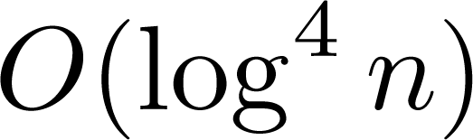
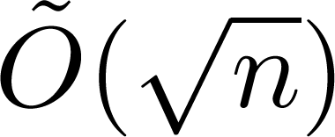
Our Results
Theorem 1: Gen-MSSC
Constant factor randomized approximation algorithm.
(improves on O(log n)-approximation algorithm of Azar et al. (STOC 2009)
Theorem 2: Non-Clairvoyant Gen-MSSC
-approximation algorithm if all requirements are powers of two.
-approximation algorithm in the general setting.

Slide 8

Why is the general problem different?
When k_{S} is 1 for all sets
  The greedy algorithm is a 4-approximation.
  (choose the element which belongs to most uncovered sets)
How do we generalize this for higher k_{S}?
  Could try to say,
    Choose the set of elements maximizing
    Finding this maximizer is not easy.

Slide 9
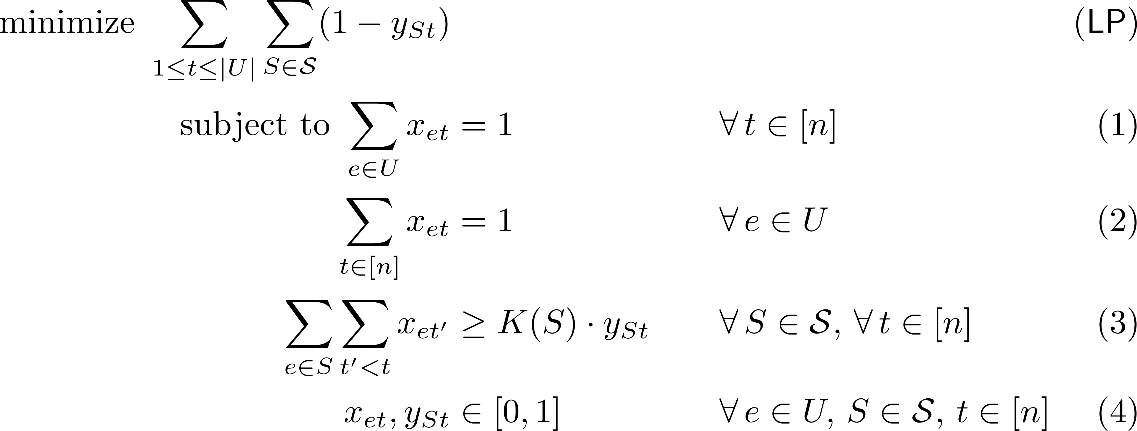
Next attempt: LP Formulation
Bad
Integrality
Gap

Slide 10
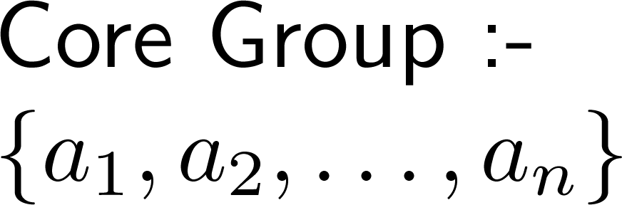

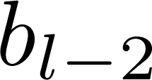
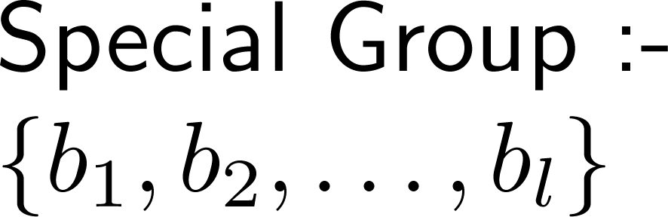

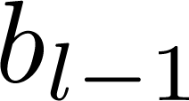
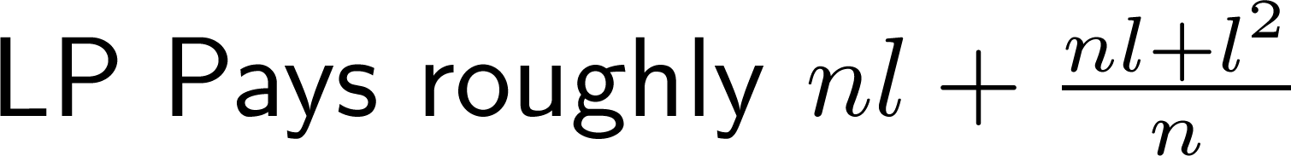


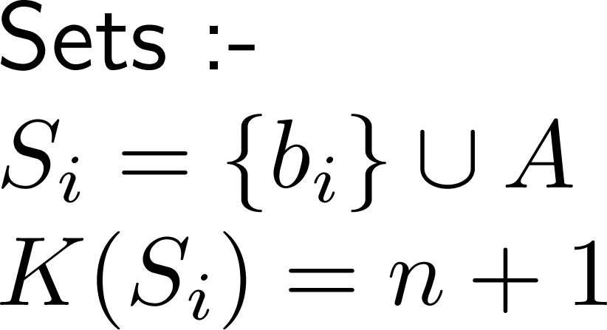







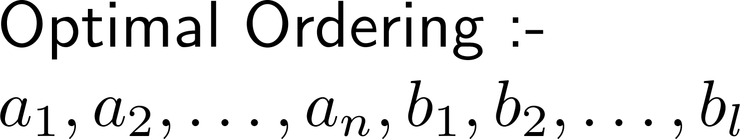
Integrality Gap Example

Slide 11
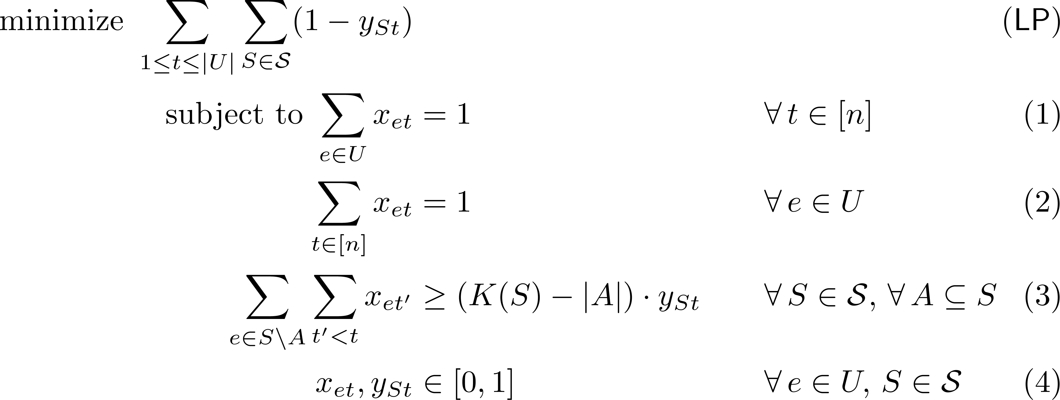
A Strengthened LP Formulation
Knapsack Cover Inequalities

Slide 12
The Rounding Algorithm
First Attempt: Randomized Rounding
For each time t and element e,
tentatively place element e at time t with probability x_{et}
Time t

Slide 13
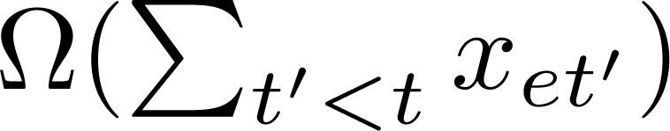
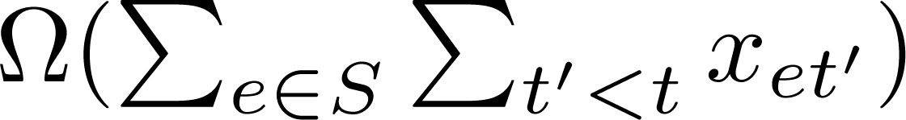
The Rounding Algorithm
What we know
1. At each time t, the expected number of elements scheduled is 1.
2. The probability that e is rounded before time t is
3. Expected no. of elements (in S) rounded before t is
4. Look at half-time of a set:
with constant probability, constant fraction of requirement selected.
(would give us log n approximation, but looking for constant)
Time t

Slide 14
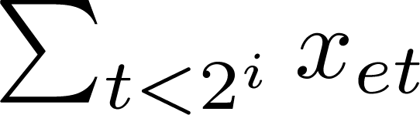
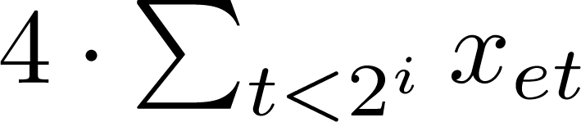
A (Slightly) Different Rounding
Consider an interval [1, 2^{i}]
  If is more than ¼, include e in O_{i}
  Else include e in O_{i} with probability
Expected number of elements rounded: 4.2^{i}
Consider a set such that y_{S,2}^{i} is ½
  The good elements are included with probability 1.
  Look at strengthened constraint for bad elements.
  Any set “happy” with constant probability.

Slide 15
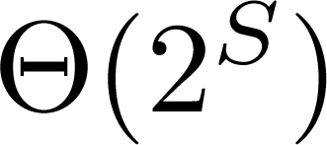
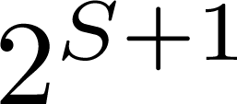
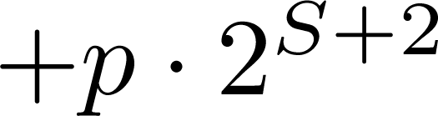
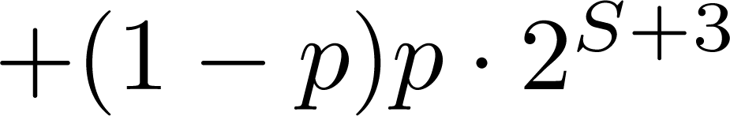
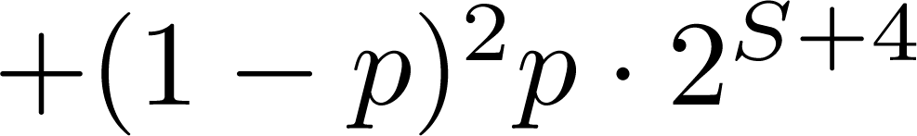

Putting the pieces together
Let O_{i} denote the rounding for the interval [1, 2^{i}]
Say the final ordering is O₁ O₂ O₃ … O _{log n}
How much does a set pay? (say its half time was 2^{S})
…
2^{S+1}
2^{S+2}
2^{S+3}

Slide 16
Wrapping Up
Look at any set which was paying roughly 2^{S} in LP
Pays roughly 2^{S} in the randomized rounding
  In expectaction
Total Expected Cost is O(1) LP Cost
  Linearity of Expectation
Constant Factor Approximation Algorithm
  Can be generalized to non-clairvoyant setting

Slide 17
Introduction and Outline
In this talk
  We consider the following problems
a) Generalized Min-Sum Set Cover/Web-Search Re-Ranking
b) Online Broadcast Scheduling
Explain these two problems
  Our results
Get into details
  For Gen-MSSC

Slide 18



Client-Server System
Page C at time 3
Page A at time 1
Page B at time 1
Page A at time 2
Page A at time 3
Page A
Page C
Page B
Page A
Clients
Server
broadcast

Slide 19
Online Broadcast Scheduling
Input
  A collection of n pages
  A request sequence arrives online
    Request r: arrival time a(r), requested page p(r)
Output
  A broadcast of pages, one at a time
Objective Function
  Minimize Average Response Time
  Minimize Maximum Response Time
  …

Slide 20
An Example
Instance has 3 pages
A
B
C
A
B
A
B
C
A
B
Total Response Time: 1 + 2 + 3 + 3 + 3 = 12
C
A
B
Total Response Time: 2 + 3 + 1 + 1 + 1 = 8

Slide 21
Known Results (Average Response Time)
In the offline setting
  O(log²n)-approximation algorithm [BCS06]
In the online setting
  very strong lower bounds if no speed-up
  with (2+є) speed-up, O(1/є²)-competitive [EP09]

Slide 22
Our Results
Theorem 1: Online Broadcast to Minimize Avg. Response Time
O(1/є³)-competitive algorithm (1+є)-speed algorithm.
Theorem 2: Non-uniform Pages, Dependent Requests
O(1/є³)-competitive algorithm (1+є)-speed algorithm in the cover-all case.
Lower bound of log n on speed-up in the cover-any case.

Slide 23
Summary
Studied the following two scheduling problems:
Generalized Min-Sum Set Cover
  Constant Factor Approximation Algorithm
  Poly-logarithmic Approximations in Non-Clairvoyant model
Online Broadcast Scheduling
  (1+є)-speed, 1/є³-competitive online algorithm
  Can extend to variable sized pages and dependent requests also.

Slide 24
Thank You!
Questions?

