Slide 1
Inapproximability of the Multi-Level Facility Location Problem
Ravishankar Krishnaswamy
Carnegie Mellon University
(joint with Maxim Sviridenko)

Slide 2
Outline
Facility Location
Problem Definition
Multi-Level Facility Location
Problem Definition
Our Results
Our Reduction
Max-Coverage for 1-Level
Amplification
Conclusion

Slide 3
(metric) Facility Location
Given a set of clients and facilities
Metric distances
“Open” some facilities
Each has some cost
Connect each client to nearest open facility
Minimize total opening cost plus connection cost
facilities
metric
clients

Slide 4
Facility Location
Classical problem in TCS and OR
NP-complete
Test-bed for many approximation techniques
Positive Side 1.488 Easy [Li, ICALP 2011]
Negative Side 1.463 Hard [Guha Khuller, J.Alg 99]

Slide 5
Outline
Facility Location
Problem Definition
Multi-Level Facility Location
Problem Definition
Our Results
Our Reduction
Max-Coverage for 1-Level
Amplification
Conclusion

Slide 6
A Practical Generalization
Multi-Level Facility Location
There are k levels of facilities
Clients need to connect to one from each level
In sequential order (i.e., find a layer-by-layer path)
Minimize opening cost plus total connection cost
Models several common settings
Supply Chain, Warehouse Location, Hierarchical Network Design, etc.

Slide 7
The Problem in Picture
Level 3 facilities
metric
Level 2 facilities
Level 1 facilities
clients
Obj: Minimize total cost of blue arcs plus green circles

Slide 8
Multi-Level Facility Location
Approximation Algorithms
3 approximation
[Aardal, Chudak, Shmoys, IPL 99] (ellipsoid based)
[Ageev, Ye, Zhang, Disc. Math 04] (weaker APX, but faster)
1.77 approximation for k = 2
[Zhang, Math. Prog. 06]
Inapproximability Results
Same as k=1, i.e., 1.463

Slide 9
Outline
Facility Location
Problem Definition
Multi-Level Facility Location
Problem Definition
Our Results
Our Reduction
Max-Coverage for 1-Level
Amplification
Conclusion

Slide 10
Our Motivation and Results
Are two levels harder than one?
(recall: 1-Level problem has a 1.488 approx)
Theorem 1: Yes! The 2-Level Facility Location problem is not approximable to a factor of 1.539
Theorem 2: For larger k, the hardness tends to 1.611

Slide 11
State of the Art
Establishes complexity difference between 1 and 2 levels
1.463
1-level
hardness
1.488
1-level
easyness
[Li]
1.539
2-level
hardness
[KS]
1.611
k-level
hardness
1.77
2-level
easyness
3.0
k-level
easyness

Slide 12
Outline
Facility Location
Problem Definition
Multi-Level Facility Location
Problem Definition
Our Results
Our Reduction
Max-Coverage for 1-Level
Amplification
Conclusion

Slide 13
Source of Reduction: Max-Coverage
Given set system (X,S) and parameter l
Pick l sets to maximize the number of elements
Hardness of (1 – 1/e)
[Feige 98]
sets
(l = 2)
elements

Slide 14
Pre-Processing: Generalizing [Feige]
Given any set system (X, S) and parameter l
Suppose l sets can cover the universe X
[Feige] NP-Hard to pick l sets,
To cover at least (1 – e⁻¹) fraction of elements
[Need] NP-Hard to pick βl sets, for 0 ≤ β ≤ B
To cover at least (1 – e^{-β}) fraction of elements

Slide 15
The Reduction for 1 Level
sets = facilities
S
metric:
direct edge (e,S) if e ∈ S
e
elements = clients

Slide 16
The Reduction for 1 Level
Yes case
l sets can cover the universe
No case
Any βl sets cover only 1 – e^{-β} frac.
Sets/Facilities
Sets/Facilities
Elements/Clients
Elements/Clients
All clients
connection cost = 1
The other e^{-β} clients incur
connection cost ≥ 3

Slide 17
Ingredient 2: The Reduction (cont.)
OPT (Yes Case)
ALG (No Case)
l sets can cover all elements
so, open these l sets/facilities
If ALG picks βl facilities,
it “directly” covers only (1 – e^{-β}) clts
(rest pay at least 3 units to connect)
Can we improve on this?
Total connection cost = n
Total opening cost = lB
Total cost = n + lB
Total connection cost
= (1 – e^{-β}) n + (e^{-β} n)*3
= n (1 + 2e^{-β})
Total opening cost = βlB
Total cost = n (1 + 2e^{-β}) + βlB
Optimize B

Slide 18
Outline
Facility Location
Problem Definition
Multi-Level Facility Location
Problem Definition
Our Results
Our Reduction
Max-Coverage for 1-Level
Hardness Amplification
Conclusion

Slide 19
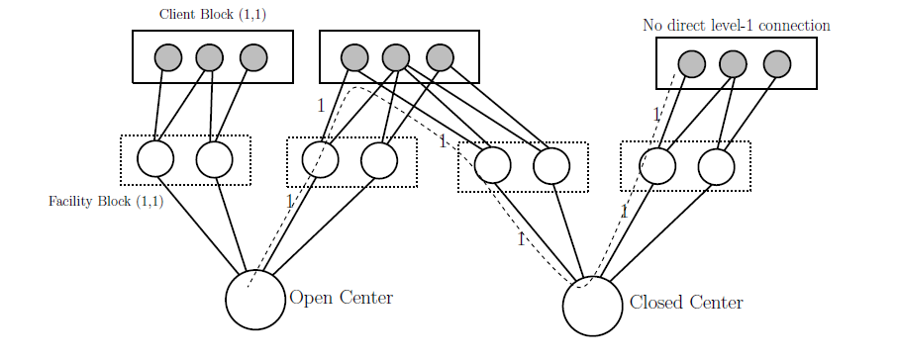
Hardness Amplification with 2-Levels
One Level Case
Two Level Case
The “bad” e^{-β} fraction incur a cost of 3
Indirect cost
Other (1 – e^{-β}) fraction of clients incur cost 1
Direct cost
The “bad” e^{-β} fraction incur a cost of 6
Indirect cost to level 2
Other (1 – e^{-β}) fraction of clients can incur > 2
If level 1 choices are sub-optimal

Slide 20
Construction for 2 Levels
Place Max-Coverage set system
For each (e,S) edge, place an identical sub-instance
Identify the corresponding elements across (e,*)
S
Level 2
Level 1
Clients
e

Slide 21
An Illustration
set system
2-level facility location instance
1) 3 Client blocks, each has 3 clients
2) Level 2 view embeds the set system
3) Each level 1 view for (e,S) also embeds the set system

Slide 22
Completeness and Soundness
If the set system has a good “cover”
Then we can open the correct facilities, and
Every client incurs a cost of 2
If ALG can find a low-cost fac. loc. solution
Then we can recover a good “cover”
From either the level 2 view
Or one of the many level 1 views

Slide 23
Where do we gain hardness factor?
set system
Where we gain over 1-level hardness!
2-level facility location instance
Observation 1: “Indirect connections” to level 2 facilities cost at least 6
Observation 2: Even “direct connections” can pay more than 2

Slide 24
A word on the details
Alg may pick different solutions in different level-1 sub-instances
Some of them can be empty solutions,
And in other blocks, it can open all facilities..
Need “symmetrization argument”
Pick a random solution and place it everywhere
Need to argue about the connection cost
Work with a “relaxed objective” to simplify proof
Both are not useful as Max-Coverage solutions

Slide 25
Conclusion
Studied the multi-level facility location
1.539 Hardness for 2-level problem
1.61 Hardness for k-level problem
Shows that two levels are harder than one
Can we improve the bounds?
Thanks, and job market alert!

