Slide 1
Scheduling on Heterogeneous Machines: Minimize Total Energy + Flowtime
Ravishankar Krishnaswamy
Carnegie Mellon University
Joint work with Anupam Gupta and Kirk Pruhs
CMU U. Pitt.

Slide 2

The Fact of Life
The future of computing sees many cores
And not all of them are identical!
Different types of processors are tuned
with different needs in mind
Some are high power consuming, fast processors
Others are lower power, slower processors
(but more power-efficient)
How do we utilize these resources best?
Design good scheduling algorithms for multi-core

Slide 3
The Problem we Study
Scheduling on Related Machines
Scheduling with Power Management

Slide 4
Scheduling on Related Machines
We have a set of m machines, and n jobs arrive online
Machine i has a speed s_{i}
Schedule jobs on machines to minimize average flow-time
Garg and Kumar [ICALP 2006]
O(log² P)-approximation algorithm
Anand, Garg, Kumar 2010: O(log P)-approximation algorithm
Chadha et al [STOC 2009]
(1+∈)-speed O(1/ ∈)-competitive online algorithm
Reality: Machines have different efficiencies!
But how do we capture this?

Slide 5
Scheduling with Energy Constraints
Minimize flow time subject to energy budgets
Does not make much sense in an online setting
Jobs continually keep coming and going
Very strong lower bounds exist
Screwed if we save on energy
Screwed if we use up a lot of energy!
Often employed modeling fix
Minimize total flow time + total energy consumed

Slide 6
Energy/Flow Tradeoff [Albers Fujiwara 06]
Job i has release date r_{i} and processing time p_{i}
Optimize total flow + ρ * energy used
(example: If the user is willing to spend 1 unit of energy for a 3 microsecond improvement in response, then ρ=3.)
By scaling processing times, assume ρ=1
Factor ρ: amount of energy user is willing to spend to get a unit improvement in response

Slide 7

Problem Definition/ Model
Collection of m machines, n jobs arrive online
Each machine i has a different power function P_{i}(s)
Power
P(s)
Machine i
Speed s
Schedule jobs and assign power setting to machines to minimize total flowtime + energy

Slide 8
Known Results
The case of 1 machine is well understood
Bansal et al. [BCP09] showed the following:
Weighted Flowtime | (1+∈)-speed O(1/ ∈)
Unweighted Flowtime | O(1)-competitive
Power Function | Arbitrary
Scheduling Algorithm | Highest Density First
Speed Scaling Policy | P⁻¹(W(t))
What about multiple machines?
How do we assign machines to jobs upon arrival?

Slide 9
Our Results
Weighted/Unweighted | (1+∈)-speed O(1/ ∈)
Power Function | Arbitrary, Different for Machines
Scheduling Algorithm | Highest Density First
Speed Scaling Policy | P_{i}⁻¹(W_{i}(t))
Assignment Policy | “Do Least Harm”®
Will Explain Soon
Scalable online algorithm for minimizing flowtime + energy in heterogeneous setting
Speed Augmentation is needed for multiple machines because of Ω(log P) lower-bounds
for even identical parallel machines, and objective of minimizing sum of flow times

Slide 10
Analysis
Contribution of any alive job at time t is w_{j}
Total rise of objective function at time t is W_{A}(t)
Would be done if we could show (for all t)
[W_{A}(t) + P_{A}(t)] ≤ O(1) [W_{O}(t) + P_{O}(t)]
w_{j}(C_{j} – a_{j})

Slide 11

Amortized Competitiveness Analysis
Sadly, we can’t show that, not even in the no-power setting
There could be situations when |W_{A}(t)| is 100 and |W_{O}(t)| is 10 (better news: vice-versa too can happen.)
Way around: Use some kind of global accounting.
When we’re way behind OPT
When OPT pay lot more than us

Slide 12

Banking via a Potential Function
Define a potential function Φ(t) which is 0 at t=0 and t=
Show the following:
At any job arrival,
ΔΦ ≤ α ΔOPT
(ΔOPT is the increase in future OPT cost due to arrival of job)
At all other times,
Will give us an (α+β)-competitive online algorithm

Slide 13
Intuition behind our Potential Function
There are n jobs, each weight 1 and processing time p_{j}
Estimate future cost incurred by algorithm HDF at speed P⁻¹(n)
While first job is alive, at each time, we pay W_{A}(t) + P_{A}(t) = 2n
(job 1 is alive for time p₁/ P⁻¹(n))
Next we pay W_{A}(t) + P_{A}(t) = 2(n-1) for time p₂/ P⁻¹(n-1)
+ 2(n-2) for time p₃/ P⁻¹(n-2)
+ 2(n-3) for time p₄/ P⁻¹(n-3)
In Total,

Slide 14
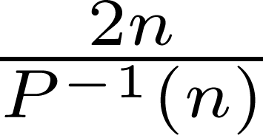
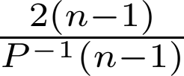
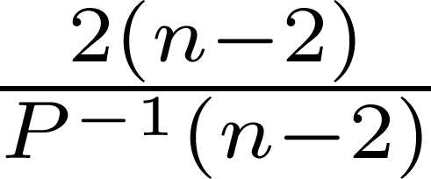
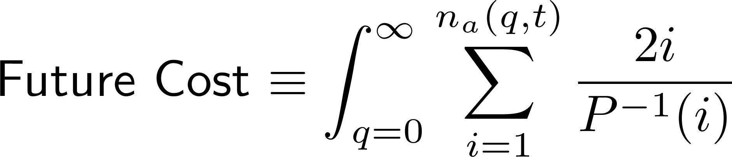
An Alternate View
1
1
2
1
2
3
p₁
p₂
p₃

Slide 15
Going back to our Algorithm
Result | (1+∈)-speed O(1/ ∈)
Power Function | Arbitrary, Different for Machines
Scheduling Algorithm | Highest Density First
Speed Scaling Policy | P_{i}⁻¹(W_{i}(t))
Assignment Policy | “Do Least Harm”®
For each machine, have estimate of future cost according to current queues.
Send new job to machine which will minimize the increase in total future cost.

Slide 16
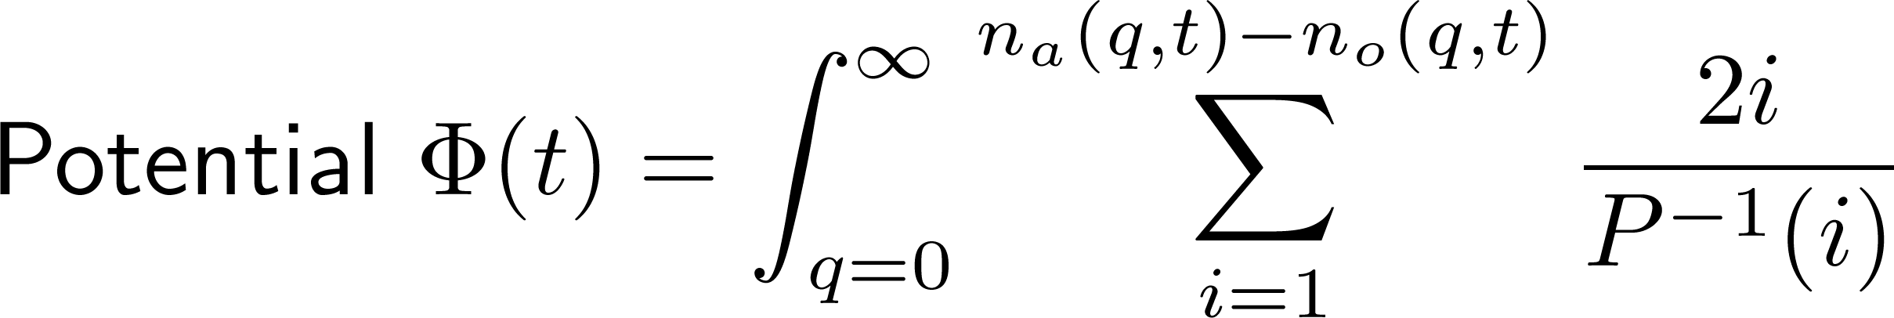
The Potential Function
Potential Function Definition
Characterize the “lead” OPT might have

Slide 17
Analysis
Bound jump in potential when a job arrives
Can be an issue when we assign it to machine 1 but OPT assigns it to machine 2
We show that this increase is no more than the increase in OPT’s future cost because of job arrival
Summing over all such job arrivals, this can be at most the total cost of OPT.

Slide 18
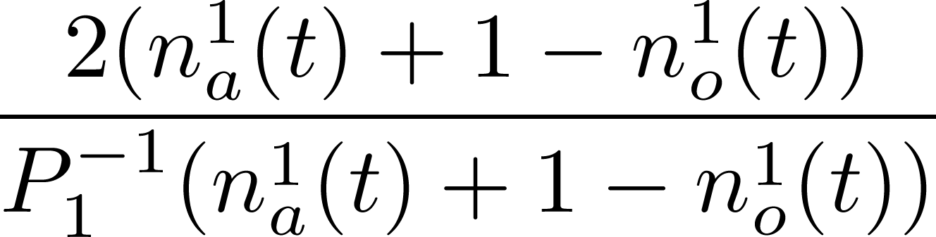
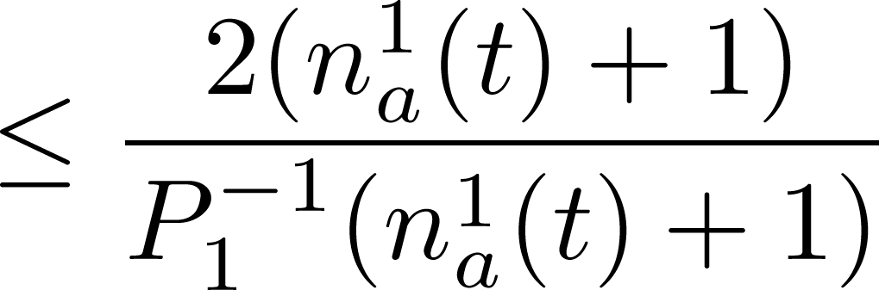
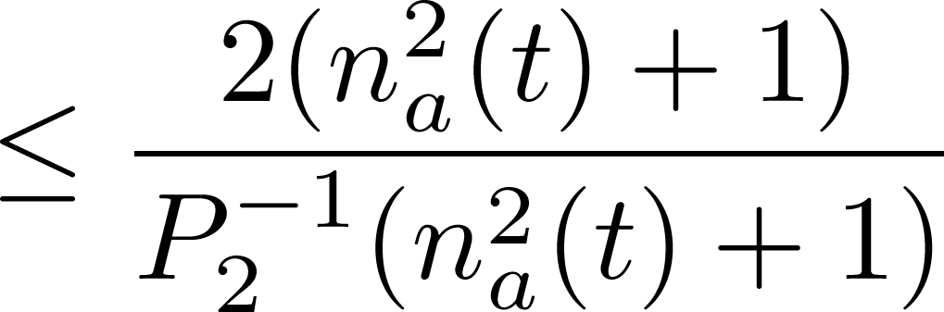
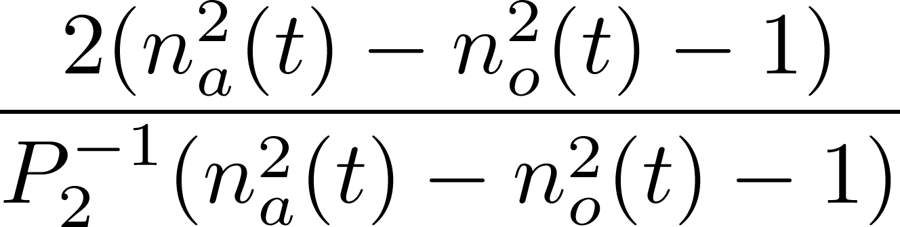
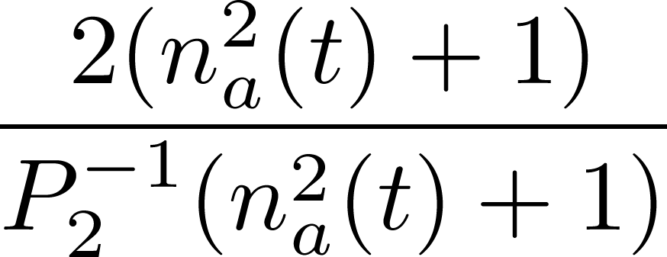
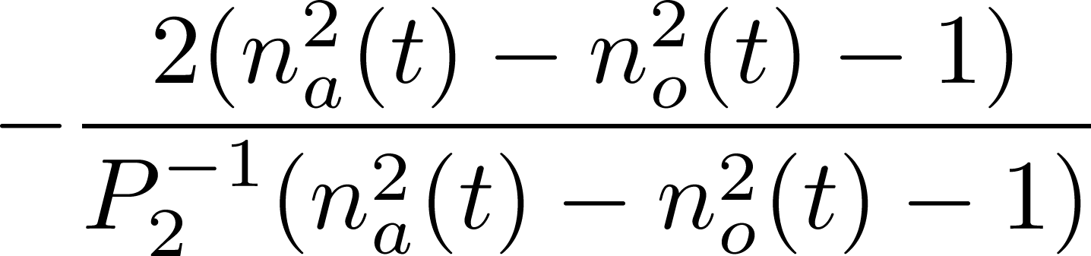
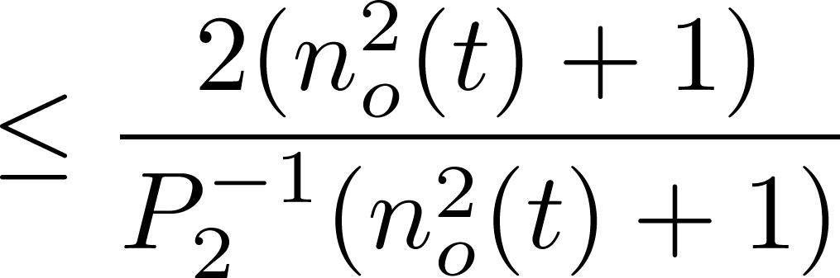
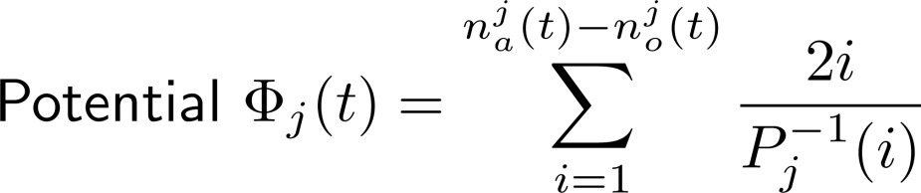
Simple Case: Unit Size Jobs
Monotonicity of x/P⁻¹(x)
Assignment Algorithm
Increase due to Alg assigning job to Machine 1:
Decrease due to Opt assigning job to Machine 2:
Inc. future cost of OPT
x/P⁻¹(x) is concave
Net Change:

Slide 19
Banking via a Potential Function
Define a potential function Φ(t) which is 0 at t=0 and t=
Show the following:
At any job arrival,
ΔΦ ≤ α ΔOPT
(ΔOPT is the increase in future OPT cost due to arrival of job)
At all other times,
Will give us an (α+β)-competitive online algorithm

Slide 20
Running Condition
On each machine, we can assume OPT runs BCP
HDF at a speed of P_{j}⁻¹(W^{j}_{o}(t))
Our algorithm does the same
HDF at a speed of P_{j}⁻¹(W^{j}_{a}(t))
Show that using the potential function we defined,
holds for each machine, and therefore holds in sum!
proof techniques use ideas for single machine [BCP09]

Slide 21
Banking via a Potential Function
Define a potential function Φ(t) which is 0 at t=0 and t=
Show the following:
At any job arrival,
ΔΦ ≤ α ΔOPT
(ΔOPT is the increase in future OPT cost due to arrival of job)
At all other times,
(needs (1+∈)-speed augmentation..)
Will give us an (α+β)-competitive online algorithm

Slide 22
In Conclusion
Have given the first scalable scheduling algorithm for heterogeneous machines for “flow+energy”
An intuitive potential function, and analysis
Can be used for other scheduling problems?
Open Question
What if we do not know job sizes (Non-Clairvoyance)?
Thanks a lot!

