Slide 1
Approximation Techniques for Stochastic Optimization
Ravishankar Krishnaswamy
Carnegie Mellon University

Slide 2
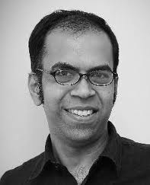

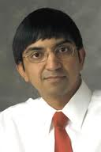

Based on…
Joint works with
Anupam Marco Viswanath R.
Gupta Molinaro Nagarajan Ravi

Slide 3
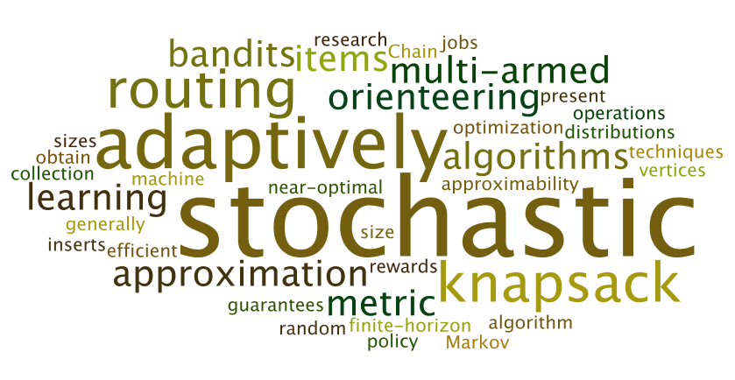
Outline
Introduction | Stochastic Orienteering | Other Applications of Framework | Future Work and Summary
Model Studied
Focus Problems
Our Main Results

Slide 4
Algorithms in the Real World
Fact of life: Optimization problems occur everywhere
Too optimistic!
Know all model
Too pessimistic!
Know none model
Deterministic
Optimization
“Know some” model
Stochastic Optimization
(try and get the best of both worlds)
Online
Optimization
Initiated by Dantzig 1955, in attempt to capture uncertainty in LPs
for modeling real-world optimization problems

Slide 5
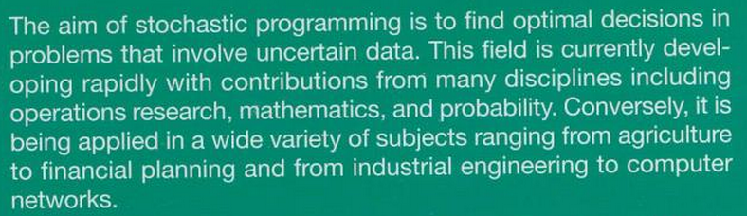
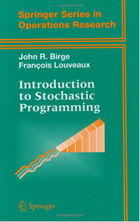
Quick Intro to Stochastic Optimization
near
efficiently
Introduction to Stochastic Programming
- Birge and Louveaux
Our Focus: add
Computer Science to list

Slide 6
Quick Intro to Stochastic Optimization
Key Issues in Stochastic Optimization
Modeling uncertainty in optimization problems
How uncertainty changes the solution space
Techniques to manage uncertainty
This Talk: Viewing these issues through the Approximation Algorithms lens

Slide 7
Example: Knapsack Problem
Given n jobs, each with reward and size
and Knapsack of total capacity B
Schedule a subset of jobs of total size B
Maximize total reward
NP-Complete, Know very good approx. algos
Reward 10
25
8
20
20
Capacity B

Slide 8
Stochastic Knapsack
Jobs have random (sizes,rewards)
Distribution given as input
True values revealed only after job placed into Knapsack
10 w.p ½
Reward 10
0 w.p ½
50 w.p 0.6
8 w.p 1
20 w.p 0.2
20 w.p 0.9
5 w.p 0.4
10 w.p 0.8
20 w.p 0.1
Capacity B
Modeling uncertainty in optimization problems
How uncertainty changes the solution space
Techniques to manage uncertainty

Slide 9
Stochastic Knapsack
OPT is now an adaptive policy
Next action depends on prior outcomes!
reward,size
1
Job 2
3
4
2
10 w.p ½
50 w.p 0.6
8 w.p 1
50,6
20 w.p 0.2
20 w.p 0.9
5,4
0.4
0.6
probability
Job 5
Job 3
0 w.p ½
5 w.p 0.4
10 w.p 0.8
20 w.p 0.1
Job 3
Job 1
Job 5
Job 4
Capacity B
Total Reward: 33
…
Total Reward: 10
…
Quality: Expected total reward
Modeling uncertainty in optimization problems
How uncertainty changes the solution space
Techniques to manage uncertainty

Slide 10
Stochastic Knapsack
Stay Tuned!
Modeling uncertainty in optimization problems
How uncertainty changes the solution space
Techniques to manage uncertainty

Slide 11
Stochastic Knapsack
Stochastic Scheduling Problems
E.g., Jobs are randomized algorithms
Different (size,utility) depending on randomization
Widely studied in Operations Research
[Weber 82], [Weiss 95], [Uetz 01], etc.
Use heuristics in server scheduling, inventory, etc.
Based on expected values, variance, etc.
Can we explain their “effectiveness” theoretically?

Slide 12

Focus of this talk
View from
Approx. Algos lens
Stochastic Knapsack
General
Solution Framework
Stochastic Routing
Problems
Multi-Armed Bandit Problems
Well-studied in
Operations Research
Well-studied in
Machine Learning

Slide 13
Our Results
Efficient approximation algorithms for
General Stochastic Knapsack
Multi-Armed Bandits
Stochastic Orienteering
Prior work: No theoretical guarantees or only for special cases!
[Gupta, K, Molinaro, Ravi FOCS 2011] and [Gupta, K, Nagarajan, Ravi SODA 2012]

Slide 14
Our Results
(meta)
Understanding techniques for the
design and analysis of approximation algorithms
for stochastic optimization problems
OPT is adaptive, ALG may well need to be!

Slide 15
Outline
Introduction | Stochastic Orienteering | Other Applications of Framework | Future Work and Summary
Introduction | Stochastic Orienteering | Other Applications of Framework | Future Work and Summary
Model Studied
Focus Problems
Our Main Results
Problem Definition
Results
Motivating our Reduction
Main Reduction to Knapsack Orienteering
Proofs
Lessons

Slide 16
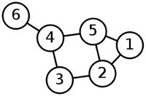
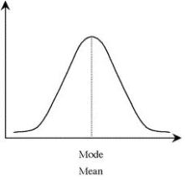

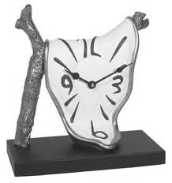
Stochastic Orienteering
Graph with metric distances
Distribution of wait times at vertices
Fixed rewards at vertices
Total budget B

Slide 17
Objective
Design a (possibly) adaptive strategy to
reward,size
Visit 2
5,4
50,6
0.4
0.6
probability
Visit 5
Visit 3
Visit 3
Visit 1
Visit 5
Visit 4
Total Reward: 33
…
Total Reward: 10
…
Maximize expected total reward

Slide 18


A Toy Example
Post Office
6 hrs
2 hrs
2 hrs
Time Up ☹
Food
1/2 hr
3 hrs
6 hrs
2 hrs
Time Up ☹
½ hr
0 Tasks
9AM
11AM
1PM
4PM
4:30PM
5PM
2 Tasks
Budget

Slide 19

Our Interest in the Problem
Heuristics (or) Absolute Guarantees for Special Cases
Approximation Algorithms
Deterministic
Orienteering
Very Extensive
Literature
[Blum et al. 03],
[Bansal et al. 04], etc.
[Steward, Golden 83],
[Jalliet 85], [Laporte, Louveaux 87], [Bertsimas 88, 91],
[Ilhan 07]
Stochastic
Orienteering

Slide 20
Our Interest in the Problem
(meta)
simple
Many heuristics work well in practice/simulations.
Can we explain this phenomenon theoretically?
what tools do we require for design and analysis?

Slide 21
Main Results
Job 2
Job 2
Job 5
Job 5
Job 3
Job 3
J 3
J 1
J 5
J 4
Theorem: We find a non-adaptive tour which is
O(log log B) approximation to best adaptive tour
O(1) approximation to best non-adaptive tour
(recall: B is the budget of the problem,
all distances and wait times are integers)

Slide 22
Outline
Introduction | Stochastic Orienteering | Other Applications of Framework | Future Work and Summary
Problem Definition
Results
Motivating our Reduction
Main Reduction to Knapsack Orienteering
Proofs
Lessons

Slide 23
High Level Approach
Adaptive OPT
Non-Adaptive Algorithm
Using
mean values
Deterministic Problem (P)
Solve P
We have much expertise at solving deterministic optimization problems!
Natural candidate: deterministic version of orienteering itself?

Slide 24
Attempt 1: Reduction to Deterministic Orienteering
i) Replace each stochastic job by its mean wait time
ii) Find a path of (total length + waiting time) at most B,
maximize total reward
Deterministic Orienteering Problem
(know good approximation algorithms)
Natural Heuristic,
deployed in many OR analyses
Q: How good is this solution?

Slide 25


Bad Example for Reduction
Deterministic instance encodes mean,
but not “variance”! ☹
B co-located jobs
Wait 0 w.p 1 – 1/B
B w.p 1/B
B-1
Mean wait 1
B-1
Deterministic Instance OPT = 2 jobs
Stochastic Instance OPT
= Ω(B) jobs
Jobs of
deterministic
wait time ½

Slide 26
Knowing OPT better to Control Variance
Suppose OPT always travels for T* units
It is always solving side knapsack with budget B-T*
Should truncate all size distributions at B-T*
No point supporting larger sizes, no profit anyway
Get much better control over the variance!
different
sample paths
In OPT
T*
B

Slide 27
Fixing the problematic case
T* = B-1,
So truncate at 1
B co-located jobs
Wait 0 w.p 1 – 1/B
B w.p 1/B
B co-located jobs
Wait 0 w.p 1 – 1/B
1 w.p 1/B
B-1
New Mean 1/B
Mean wait 1
Now the deterministic instance has good total reward..
Q: Is there a single good truncation threshold?

Slide 28
Fixing the problematic case
when we don’t know OPT’s structure well enough
(recall OPT is an adaptive decision tree)
Q: Is there a single good truncation threshold?

Slide 29
Yes there is! (and here’s how we find it)
Try all possible truncation values!

Slide 30
Our Algorithm
For all T = 1, 2, 4, …, B
Choose solution with most reward
i) Truncate each job’s distribution at B-T
ii) Set size of job to be its truncated expectation
iii) Find a path of length at most T s.t
Total size of jobs visited is at most B – T
Maximize total reward
prob.
B-T
size
Clearly Non-Adaptive
Theorem: Finds a non-adaptive tour which is
O(log log B) approximation to best adaptive tour
but how good is it?
and is it polytime?

Slide 31
Outline
Introduction | Stochastic Orienteering | Other Applications of Framework | Future Work and Summary
Problem Definition
Results
Motivating our Reduction
Main Reduction to Knapsack Orienteering
Proofs
Lessons

Slide 32
Steps of the Proof
For all T = 1, 2, 4, …, B
Choose solution with most reward
i) Truncate each job’s distribution at B-T
ii) Set size of job to be its truncated expectation
iii) Find a path of length at most T s.t
Total size of jobs visited is at most B – T
Maximize total reward
Knapsack Orienteering
Q1) Is there a good solution for the above algorithm?
Q2) Can we implement step iii) efficiently?
Q3) How does this solution perform on original stochastic instance?

Slide 33
Steps of the Proof
Adaptive OPT
Non-Adaptive Algorithm
Q1) O(log log B)
Q3) O(1)
for some T*
Q1) Is there a good solution for the Knapsack Orienteering algorithm?
Q2) Can we implement Knapsack Orienteering efficiently?
Q3) How does a KO solution perform on original instance?
Knapsack Orienteering
Solve KO
Deterministic Problem (P)
Solve P
Q2) O(1)

Slide 34
Knapsack Orienteering → Non-Adaptive Tour
Given a path of reward R, length T
Total size of items visited is at most B-T
Non-Adaptive Sol^{n}: Visit in same order!
At each vertex, simply skip with probability ½
Total distance travelled at most T
Expected total size at most (B-T)/2
All jobs finish within B-T with probability ½
Analysis

Slide 35
Steps of the Proof
Q1) Is there a good solution for the Knapsack Orienteering algorithm?
Q2) Can we implement Knapsack Orienteering efficiently?
Q3) How does a KO solution perform on original instance?
Adaptive OPT
Non-Adaptive Algorithm
Q1) O(log log B)
Q3) O(1)
for some T*
“Knapsack Orienteering”
Solve Knap. Orient.
Q2) O(1)

Slide 36
Stochastic OPT → Knapsack Orienteering
Want: Exists some sample path in adaptive OPT
If travelling T*, then sum of truncated means is B-T*
And total reward is Ω(E[OPT]/α)
Feasible solution for Knapsack Orienteering
Visit 1
For all T = 1, 2, 4, …, B
Choose solution with most reward
(10,8)
(3,5)
i) Truncate each job’s distribution at B-T
ii) Set size of job to be its truncated expectation
iii) Find a path of length at most T s.t
Total size of jobs visited is at most B – T
Maximize total reward
0.7
0.3
Visit 2
Visit 3
Visit 4
Visit 3
Visit 2
Visit4
Total Reward: 14
…
Total Reward: 10
…
Knapsack Orienteering

Slide 37
Stochastic OPT → Knapsack Orienteering
Want: Exists some sample path in adaptive OPT
If travelling T*, then sum of truncated means is B-T*
And total reward is Ω(E[OPT]/α)
Well-Behaved Sample Path: If travel time is T, then sum of truncated means is at most α(B-T)
Easy Case: every sample path is well-behaved
Convexity: at least one sample path has reward E[OPT]
Feasible solution for Knapsack Orienteering
Intuition: For every sample path in OPT, if travel time is T, then sum of actual wait times is at most (B-T)

Slide 38
Handling misbehaving sample paths
Chop off OPT when it misbehaves!
Star Node: First node along sample path when sum of truncated means exceeds α (B-T)
Chop off OPT beneath star nodes!
New OPT is well-behaved
Reward lost at most Pr[OPT reaching “star”] x E[OPT]
Key Lemma
Pr [OPT reaching a “star”] ≤ ½

Slide 39

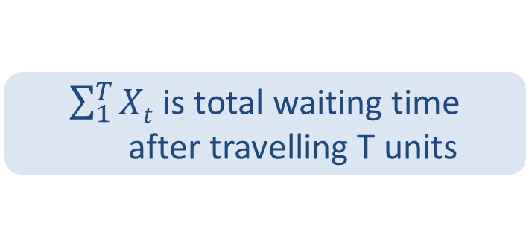
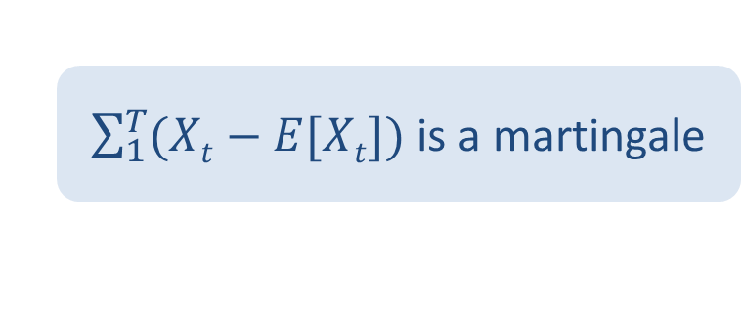
Viewing OPT as a Stochastic Process
After travelling for t units
If processing a job,
$Xt$ ≡ r.v for waiting time
If not at any vertex,
$Xt$ ≡ 0
Home
X₁ ≡ 0
X₂ ≡ 0
X₃ ≡ 0
2
X₄ ≡
5
Send Mail
S = 5
S = 2
$\sum_{1}^{T}{Xt}$ is total waiting time
after travelling T units
X₅ ≡ 0
X₅ ≡ 0
X₆ ≡ 0
Buy Food
$\sum_{1}^{T}{(Xt−E[Xt])}$ is a martingale
Buy Tix
1
X₆ ≡
2

Slide 40

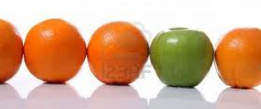
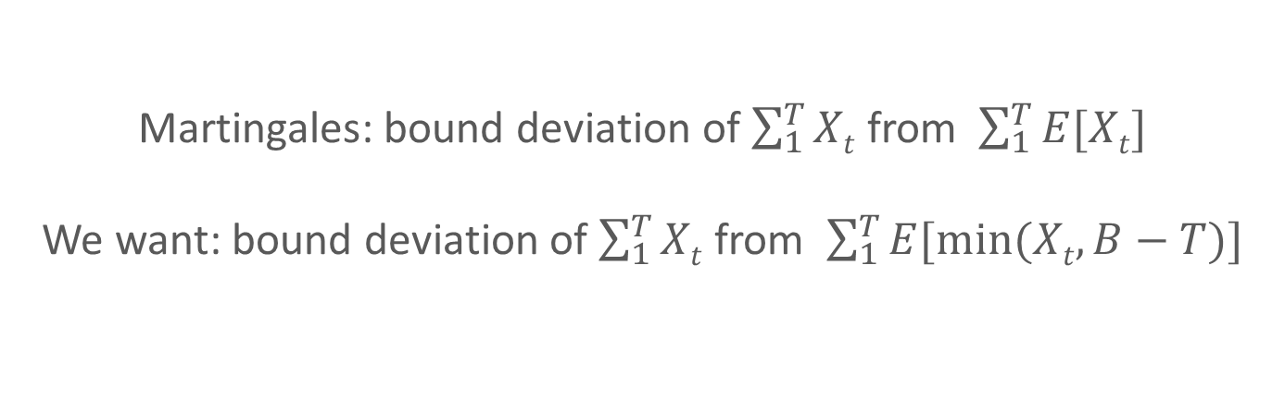
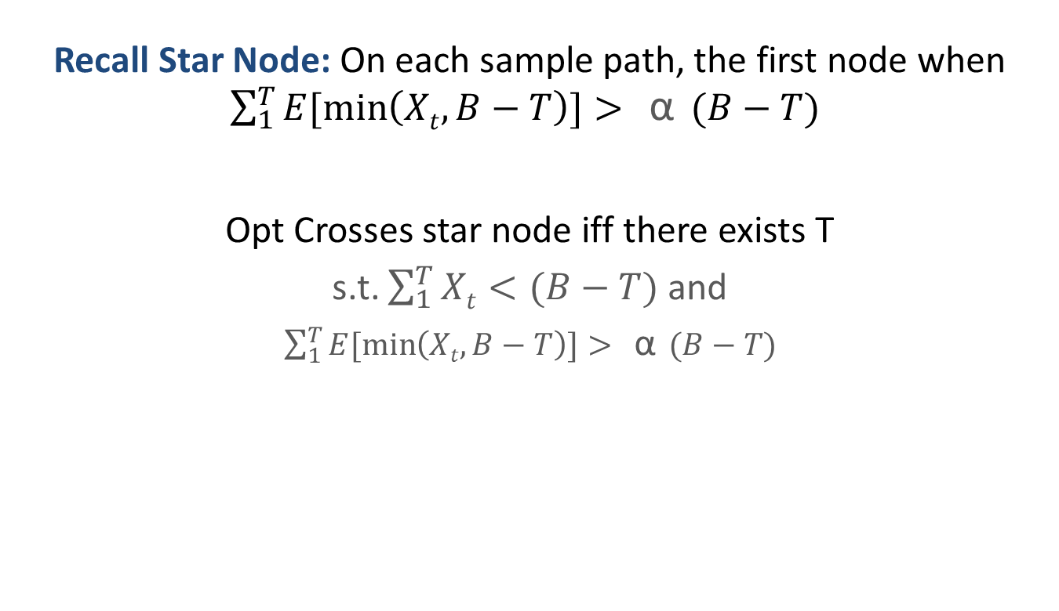
Towards Proving the Key Lemma
Recall Star Node: On each sample path, the first node when $\sum_{1}^{T}{E[\min\left(Xt,B−T\right)]>{\text{α}{ (B−T)}} }$
Opt Crosses star node iff there exists T
s.t. $\sum_{1}^{T}{Xt}<(B−T)$ and
$\sum_{1}^{T}{E[\min\left(Xt,B−T\right)]>{\text{α}{ (B−T)}} }$
Key Lemma
Prob < ½
Martingale
Concentration Bounds?
T itself is a random variable
(stopping time: reaching star node)
Martingales: bound deviation of $\sum_{1}^{T}{Xt}$ from $\sum_{1}^{T}{E[Xt}]$
We want: bound deviation of $\sum_{1}^{T}{Xt}$ from $\sum_{1}^{T}{E[min⁡(Xt, B−T)}]$

Slide 41
Proving Non-Standard Concentration
Run log B martingale processes in parallel
For different truncation thresholds
Martingale Concentration in each
Freedman’s Inequality
Union bound gives O(1) concentration
for α = O(log log B)

Slide 42
What’s left to show?
Can approximate Knapsack Orienteering well
Reduction to Orienteering using Lagrangean relaxation
lift the Knapsack constraint into objective
O(1) approximation
Adaptive OPT
Non-Adaptive Algorithm
Q1) O(log log B)
Q3) O(1)
for some T*
“Knapsack Orienteering”
Solve Knap. Orient.
Q2) O(1)

Slide 43
Outline
Introduction | Stochastic Orienteering | Other Applications of Framework | Future Work and Summary
Problem Definition
Results
Motivating our Reduction
Main Reduction to Knapsack Orienteering
Proofs
Lessons

Slide 44
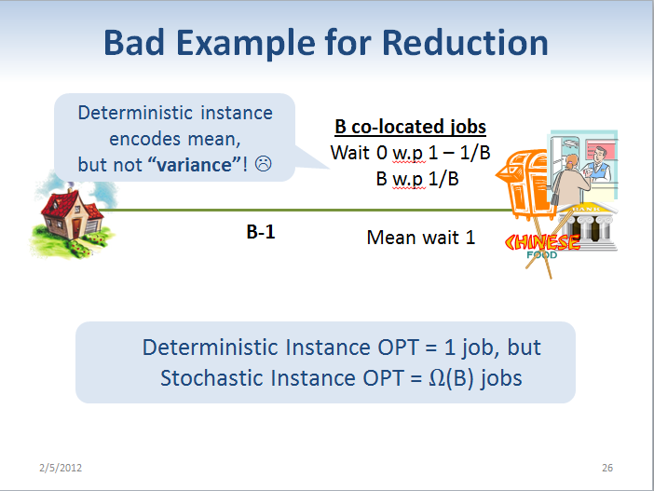
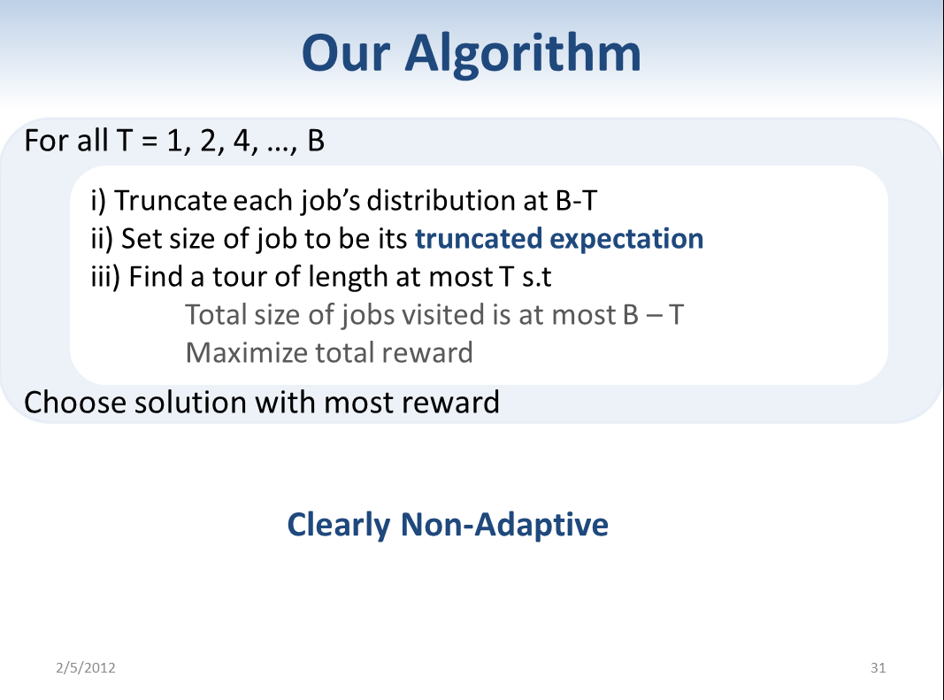
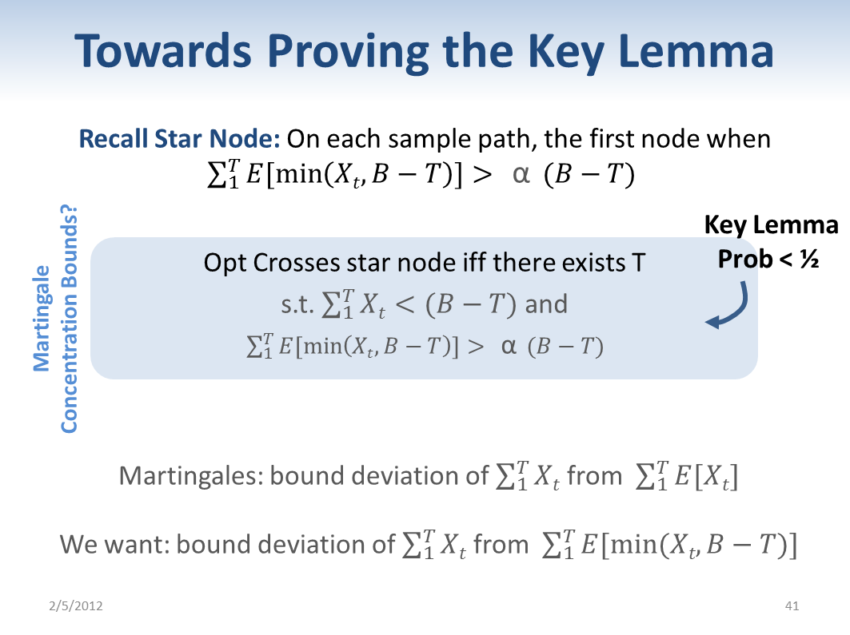
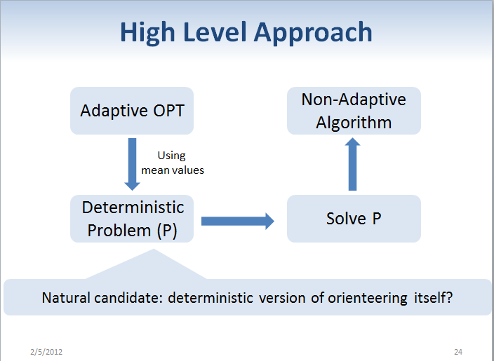
Recap and Lessons

Slide 45
Recap and Lessons
General Framework via Deterministic Surrogate
Can surrogate control variance?
Can surrogate handle correlations?
Is surrogate general enough to yield adaptive solutions?
Yes, but often push difficulty into analysis
Because surrogate is “strengthening”
And not a relaxation

Slide 46
Outline
Introduction | Stochastic Orienteering | Other Applications of Framework | Future Work and Summary
Introduction | Stochastic Orienteering | Other Applications of Framework | Future Work and Summary
Problem Definition
Results
Motivating our Reduction
Main Reduction to Knapsack Orienteering
Proofs
Lessons
Problems
Results
Knapsack: Handling Correlations
MAB: Handling Adaptivity

Slide 47
General Stochastic Knapsack
Jobs have random (sizes,rewards)
Distribution given as input
Actual values revealed only on job completion
Goal: adaptively schedule jobs to maximize reward
Our Results
i) Constant-factor approximation for correlated setting
ii) Even allow preemptions and cancellations
Prior work: assume reward and size are independent
[Dean, Goemans, Vondrak 04], [Bhalgat, Goel, Khanna 11]
Jobs can crash: simplest example of correlations

Slide 48
Going back to the framework..
Surrogate: Linear Program for Knapsack (using mean values)
strengthened
Adaptive OPT
Non-Adaptive Algorithm
Averaging
Argument
Randomized
Rounding
Suitable Surrogate
Surrogate = LP
“Knapsack Orienteering”
Solve Surrogate
Solve Knap. Orient.
Details in [Gupta, K, Molinaro, Ravi FOCS 2011]

Slide 49


The Multi-Armed Bandits Problem
$1
$½
0.99
0.01
½
½
$1
$10
0.1
$2/3
$1/3
0.9
1.0
2/3
1/3
2/3
0.4
1/3
$0
$3/4
$1/2
$1/4
0.6
…
Given: n Markov Chains and starting states
Goal: at each step, adaptively choose one Markov chain
(then that chain makes random transition)
Maximize total reward of all visited states in B steps

Slide 50
Our Results
i) Constant-factor adaptive algorithm for general MABs
ii) Adaptivity is a necessary evil
Prior Work: each Markov Chain is a martingale process
[Guha, Munagala 07], [Goel, Khanna, Null 09]
Correlated Knapsack: simple e.g. of non-martingaleness
Machine Learning Framework: Min. regret vs best fixed chain
(guarantees depend on horizon length)

Slide 51
Using the same Framework
Surrogate: Linear Program for Knapsack (using mean values)
strengthened
Adaptive OPT
Non-Adaptive Algorithm
Averaging
Argument
Adaptive
Rounding
Suitable Surrogate
Surrogate = LP
“Knapsack Orienteering”
Solve Surrogate
Solve Knap. Orient.
Details in [Gupta, K, Molinaro, Ravi FOCS 2011]

Slide 52
Future Directions
Approximability of Stochastic Optimization
Growing subject, lots of problems to study
Only understand basic problems now
What about Restless Bandits Problem, e.g?
Techniques for Non-Linear Objectives
Handle variance of ALG’s reward
Adaptively probe vertices today to minimize TSP tomorrow
Adaptively learn labels to minimize net classification error
Can we use our framework?

Slide 53
Other Research Areas
Network Design
First online algorithm for survivable network design (SNDP)
[Gupta, K, Ravi STOC 2009, SODA 2010]
Use tree embeddings to get polynomial size set cover for SNDP
Online Scheduling
Near-optimal online algorithm for broadcast scheduling
[Bansal, K, Nagarajan ICALP 2010]
Solve fractional problem online + online rounding strategy
Online primal-dual for convex programming
[Gupta, K, Pruhs Manuscript 2012]
Energy-Aware Scheduling
[Gupta, K, Pruhs ICALP 2010]

Slide 54
Summary
Approximability of Stochastic Optimization
Framework via reduction to deterministic surrogate
Surrogate must handle variance, correlation, adaptivity, etc
Works for Orienteering, Knapsack, MAB
Several future directions
Applications in machine learning, operations research
Exciting times ahead! ☺

Slide 55
Thank You Notes ☺
Thank you, questions?
Based on joint works with Anupam Gupta, Marco Molinaro, Viswanath Nagarajan, and R. Ravi
Slides located at http://www.cs.cmu.edu/~ravishan/ttic.pptx
Email: kravi@cs.cmu.edu

Slide 56
Back Up Slides

Slide 57


More Generally..
Stochastic Routing
Stochastic jobs are located on a metric
Know actual values only after visiting and processing job
Inventory Routing [e.g., Fedex pick up]
Widely studied in OR
[Steward, Golden 83], [Jalliet 85], [Laporte, Loveauu 87], [Bertsimas 88, 91], [Ilhan 07], etc.
No theoretical guarantees
Against adaptive OPT
Stochastic Knapsack
Stochastic Routing
Multi-Armed Bandit Problems
2 hrs
3 hrs
½ hr

Slide 58
More Generally..
Multi-Armed Bandits
Jobs have more complex state spaces
(Markov Chains instead of just (size,reward) dist.)
Budgeted learning problems
Widely studied in ML
Regret guarantees against fixed strategy in hindsight
Can we approximate adaptive OPT?
Currently only very special cases
$1
0.99
0.01
$1
$10
50 w.p 0.6
0.1
0.9
1.0
5 w.p 0.4
0.4
$0
0.6

Slide 59
Adaptive Strategies
3 stochastic jobs, knapsack size 1
Jobs are (Las Vegas) randomized algorithms
Size 0.2 w.p ½
0.6 w.p ½
Size 0.8 w.p 1
Size 0.4 w.p ½
0.9 w.p ½

Slide 60
Optimal Adaptive Policy
Expected Reward: 2x(1/2) + 2x(1/4) + 1x(1/4) = 1.75
size = 0.8
2 jobs [prob ½]
size = 0.2
Size 0.8 w.p 1
Size 0.2 w.p ½
0.6 w.p ½
2 jobs [prob ¼]
size = 0.6
size = 0.4
size = 0.9
1 job [prob ¼]
Size 0.4 w.p ½
0.9 w.p ½

Slide 61
Optimal Non-Adaptive Policy
Expected Reward: 2x(1/2) + 1x(1/1) = 1.5
2 jobs [prob ½]
size = 0.8
size = 0.2
Size 0.8 w.p 1
Size 0.2 w.p ½
0.6 w.p ½
size = 0.6
1 job [prob ½]
size = 0.8
Size 0.8 w.p 1

Slide 62
A Special Case
Each Markov Chain is a caterpillar
A play means processing one unit of a job
Stoc. Knapsack with Correlations and Preemptions
Budget B = number of plays allowed
j₁
(size 2, reward r₁₂)
r₁₁
r₁₂
r₁₃
j₂
(size 1, reward r₂₁)
r₂₁
r₂₂
r₂₃

