Slide 1


INTERNSHIP PRESENTATION ON MACHINE LEARNING
Presented by:
RAKSHITHA S (1AT16CS081)
Internship Guide:
Mr Vijay Swaroop A
Dept. of CS&E , Atria Institute of Technology
Bangalore
Department of Computer Science & Engineering,
Atria Institute of Technology

Slide 2
TABLE OF CONTENTS
Introduction about the company
Domain
Tasks performed
Outcomes
Conclusion

Slide 3
Introduction
Name of the company: Techciti Technologies & Private Ltd.
Duration: 3 months
Department(in the internship): Software Intern Department
Company Guide’s Name: Mr. Harish L
Details regarding the Company:
TechCiti recognizes the importance of implementing the right solution for any business. It offers a wide range of services to build a solution that is right for your business needs. Every business, no matter the size, needs advice and support. They have a several years of technical experience and have accumulated a wealth of IT infrastructure knowledge. Their free consultation service helps you to establish your requirements. It will be with you every step of the way, from product selection through to configuration and installation.
TECHCITI has been recognized as an industry leader in the development and implementation of websites, software solutions that consistently exceed client expectations.

Slide 4
SERVERS AND STORAGE : Servers and storages includes SERVERS of RACK, TOWER & BLADE
IP (INTERNET PROTOCOL) INFRASTRUCTURE WIRED & WIRELESS : Routers, switches & Fiber optics and Ethernet solutions and solutions Wireless infrastructure solutions
UNIFIED COMMUNICATIONS AND COLLABORATION: small meeting / board room solutions , training room solutions , digital signage & led display solutions
LAPTOP, DESKTOPS & PERIPHERALS:
SOFTWARE BUSINESS APPLICATIONS
SERVICES: End to End IT infrastructure solutions, Enterprise software solutions, Web application development.

Slide 5
DOMAIN: MACHINE LEARNING
Machine Learning is the field of study that gives computers the capability to learn without being explicitly programmed. ML is one of the most exciting technologies that one would have ever come across. As it is evident from the name, it gives the computer that makes it more similar to humans: The ability to learn. Machine learning is actively being used today, perhaps in many more places than one would expect.
How ML works? A Machine Learning system learns from historical data, builds the prediction models, and whenever it receives new data, predicts the output for it. The accuracy of predicted output depends upon the amount of data, as the huge amount of data helps to build a better model which predicts the output more accurately. Suppose we have a complex problem, where we need to perform some predictions, so instead of writing a code for it, we just need to feed the data to generic algorithms, and with the help of these algorithms, machine builds the logic as per the data and predict the output
Features of ML:
Machine learning uses data to detect various patterns in a given dataset.
It can learn from past data and improve automatically.
It is a data-driven technology.
Machine learning is much similar to data mining as it also deals with the huge amount of the data.
ML history, Ml applications in each domains was analysed, Life cycle of ML, Data processing was all learnt.

Slide 6
Tasks Performed:
CLASSIFICATION OF CANCEROUS CELLS USING ML AND ALSO SUGGESTING THE THERAPY REQUIRED.
Installation of python and ML software and executions
ML in Supervised learning
Classification types and Regression types were learnt
ML with Python
Working both ML & python by considering few basic examples:
Working on a project called Classification of Cancerous stages Profiles Using Machine Learning:
Applying supervised algorithm called Regression and Classification algorithms on Cancer dataset.
Visualization in ML with various plots

Slide 7
Working on a project called Classification of Cancerous stages Profiles Using Machine Learning:
Here the first and the foremost step involved is collection of dataset of patients with cancer.
The breast cancer data was collected by the Netherlands Cancer Institute (NKI) and published on Nature 415 by van’t Veer et al. in 2002. It included clinical features but also gene expression levels; these represent how active genes and those that might contribute to cancer by being over-active or under-active.
A cleaned version of this dataset was found on dataworld.com which was imported into a Pandas data-frame. It included expression levels of the 1554 most variable genes and 17 clinical features for 272 patients.
A data dictionary was constructed by researching measures for breast cancer studies and by using the readme file associated with the original uncleaned dataset.
Data consists of Patient id, age, name, event-death, survival, time-recurrence, chemotherapy, hormonal therapy, amputation, hist-type, diameter of tumour, posnodes, grade, angionv, lymphinfil, barcode, gene id. Based on these parameters the patient was analysed the type of cancer called MALIGN or BENIGN that is represented as 1 or 0. Based on the accuracy obtained from each ML supervised algorithms the treatment of the therapy is involved that is amputation, chemo therapy or hormonal therapy.

Slide 8
Applying supervised algorithm called Regression and Classification algorithms on Cancer dataset.
Relationship between clinical variables and prognosis: there was a positive correlation between the event of death and variables known to be associated with poor prognosis (tumour diameter, number of positive nodes, tumour grade), but a negative correlation between age and event death, which was unexpected given that cancer is an age-associated disease.
Time related features v/s Eventdeath: There were strong negative correlations between event death and a) the time between first treatment and follow-up and b) the time between first treatment and recurrence; the longer someone had survived or been disease free, the less likely they were to die.
Therapy’s underwent by patients are: Chemotherapy, Hormonal therapy, Amputation These are the 3 treatments should be given to patients when based on malignant and benign type of cancers.

Slide 9
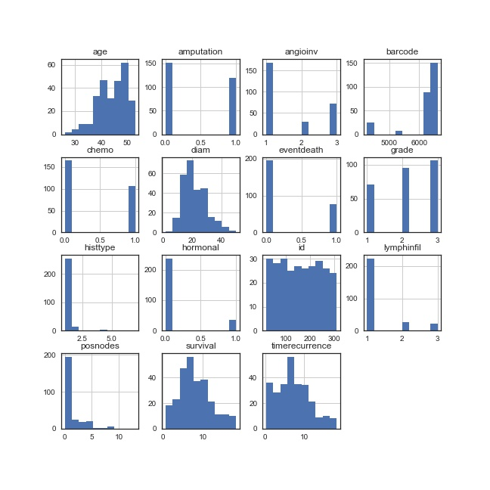
Outcomes
Technical outcomes

Slide 10

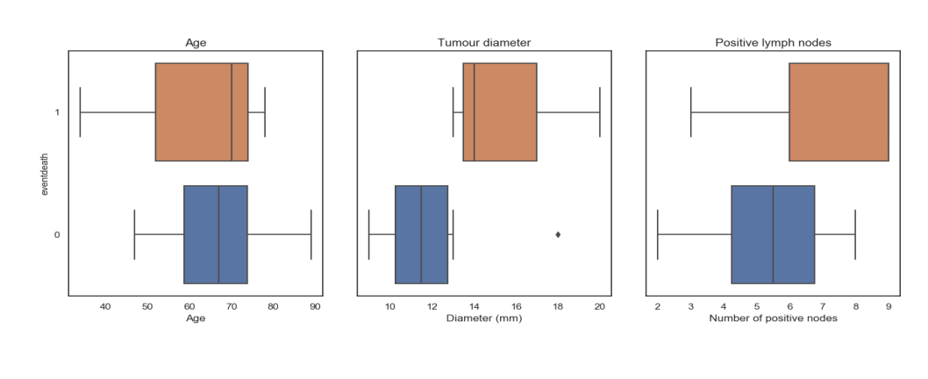
OUTOCOME:
PLOT OF DATASET:
PLOT OF CLINICAL VARIABLES AND PROGNOSIS
SURVIVAL PLOT
PLOT OF CLINICAL VARIABLES

Slide 11
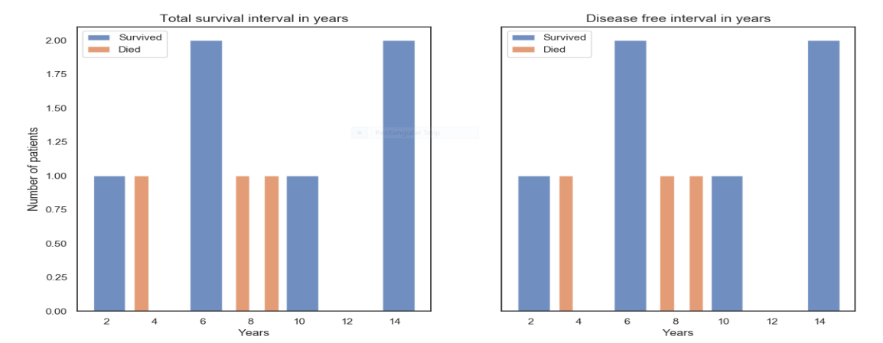
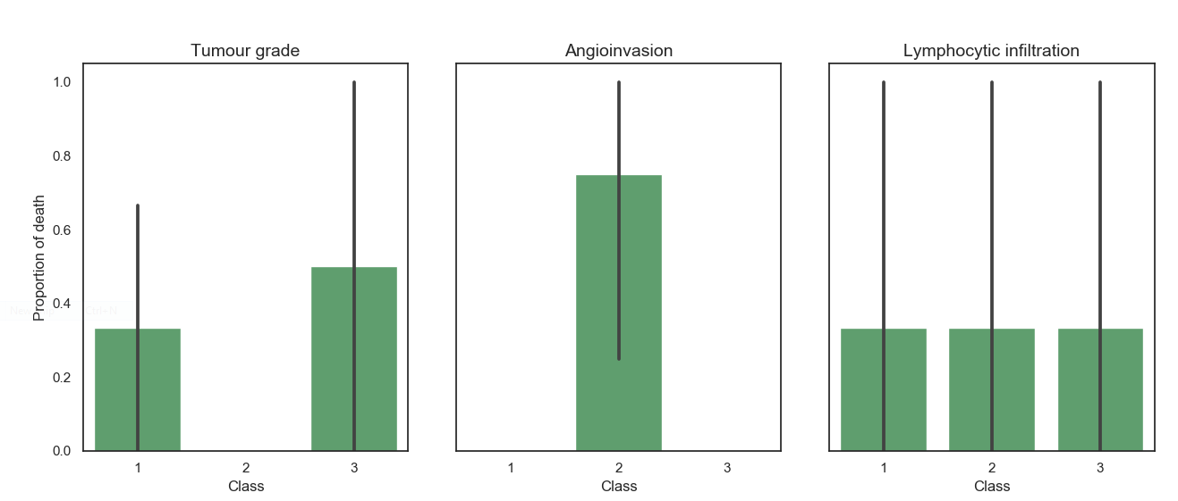
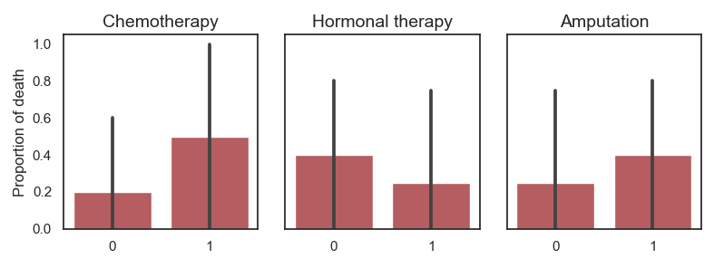
SURVIVAL PLOT
PLOT OF CLINICAL VARIABLES
CLINICAL THERAPIES PLOT

Slide 12
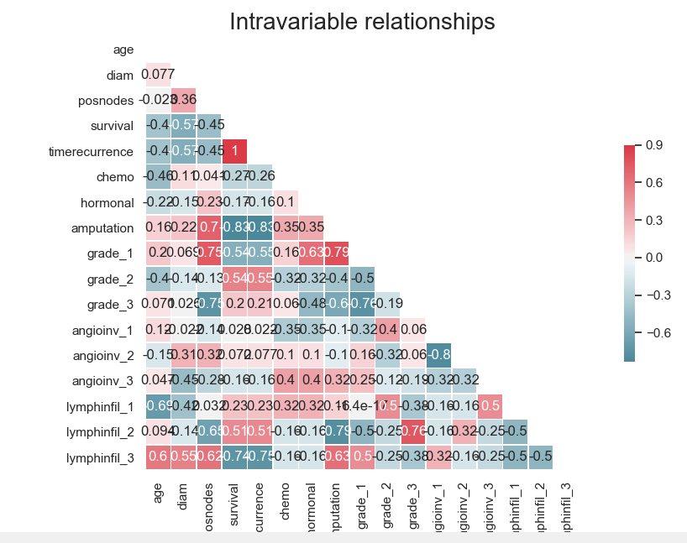
SEABORN PLOT ON INVARIANT RELATIONSHIP

Slide 13
Conclusion
Overall experience…There are a variety of options available for cancer treatment. The type of treatment recommended for an individual is influenced by various factors such as cancer-type, severity of cancer (stage) that is either MALIGN or BENIGN and recommended therapies required. To study anti-cancer therapies we need to understand cancerous profiles. These profiles carry information which can reveal the underlying factors responsible for cancer growth. Hence there is a need to analyse cancer data for predicting optimal optimal-treatment options and detect survival period and death period of a patient. Therefore analysis of profiles can help predicting and discover potential therapies and survival. In this paper the main aim is to provide ML based classification technique for cancerous profiles.
Scikit-learn comes with a few small standard datasets that do not require downloading any file from any external website. The dataset that we will be using for our machine learning problem is the Breast cancer wisconsin (diagnostic) dataset. The dataset includes several data about the breast cancer tumors along with the classifications labels, viz., malignant or benign.
Machine learning involves computers discovering how they can perform tasks without being explicitly programmed to do so. For simple tasks assigned to computers, it is possible to program algorithms telling the machine how to execute all steps required to solve the problem at hand; on the computer's part, no learning is needed. For more advanced tasks, it can be challenging for a human to manually create the needed algorithms.
Internship Presentation
13

Slide 14
Working with experienced and more skilled individuals
Working with some of the best developers, designers and managers in information technology department, solving problems that you can never face in a college environment, bonding with other interns that make up a very diverse demographic.
Benefits derived from internship
The field attachment was of great importance, some of the benefits include
Internship helped me understand work ethics, employment demands, responsibilities and opportunities.
Field attachment provided career direction and confidence in my abilities by narrowing down the list of potential careers.
My internship gave me the opportunity to try out computer related activities i.e. dismantling a computer which I had not previously considered and broadened my horizons through converting my academic knowledge into industry skills.
It prepared me for the working environment.
It enhanced my CV needed to negotiate future jobs
Learnt Python, Machine Learning in Python by doing a project.

Slide 15
Queries ?
ANY QUERIES?

Slide 16
THANK YOU

