Slide 1

IOT BASED ANTIPOACHING OF TREES IN FOREST USING WIRELESS NETWORK
TEAM MEMBERS: RAKSHITHA S(1AT16CS081)
SRISHTI PANDIT(1AT16CS103)
TEJAS R JOSHI(1AT16CS113)
PROJECT GUIDE: PROF CHANDINI UNNIKRISHNAN

Slide 2
Contents
Introduction
Objectives
Literature Survey
Time schedule
Methodology
Results & Discussion
Outcomes
Conclusion

Slide 3
Introduction
Illegal movement of trees in the woods, acts as a major trouble to forest capital. A serious economic damage which will ultimately have a terrible effect on the environment. Illegal movement of trees has lead to expand the risk of natural resources getting extinct, wild animals are losing their natural habitats causing variance in the nature.
Advance work based on Anti-Poaching system provide work based on wireless sensor network(WSNs). The purpose was to save the trees in forests and save the animals. Wireless devices networks in the most evolving technology and is employed in numerous applications. WSN consists of nodes integrated with sensors, communication module, powering unit interface controlled by a microprocessor.
The peculiar characteristics of a wireless device networks like power consumption, compactness, and low price makes it possible technology for type of application like observance, maintenance, security, and controlling. During this project a wireless device network is meant to watch the valuable trees.
Poaching of economically valuable trees like Sandalwood have increased staggeringly. Therefore, it is necessary to require measures which might facilitate preserve our natural resources.
“Implementation Of Wireless Device Network” is to watch the illegal activity and alerting concerning the poacher. The sensor network system designed won’t be ready to stop the extralegal poaching activities.
In a cluster of 15-20 tree nodes can be formed with a master node having additional resources to communicate with the base station which will be located at the entrance of the forest/ farm which will communicate with the control room server.

Slide 4
Objectives
Most fierce blazes in forests are brought about by individuals because of abuse of flame for change to woodlands to agrarian terrains.
The goal of the task is to keep the sneaking, illegal movement and other anthropogenic exercises in the forest. Such sort of framework can be utilized in any zone of backwoods which is exceptionally influenced by pirating and illicit cutting.
There is no requirement for the watchman to travel entire woods. We can see the visuals of the considerable number of happenings in the backwoods at the base station. Accurate area of the tree cutting can be found effectively as well.
The sensor information is prepared in the microcontroller and is transmitted to the collector unit. The recipient unit chooses weather the ecological conditions prompts woods fire or not and is likewise cautioned about the unlawful exercises assuming any.

Slide 5
Literature Survey
In tropical recent years, poaching of treasured trees which are mostly been hugely increased due to man’s self- regarding wishes over the top include Sandalwood, Teakwood, Pine and Rosewood. Trees have been much creativity carry out by different system of government, and in specific government of India, to allay this problem. This holds enlistment of anti- poacher for deployment and training complete forest.
However, there is many of the actions have remained largely ineffective. There is hopeful solution for the prevention of forest trees is- “the implementation of Wireless Sensor Networks (WSN’s)” which is a robust, effective and practicable technology for monitoring and controlling.
WSN is a most developing technology, widely used in many applications which can be involved monitoring and controlling. In forest, it is already deployed for fire detection, rearing/ poaching of wild animals. It facilitates preservation and easy conduction.
They exclude the use of lavish things like cables and decrease the cost. In this extract, the presented design for a portable wireless sensor node which is the part of a Wireless Sensor Networks. It will be attached on tree trunk of each tree, accomplished to identify theft and also repeatedly start and send signals to Central Base Station.
The system is low power design, and it is more successfully work with rechargeable batteries which can charge active by natural solar system. A solar panel is taken in the system to use for recharging node’s batteries. It can avoid regular manual change.

Slide 6
Time schedule
Sno. | Activity | Specification | Duration
1). | Platform Setup | Windows 10 software:- Arduino | 14-01-2020 20-01-2020
2). | Identification of demo features | I/P: no. of trees in a forest O/P: trees protected or cut off | 25-01-2020 31-01-2020
3). | Feature specification | Collection of data Pre processed data Analysis of data Results | 2-02-2020 10-02-2020
4). | Algorithm design | None | --------------
5). | Implementation | Data containing trees in forests by applying sensors and buzzers while cutting down a trees in a forest | 20-02-2020 1-03-2020
6). | Test | Sensors are being used and from that preventing trees from deforestation and saving the environment. | 10-03-2020 20-03-2020

Slide 7
Methodology
The proposed WSN consists of:-
Each device consists of 15-20 sensor nodes. These devices will have sensor input as that the data of the accelerometer and microphone.
The main node will receive the data from all the sensing nodes and will then transfer it to the base station. It processes the message from the sensor nodes and turns on the alarm levels.
Base station receives the message from one master node.
Here the sensing node comprises of four basic components 1)A sending unit 2) A processing unit 3) A trans receiver unit and a charging unit. All the components and the sensors that are selected have a low power consumption profile. Apparently, the node designed is an end device of WSN. Sensing node will transfer only alerts messages and only reply back to the query of the major request. The master will always monitor all the sensing device over particular time along with the poaching alert, with respect to some critical conditions, the alarming messages are also transmitted by the node to master. These alarms are like sensors, fails alerts, power down alert etc.
The input is fetched from the base station which has the whole information and details of the trees in the forest. This consists of three major sensors such as tilt sensor, sound sensor, and temperature sensor. These sensors plays an important role in this project. Whenever there is a situation of bending of tree due to storm or adverse environmental conditions, the sensor helps in detecting it. And whenever the situation, such as high temperature, temperature sensor plays an major role. Sound sensor plays an important role which is also important. These are all maintained using an app called as BLYNK app which stores all the information and details of the sensors. All the sensors and the controller be set up at the tree. When logging occurs, the sound generated due to axing the tree is sensed by the sound sensor. Arduino through the relay switch activities the buzzer notifying the security personnel. Also, if there and tree bends beyond the threshold angle, the buzzer is activated.

Slide 8
Results & Discussion
Various tests were carried out to acquire vibrations of cutting tree/branches. Sensors were mounted on big enough wood trunks which was to be cut in sawmill and in carpenter’s shop, where electrical cutter & saw-tooth machine were used for cutting.
Sensor node will transmits only alerts message and reply to query of master request, due to constraints of low power consumptions. Master will continuously monitor all sensors over a specific time interval.
This presents a low cost and low power WSN node to detect theft/smuggling contributing to the protection of important & costly species of tree.
And simulations and experimental results have been compared to validate the proposed design. The peer to peer communication between the node and the computer is implemented here.
Using this system, we can easily track the illegal activity which reduces deforestation and helps in sustaining the ecological balance and also protects the wildlife and their habitat.

Slide 9
Outcomes
The main aim of this project is to save the beneficial trees. Using this system, we can easily track the illegal activity which reduces deforestation and helps in sustaining the ecological balance and also protects the wildlife and their habitat. It uses various sensors such as vibration sensor to check the vibration and angle of a tree while it is being cut. When an abnormal condition is noticed, GSM immediately sends a message to the base station. The sound sensor helps in distinguish sneaking.

Slide 10
Conclusions
This presents a low cost and low power WSN node to detect theft/smuggling contributing to the protection of important & costly species of tree. And simulations and experimental results have been compared to validate the proposed design. The peer to peer communication between the node and the computer is implemented here.
It uses various sensors such as vibration sensor to check the vibration and angle of a tree while it is being cut. When an abnormal condition is noticed, GSM immediately sends a message to the base station. The sound sensor helps in distinguish sneaking.
The future scope of work is implementation of Multi-node network and incorporation of microphone, motion detector sensor & temperature sensor to make systems more effective to acquire data such human or animal interference, fire detection etc.

Slide 11


Slide 12
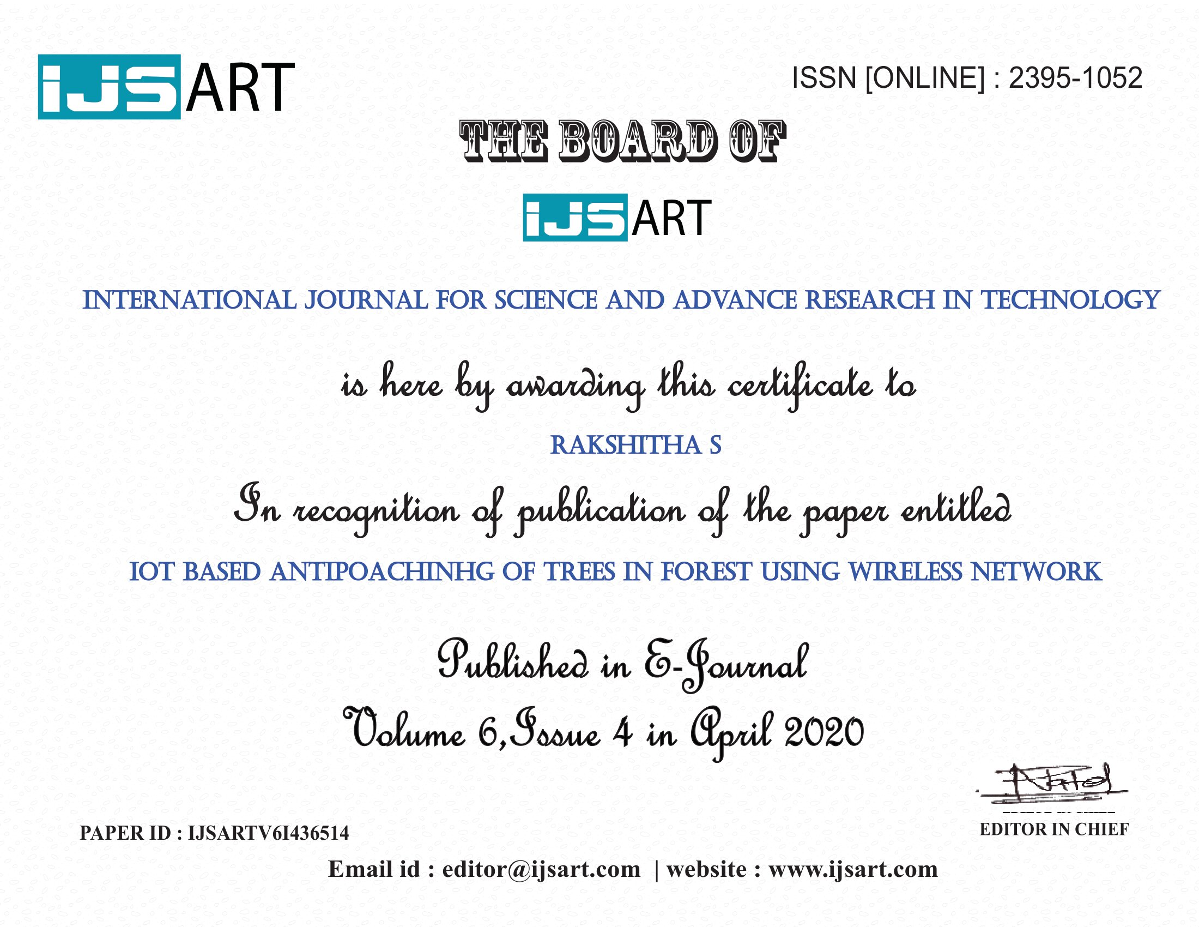

Slide 13
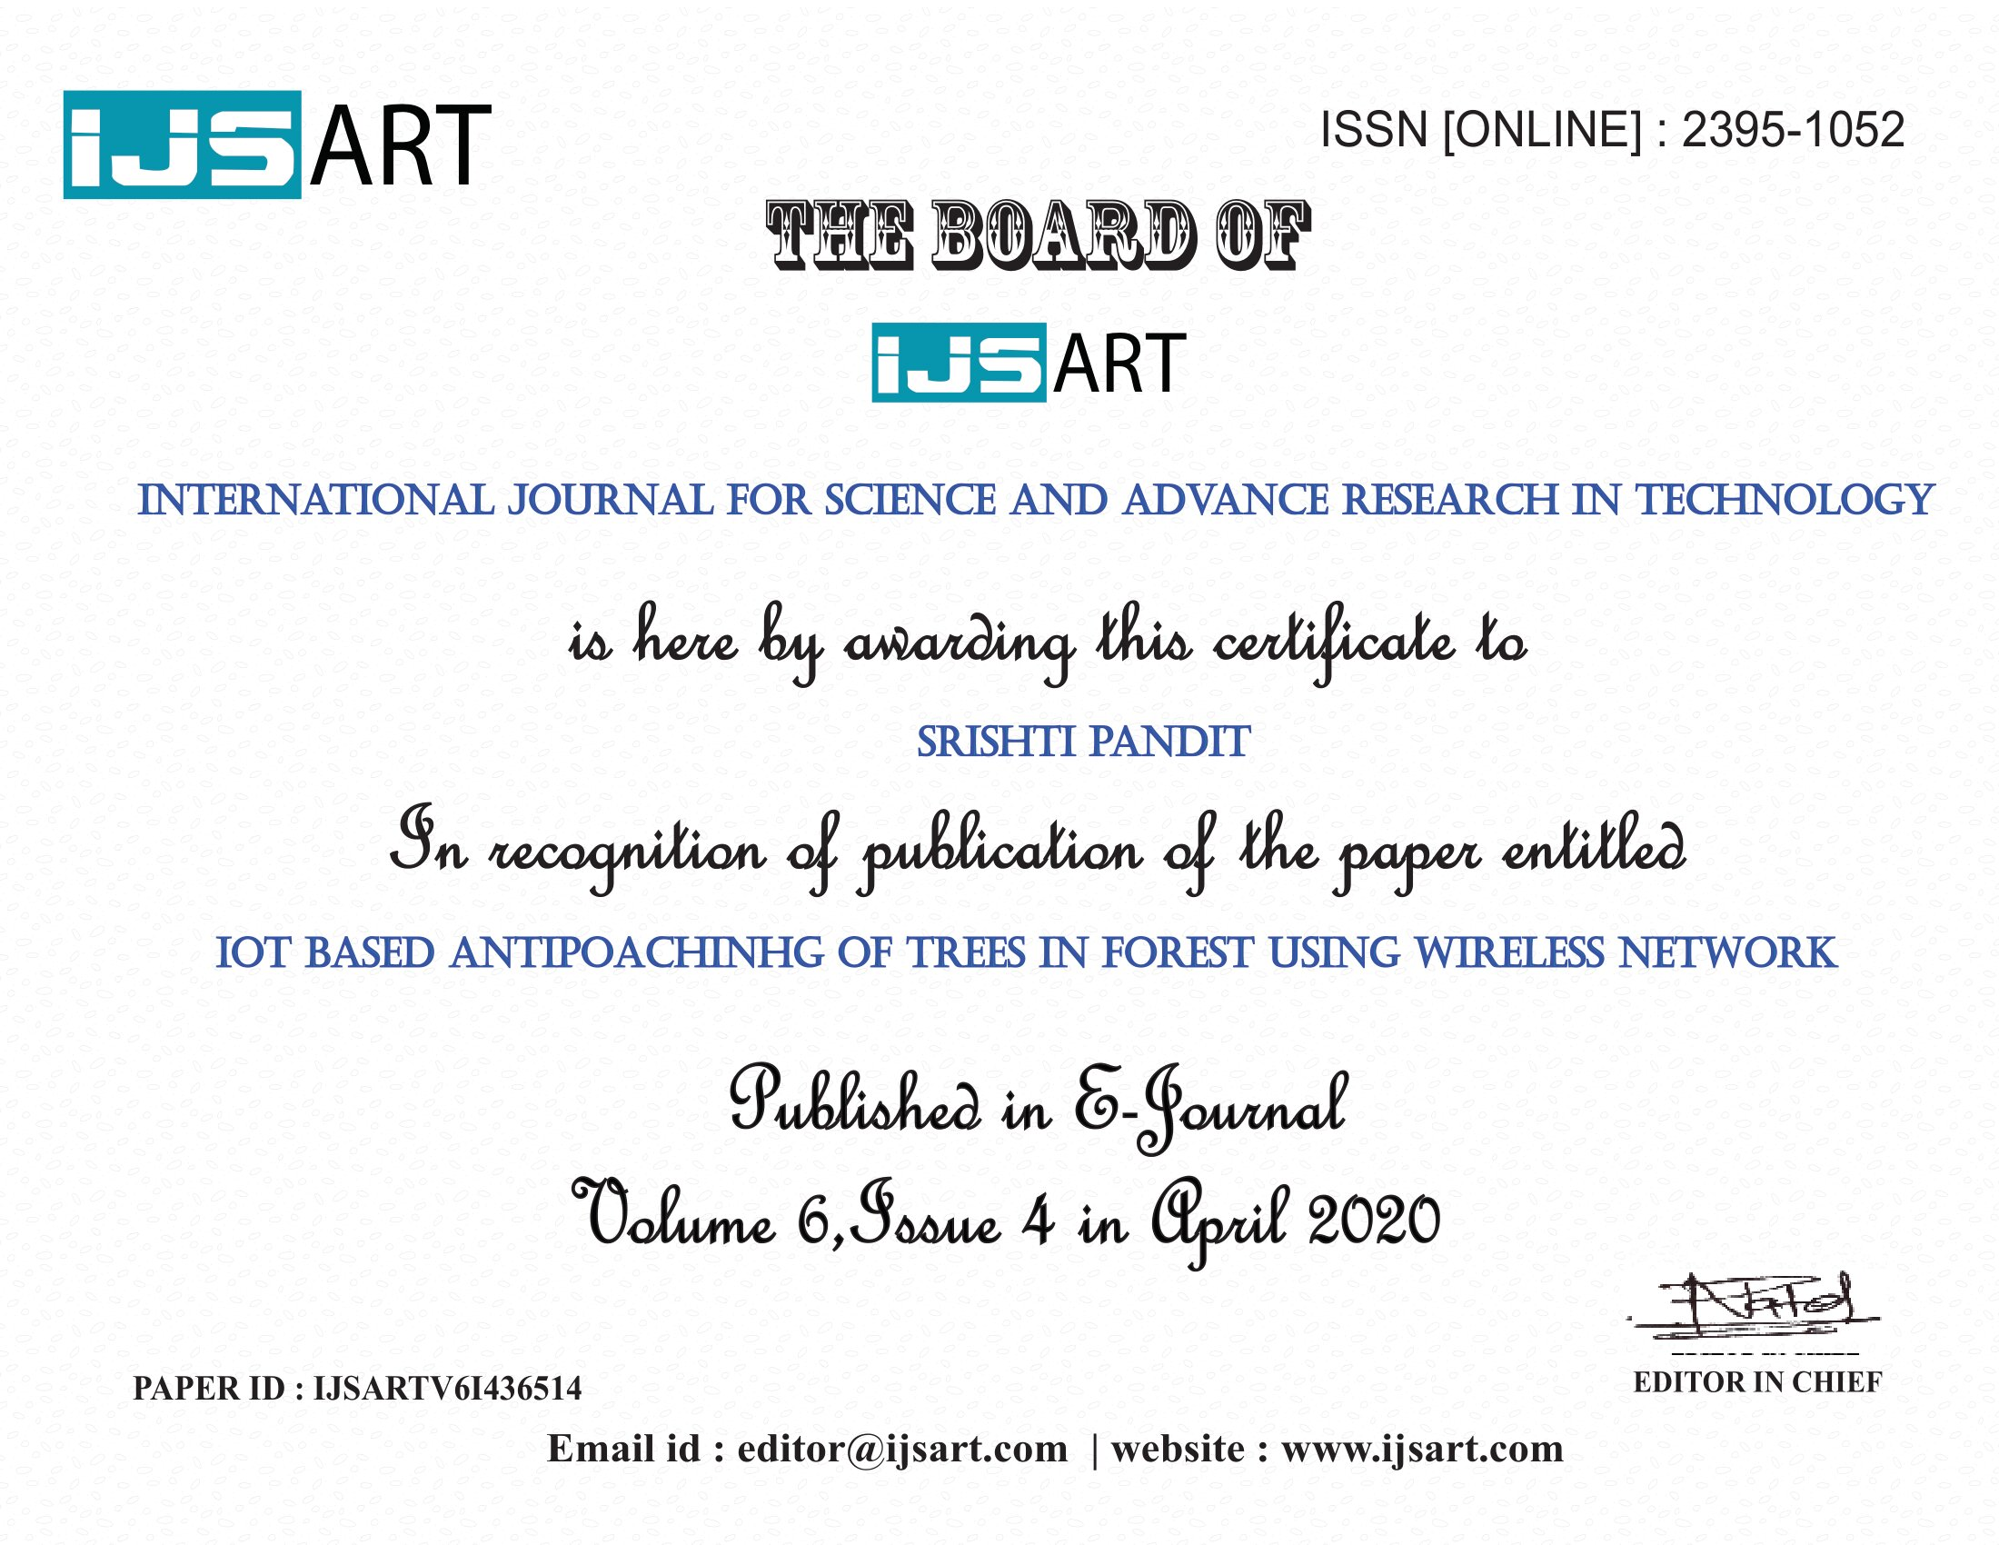

Slide 14


Slide 15


