Slide 1
FLOOD FORECASTING USING DEEP NEURAL NETWORK
DONE BY: RAKSHITHA S (1AT16CS081)
GUIDE: CHANDINI UNNIKRISHNAN

Slide 2
CONTENTS:
Abstract
Introduction
Literature Survey
Implementation
Applications and Future Work
Conclusion
Paper Publication Details
Bibliography

Slide 3
ABSTRACT:
Basically flood is both natural and ecological process which occurs when water inundates land, overflow of water, gathering of water in the land basins and also due to drainage. This influences damaging of human, flora and fauna’s lives, environmental destruction, mental depressions on human and also economy of the country. Today India is also one of the flood affected nation among the world with the best example of recent flood in Kerala on August 2018. There are wide technologies such as Internet of things (IOT), Machine Learning (ML), used in prediction of flood based on the parameters such as temperature, rainfall, water level, humidity, pressure, etc. But the real challenge is to estimate the occurrence of flood with the limited number of parameters such as rainfall intensity and air intensity and also alert people. Therefore according to Deep Neural Network (DNN), flood is forecasted based on only few parameters. In addition DNN is also compared with K-Nearest Neighbor (KNN) in terms of accuracy, precision and recall. The overall outcome taken from this is to effectively forecast the flood based on the calculations on the intensities only before the occurrence of flood and also to alert people through online flood portal system so that many dangerous effects could be stopped.

Slide 4
INTRODUCTION
Flood is one of the dangerous environmental effects which occur due to many reasons such as, when there is a high volume of water carried by rivers, creeks and many geographical features to the areas where water cannot be drained easily, accumulation of water in the river basins where when there is a heavy rainfall which again results in flood, drainage system are not consistently checked by civil department severely hinders the main operation of acceptable drainage system.
As India is one of the second highest populated nations, flood impacts high destruction by causing more fatalities on lives and properties. This can also results in completely destroying under developed areas.
This results on a high amount of risk. In recent years, there are wide technologies in Information Technology (IT) easing in flood management. Example, there are many parameters are taken into considerations and using respective sensors in manipulating each process. The same goes in practicing of geological and meteorological data related to flood, where Artificial Neural Network (ANN) comes into picture in prediction.

Slide 5
The best well–known model used in ANN in analyzing flood is by using a technique called Adaptive Neuro–Fuzzy Inference System (ANFIS) model where, this warns people or respective station in flood occurrence and also flood possibility can be analyzed or determined.
. Various works have been in progress on the use of ANN algorithms for forecasting flood through the parameters such as water level, flow, humidity, waves speed, dryness of earth, and so on. But the bigger disadvantage is that in all those systems the flood monitoring systems have focused on ANN by using an approach of single hidden layer on the above parameters. Moreover, ML algorithms such as linear regression, SVM, Forest classifiers are also employed accordingly. However, none of the proposed models planned on the parameters such as rainfall and air intensity for predicting in an early stage. More concentrated parameters are water level which will not be constant and not sufficient in predicting flood. flood early warning for India where only air and rainfall intensities taken into consideration.

Slide 6
The main aim of the paper is
To collection the dataset pertaining to air intensity, rainfall intensity and merging them into a single dataset, validation of KNN, validation of DNN, comparative analysis of KNN and DNN for accuracy on the flood prediction, and also a warning alerts as danger to respected people and departments.

Slide 7
LITERATURE SURVEYS:
[1] P. Mitra et al (2016) investigated forecasts flood by using both IOT and ANN in such a way that, it uses many sensors for checking many parameters and also uses zig-bee configuration with a micro controller unit. Rainfall, water level, humidity, pressure parameters are collected from WSN model and a log sigmoid curve is plotted using MATLAB Neural Network Tool box software. Based on the threshold value coefficient correlation on each process is validated which is a long and a tedious process.
[2] S. Bande and V. V. Shete (2017) considered Raspberry module acts as IOT node with Wi-Fi using WLAN technology in a Wi–Fi hotspot and may obtain internet access using it. ANN is used for analysis of data with NARAX architecture with step consideration alert.
[3] S. I. Abdullahi, M. H. Habaebi and N. A. Malik (2018) forecasting is done with IOT where a Node MCU ESP8266 enables transmission of data collected from sensor on the Thing Speak Channel for best visualization. And when it comes to ANN Microsoft’s Azure Machine Learning is used to predict flood occurrence. And the main result shows percent of accuracy and precision.

Slide 8
Implementation:
Here the datasets of rainfall and air intensities are collected on the daily aspects of weather checking. There are different classification of both air and rain intensities which are also collected. Based on these parameters the datasets are merged by classifying training and test splits. These are also pre-processed.
Pre-processing takes place by computation with KNN and DNN. The percent of results of two techniques are compared one another through accuracy, precision, and recall calculations based on the confusion matrix. By analyzing those value bar plots are also plotted graphically where an alert can be verified. These alerts of DANGER predicts flood through online flood portal system by Meteorological departments.
The innovative thing here is to collect few parameters instead of validating various parameters which keeps changing constantly without any guarantees. Here the main ability to perform all these tasks is done by DNN where it can collect unstructured data which overkills complexities with an activation function Leaky ReLU which results effectively even considering vast amount of data. These signals for flood prediction level through different weights which can save many lives over deterioration.

Slide 9
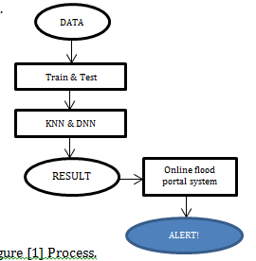

Slide 10
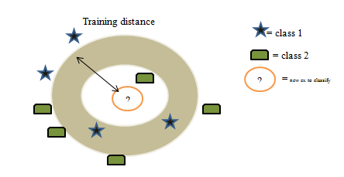

The first methodology used here is KNN:
KNN is one of the simplest classification algorithm which is easier to pick up. KNN can also be used for classification purpose where the output is a class membership. This mainly use the datasets defined in which dataset are separated into several classes to predict the classification of a new sample point. Here, this is mainly done on feature similarity between the two different data as KNN works effectively on the feature similarity also.
The second step used is here DNN:
MLP is the min component used in this system: MLP is used because, each unit of its perceptron receives multiple input signals and threshold value is set. If the value of the input signal exceeds the set threshold value, it will output a signal or sometimes do not proceed with the output.
$$weight=weight+learning_{rate}∗\left(expected−predicted\right)∗x$$

Slide 11
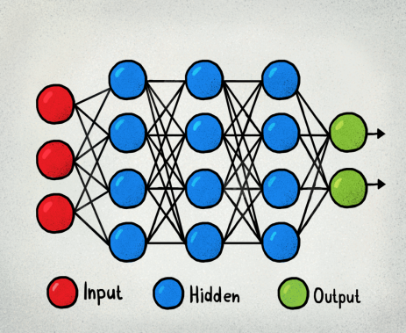
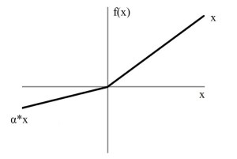
The major advantage here is to classify the given input parameters. Now these, MLP is proceeded with an activation functions which are really important to learn and make a sense of something which are more complicated
After the usage of DNN modeling the main theme used is here activational functional called
Leaky ReLU.

Slide 12

Syncing with Activation Function called Leaky ReLU
The various activation functions in neural networks are Linear Activation function, non-linear, sigmoid, Tanh, ReLU, Leaky ReLU. Among those, here Leaky ReLU is chosen because, it fixes the “dying ReLU” as it doesn’t have 0 slope parts. And also it speeds up training, where a mean activation closer to 0 makes training faster.
Customized version of P ReLU is leaky ReLU. Constant multiplier α is equal to 0.1 for this customized function. This sometimes varies to 0.01 in []. In each session alpha value is picked for the calculation.
Leaky ReLU is defined to address this problem. In ReLU function x is defined to be 0 for negative values of x, we define it as an extremely small component of x, the mathematical expression is :
$f\left(x\right)=0.01, x<0$
$=x, x≥0$

Slide 13

$PRECISION=TP/(TP+FP)$
$ACCURACY=(TP+TN)/(TP+FP+FN+TN$
$RECALL=TP/(TP+FN)$
After Leaky ReLU activation a graph is plotted with the comparision of KNN as well as DNN. The comparision will be high for DNN. Accuracy, Precision, Recall are also calculated for the prediction of
flood. According to the values obtained an alert can be developed
using online portal system as “danger” through meterological
depatrments.
This is also done through confusion matrix as
Y = 0 | Y = 1
TRUE NEGATIVE | FALSE POSITIVE | X = 0 | TRUE LABEL
FALSE NEGATVE | TRUE POSITIVE | X = 1

Slide 14
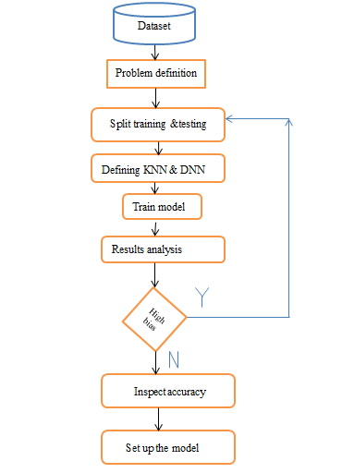
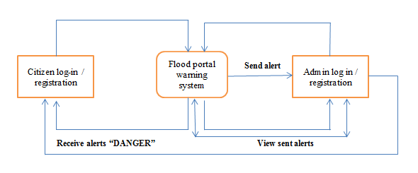

Slide 15
Applications and future work:
Floods can be predicted using Ann - deep learning techniques so that people who resides near ocean or rivers can be protected as an early head.
Environment can be saved.
Economy can be improved.
Future work can be:
With the advancement of neural networks for prediction, further work can be implemented by considering a most recent dataset which could achieve higher accuracy. Second, other topographical factors including flood water level can be considered in order to predict floods more precisely for different cities/states in India. Last, by including standard machine learning paradigms, the results obtained open the field for further research and development of new methods.

Slide 16
Conclusion:
Therefore a system pertaining towards deep neural network is developed where flood occurrence with highest accuracy predicted by using temperature and
rainfall intensity. Network is developed where flood occurrence with highest accuracy predicted by using temperature and rainfall intensity. Based on this flood prediction, an alert of DANGER is created on the respective areas through online flood portal system which can save many lives. According to the datasets collected on each days noting of values of parameters, which is fed into KNN and DNN, therefore result.
indicates that DNN can be efficiently used for forecasting flood with its percentage calculation. The most recent dataset can be collected from recent Kerala flood occurrence in order to achieve best result and verification of this system.

Slide 17
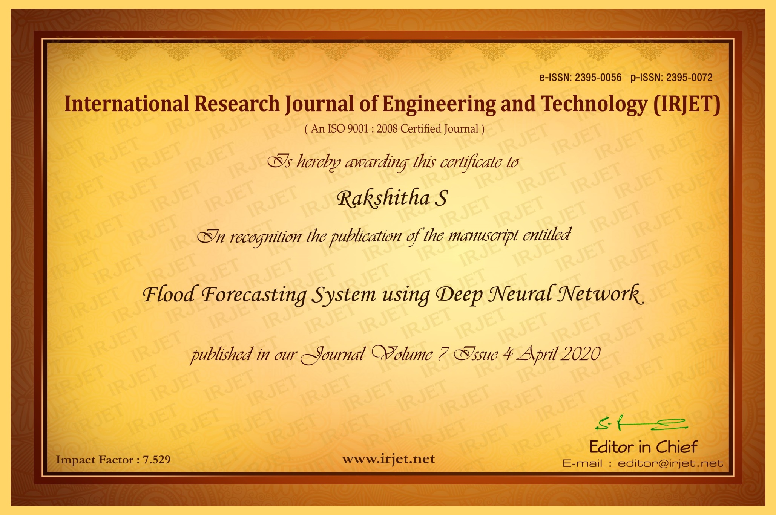
PAPER PUBLICATION DETAILS:

Slide 18
BIBLIOGRAPHY
[1] P. Mitra et al., "Flood forecasting using Internet of things and artificial neural networks," 2016 IEEE 7th Annual Information Technology, Electronics and Mobile Communication Conference (IEMCON), Vancouver, BC, 2016, pp. 1-5.
[2] S. Bande and V. V. Shete, "Smart flood disaster prediction system using IoT & neural networks," 2017 International Conference On Smart Technologies For Smart Nation (SmartTechCon), Bangalore, 2017, pp. 189-194.
[3] S. I. Abdullahi, M. H. Habaebi and N. A. Malik, "Flood Disaster Warning System on the go," 2018 7th International Conference on Computer and Communication Engineering (ICCCE), Kuala Lumpur, 2018, pp. 258-263.

Slide 19
THANK YOU.

