Slide 1
IOT BASED ANTI POACHING -ALARM SYSTEM FOR TREES IN FOREST USING WIRELESS SENSOR NETWORK
GROUP MEMBERS:-
SRISHTI PANDIT (1AT16CS103)
TEJAS. R. JOSHI (1AT16CS113)
RAKSHITHA. S (1AT16CS081)
GUIDE:-CHANDINI UNNIKRISHNAN

Slide 2
PROBLEM STATEMENT
For many days we are reading in the newspapers about smuggling of the tress. These trees are very costly. These are mostly useful in the medical sciences as well as cosmetics. Because of huge amount of money involved in selling of such tree woods and lots of incidents are happening of cutting of tree and their smuggling.
Nowadays, there are many incidents about smuggling of trees like Sandalwood, Sagwan etc. These trees are very costly and meagre. To restrict their smuggling and to save forests around the globe some preventive measures needs to be displayed.
To limit their sneaking and to spare woodlands around the world some preventive estimates should be conveyed. We have built up a framework which can be utilized to limit sneaking.

Slide 3
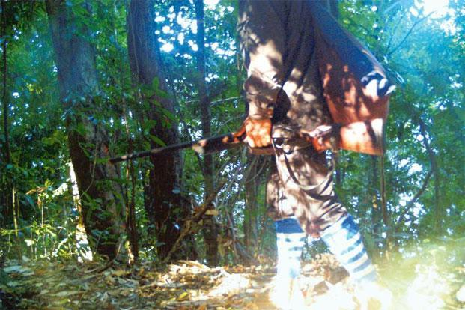
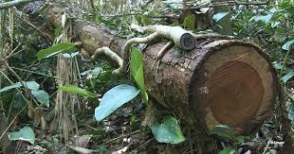
However, there is many of the actions have remained largely ineffective. There is hopeful solution for the prevention of poaching of forest tress is –“the implementation of Wireless Sensor through IOT.

Slide 4
EXISITING SOLUTION
The existing solution was designed by using flex sensors and ZigBee.
Wireless communication in this system used by the ZigBee module which is very slow and has a lesser range than WI-FI module .
Flex sensors are merely used sensors but tilt sensors are used to measure the slope or elevation and readouts apart from just signals.

Slide 5
LITERATURE SURVEY 1 :->
Here there is many of the actions have remained largely ineffective. There is hopeful solution for the prevention of forest trees- THE IMPLEMENTATION OF WIRELESS SENDOR NETWORKS(WSNs),which is a robust, effective and most developing technology for monitoring and controlling.
There are several features of wireless networking technology as protocol routing, power management, network structure and hierarchical networks.
In a network, the cluster of a nodes is around 5-10 trees. This can be formed a cluster with a master node having extra properties and to communicate with central base station.
There are four components in the sensor node are as:-
1. Sensing Modules
2. Controlling processor unit
3. A trans receiver unit
4. Power Unit.

Slide 6
LITERATURE SURVEY 2 :->
Wireless Sensor Networks is the most evolving technology and is used to various applications. WSN consists of nodes integrated with sensors, communication module, powering unit interfaced with and controlled by a low power microprocessor.
Poaching of economically valuable trees such as sandalwood, teakwood ,rosewood and pinewood have increased tremendously due to man’s selfish needs, therefore it is necessary to take measures which can help in preserving our natural resources.
The most promising solution in such a scenario is “IMPLEMENTATION OF WIRELESS SENSOR NETWORK” to monitor the poaching activity.
The wireless sensor node designed to prevent the poaching of trees consists of the following modules:-
1. Processing unit:MSP430F5528 microcontroller
2. Sensing unit:ADXL362 accelerometer
3. Communication unit:CC2500 trans receiver
4. Power supply unit

Slide 7
LITERATURE SURVEY 3 :->
The main idea in this paper is to design a portable wireless sensor node which is a part of wireless sensor network. It will be mounted on trunk of each tree, capable of detecting theft as well as automatically initiate and send alarm signals if any to remote terminal through the wireless media.
A network interface used here is RF module standard or ZigBee which is developed as an open global standard for wireless technology and supports basic communication interface of low-cost, low-power wireless sensor networks.
In a network, a cluster of 15-20 trees node can be formed with a master node having additional resources and intelligence to communicate with the base station.
The base station is located at the entrance of the forest

Slide 8
SOLUTION DESCRIPTION:
To keep abreast of home living environment, a home environment monitoring device based on aurdino was designed. With Aurdino UNO hardware platform and various sensors to acquire the indoor temperature, humidity, light and combustible gas changes in real-time, then upload this to the monitoring platform, according to the collected data to adjust the surrounding environment.
The test results show that the design can achieve the collection and stably upload of home environment data, and meet the design requirements of remotely monitoring the living environment conditions.
The invention has follow advantages: low cost, small power consumption, simple structure and convenient installation.. Here, we proposed wireless controlled system for poaching of tress. In this, we use three different sensors.
NODE DEVELOPMENT- There will be multiple area field based on RSSI of the sensor node to cover the entire farm
The important role in this project is played by 3 useful sensors called,
Tilt sensors, temperature sensors, sound sensors.

Slide 9
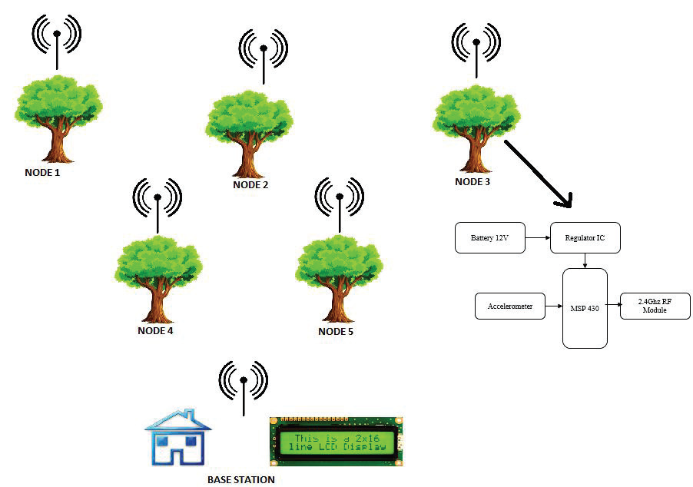
Representation:

Slide 10
WHY THE PROPOSED SYSTEM IS BETTER THAN EXISTING ONE!
Existing system has more disadvantages such as,
Protection of entire forest through solar and electrical fencing which is of nearly waste because, as the land increases proportionally.
There is another method by using software controlled devices to notice any breakage in continuities of any parameter. For example, by sensing heat of human body. This technique is more suitable for conservation of Trees in farms no other Animals are likely to enter other than Human beings and also where the area to be considered for preservation area is small as possible. However, this method is inadequate for poaching control in Wild forest as the forests are marked with presence of creatures other than Human-being.

Slide 11
To control against poaching there is another method hiring Security personal for monitoring the entire area for suspicious Activity. This method is exiting to control poaching. But there is physical limitations in Human it is hard to monitor the entire area continuously, this method is failure for the larger area thus the hiring of guards proves unreliable and inadequate.
For the larger area installation of CCTV cameras proves very costly and is hard to implement due to limitation of power supply in deep forest areas.
By using RF-ID is latest trend for conservation of trees. It is to tag an RF-ID to trees just like tagging an Animal for knowing. However, this technology doesn’t give Real Time Information while the activity is happening. Activity is detected only when the Tree leaves its Initial position

Slide 12
“This undertaking presents a Microcontroller, sound sensor and IOT based WSN hub to distinguish robbery/sneaking adding to the insurance of vital and expensive types of tree. Reproductions and trial results have been contrasted with approve the proposed structure. The shared correspondence between the hub and the PC is executed here. “
The future extent of work is execution of Multi-hub system and fuse of mouthpiece, movement identifier sensor and temperature sensor to make frameworks increasingly powerful to obtain information such human or creature obstruction, fire location.

Slide 13
METHODOLOGY
This system will consists of two modules one involving sensors and controller module which will be at tree spot and another one is at the android phone.
The BLYNK application will continuously receive sensor data.
This is an IOT based project where the sensor data is continuously uploaded to the cloud(BLYNK server) over a WIFI module.
Tilt sensors and the buzzer turns on when the trees bends and for the temperature sensor water pump is turned on in case of forest fire through relay switch.
ARDUINO UNO, TILT SENSORS, RELAY SWITCHES, WIFI MODULE, TEMPERATURE SENSORS, SOUND SENSORS
All the sensors and the controller will be set up at the tree. When logging occurs , the sound generated due to axing the tree is sensed by the sound sensor. Aurdino through the relay switch activities the buzzer notifying the security personnel. Also if the tree bends beyond threshold angle, the buzzer is activated.

Slide 14
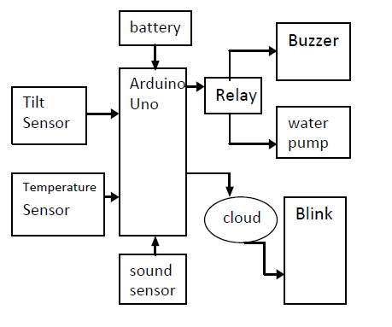
Representation:

Slide 15
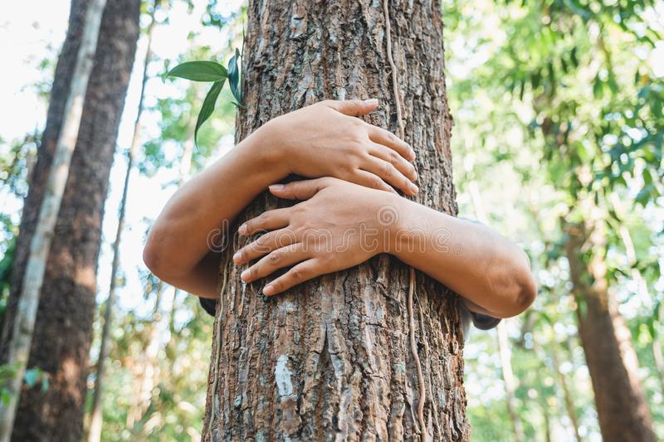
THANK YOU!!!!!!!!

