Slide 1
Department of Computer Science
Master of Science in Computer Science
PATHII
An AI-Powered Memory Assistant
Using RAG, Voice Capture & Knowledge Graph
Submitted by
Devesh Reddy
II M.Sc Computer Science
Reg No : ______________
Under the supervision of :
________________________
Assistant Professor
Department of Computer Science
SONA College of Arts and Science • November 2026

Slide 2
SYNOPSIS
02
SYNOPSIS
People lose valuable knowledge across notes, chats, recordings and documents.
Manual note-taking is scattered, unsearchable beyond keywords and easy to forget.
Proposed system captures memory via voice, text, images and PDFs.
RAG pipeline: BGE-M3 embeddings + Qwen3 8B for context-aware answers.
Vector search on Qdrant, relational data in PostgreSQL, entities in Neo4j.
Student workflows (flashcards, quizzes) and professional workflows (meeting summaries).
Full web application: Next.js user panel + admin console.
RAG
Voice Capture
Knowledge Graph
AI Recall

Slide 3
AGENDA
03
Overview
Introduction
Hardware Specification
Software Specification
Existing System
Drawbacks of Existing System
Proposed System
System Architecture
Input Design
Output Design
Testing and Implementation
Conclusion
1
Multi-Modal
Voice · Text · Image · PDF
2
RAG Engine
BGE-M3 + Qwen3 8B
3
Knowledge Graph
Neo4j entity linking

Slide 4
INTRODUCTION
04
INTRODUCTION
What is an AI Memory Assistant?
A personal knowledge system that captures everything you read, hear and discuss — then recalls it on demand using semantic search and AI-generated answers.
Our Solution
✓
RAG chat over your own memories
The challenges are:
✓
One-tap voice capture with live transcript
Information is scattered across apps, notebooks and chats
Keyword search cannot find ideas phrased differently
Important details from meetings and lectures are forgotten
Re-reading everything manually is slow and unreliable
✓
Auto-extracted people, tasks & tags
✓
Knowledge graph of connected ideas
✓
Study aids: flashcards and quizzes
✓
Admin console for the whole platform
≈ 20% of the workweek is spent just searching for information.
Source: McKinsey Global Institute

Slide 5
SPECIFICATION
05
SYSTEM SPECIFICATION
Hardware Configuration
Software Configuration
Processor
Intel Core i5 or equivalent
Frontend
Next.js 16 · React 19 · TypeScript
RAM
8 GB (Minimum: 4 GB)
Backend
Python FastAPI · Node.js Express
Storage
256 GB HDD / SSD
Databases
PostgreSQL · Qdrant · Neo4j · Redis
System Type
Laptop / Desktop
AI Models
Qwen3 8B · BGE-M3 · Whisper v3
Input
Keyboard, Mouse & Microphone
DevOps
Docker · Kubernetes · Grafana
Output
Monitor / Display Screen
IDE
Visual Studio Code
OS
Windows 10 / Windows 11

Slide 6
SPECIFICATION
06
SOFTWARE SPECIFICATION
OS: Windows 10 / 11
→ Platform to run application
Frontend: Next.js, React, TypeScript
→ User panel + admin console UI
Styling: Tailwind CSS 4
→ Responsive dashboard design
Backend: Python FastAPI + Express
→ Microservices & API gateway
AI: Qwen3 8B, BGE-M3, Reranker
→ Answer generation & semantic search
Speech & Vision: Whisper v3, Qwen2.5-VL
→ Voice transcripts, OCR, image understanding
Data: PostgreSQL, Qdrant, Neo4j, Redis
→ Records, vectors, graph, cache
Infra: Docker, Kubernetes, Grafana
→ Deployment, scaling & monitoring

Slide 7
CURRENT STATE
07
Existing System & Drawbacks
Existing System
Drawbacks
Manual note-taking apps and paper notes
Folders and tags for organisation
Keyword-only search across files
Voice recordings stored, never transcribed
Separate apps for notes, tasks and files
Meetings recorded but never summarized
Study material revisited from scratch
No connection between related notes
✗
Retrieval depends on remembering exact words
✗
Knowledge stays fragmented across many apps
✗
No summaries of long documents or meetings
✗
No reminders linking people, tasks and dates
✗
Useful insights are forgotten, not recalled
✗
No admin oversight for team or class usage

Slide 8
SOLUTION
08
PROPOSED SYSTEM
An AI-powered memory platform that captures knowledge from voice, text, images and documents, stores it as searchable embeddings and a knowledge graph, and answers questions with a RAG pipeline built on the user's own memories.
RAG Chat
Multi-Modal Capture
Knowledge Graph
Ask questions; answers grounded in your own memories with citations.
Voice notes, quick text, images and PDFs ingested in one tap.
Neo4j links people, topics and events for smart recall.
Student Workflow
Professional Workflow
Admin Console
Auto study plans, flashcards and quiz generation.
Meeting summaries, action items and daily briefings.
Users, AI usage, integrations, system health and roles.

Slide 9
DESIGN
09
SYSTEM ARCHITECTURE
Capture
Voice · Text · Image · PDF
AI Processing
Whisper v3 · PaddleOCR · Qwen2.5-VL
Embedding
BGE-M3 vector encoding
RAG
Rerank + Qwen3
Qdrant — Vector Store
semantic similarity search
PostgreSQL — Records
users, memories, tasks
Neo4j — Graph
entities & relations
Redis — Cache
fast reads
User & Admin UI — Next.js 16 · React 19 (24 routes, production build)
Planned deployment: Docker + Kubernetes with Prometheus / Grafana monitoring (per system design).

Slide 10
DESIGN
10
INPUT DESIGN
Voice Capture
Note & Document Upload
Thought / Idea
Title
Speak naturally — AI organizes the details
Enter a title
Live Transcript
Content / Description
Your speech appears here while recording
Type or paste notes
Auto Tags
Tags
Meeting, Idea, Follow-up
Personal, Work, Ideas
MIC
Tap to start recording
AI analysis: summary, tags, action items
Upload Document / Image
Supported: PDF • JPG • PNG • DOCX

Slide 11
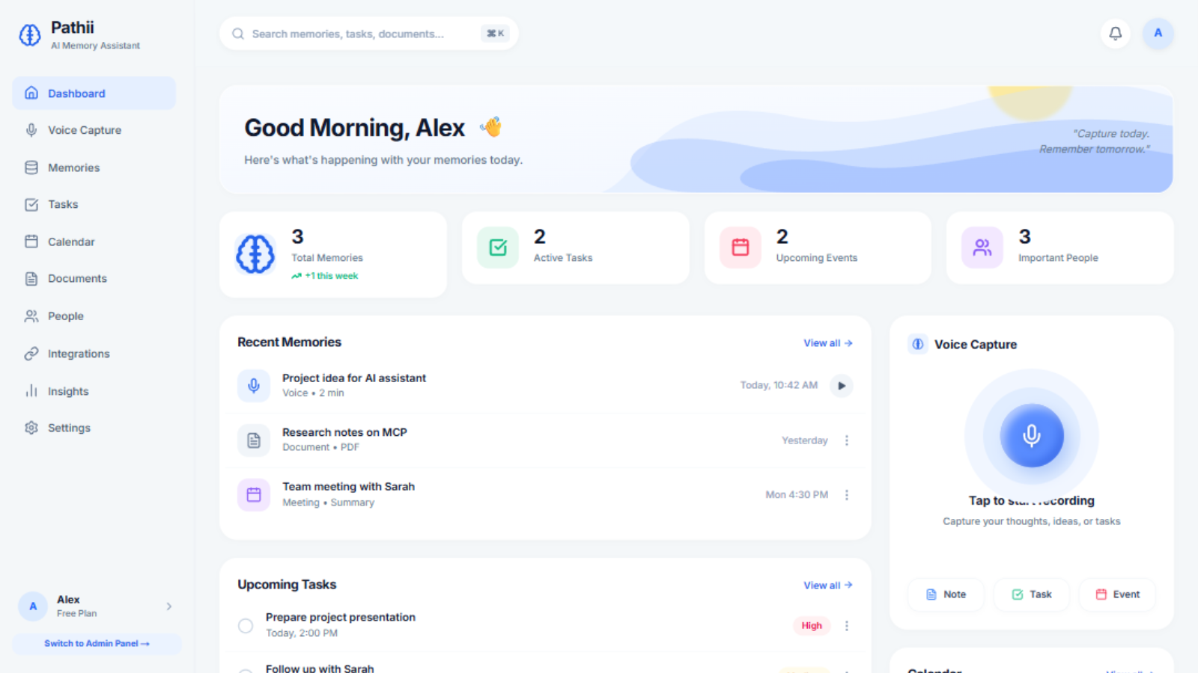
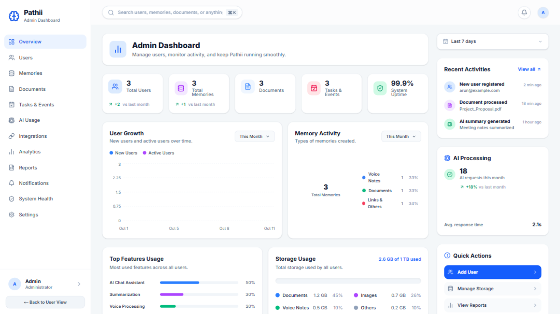
DESIGN
11
OUTPUT DESIGN
User Panel — Memory Dashboard
Admin Console — Platform Overview
24 routes total: 11 user-panel pages + 13 admin pages · responsive from 607px to 1920px

Slide 12
VERIFICATION
12
System Testing & Implementation
01
Unit Testing
02
Integration Testing
Each module — capture forms, search filters, toggles, tables and every button across all 24 pages — tested individually for correct behaviour.
Page flows verified end-to-end: capture → transcript → auto-tags → memory list, and admin tables → filters → CSV export.
03
Functional Testing
04
UI & Responsive Testing
All required functions — search, filter, add, delete, export and navigation — perform as expected on empty and seeded data.
Interface verified across screen sizes (607px–1920px): no overflow or overlap, hidden scrollbars, toasts and overlays working.
24/24 routes pass production build • zero runtime console errors • all interactive controls verified

Slide 13
SUMMARY
13
CONCLUSION
The AI Memory Assistant (Pathii) has been successfully designed and developed as a complete, production-ready web platform. It combines multi-modal capture, a RAG pipeline and a knowledge graph with practical user and admin interfaces for students and professionals.
✓
24-page application: user panel and admin console, fully responsive
✓
Every interactive control implemented and verified in-browser
✓
RAG architecture designed with Qwen3 8B, BGE-M3 and reranking
✓
Multi-modal ingestion: voice, text, images and PDF documents
✓
Clean production build with monitoring-ready deployment design
✓
Next step: wire FastAPI backend for persistent, multi-user data
“Capture today, remember tomorrow.”

Slide 14
T H A N K Y O U
Pathii — An AI-Powered Memory Assistant Using RAG, Voice Capture & Knowledge Graph
DEVESH REDDY | M.Sc Computer Science | SONA College of Arts and Science | 2026

