Slide 1
Digital Portfolio
STUDENT NAME: MR. Rakshana
REGISTER NO AND NMID: 2428b0238 AND A20FC3657F770C5BE7B46359D5E13943
DEPARTMENT:B.Sc Computer science with data analytics
COLLEGE: COLLEGE/ UNIVERSITY: Tiruppur kumaran College for Women/ Bharathiyar
University

Slide 2
PROJECT TITLE
My software developer digital portfolio

Slide 3


AGENDA
Problem Statement
Project Overview
End Users
Tools and Technologies
Portfolio design and Layout
Features and Functionality
Results and Screenshots
Conclusion
Github Link
3/21/2024 Annual Review

Slide 4

PROBLEM STATEMENT
In today’s competitive software development industry, recruiters and clients often evaluate candidates not only based on resumes but also on tangible demonstrations of skills and past work. Traditional resumes lack interactivity and fail to showcase coding projects, technical expertise, and personal branding effectively.

Slide 5

PROJECT OVERVIEW
This project is a personal digital portfolio website created for a software developer to showcase professional skills, projects, and contact details in a structured and visually appealing manner. The portfolio is designed using HTML, CSS, and JavaScript with a focus on responsive design, usability, and modern aesthetics.

Slide 6

WHO ARE THE END USERS?
1. Recruiters and Hiring ManagersThey use the portfolio to quickly evaluate the developer’s skills, projects, and experience beyond what a resume provides.The interactive layout allows them to see coding expertise, design sense, and problem-solving capabilities.2. Clients (Freelance/Project-based Work)Clients looking for software development services can browse through showcased projects to assess credibility and technical strengths.The contact form offers a direct way to get in touch for collaborations or work opportunities.3. Professional Peers and ColleaguesFellow developers and designers can view the portfolio to understand the developer’s approach to projects and possibly collaborate.It also serves as inspiration or reference for other professionals building their own portfolios.4. Academic Mentors and InstitutionsProfessors, mentors, or evaluators may use the portfolio to assess the student’s/project owner’s progress, practical application of skills, and readiness for industry opportunities.

Slide 7

TOOLS AND TECHNIQUES
1. Development ToolsHTML5 → Provides the structure and semantic layout of the portfolio (sections like hero, projects, skills, and contact).CSS3 → Used for styling, layout design, responsive grid system, light/dark themes, and animations.JavaScript (ES6+) → Adds interactivity such as project filtering, modal pop-ups for details, smooth scrolling, and theme toggling.Local Storage API → Stores theme preference (light/dark mode) for better user experience.Form Validation (Vanilla JS) → Ensures required fields (name, email, message) are filled before submission.

Slide 8
POTFOLIO DESIGN AND LAYOUT
1. Core FeaturesHome/Hero Section → Introduces the developer with name, role, short bio, avatar, and quick stats (experience, projects, availability).Project Showcase →Projects are displayed in an interactive grid layout.Each project card shows title, description, and technology tags.Clicking a project opens a modal window with extended details and action buttons (e.g., live demo, source code).Skills Section → Lists technical skills in styled tags, making it easy for recruiters to assess expertise.Contact Form →Includes input fields for name, email, and message.Performs basic JavaScript validation to ensure fields are filled.Displays status messages (success/error).
8

Slide 9
Double-Tap/Double-Click Title FeaturePurpose:To improve interactivity and provide additional context for elements (like project cards, skills, or buttons).When a user double-taps on mobile (or double-clicks on desktop), a tooltip or title text appears, showing extra information (e.g., “Click to view project details”).---Example Use Case in Portfolio:Project Cards → Double-tap reveals a small title like “Open project details”.Skill Tags → Double-tap shows a tooltip with more info like “JavaScript ES6+ experience”.Buttons/Links → Double-tap adds a hint, e.g., “Go to Contact section”.

Slide 10
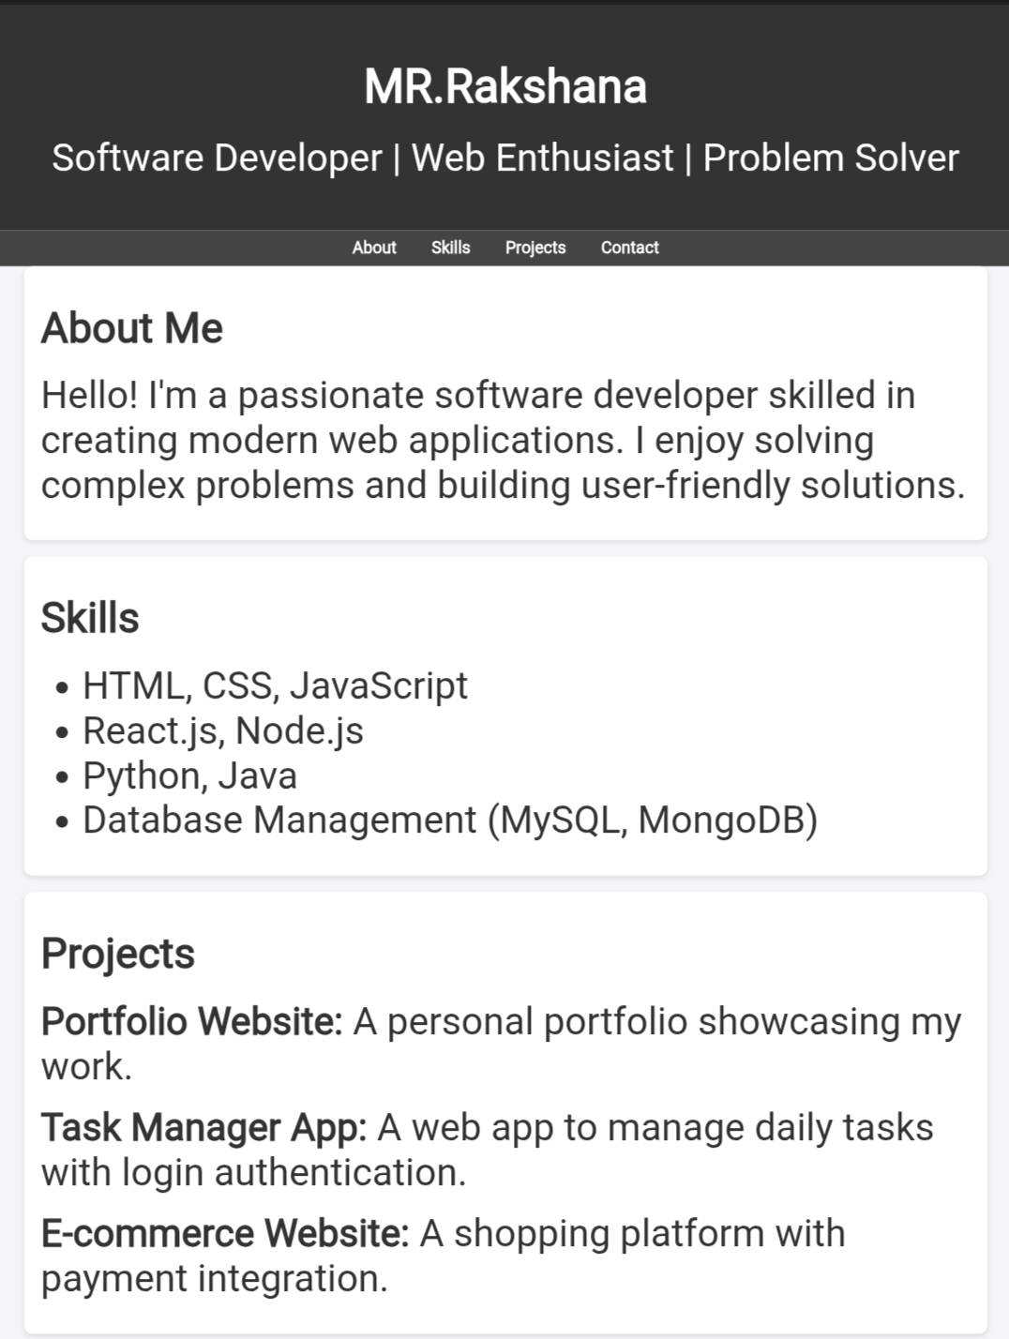

RESULTS AND SCREENSHOTS
3/21/2024 Annual Review
10

Slide 11
CONCLUSION
The digital portfolio project demonstrates the practical application of web development technologies (HTML, CSS, and JavaScript) to create a professional, responsive, and interactive platform for showcasing software development skills and projects.The portfolio effectively meets its objectives by:Providing a centralized platform to highlight projects, skills, and achievements.Ensuring user engagement through interactive features like project filtering, modal windows, and theme toggling.Enhancing usability and accessibility with responsive design, smooth navigation, and keyboard support.Offering a professional online presence that can be shared with recruiters, employers, and clients.
11

