Slide 1
Spring MVC Flow
Submitted By-
Raksha Saxena
87859_FS

Slide 2
Advantages of Spring MVC
Supports RESTful URLs.
Annotations based configurations.
Supports to plug with other MVC framework like Structs etc.
Flexible in supporting different view types like JSP,XML,PDF etc.

Slide 3
Spring MVC
In Spring Web MVC, DispatcherServlet class works as the front controller. It is responsible to manage the flow of the spring mvc application.
The @Controller annotation is used to mark the class as the controller in Spring 3.
The @RequestMapping annotation is used to map the request url. It is applied on the method.

Slide 4
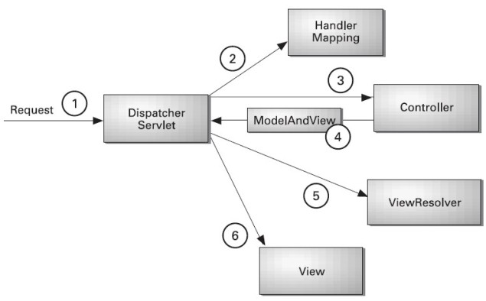
Understanding the flow of Spring Web MVC

Slide 5
Flow of diagram:-
As displayed in the figure, all the incoming request is intercepted by the Dispatcher Servlet that works as the front controller. The Dispatcher Servlet gets entry of handler mapping from the xml file and forwards the request to the controller. The controller returns an object of Model And View. The Dispatcher Servlet checks the entry of view resolver in the xml file and invokes the specified view component.

Slide 6
Spring Web MVC Framework Example
Let's see the simple example of spring web MVC framework. There are given 7 steps for creating the spring MVC application. The steps are as follows:
Create the request page (optional)
Create the controller class
Provide the entry of controller in the web.xml file
Define the bean in the xml file
Display the message in the JSP page
Load the spring core and mvc jar files
7. Start server and deploy the project

Slide 7
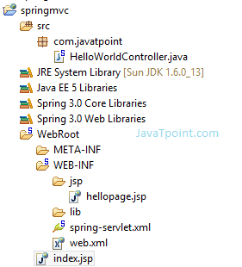
Directory Structure Of Spring MVC

Slide 8
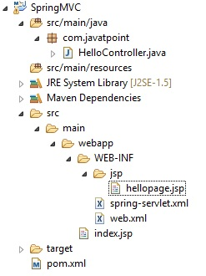
Directory Structure of Spring MVC using Maven

Slide 9
Required Jar files or Maven Dependency
To run this example, you need to load:
Spring Core jar files
Spring Web jar files
If you are using Maven, you don't need to add jar files. Now, you need to add maven dependency in pom.xml file.

Slide 10
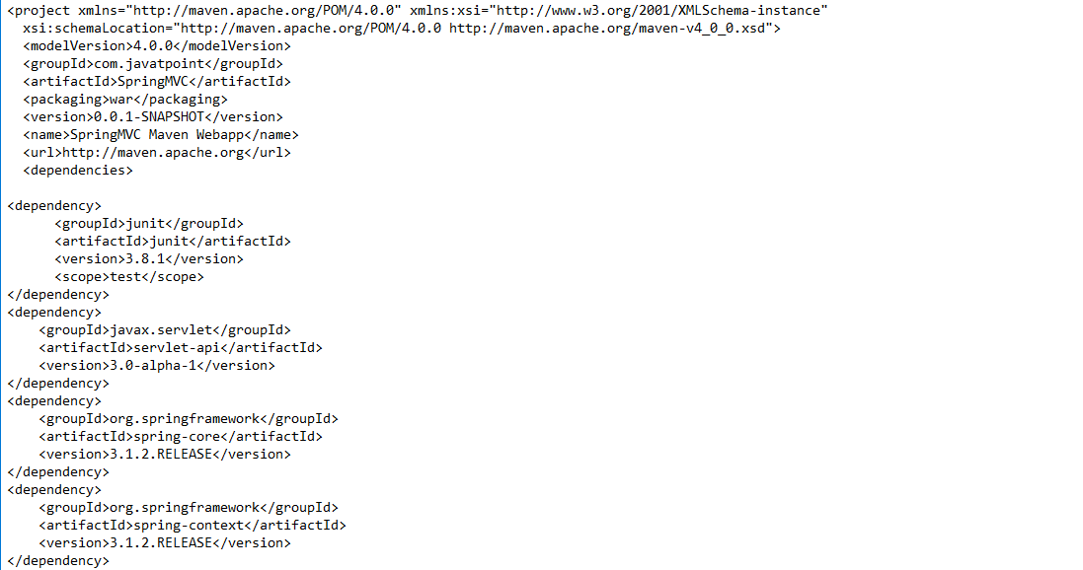
Pom.XML

Slide 11
<dependency>
<groupId>org.springframework</groupId>
<artifactId>spring-beans</artifactId>
<version>3.1.2.RELEASE</version>
</dependency>
<dependency>
<groupId>org.springframework</groupId>
<artifactId>spring-webmvc</artifactId>
<version>3.1.2.RELEASE</version>
</dependency>
</dependencies>
<build>
<finalName>SpringMVC</finalName>
</build>
</project>

Slide 12
1) Create the request page (optional)
This is the simple jsp page containing a link. It is optional page. You may direct invoke the action class instead.
index.jsp
<a href="hello.html">click</a>

Slide 13
2) Create the controller class
To create the controller class, we are using two annotations @Controller and @RequestMapping.
The @Controller annotation marks this class as Controller.
The @Requestmapping annotation is used to map the class with the specified name.
This class returns the instance of ModelAndView controller with the mapped name, message name and message value. The message value will be displayed in the jsp page.

Slide 14
HelloWorldController.java
package com.javatpoint;
import org.springframework.stereotype.Controller;
import org.springframework.web.bind.annotation.RequestMapping;
import org.springframework.web.servlet.ModelAndView;
@Controller
public class HelloWorldController {
@RequestMapping("/hello")
public ModelAndView helloWorld() {
String message = "HELLO SPRING MVC HOW R U";
return new ModelAndView("hellopage", "message", message);
}
}

Slide 15
3) Provide the entry of controller in the web.xml file
In this xml file, we are specifying the servlet class DispatcherServlet that acts as the front controller in Spring Web MVC. All the incoming request for the html file will be forwarded to the DispatcherServlet.
Web.XML
<?xml version="1.0" encoding="UTF-8"?>
<web-app version="2.5"
xmlns="http://java.sun.com/xml/ns/javaee"
xmlns:xsi="http://www.w3.org/2001/XMLSchema-instance"
xsi:schemaLocation="http://java.sun.com/xml/ns/javaee
http://java.sun.com/xml/ns/javaee/web-app_2_5.xsd">
<servlet>
<servlet-name>spring</servlet-name>
<servlet-class>org.springframework.web.servlet.DispatcherServlet</servlet-class>
<load-on-startup>1</load-on-startup>
</servlet>
<servlet-mapping>
<servlet-name>spring</servlet-name>
<url-pattern>*.html</url-pattern>
</servlet-mapping>
</web-app>

Slide 16
4) Define the bean in the xml file
This is the important configuration file where we need to specify the ViewResolver and View components.
The context:component-scan element defines the base-package where DispatcherServlet will search the controller class.
Here, the InternalResourceViewResolver class is used for the ViewResolver.
The prefix+string returned by controller+suffix page will be invoked for the view component.
This xml file should be located inside the WEB-INF directory.

Slide 17
spring-servlet.xml
<?xml version="1.0" encoding="UTF-8"?>
<beans xmlns="http://www.springframework.org/schema/beans"
xmlns:xsi="http://www.w3.org/2001/XMLSchema-instance"
xmlns:p="http://www.springframework.org/schema/p"
xmlns:context="http://www.springframework.org/schema/context"
xsi:schemaLocation="http://www.springframework.org/schema/beans
http://www.springframework.org/schema/beans/spring-beans-3.0.xsd
http://www.springframework.org/schema/context
http://www.springframework.org/schema/context/spring-context-3.0.xsd">
<context:component-scan base-package="com.javatpoint" />
<bean class="org.springframework.web.servlet.view.InternalResourceViewResolver">
<property name="prefix" value="/WEB-INF/jsp/" />
<property name="suffix" value=".jsp" />
</bean>
</beans>

Slide 18
5) Display the message in the JSP page
This is the simple JSP page, displaying the message returned by the Controller.
It must be located inside the WEB-INF/jsp directory for this example only.
hellopage.jsp
Message is: ${message}
THANKYOU

