Slide 1
Dynamic Pricing Strategies For Fitness Classes Based On Demand,Time And Location
cult.fit
- Dhanshree Rakshe

Slide 2
Executive Summary
This presentation proposes the adoption of a Dynamic Pricing Strategy for fitness classes, aimed at optimizing revenue, enhancing customer satisfaction, and improving class attendance rates.
By leveraging real-time data on demand, time of day, and location, this strategy tailors pricing to match customer willingness to pay and class availability, leading to a more efficient allocation of resources.
Key Business Goals:
Maximize Revenue: Capturing high-value customers during peak demand periods and offering attractive pricing during off-peak hours.
2) Optimize Class Attendance: Improve class utilization by offering discounts or promotions during under-booked times and charging premium prices during high-demand periods
3) Enhance Customer Experience: Provide more flexible pricing options that align with customer preferences, increasing retention and satisfaction.

Slide 3
Introduction
Fitness classes are a crucial revenue source for gyms and fitness centers, but optimizing attendance and pricing remains a challenge. The goal is to implement a data-driven, customer-centric approach that boosts profitability and offers flexible pricing options.
Challenges –
1) Static pricing leads to fluctuating attendance, with classes being under-booked during off-peak hours and over-crowded during peak times.
2) Lack of flexibility in pricing may result in missed revenue opportunities during high-demand periods and reduced participation during low-demand times.
Recommendations
1) Demand-Based Pricing: Adjust prices based on demand, charging higher rates during peak times (e.g., evenings, weekends) and offering discounts during off-peak hours to increase attendance.
2) Time-Based Pricing: Introduce time-sensitive pricing to incentivize participation during slower hours. Classes in early mornings or midday hours may be offered at lower rates to fill spaces.
3) Location-Based Pricing: Tailor pricing to the location of the fitness classes, considering factors such as the local market's demographics and disposable income. More affluent areas or locations with higher competition can support higher pricing.

Slide 4
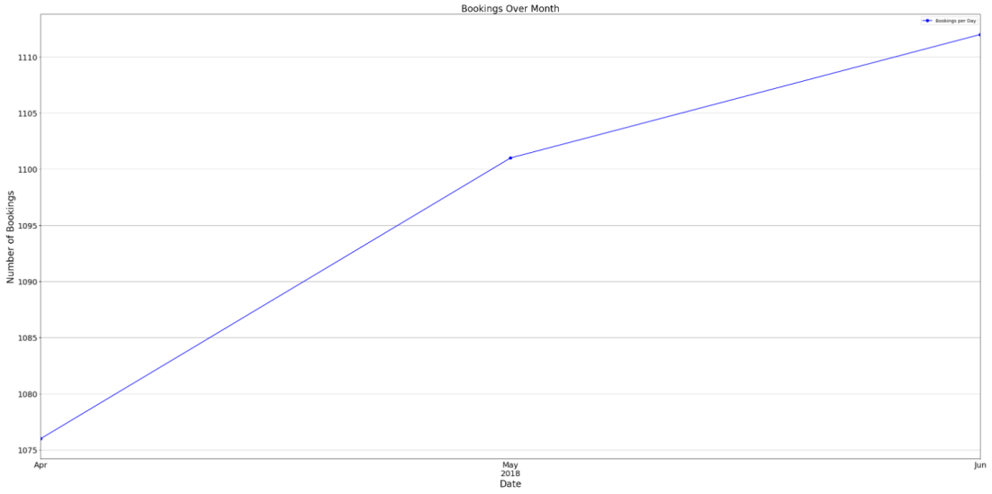
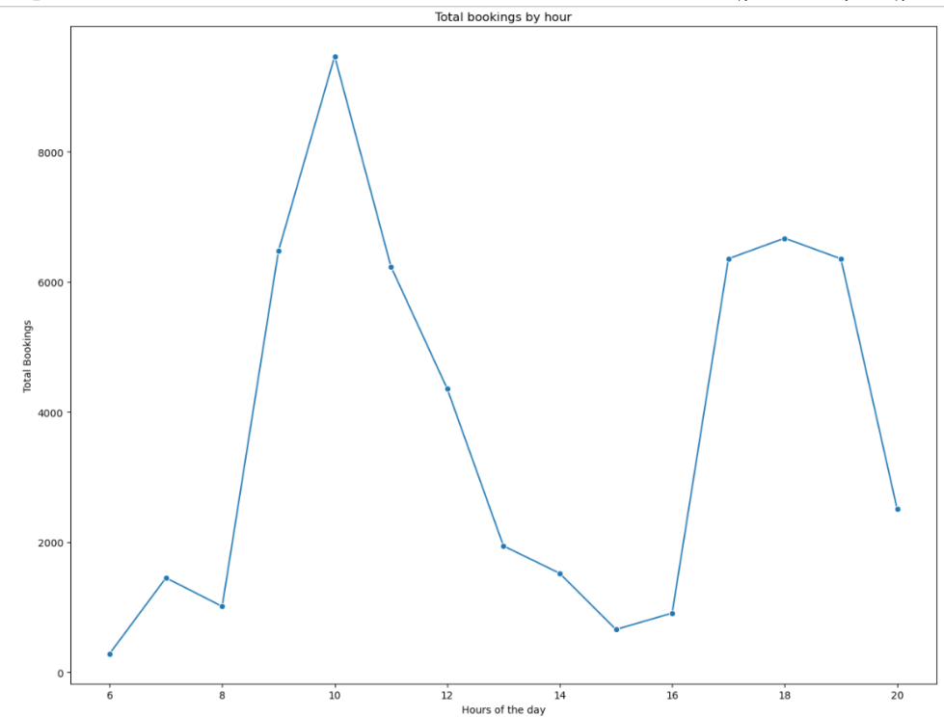
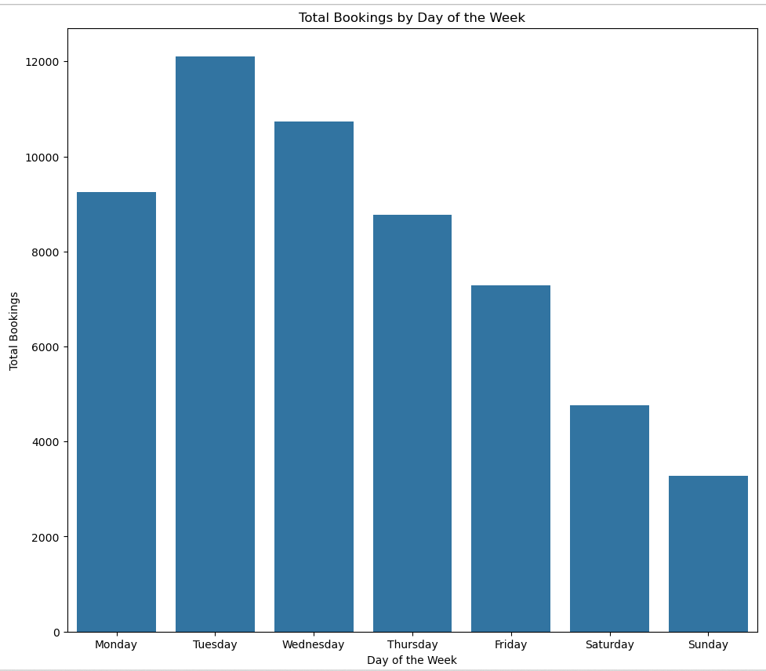
Current Situation/Market Analysis
Summarizing data on day of week and hourly basis
Weekdays tend to be busier than weekends, with more people attending during the weekdays.
Additionally, mornings (9 AM to 12 PM) and evenings (5 PM to 7 PM) are the peak times, while early mornings and noon tend to have fewer participants.

Slide 5
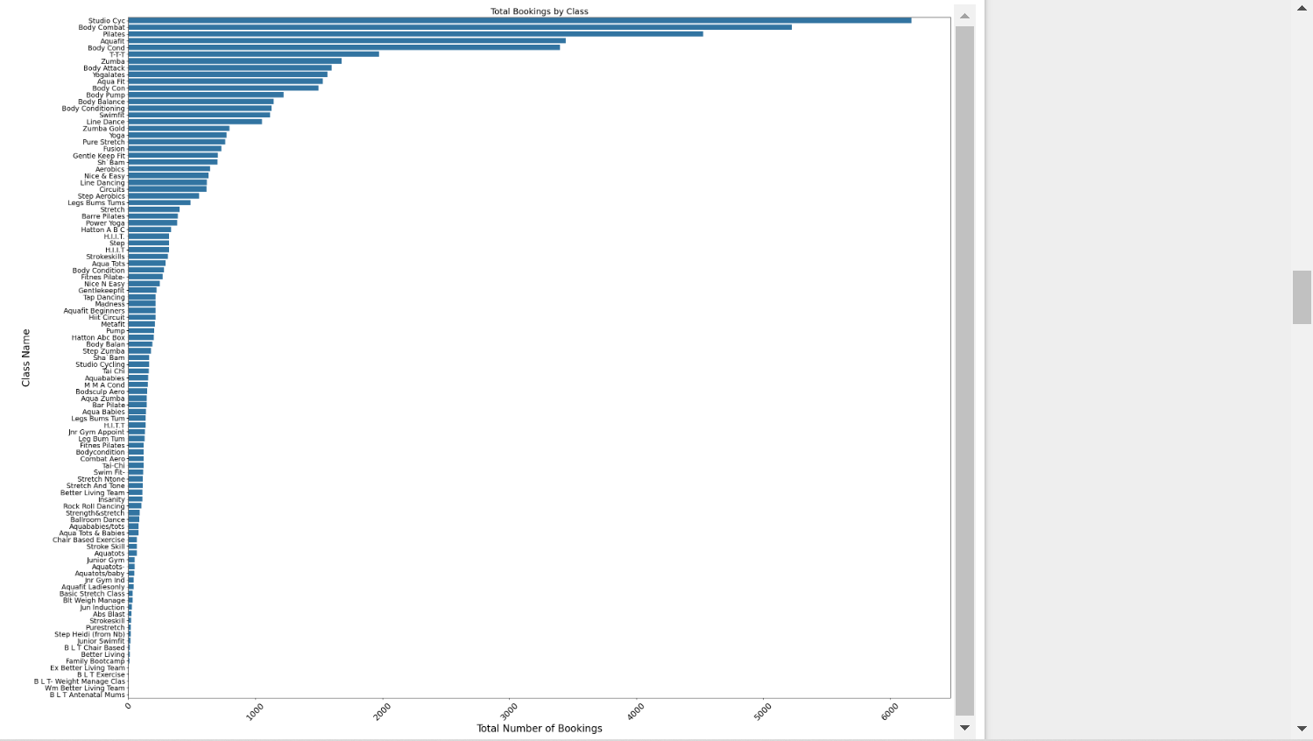
Current Situation/Market Analysis
studio cyc,body combat ,
pilates ,Aquafit,Body Cond
these classes having more bookings .
BLT exercise ,BLT weight
manage class , WM better living team , BLT Antenatal Mums .

Slide 6
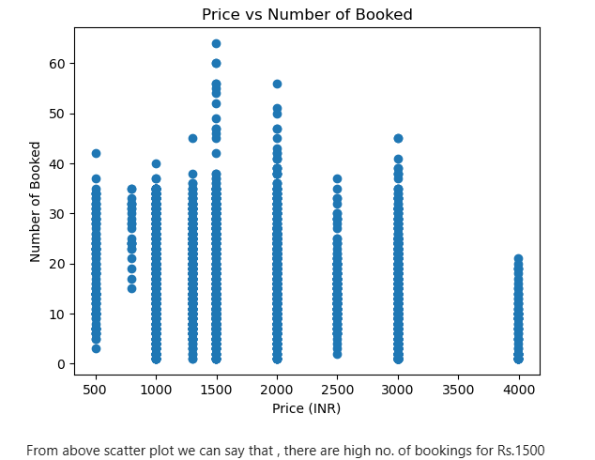
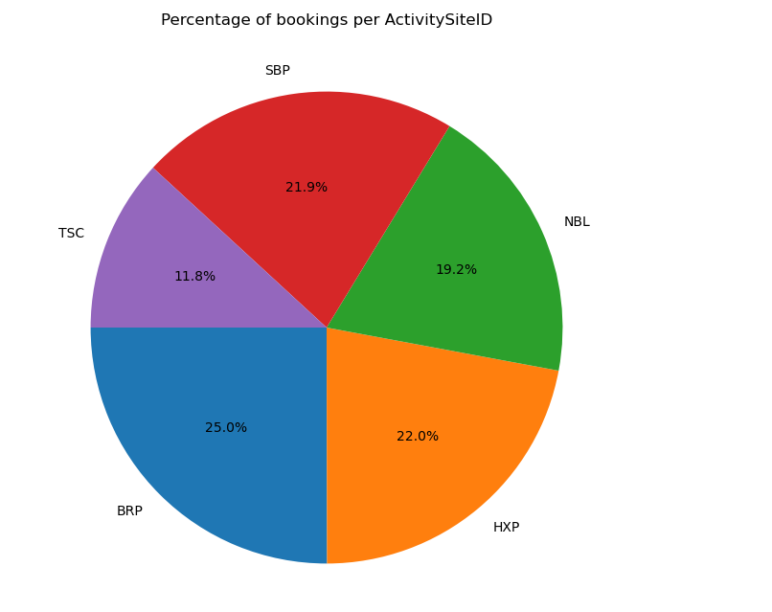
Current Situation/Market Analysis
The "BRP" center has the highest percentage of bookings, while the "TSC" center has the lowest.
Also , Most of the peoples booking for Rs.1500

Slide 7
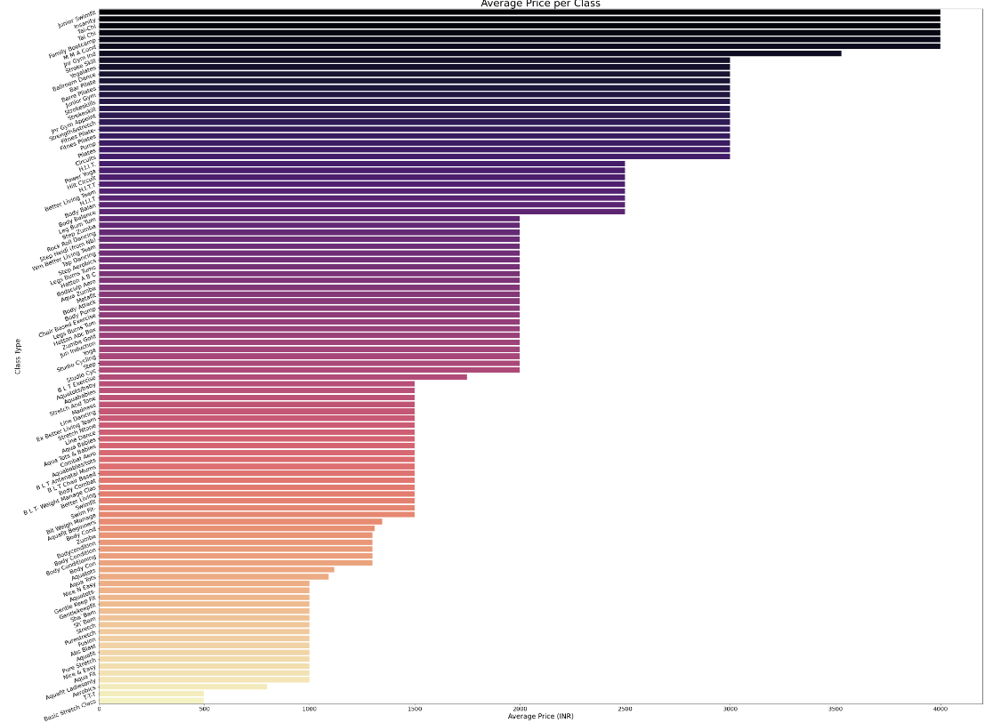
Current Situation/Market Analysis
From above graph , we can see junior swimfit, insanity, Tai-Chi , family bootcamp these all have higher price

Slide 8
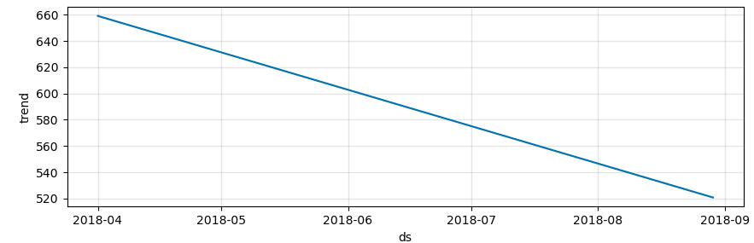
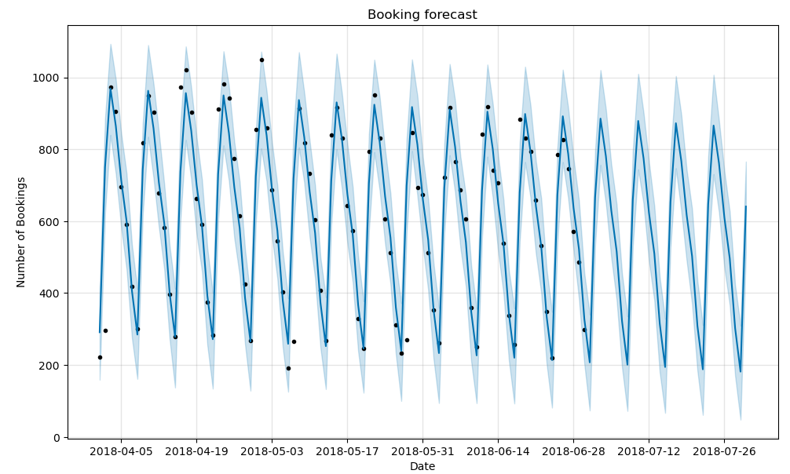
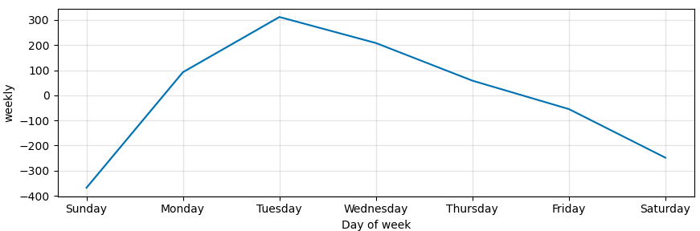
Future Predicted Data
The predicted graph shows a downward trend, with a higher number of bookings occurring on weekdays.

Slide 9
Business Recommendations
To maximize revenue and optimize class attendance, it is recommended that the fitness center implement a Dynamic Pricing Strategy based on demand, time of day, and location. By adjusting prices in real-time according to these factors, the business can:
1) Increase Revenue: Charge premium prices during peak demand periods (e.g., evenings and weekends) while offering discounted rates during off-peak times to fill classes and generate consistent revenue.
2) Enhance Customer Experience: Provide more flexible and personalized pricing options, allowing customers to choose classes based on their schedule and budget, improving satisfaction and retention.
3) Maximize Class Utilization: Drive attendance during slower hours by offering attractive pricing, ensuring that classes are fully booked and resources are used efficiently.
4) Stay Competitive: Position the fitness center as a flexible, data-driven business that adapts to customer needs and market trends, improving customer loyalty and attracting new members.
By adopting this dynamic pricing approach, the fitness center will be able to meet both business objectives and customer expectations, ultimately driving growth and profitability.

Slide 10
Proposed Recommendations
Dynamic pricing refers to the practice of adjusting prices in real-time based on various factors such as demand, time, popularity, and location to optimize revenue and profitability.
Key Rules of Dynamic Pricing:
Demand-Based Pricing: Prices fluctuate in response to real-time demand, allowing businesses to maximize revenue by charging higher prices when demand is high and lower prices when demand is low.
2) Time-Based Pricing: Prices are adjusted based on time, with different rates for peak and off-peak hours, aligning with customer preferences and enhancing profitability.
3) Popularity-Based Pricing: Products or services that are in high demand or have gained popularity are priced higher, leveraging the increased interest to capture more revenue.
4) Location-Based Pricing: Prices are customized according to regional demand patterns, optimizing revenue by taking advantage of geographic differences in consumer willingness to pay.

Slide 11
Pricing Strategies
Demand-Based Pricing
1) High Demand, High Price: Increase prices during times of high demand to capture more revenue.
2) Low Demand, Low Price: Reduce prices during low demand periods to encourage sales and maintain occupancy or sales volume.
3) Price Surge: Use surge pricing during events, holidays, or unexpected demand spikes to maximize revenue.
Seasonal and Event-Based Pricing
1) Seasonal Adjustments: Increase prices during peak seasons (e.g., summer, holidays) and lower them during the off-season to balance demand and optimize revenue.
2) Event-Driven Pricing: Adjust prices around major events, conferences, or holidays to take advantage of increased demand.
Time-Based Pricing
1) Peak vs. Off-Peak Pricing: Adjust prices based on the time of day, week, or year. Charge premium prices during peak hours, seasons, or days (e.g., weekends or holidays), and offer discounts during off-peak times.
2) Early Bird & Last-Minute Pricing: Offer discounted prices for customers who book early or at the last minute, capturing different segments of demand.
Location-Based Pricing
1) Regional Adjustments: Set prices according to geographic regions where demand or purchasing power varies. For example, prices may be higher in urban areas with more disposable income or lower in rural areas.
2) Localized Events: Adjust prices during local events, festivals, or holidays based on increased demand in specific locations.

Slide 12
Thank You !

