Slide 1
Invoice Processing Using RPA
Team Members:
1.Nandhakumar.A
2.Rakshana.B
3.Suryakala.M
Industrial Guide:
Mrs. Pavithra
Faculty Guide:
Mr. Suresh Kumar
Department of CSE, KGiSL Institute of Technology, Coimbatore

Slide 2
Abstract
Invoice processing using RPA has performed with a help of Ui-Path. Collect a invoice template in different format and read those mails in ui-path.
Processing those unread mails by using required activities. Depend on those activities we automate the mail.
Then convert those PDF file to Excel sheet format.
Department of CSE, KGiSL Institute of Technology, Coimbatore

Slide 3
Existing system
The Client uses MS EXCEL, and maintains their product list, customer list and print the invoice ,however it is not possible to share the data from multiple system in multi user environment.
It contain lot of duplicate work and also changed of mistake.
When the product price are no security everyone can access any report and sensitive data,also no report to find the sales volume,stock ,stock list and summary report.
Department of CSE, KGiSL Institute of Technology, Coimbatore

Slide 4
Proposed System
The invoice system is used to overcome the entire problem which they are facing currently, and making complete automation of billing and invoice system.
The first step of the process consists out of the selection of the right PDF invoice in a dedicated folder.
For the RPA bot, it does not matter which application is used to process the invoice data. This can be any kind of accounting.
And next step reading the invoice form the folder one by one and extracting the key information from the invoice data.
After success fully registering the each invoice ,the software robots are then able to send posting notifications in the form of emails to responsible employees.
Other background activities, During this whole process the software robots are also running background activities such as monitoring the dedicated invoice folder or its email address, performing basic checks to see is company's database is open and verifying by the vendor information. And the invoice matches what is already in the database.
Department of CSE, KGiSL Institute of Technology, Coimbatore

Slide 5
Literature Review
Drawbacks of existing methods
There are some potential downsides to using invoices, but these are mostly caused by poor management and inadequate process.
High operational costs per invoice on both sender and receiver side
References
https://www.uipath.com/blog/uipath-at-work-automating-the-invoice-process
https://www.image-1.com/document-scanning-service-blog/rpa-for-ap-invoice-processing-automation/
Department of CSE, KGiSL Institute of Technology, Coimbatore

Slide 6
Architectural Design DFD
START
Submit Email Login
Notification to Client
Unread Message
Receive Email
Read as a PDF
Extract to Excel
Department of CSE, KGiSL Institute of Technology, Coimbatore
Department of CSE, KGiSL Institute of Technology, Coimbatore

Slide 7
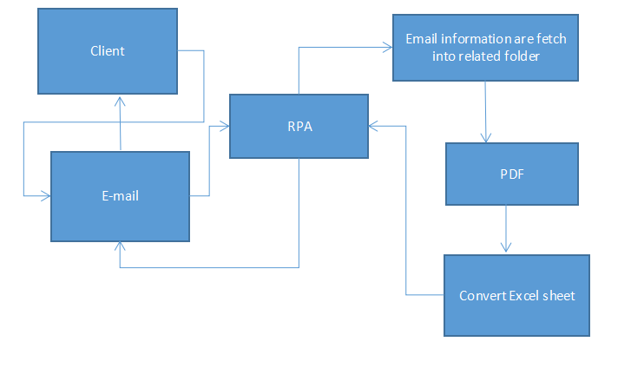
Data Flow Diagram Level 0
Department of CSE, KGiSL Institute of Technology, Coimbatore

Slide 8
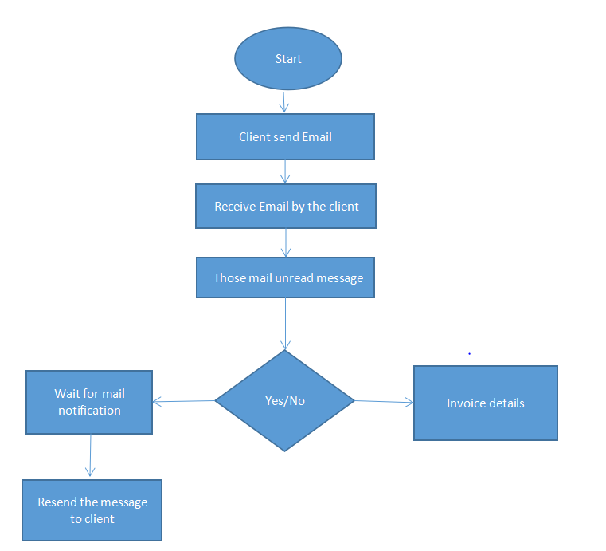
Data Flow Diagram-Level 1
Department of CSE, KGiSL Institute of Technology, Coimbatore

Slide 9
Module Split-up
Module I:
Create a invoice template.
Attach a template into email.
Module II:
Read a unread message using Ui-Path.
Convert into required PDF.
Module III:
Create a flow for all invoice.
Convert those invoice from PDF to Excel sheet.
And send a mail notification to the required client.
Department of CSE, KGiSL Institute of Technology, Coimbatore

Slide 10
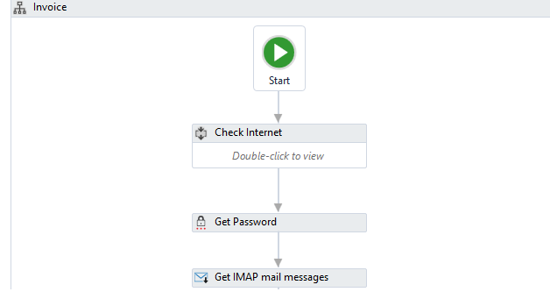
Snapshots
Department of CSE, KGiSL Institute of Technology, Coimbatore

Slide 11
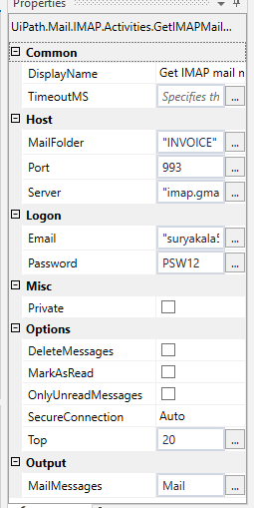
Receive Mail

Slide 12
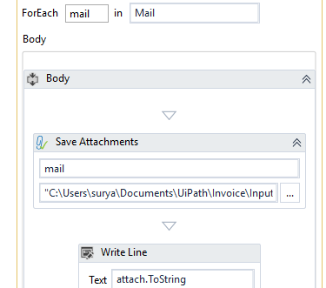
Attachment

Slide 13
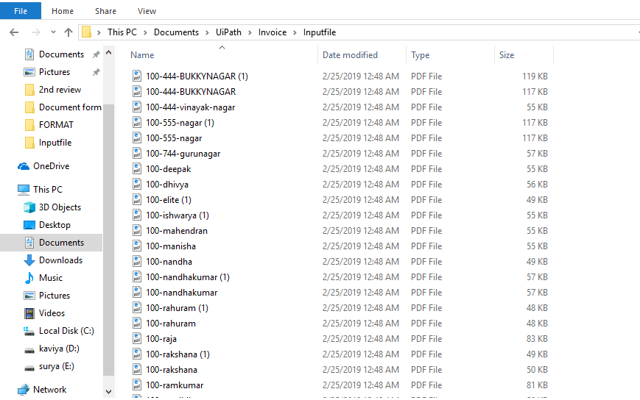
Attached PDF

Slide 14
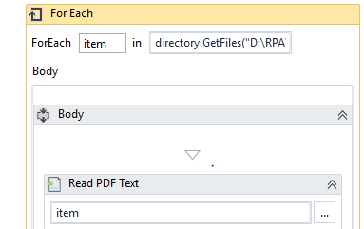
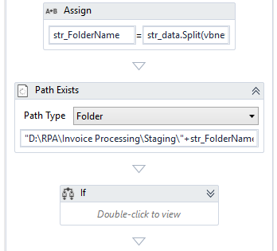
Get Files

Slide 15
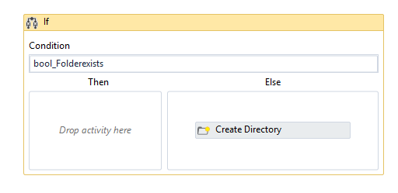
Directory

Slide 16
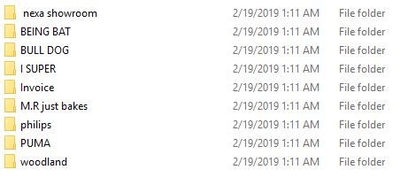
Output

Slide 17
THANK YOU
Department of CSE, KGiSL Institute of Technology, Coimbatore

