Slide 1
TECHNICAL REPORT · AUGUST 2026
TEAM GOLDILOCKS
FeelsLike.
A
B
Conf. Room
Buildings that listen.
C
A digital-twin building optimizer that turns occupant feedback into safe, constraint-aware HVAC actions.
Open Office
Cabin
D
E
Rakshit
24BYB1117
Gokul R
24BCE1188
Dishal LS
24BCE1670
Lobby
Cafeteria
Dhanishkanth
24BCE1348
−26.6%
0
₹1,729
HVAC energy
occupied comfort-violation minutes
saved over 7 simulated days
Notes:
FeelsLike turns occupant complaints into safe HVAC actions on a digital twin. Headline: 26.6% less energy with zero occupied comfort violations.

Slide 2
01· PROBLEM
FEELSLIKE
Buildings run deaf
HVAC is scheduled for the building, not for the people inside it.
40–50%
Commercial buildings spend roughly 40–50% of their electricity on HVAC.
of commercial electricity goes to HVAC
Fixed schedules overcool everyone to insure against feedback that arrives late or never.
22°C
People already provide the missing signal: “it’s stuffy”, “I’m freezing”, “there’s a draft”.
typical aggressive fixed setpoint
−26.6%
FeelsLike closes the loop: complaint → typed constraint → HVAC action → measured outcome.
energy in our 7-day A/B, with zero occupied violations
FeelsLike · Team Goldilocks
02 / 14
Notes:
HVAC is 40–50% of commercial electricity; fixed schedules overcool because buildings never hear their occupants. The complaints are the missing sensor.

Slide 3
02· ARCHITECTURE
FEELSLIKE
One contract connects the whole system
01
02
03
04
05
06
Occupant
Parser
Constraint store
Controller
Digital twin
Dashboard
Plain-language feedback
LLM with a rules fallback
Decay and arbitration
Setpoint and fan commands
5-zone RC thermal model
Live race and floor plan
THE TYPED CONTRACT
ParsedComplaint→Constraint→Controller→Twin
The LLM never controls the HVAC directly.
It only classifies a message into a validated schema — the control math stays deterministic.
FeelsLike · Team Goldilocks
03 / 14
Notes:
Six stages, one typed contract. The LLM only classifies a message into a validated schema; deterministic control math acts.

Slide 4
03· DIGITAL TWIN
FEELSLIKE
The twin models real building physics
Five zones · real adjacency · deterministic weather · capacity-limited HVAC
WHAT THE TWIN MODELS
A
B
Conf. Room
Envelope conduction and inter-zone coupling
C
Solar and occupant heat gains
Open Office
Cabin
HVAC cooling with finite capacity
D
E
Ventilation energy and outdoor-air coupling
Lobby
Cafeteria
Occupied comfort band: 23.0–26.5°C
≈520 m² simulated floor plate, coupled through shared walls
₹9 / kWh energy price
0.71 kg CO₂ / kWh grid factor
FeelsLike · Team Goldilocks
04 / 14
Notes:
Five-zone RC model with real adjacency, solar and occupant gains, finite HVAC capacity, ventilation coupling. Comfort band 23.0–26.5°C occupied.

Slide 5
04· NLP PARSER
FEELSLIKE
The parser understands how people talk
One chat message in → one validated constraint out
“it’s really stuffy in Conference Room B”
ZONE_B
STUFFY
“cabin mein bahut garmi hai bhai”
ZONE_C
TOO_HOT
“It’s fine now, thanks”
RETRACTION
CLEARS CONSTRAINT
~0 ms
0.3–0.8 s
1–2 s
rules-fallback latency
typical Groq path
hosted LLM end-to-end
FeelsLike · Team Goldilocks
05 / 14
Notes:
Handles casual English, Hinglish and retractions. The rules fallback answers in ~0 ms when the LLM is slow or down — the demo never stalls.

Slide 6
05· CONSTRAINT ENGINE
FEELSLIKE
Constraints act as recency-weighted votes
influence=severity×confidence×decay
LIVE CONFLICT
decay(t) = 0.5^(age / 45 min) · a constraint expires after 2 h
“stuffy”
severity 2 · 3 min ago
VS
“too cold”
severity 2 · 1 min ago
1.00
→−0.1°C compromise
0.50
0.25
severity-weighted, tilted toward the fresher claim
0
Both claims decay, so neither occupant wins forever.
now
+45 min
+90 min
+2 h · expired
FeelsLike · Team Goldilocks
06 / 14
Notes:
Constraints decay with a 45-minute half-life and expire at 2 hours. Conflicts resolve as a severity-weighted compromise — here −0.1°C. Nobody wins forever.

Slide 7
06· RESULTS — 7-DAY A/B
FEELSLIKE
−26.6%
HVAC energy vs the static schedule
0 min
₹1,729
136 kg
occupied comfort violations
cost saved in 7 days
CO₂ avoided
FeelsLike · Team Goldilocks
07 / 14
Notes:
The 7-day A/B: 26.6% less energy than the static schedule, zero occupied violation minutes, ₹1,729 and 136 kg CO₂ saved.

Slide 8
07· FULL RESULTS
FEELSLIKE
The full comparison makes the trade-off explicit
CONTROLLER
KWH
COST ₹
KG CO₂
VIOL-MIN
SAVED
HVAC ENERGY · KWH / 7 DAYS
Static 22°C
722.4
6,502
512.9
16,328
—
Static 22°C
722
Reactive 24°C
493.4
4,441
350.3
429
31.7%
Reactive 24°C
493
FeelsLike · rules
SHIPPED
530.3
4,773
376.5
0
26.6%
FeelsLike · rules
530
FeelsLike · PPO
512.7
4,614
364.0
22
29.0%
FeelsLike · PPO
513
The hard part is not saving energy. It is saving energy while keeping the comfort promise.
FeelsLike · Team Goldilocks
08 / 14
Notes:
Reactive saves more energy — 31.7% — but costs 429 violation minutes. FeelsLike rules keeps the comfort promise at 26.6%. That trade-off is the product.

Slide 9
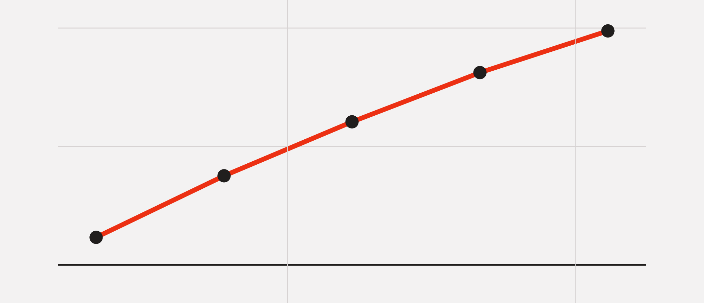
08· PPO TRACK
FEELSLIKE
PPO wins on energy, not yet on comfort
2M training steps · 18-D observation · 5-D continuous action
MEAN EPISODE REWARD OVER TRAINING
HONEST DECISION
PPO beats rules on energy: −2.8 kWh / day.
But it averages2 violation minutes / day.
ACCEPTANCE BAR
Win on energy at equal-or-better comfort. Not cleared yet.
0
0.5M
1.0M
1.5M
2.0M steps
Mean reward −91.8 → −86.8, still climbing at 2M steps.
FeelsLike · Team Goldilocks
09 / 14
Notes:
PPO beats rules by 2.8 kWh/day but averages 2 comfort-violation minutes per day. The acceptance bar — win on energy at equal-or-better comfort — is not cleared, so rules ship.

Slide 10
09· NLP BENCHMARK
FEELSLIKE
The blind probe is the honest number
70
measured on 20 unseen cases — never used for tuning
95
95
labeled cases
90
85
80
30 dev · 40 held-out · 20 blind probe, never tuned on
75
70
Covers typos, sarcasm, Hinglish, retractions and negatives.
60
Exact triple on unseen phrasings: 80% (tuned split reads higher).
Rules
LLM · Groq
Zone
Issue
Detection
Exact triple
FeelsLike · Team Goldilocks
10 / 14
Notes:
Dev accuracy is 100% for both parsers — the held-out set is the honest number: LLM 60% vs rules 55% on exact triples, across typos, sarcasm, Hinglish and retractions.

Slide 11
10· LIVE SYSTEM
FEELSLIKE
The demo is built to survive failure
Three synchronized views over the same twin — the rules fallback keeps it alive if the LLM stalls
RACE
FLOOR PLAN
OCCUPANT CHANNEL
Paired energy bars
Five zones, live
Chat with receipts
Static vs FeelsLike, with a live saved-% counter.
Temperature, occupancy, setpoints and active constraints.
Parse source, latency and an explanation for every action.
THE 3-MINUTE STORY
0:00
0:20
1:00
1:30
2:20
2:45
hook
first complaint
conflict
A/B race
money and carbon
the closing line
FeelsLike · Team Goldilocks
11 / 14
Notes:
The live demo: energy race, floor plan, occupant channel — three synchronized views over the same twin. Three minutes from hook to close, and the rules fallback keeps it alive if the LLM stalls.

Slide 12
11· SCALE
FEELSLIKE
The mechanism scales with floor area
The simulated building is ~520 m². The approach needs no new hardware — the feedback loop is the retrofit.
MEASURED
7 simulated days · ~520 m²
192 kWh
₹1,729
136 kg
energy saved
cost saved
CO₂ avoided
ILLUSTRATIVE
annual · 10,000 m² office
~192 MWh
~₹18–22 lakh
~160 t
energy saved
cost saved
CO₂ avoided
Extrapolation assumes a similar climate and occupancy and the same 26.6% saving rate.
FeelsLike · Team Goldilocks
12 / 14
Notes:
Measured on ~520 m²: 192 kWh, ₹1,729, 136 kg CO₂ in 7 days. Illustrative annual extrapolation for 10,000 m²: ~192 MWh, ₹18–22 lakh, ~160 tonnes.

Slide 13
12· PRODUCTION PATH
FEELSLIKE
Limitations define the production path
KNOWN LIMITATIONS
PATH TO PRODUCTION
Simulation only — real buildings bring undersized units and surprises.
Swap the twin for BACnet / Modbus writes.
Calibrate R/C parameters from BMS logs.
Blind-probe exact-triple NLP accuracy is 80% on unseen phrasing.
Keep privacy at zone level — no per-person tracking.
Multi-zone complaints currently carry a single zone.
Clamp setpoints to 21.5–29°C and offsets to ±1.8°C.
PPO is not yet accepted for shipping.
FeelsLike · Team Goldilocks
13 / 14
Notes:
We know the gaps: simulation-only, held-out NLP accuracy, single-zone complaints, PPO not accepted. The production path: BACnet/Modbus writes, calibration from BMS logs, zone-level privacy, hard clamps.

Slide 14
FEELSLIKE
TEAM GOLDILOCKS
Buildings have been deaf for a hundred years.
We taught one to listen.
Rakshit
Gokul R
Dishal LS
Dhanish
24BYB1117
24BCE1188
24BCE1670
24BCE1348
Natural-language feedback×physics-based simulation×constraint-aware control
26.6% less energy · 0 comfort violations
FeelsLike · Team Goldilocks · August 2026
14 / 14
Notes:
Buildings have been deaf for a hundred years. We taught one to listen. Thank you.

