Slide 1

C++ Programming Internship:
Development of Console-Based Applications
IILM UNIVERSITY
Greater Noida, U.P.
INTERNSHIP PPT
STUDENT NAME
RAKSHIT NAGPAL
ENROLLMENT NUMBER
25SCS1003004400
PROGRAM & SEMESTER
B.Tech CSE • Semester III
ORGANIZATION
Thiranex
School of Computer Science and Engineering • Academic Year 2026–27

Slide 2
Internship at a Glance
02
Role
Duration
Mode
Progress
Intern – C++ Programming
19 Aug 2026 – 18 Sept 2026
Remote / Project-Based
4 Projects • 100% Completed
What the internship focused on
Internship Portfolio
• Applying core C++ concepts through practical console applications
• Designing menu-driven workflows and validating user input
• Using classes, arrays, structures and file handling where applicable
• Testing each project and maintaining source code on GitHub
Student Management System
Bank Management Application
Library Management System
Tic Tac Toe Mini Game
C++ Programming Internship • Thiranex • IILM University

Slide 3
Organization Profile — Thiranex
03
Virtual, project-based learning environment
Intern ID
• Internship offered in C++ Programming under a project-based model
• Work completed remotely with practical assignments and periodic review
• Completion is based on successful task submission and evaluation
• The internship culminates in an organization-issued e-certificate
THX-AUG2026-017
Learning Model
Practical tasks → implementation → testing → submission
Primary Domain
C++ Programming
C++ Programming Internship • Thiranex • IILM University

Slide 4
Objectives & Scope
04
Objectives
Scope
• Strengthen object-oriented and procedural programming fundamentals
• Convert problem statements into working console applications
• Practice data validation, modular logic and persistent storage
• Build confidence in testing, debugging and version control
• Four independent C++ applications
• Command-line / menu-driven user interfaces
• CRUD-style operations in management systems
• Game-state management in Tic Tac Toe
• GitHub-based source code documentation
Goal: move from C++ syntax knowledge to complete, testable mini-applications.
C++ Programming Internship • Thiranex • IILM University

Slide 5
Technologies & Development Workflow
05
C++
VS Code
G++ / MinGW
Core programming language
Development environment
Compilation & execution
Git
GitHub
Text Files
Local version control
Repository & submission
Simple data persistence
Typical workflow
Understand task
→
Design menu / logic
→
Code in C++
→
Compile & test
→
Fix edge cases
→
Push to GitHub
C++ Programming Internship • Thiranex • IILM University

Slide 6
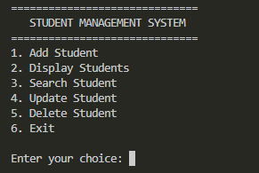
Project 01 — Student Management System
06
Managing student records through a simple menu-driven interface
Key Functions
• Add, display, search, update and delete student records
• Structured menu with clear user choices
• Basic record persistence
C++ Concepts
• Structures / classes
• Loops & conditionals
• File handling
• Input validation
Console interface — Student Management System
C++ Programming Internship • Thiranex • IILM University

Slide 7
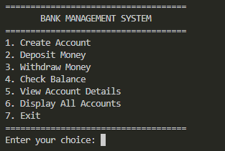
Project 02 — Bank Management Application
07
Simulating common account operations in a console application
Key Functions
• Create account and view account details
• Deposit and withdraw money
• Check balance and display all accounts
C++ Concepts
• Functions / classes
• Arithmetic operations
• File handling
• Validation of transactions
Console interface — Bank Management Application
C++ Programming Internship • Thiranex • IILM University

Slide 8
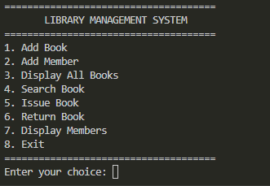
Project 03 — Library Management System
08
Handling books, members, search, issue and return workflows
Key Functions
• Add books and members
• Search books
• Issue and return books
• Display stored records
C++ Concepts
• Classes / structures
• Search logic
• State updates
• Persistent text-file data
Console interface — Library Management System
C++ Programming Internship • Thiranex • IILM University

Slide 9
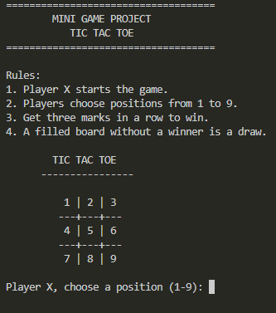
Project 04 — Tic Tac Toe Mini Game
09
Applying arrays and game-state logic to an interactive two-player game
Key Functions
• Two-player turn-based gameplay
• Position validation
• Win / draw detection
• Replay and score tracking
C++ Concepts
• array<char, 9>
• Loops & conditionals
• Class-based design
• Winning-pattern evaluation
Console interface — Tic Tac Toe Mini Game
C++ Programming Internship • Thiranex • IILM University

Slide 10
System Architecture & Methodology
10
Common architecture across the console projects
USER INPUT
→
MENU / CONTROLLER
→
VALIDATION & LOGIC
→
DATA / STATE
→
CONSOLE OUTPUT
Management Systems
Tic Tac Toe
Testing Approach
Input → CRUD operation → validation → file/data update → result
Move → validation → board update → win/draw check → next turn
Valid input + invalid input + persistence + expected output
C++ Programming Internship • Thiranex • IILM University

Slide 11
Learning Outcomes
11
What I gained from the internship
Programming
Problem Solving
Improved confidence with C++ syntax, functions, arrays, classes and file handling.
Learned to break a larger requirement into smaller functions and testable steps.
Debugging
Project Discipline
Practiced compiling, identifying logic errors and checking edge cases.
Maintained project folders, screenshots, README files and GitHub submissions.
Application Design
Independent Work
Understood how menus, validation, state and persistence work together.
Completed four different applications through a self-paced project workflow.
C++ Programming Internship • Thiranex • IILM University

Slide 12
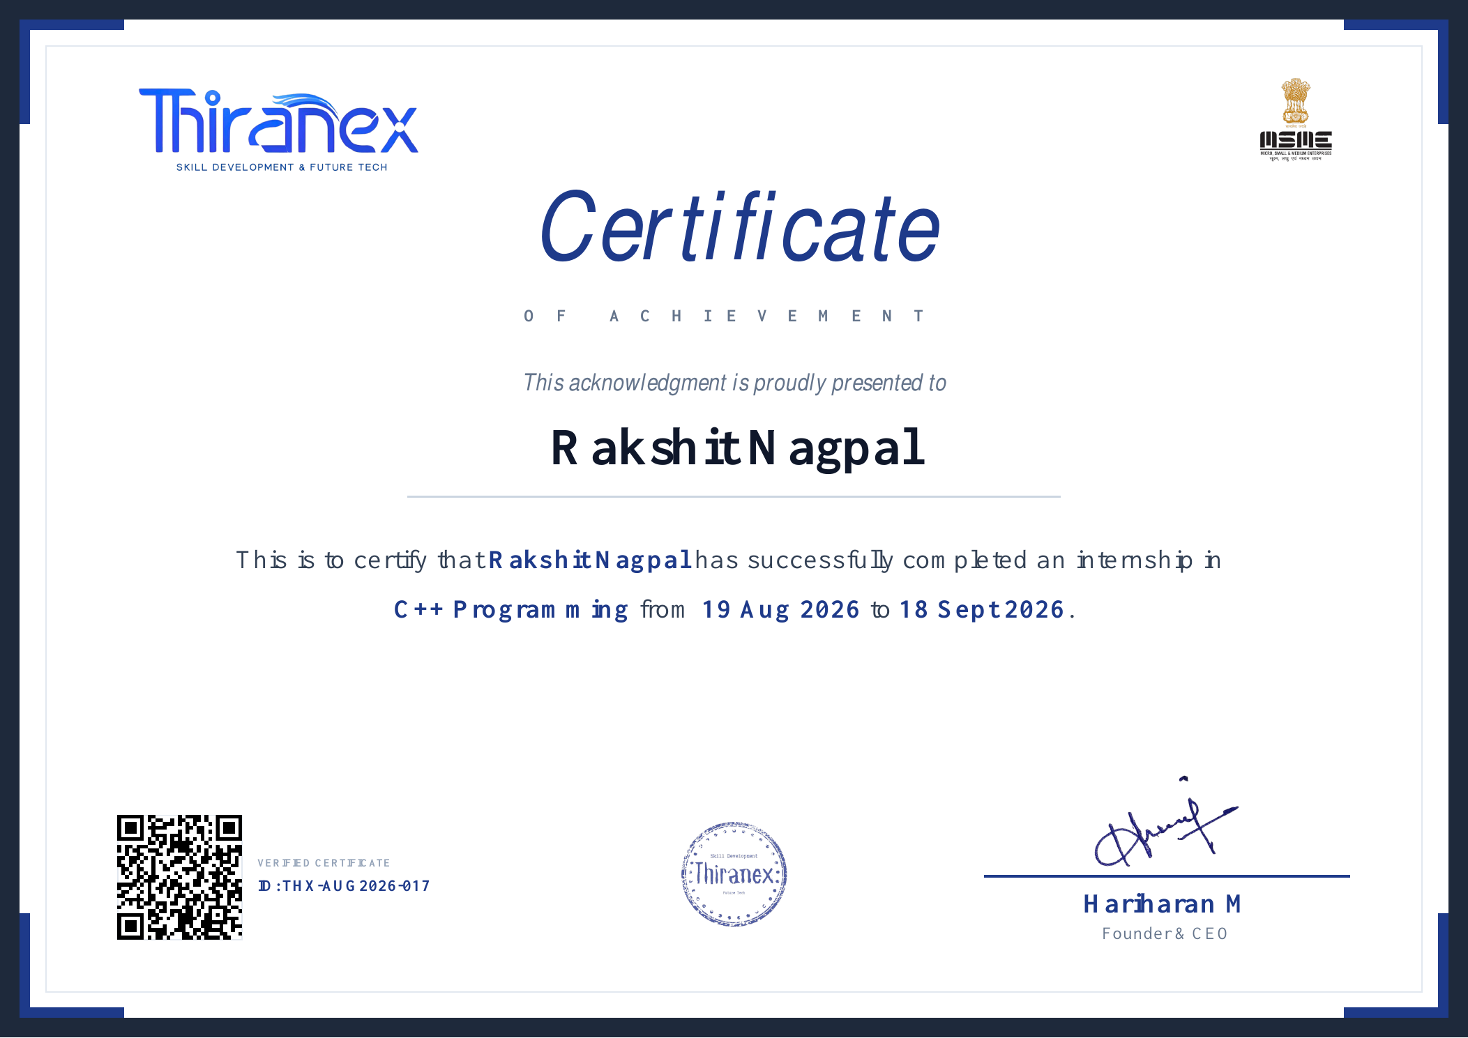
Completion Evidence
12
Completion status
• Dashboard shows 100% internship progress
• All four assigned projects are marked completed
• Official C++ Programming certificate has been received
• Internship completed on 18 September 2026
Repository
github.com/rakshit-nagpal-iilm/Thiranex-CPP-Internship
C++ Programming Internship • Thiranex • IILM University

Slide 13
Conclusion
13
From concepts to working applications.
4 / 4
• The internship provided practical exposure to building complete C++ console applications.
• Each project introduced a different problem domain while reinforcing reusable programming fundamentals.
• The final portfolio demonstrates implementation, testing, documentation and version-control practice.
Projects Completed
100% Progress
THANK YOU • QUESTIONS?
C++ Programming Internship • Thiranex • IILM University

