Slide 1
Shell Bootcamp 2024 3 Reflections for Week #1
Rakshita Bhatia
Date : 30-Aug-2024

Slide 2

About Me
There is no easy way. Everything requires hard work .

Slide 3

My learnings from this week!

Slide 4
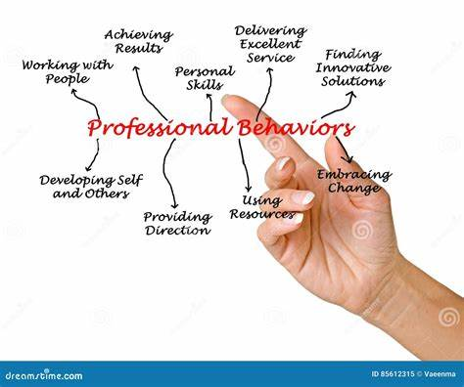
Learning 1 | My takeaways
Understood the traits of professionalism helps in improving team dynamics and personal performance
Professional behavior leads to better collaboration and productivity.

Slide 5
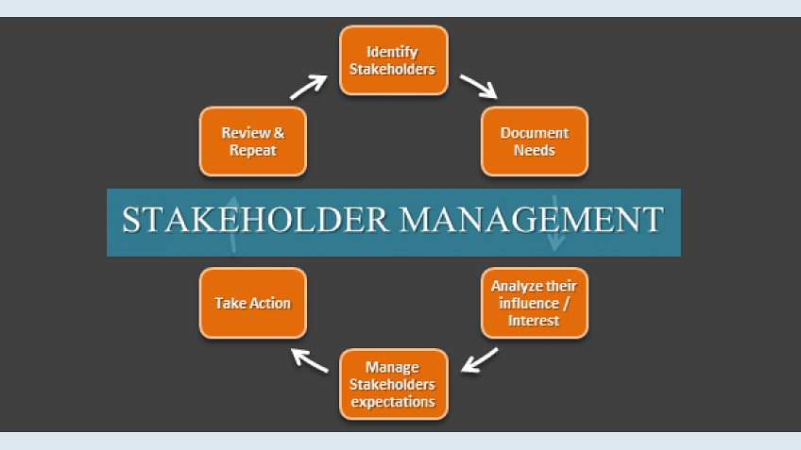
Learning 2 | My takeaways
Insights on Stakeholder Management and its importance:
Identifying and managing stakeholders is critical for project alignment and successful outcomes.
Effective stakeholder management can lead to improved project delivery and reduced risks.

Slide 6
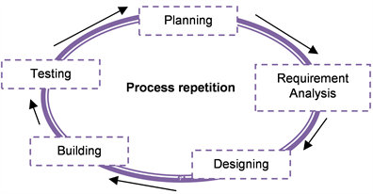
Learning 3 | My takeaways
The value of Teamwork and feedback in achieving common goals:
Teamwork , coupled with open feedback , enhances problem-solving and innovation.
Collaborative efforts lead to better results and a more cohesive work environment.

Slide 7

Relevance of learnings for my organization

Slide 8

Learning 1 | Relevance for Shell
Professionalism contributes to Shell’s brand reputation and operational efficiency.
It implements professionalism through structured employee training and adherence to core values.
The power technique helped us understand how to frame mails in the correct order, avoiding the commonly done mistakes by other employees.

Slide 9

Learning 2 | Relevance for Shell
Stakeholder management is essentially important to be able to understand business better. It helps me to understand the difference between internal and external stakeholders. The activities involved along with the theory helped with building a better foundation for the overall topic. It uses structured communication plans and stakeholder engagement strategies.

Slide 10
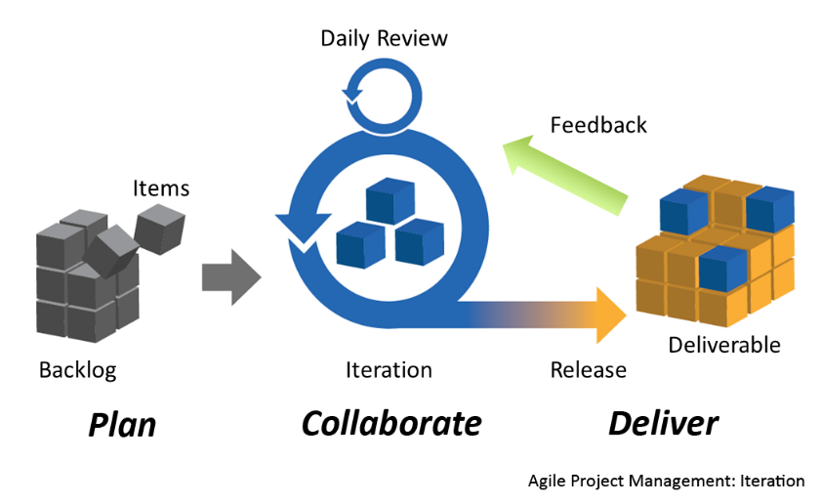
Learning 3 | Relevance for Shell
I will be able to understand how the product owner makes the various srs and brd documents and how they should be read.
I understood the various models used previously and their advantages and disadvantages.
I learnt the current applications of the agile model and the various components in it. The various types of meetings held in between and during the start and end of the sprints. How each decision is taken during a sprint. The uses of user stories for developers, and burndown charts to calculate amount of work done against the number of days passed.
[Add a graphic that provides view of how Shell implements this learning]

Slide 11

Challenges in implementing learning

Slide 12

Challenge faced while implementing Learning 1
Initially everyone was shy and scared and were very skeptical in answering in the class or to share their thoughts. But due to the fun activities and supporting teacher we were able to overcome our shyness and participate in the activities. It was difficult for everybody to adapt to the company’s expectations of professionalism.
[Add a graphic that provides evidence of what you did to overcome this challenge]

Slide 13

Challenge faced while implementing Learning 2
Stakeholder management looked like a difficult topic at first with a lot of theory. But eventually the activities made it easier to understand. It was difficult to identify all relevant stakeholders in complex projects.
[Add a graphic that provides evidence of what you did to overcome this challenge]

Slide 14
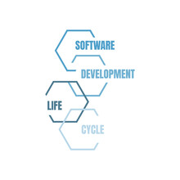
Challenge faced while implementing Learning 3
Though SDLC Models were already taught to us in the college, but it was a good recap. The role of BA and agile model had a lot of theory but were very interesting to learn.

Slide 15

Action Plan

Slide 16
My Action Plan for this Week
Actions
Timeline
Status
Going through all the concepts in class once again using notes to make sure I have no doubts going further.
Saturday & Sunday – revise over all the topics
Status of the same by the end of the week

Slide 17

Learning is also Fun!

Slide 18

Learning is also Fun!
We had an activity where each team was given a scenario and we had to do a small roleplay using our own creative ideas. Initially everyone was shy, but the some teams really performed well and added a factor of fun and humor in the environment.
We also did an activity where we had to hold a pen from all the four directions using threads which helped us learn the importance of team work and communication
team enjoyed the new learning]

Slide 19

Summary
Soft skills training – power technique, neuroplasticity, team work, stake holder management
Technical skills training – role of business analyst, sdlc models, agile model in detail.
Expected to have more technical training on technical topics in upcoming week.

Slide 20
Thank You

