Slide 1



NIT Hackathon
2026
AGRI-HIVE AI
PRIVACY-PRESERVING COLLABORATIVE INTELLIGENCE FOR PROACTIVE AGRICULTURE
Team ID: : H26AGR13
Team Lead: SWETHA.S
Team Members:
PUJA R, RAKSHITA N
Coimbatore Institute Of Technology

Slide 2
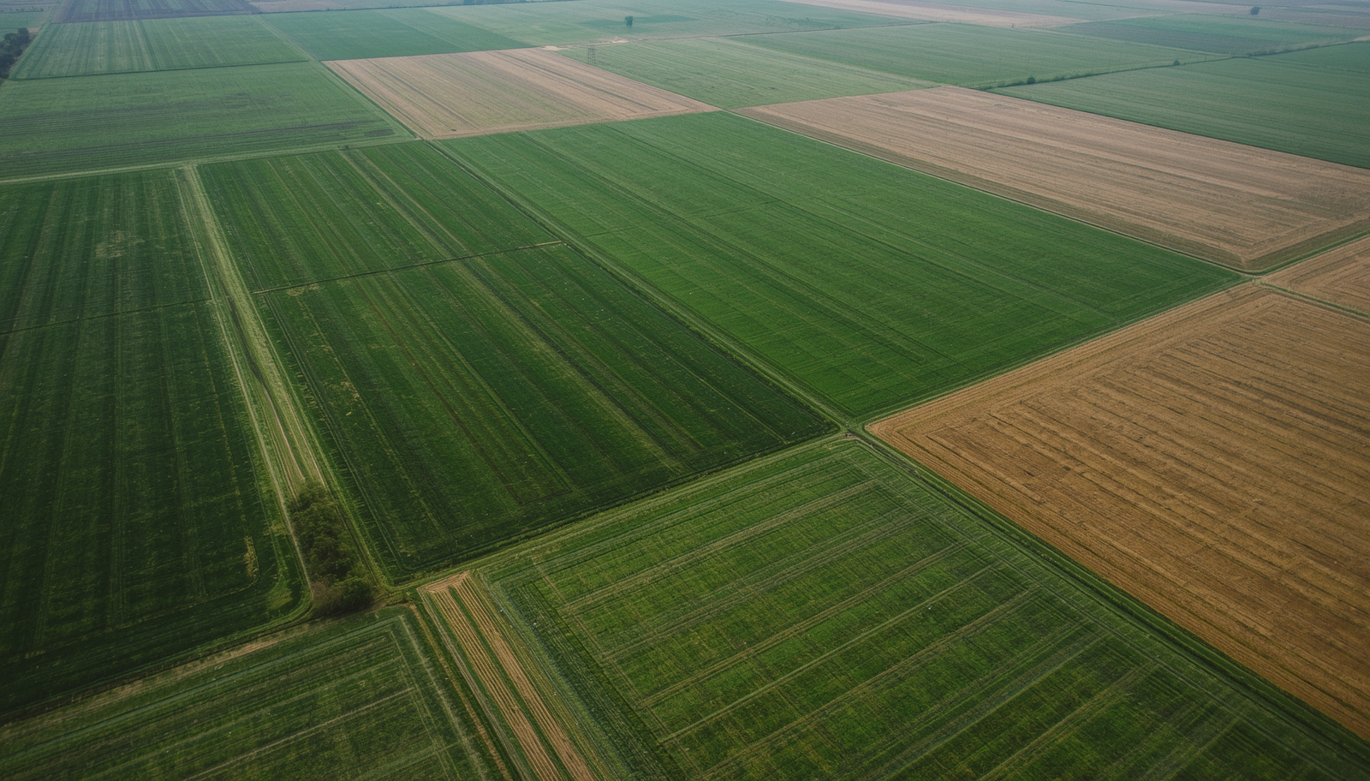

Problem Statement
AgriHive AI
02
No Regional Risk Detection
Isolated Farm AI
Privacy Barriers
Current AI systems analyze each farm independently, making it difficult to detect regional agricultural risks.
Objective: Enable secure collaboration among farms to provide proactive and privacy-preserving recommendations.
Problem: Regional agricultural threats often go undetected due to the lack of large-scale monitoring.
Objective: Provide proactive detection and early alerts for regional agricultural risks.
Farmers cannot share raw data due to privacy concerns.
Centralized AI models require sensitive farm data exposure.
Objectives:
Preserve data privacy via federated learning.
Deliver proactive
AI-driven recommendations.

Slide 3

03
Existing Solutions & Gaps
AgriHive AI
Farm-level AI → No regional intelligence
Centralized AI → Privacy concerns
Isolated systems → No collaboration
Current tools → Reactive recommendations
AgriHive AI bridges these gaps using privacy-preserving collaborative intelligence.

Slide 4
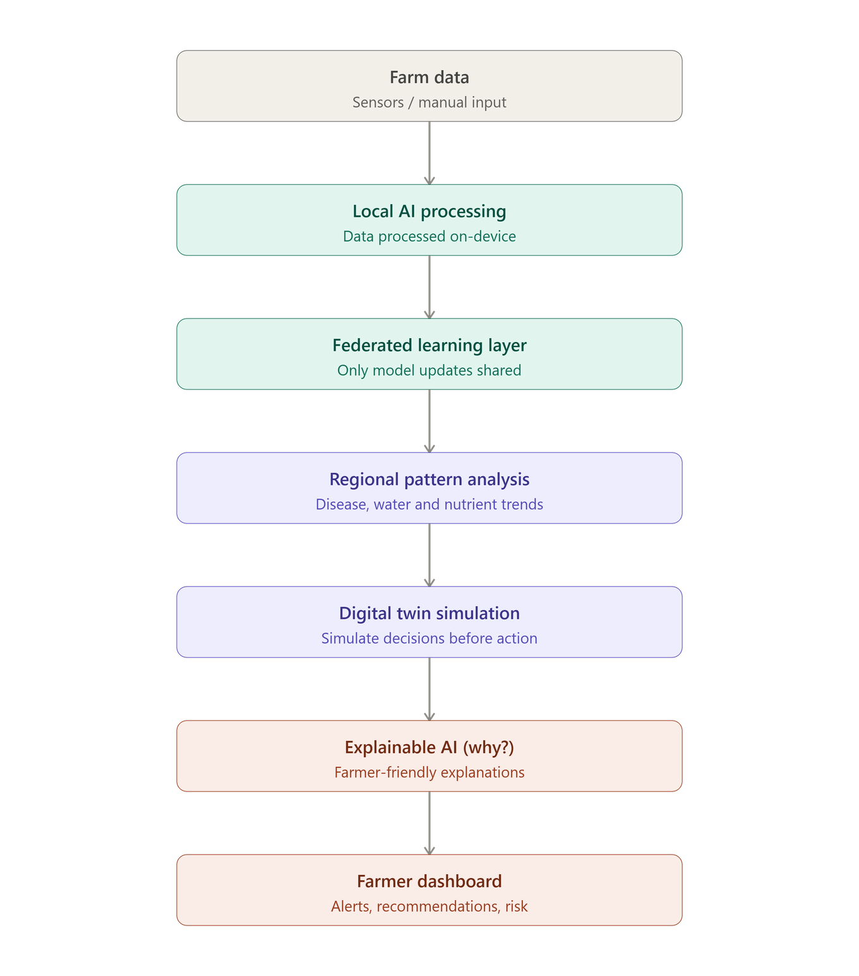
04
System
Design

Slide 5

05
Completed
✓ Problem Analysis
✓ Technology Stack Finalized
✓ System Architecture Designed
✓ Database Planning
In Progress
• Frontend Development
• Backend Development
• Model Integration
Implementation
Progress

