Slide 1
IBM University Engagement Project Submission
“Exploring the Power of Agentic AI with IBM Granite and IBM Bob”

Slide 2

Project Tile – Intelligent Market Research Assistant
Domain of Project – Business and Market Intelligence
Student Name | Recent Passport Photo | Email ID | Mobile number [WhatsApp]
Rakshita Gaonkar |  | rakshitagaonkar658@gmail.com | 8088279270

Slide 3
Intelligent Market Research Assistant
The Challenge Organizations and startups often struggle with fragmented and rapidly changing market data— customer feedback, competitor moves, industry reports, and social media trends. This information is scattered across multiple sources, time-consuming to analyze, and often outdated by the time insights are generated. The challenge is not just to collect information but to synthesize, predict, and present actionable insights for smarter decision-making.
The Objective Build an agentic AI application that acts as an intelligent market research assistant. The solution should:
Fuse Disparate Sources: Collect real-time data from news sites, analyst reports, social media, and customer reviews, and synthesize into clear, concise market snapshots.
Enable Multimodal Analysis: Accept inputs such as text, charts, or voice notes from users and refine them into structured insights, competitor comparisons, or market trends.
Create a Predictive & Agentic Layer: Analyze patterns to forecast market shifts (e.g., rising demand in a product segment) and generate alerts on competitor activities or customer sentiment changes.
Visualize the Market Pulse: Provide a dashboard with trend analysis, competitor mapping, sentiment tracking, and demand forecasts to guide data-driven business strategies.

Slide 4
Proposed Solution -
Intelligent Market Research Assistant is an AI-powered agentic market research system that collects and analyzes market information from multiple sources and converts it into useful business insights.
The proposed system will:
📊 Collect market data from news, reports, customer reviews, competitor data, and trend datasets.
🤖 Use IBM Granite + Agentic AI to understand user queries and decide which analysis tools are required.
🔎 Use RAG to retrieve relevant information from uploaded industry reports and documents.
😊 Perform sentiment analysis on customer reviews.
📈 Analyze market trends and demand to identify emerging opportunities.
🏢 Compare competitors based on available market data.
🚨 Generate alerts for important trends, competitor activities, and demand changes.
📋 Provide an interactive dashboard showing market overview, trends, competitors, sentiment, demand forecasts, and alerts.
📄 Generate market research reports in PDF format.
🎤 Support voice queries and image/chart text extraction through OCR

Slide 5
Technology Used
IBM Bob Platform – Used as the AI-powered development environment for designing, coding, and orchestrating the Intelligent Market Research Assistant.
IBM Granite Model – Used as the primary LLM for natural language understanding, reasoning, and generating market research insights.
Model: ibm/granite-3-8b-instruct
Python – Used as the main programming language for implementing the AI agent, data processing, analysis, and backend logic.
LangChain – Used to build the agent workflow and connect the Granite model with different research and analysis tools.
RAG (Retrieval-Augmented Generation) – Used to retrieve relevant information from uploaded market reports and documents before generating AI responses.
ChromaDB – Used as the local vector database for storing document embeddings and performing similarity-based retrieval for RAG.
IBM watsonx.ai – Used for connecting to IBM Granite and supporting the AI/LLM layer when IBM credentials are configured.
Streamlit – Used to create the interactive web dashboard and AI research assistant interface.
NewsAPI – Used to retrieve live news data for market research, with bundled sample data available as a fallback.
Pandas / Data Analytics – Used for processing market, competitor, sentiment, trend, and demand data.
ReportLab – Used to generate downloadable PDF market research reports.
Tesseract OCR + Pillow – Used for extracting text from uploaded images/charts

Slide 6
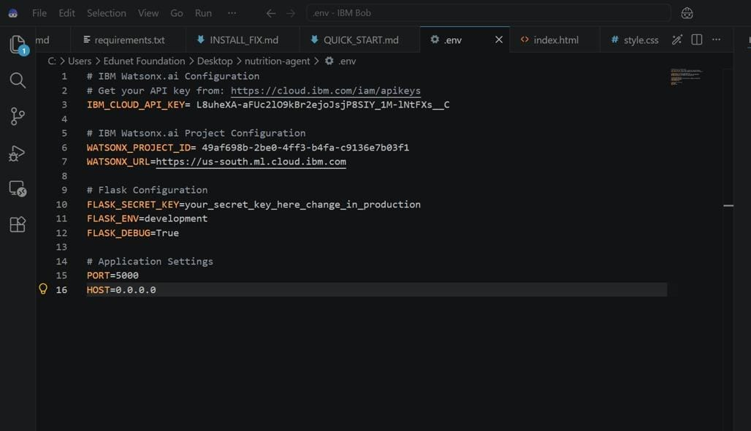
Required Files created using IBM bob -
App.py
Requirements.txt
Style.css
.env
Index.html

Slide 7
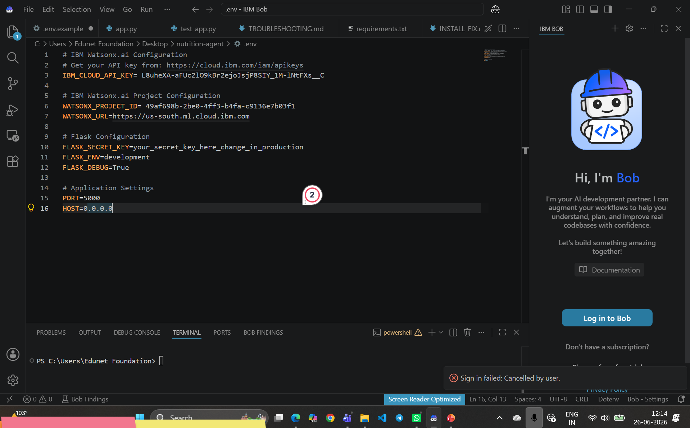
IBM Bob Screenshots:

Slide 8
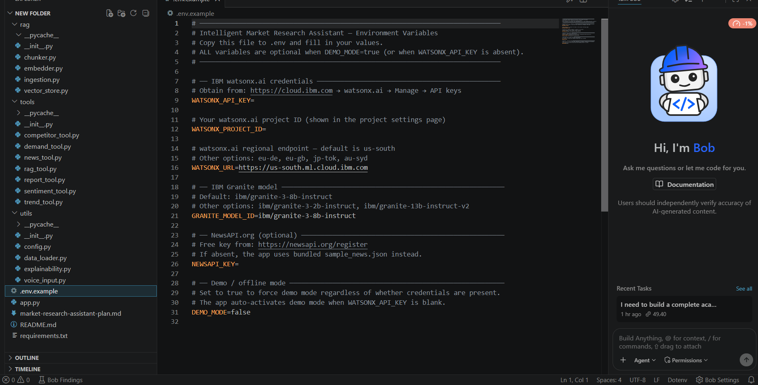

Slide 9
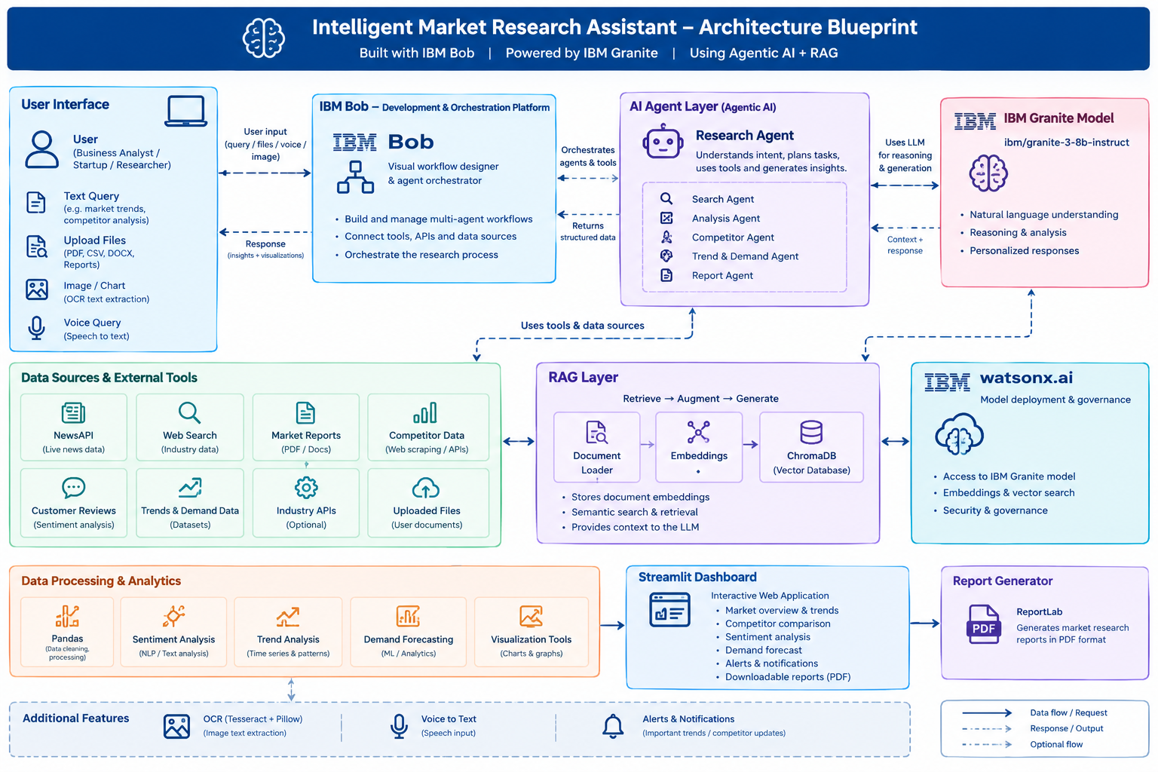
Architecture blueprint for IBM bob:

Slide 10

Role of Agentic AI in the solution
In the Intelligent Market Research Assistant, Agentic AI acts as the decision-making and orchestration layer. Instead of simply answering a question, the agent understands the user's requirement, decides what information and tools are needed, performs the analysis, and combines the results into a useful response.
🔄 How Agentic AI works in our project
User Query → Agent understands → Selects tools → Collects data → Analyzes → Generates insights → Dashboard/Report
Agent/tool | Role
Document Retrieval Agent | Retrieves relevant information using RAG
News Research Tool | Finds relevant market/news information
Sentiment Analysis Tool | Analyzes customer sentiment
Competitor Analysis Tool | Compares competitors
Trend Analysis Tool | Identifies emerging market trends
Demand Analysis Tool | Analyzes demand patterns and forecasts
Report Generation Tool | Creates structured market research reports

Slide 11
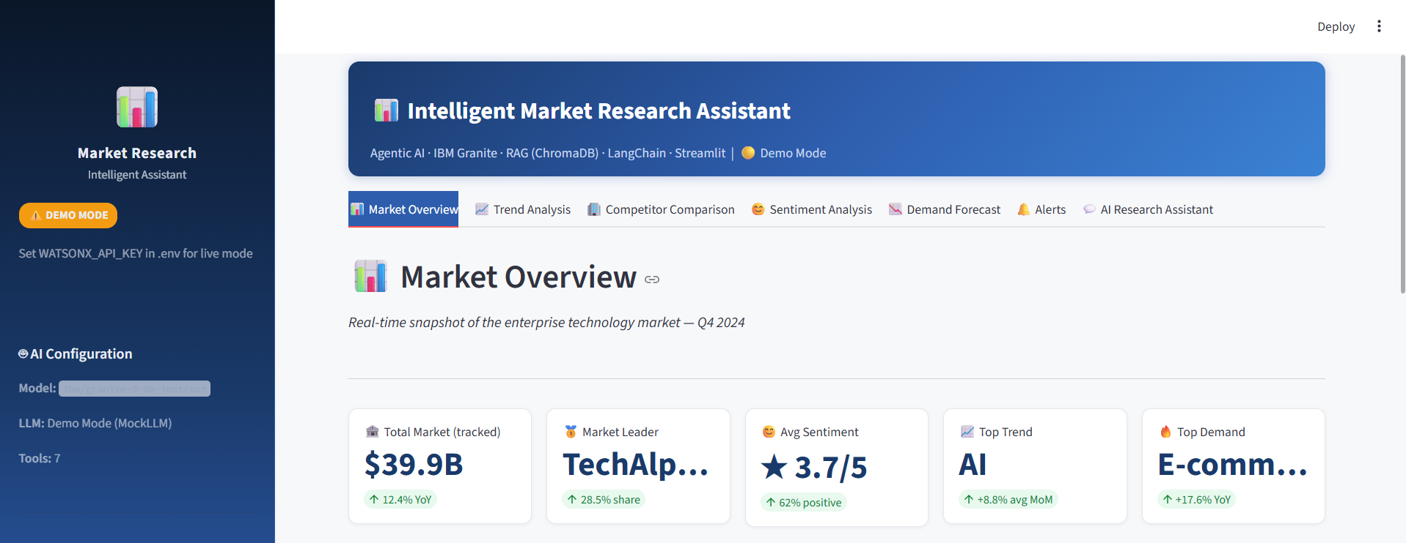
Project Output Screenshot
Please put IBM Bob output screenshots with 2-3 prompts.
You can take 2-3 more slides for each screenshot
·
·
·

Slide 12
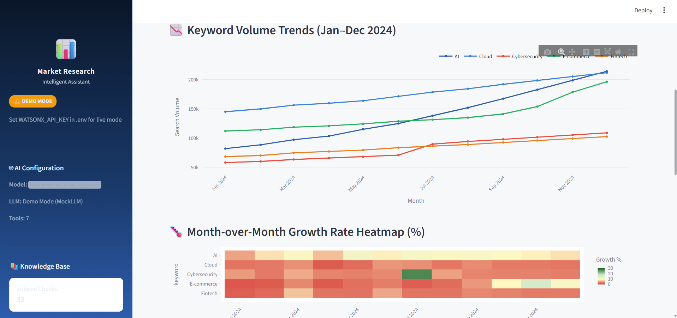
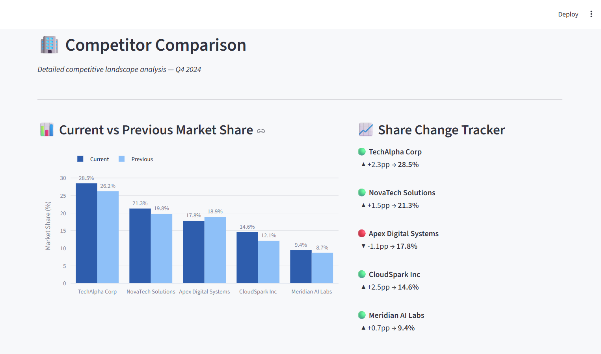
Project Output Screenshot
·
·
·

Slide 13
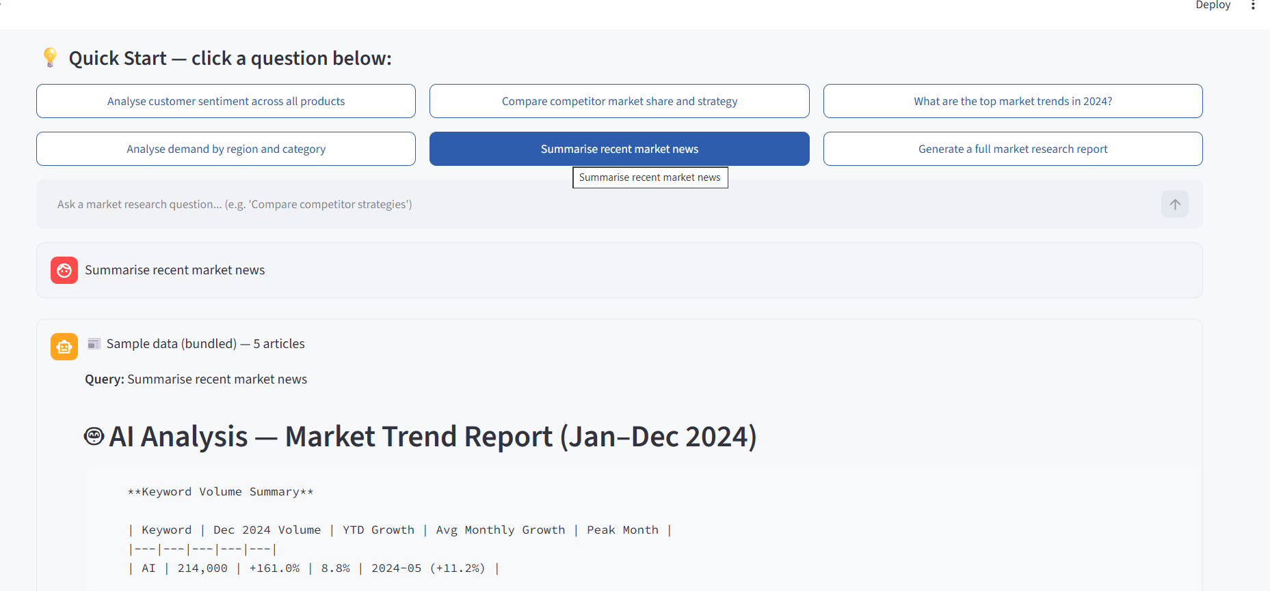
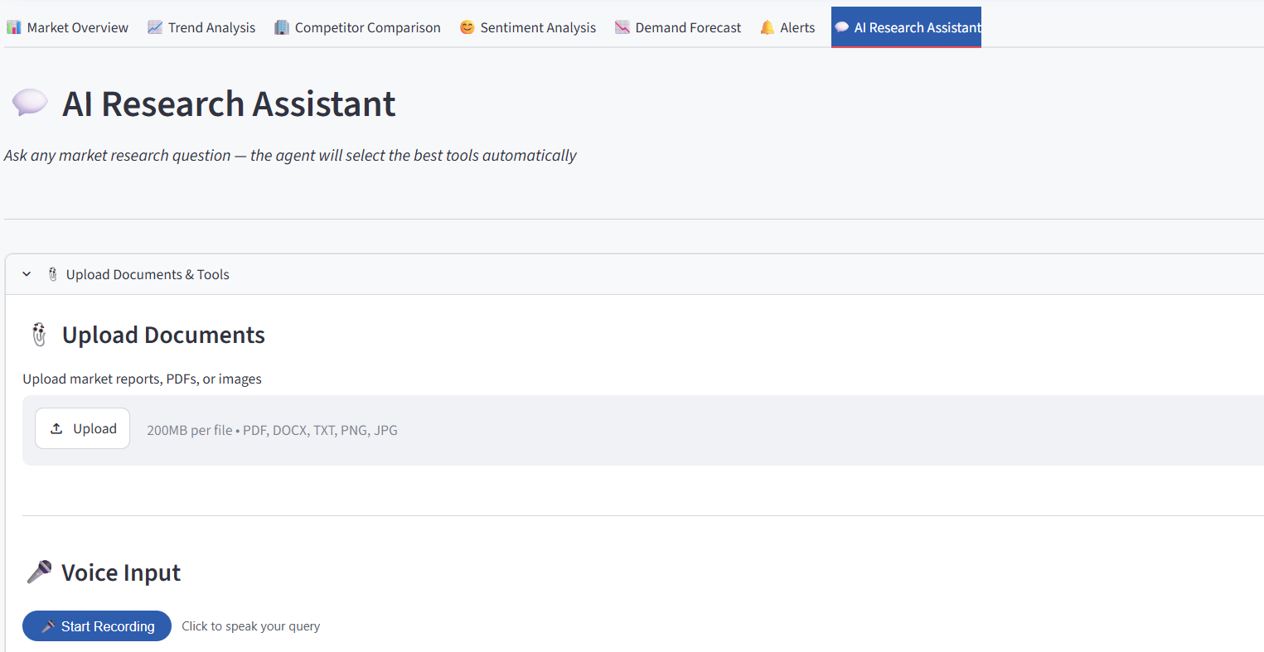
Project Output Screenshot
·
·
·

Slide 14
Novelty and Uniqueness
1. Agentic Market Research
  The system doesn't just generate a fixed answer.
  The AI agent understands the query and decides which research tools are required.
2. Multi-source Market Intelligence
  Combines information from news, market reports, competitor data, customer reviews, trends, and demand data in one platform.
3. RAG-based Evidence Retrieval
  Uploaded industry reports can be searched using RAG.
  The AI generates responses based on retrieved information rather than relying only on its general knowledge.
4. Multimodal Input
  Users can provide text, documents, images/charts, and voice queries.
  Image information is currently handled through OCR-based text extraction.
5. Integrated Competitor + Sentiment + Trend + Demand Analysis
  Instead of separate tools, the system combines:
  Competitor comparison
  Customer sentiment
  Market trends
  Demand analysis
  News research

Slide 15
Git Hub Link
·GitHub details are:
Username/Owner: rakshitagaonkar658-gif
Repository name: intelligent-market-research-assistant
Full URL: https://github.com/rakshitagaonkar658-gif/intelligent-market-research-assistant
·
·
·

Slide 16
Future Scope
More real-time data sources 🌐
Integrate more live sources such as social media platforms, customer-review websites, financial/industry APIs, and analyst reports
.
Advanced predictive analytics 📈
Use more advanced ML/time-series models to improve market-demand and trend forecasting.
True multimodal AI 🖼️
Upgrade from OCR-based image text extraction to vision-capable AI that can directly understand charts, graphs, images, and tables.
Personalized market research 🤖
Allow users to specify their industry, company, products, competitors, and target customers so the agent can provide more relevant research.
Automated competitor monitoring 🏢
Continuously monitor competitor activities such as new products, pricing changes, campaigns, and major announcements and generate alerts.
·
·
·

Slide 17
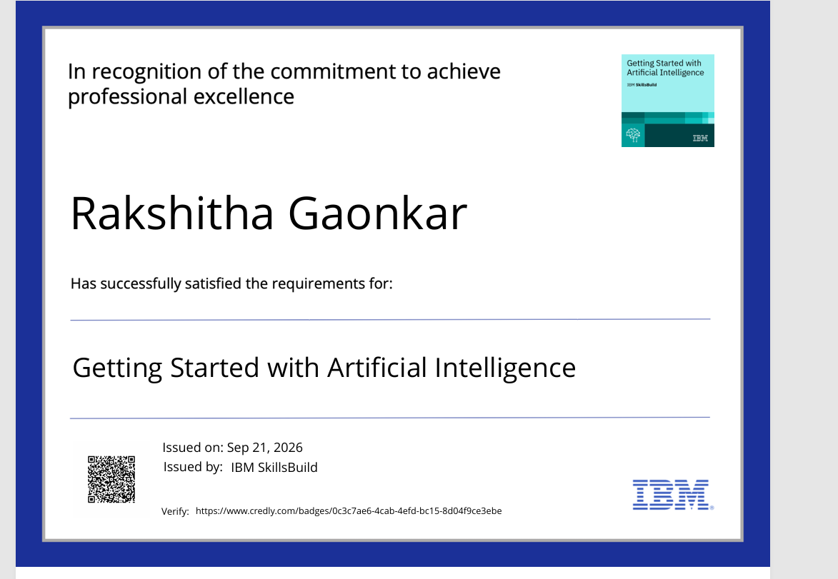
Certificates Earned:

Slide 18
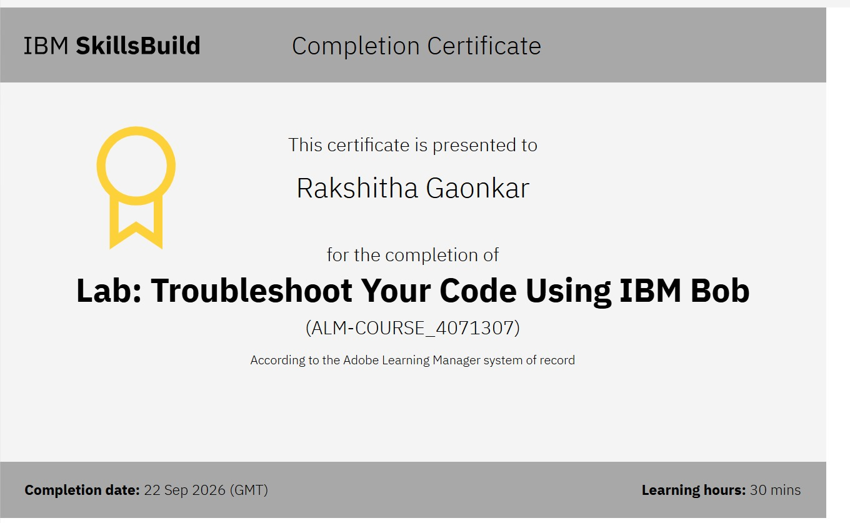
Certificates Earned:​
IBM BOB Certificate

Slide 20


