Slide 1
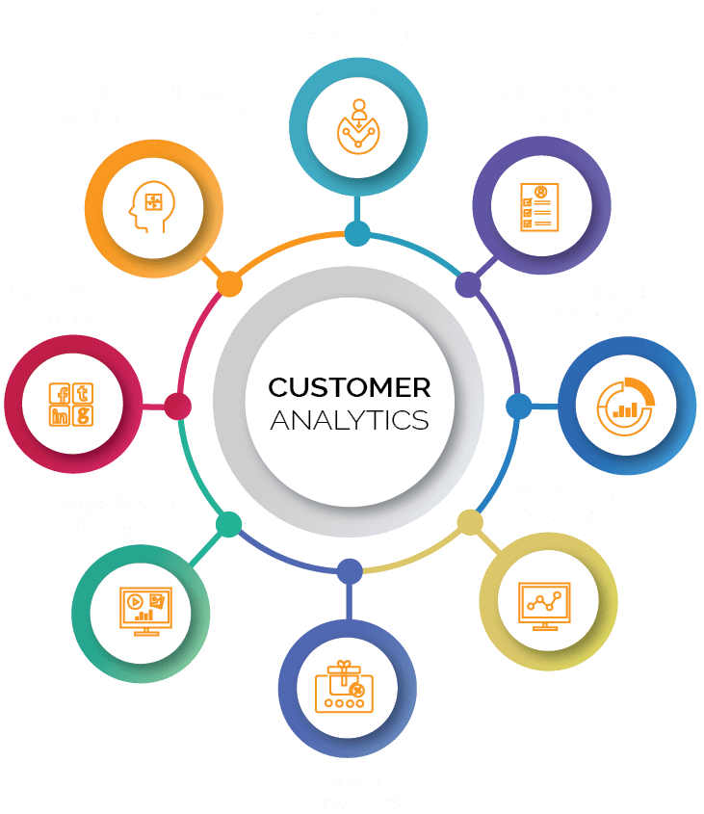
DATAMITES -INTERNSHIP
PROJECT ID: PRDA-05 CUSTOMER DATA ANALYSIS
PROJECT TEAM ID: PTID-CDA-DEC-25-1035
PROJECT BY: RAKSHITA S A

Slide 2

Dataset Overview
Total Records: 1000 transactions
Key Columns: Age, Gender, Category, Quantity, Price, Payment Method
Data Quality: No missing values or duplicates

Slide 3

Key Business KPIs
Total Revenue: 2.37 Million
Total Units Sold: 2981
Total Customers: 1000
Total Transactions: 1000
Top Product Category: Clothing

Slide 4

Customer Demographic Insights
Female customers contribute higher revenue and unit sales
Age group 28–47 shows the highest shopping activity
Middle-aged customers have stronger purchasing power

Slide 5




Product & Category Insights
Clothing is the top-selling product category
Cosmetics and Food & Beverage are the next popular categories
Category preference varies across gender

Slide 6



Payment Method Insights
Digital payments dominate over cash
Younger customers prefer digital payment methods
Payment method usage varies by product category

Slide 7

Business Recommendations
Focus marketing on age group 28–47 for higher ROI.
Increase inventory for top-selling categories like Clothing.
Promote digital payments with offers and cashback.
Run targeted campaigns based on gender and category preferences.

Slide 8
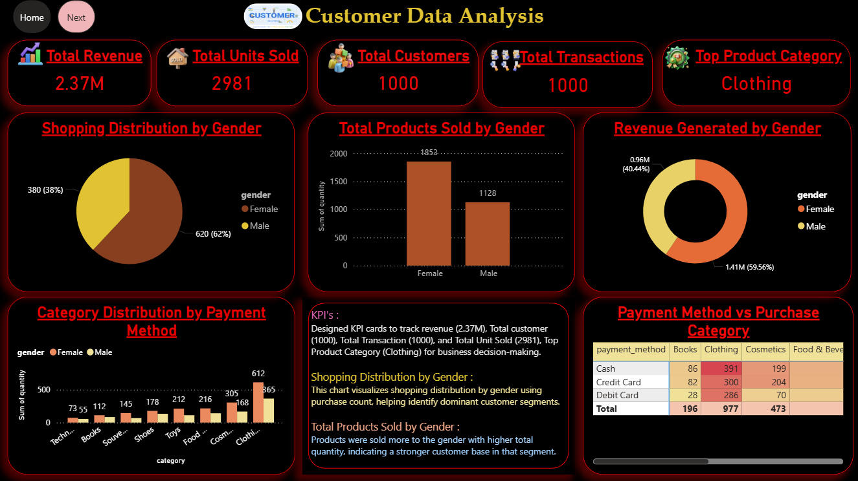
Customer Dashboard – KPIs & Gender Insights

Slide 9
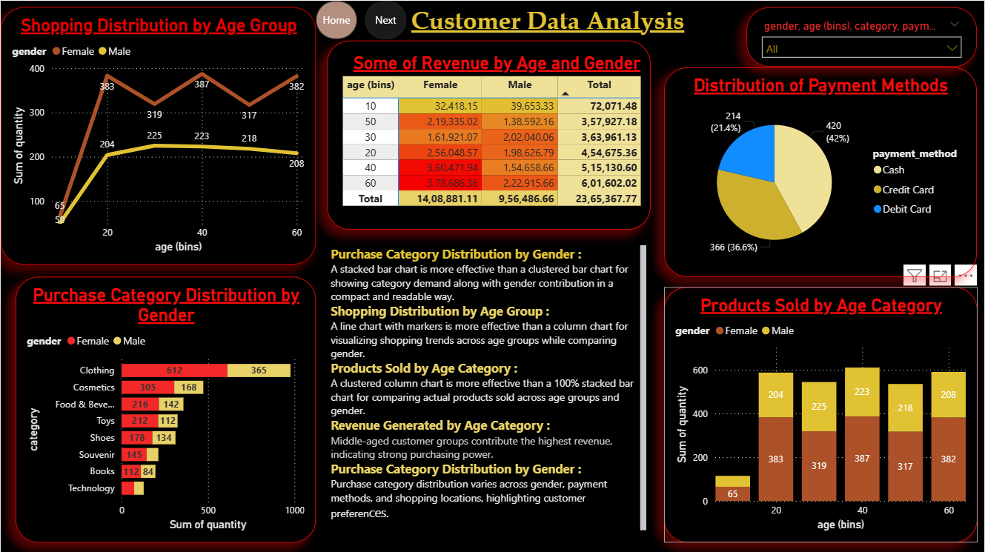
Customer Dashboard – Age, Category & Payment Insights

Slide 10

Conclusion
Dashboard gives a complete view of customer behavior
Insights support data-driven marketing and sales decisions
Helps improve revenue and customer engagement

