Slide 1
Apple Stock Analysis Dashboard

Slide 2
Project Overview
• This project analyzes Apple's stock data over multiple years.
• Dashboard includes KPIs, trends, volume insights, and comparisons.
• Visuals created in Power BI using date hierarchy, slicers, charts, and cards.

Slide 3
Key Metrics
• Sum of Close Price: 270.54K
• Average Volume: 315.43M
• Average Close Price: 24.36

Slide 4
Data Trend: Close Price by Year
• Shows long‑term growth of Apple stock price.
• Noticeable spike after 2020.
• Indicates strong market performance and investor confidence.

Slide 5
Count of Records by Month
• Uniform distribution of stock data across months.
• Ensures stable time‑series analysis.

Slide 6
Open vs Close Distribution
• Bar chart shows comparison between Open and Close values.
• Useful for identifying volatility and trading behavior.

Slide 7
Slicer and Filters Used
• Date Range Slicer (1980 – 2025)
• Day Filter (Drop‑down)
• Helps refine the dashboard for detailed analysis.

Slide 8
Pie Chart Insights
• Represents Sum of High, Low, Open, and Close.
• Each metric contributes almost equally.

Slide 9
Conclusion
• Apple stock shows long‑term growth potential.
• Dashboard helps understand performance using KPIs and trends.
• Useful for data analysis and visualization learning.

Slide 10
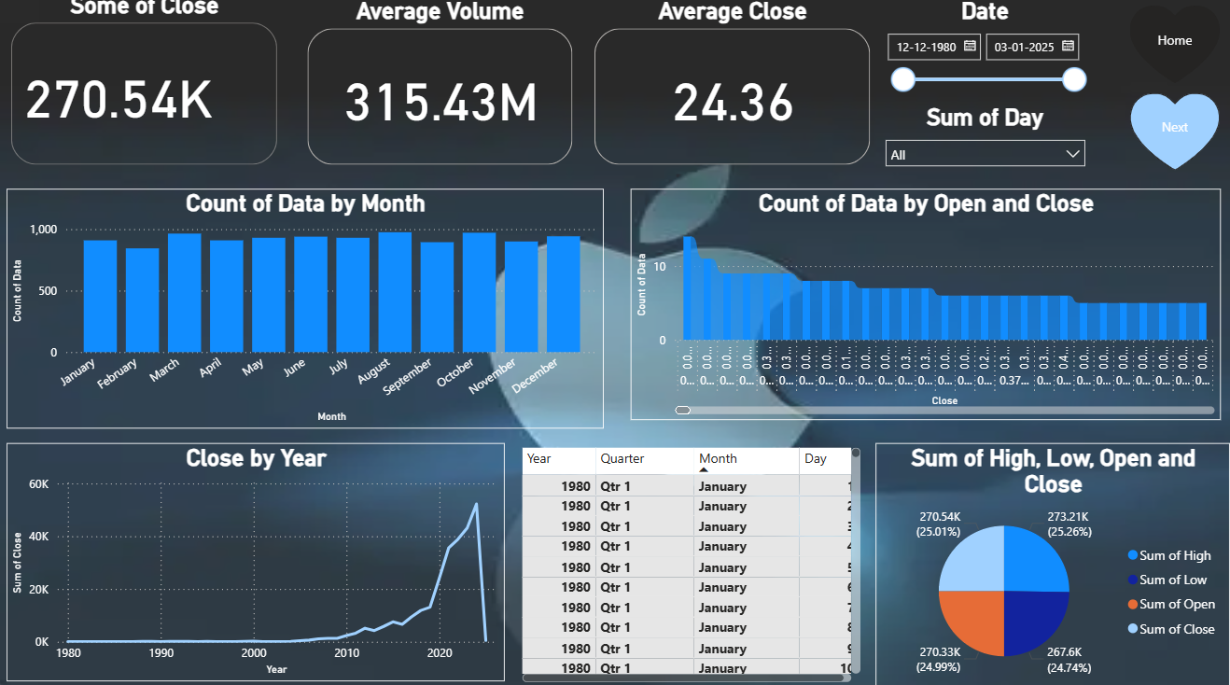
DASHBOARD

