Slide 1


AUTOMATION TESTING WITH SELENIUM JAVA & TESTNG FOR LIMEROAD.COM
Presented by Rakshit Porwal

Slide 2

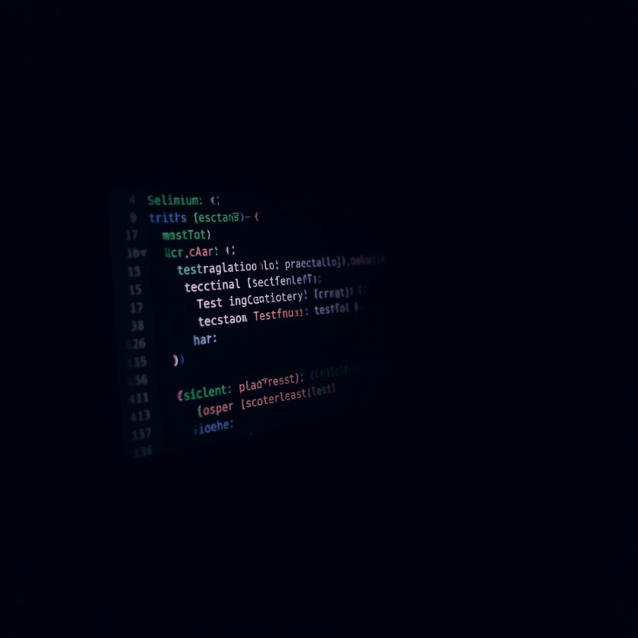
AUTOMATION TESTING WITH SELENIUM JAVA & TESTNG FOR LIMEROAD.COM
This training project focuses on automating test cases for limeroad.com to improve testing efficiency and accuracy.
• Tools: Selenium WebDriver, Java, TestNG Framework
• Automates key user flows on limeroad.com
• GitHub integration for version control & collaboration

Slide 3


AUTOMATION SETUP AND TOOLS
Selenium WebDriver: A powerful browser automation tool that enables interaction with web elements on limeroad.com, simulating real user actions across Chrome, Firefox, and other browsers.
Java & TestNG: Java serves as the programming language for writing robust test scripts. TestNG framework provides annotations (@Test, @BeforeMethod), grouping, parallel execution, and detailed HTML reports.
Environment Setup: ChromeDriver configured for browser-test integration. IDE support via Eclipse or IntelliJ IDEA. Maven for dependency management, with Selenium and TestNG libraries in pom.xml.

Slide 4



KEY TEST CASES IMPLEMENTED
Login Functionality Tests: Automated valid/invalid login scenarios on limeroad.com, verifying successful authentication, error messages, and session handling using TestNG assertions.
Product Search & Filter Validation: Automated search queries and filter selections (category, price, brand) to validate correct results, URL parameters, and page title accuracy.
Add to Cart & Checkout Automation: End-to-end test scripts covering add-to-cart, quantity updates, and checkout flow. TestNG grouping used to organize smoke and regression test suites.

Slide 5



GITHUB INTEGRATION FOR PROJECT MANAGEMENT
Repository Setup
Created a structured GitHub repo with organized folders for test scripts, config files, and reports. Clear README with setup instructions and project overview for easy onboarding.
Collaborative Workflow
Pull requests reviewed by team members before merging. Code reviews ensure quality and consistency. Commit history tracks all changes for full traceability.
Branch Management
Code pushed to remote repo using Git commands. Feature branches created for each test module. Merging managed via pull requests to maintain code integrity and history.

Slide 6

SUMMARY AND NEXT STEPS
Benefits of automation: faster regression testing, improved accuracy across test runs, and reusable scripts that reduce manual effort over time.
Challenges and lessons learned: managing dynamic web elements, handling synchronization issues, and structuring maintainable test code for limeroad.com.

Slide 7
THANK YOU!
Questions & Collaboration Welcome

