Slide 1
SecureBoot implementation for PULPissimo RISC-V framework
ECE 751 Fall 2022
Presenters : Nitya Joshi, Pragna Pulakanti, Rakshith Macha Billava, Ujwal Ravichandra
Notes:
Greetings. Today,my teammates and i will be presenting about our secureboot implementation for pulpissimo riscV framework, done in fulfilment of course project for ECE 751: embedded computing systems.

Slide 2
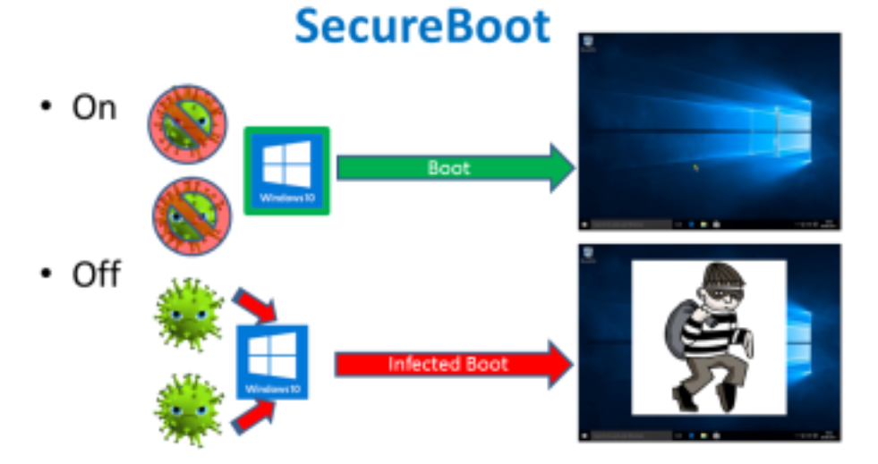
Background
Fig 1: Secure Boot Example
https://www.dignited.com/36748/what-is-secure-boot-on-windows/
Notes:
secure boot ensures that no unauthorized code is executed. It is a mechanism that establishes a Chain of Trust (CoT) on all system boot images.

Slide 3
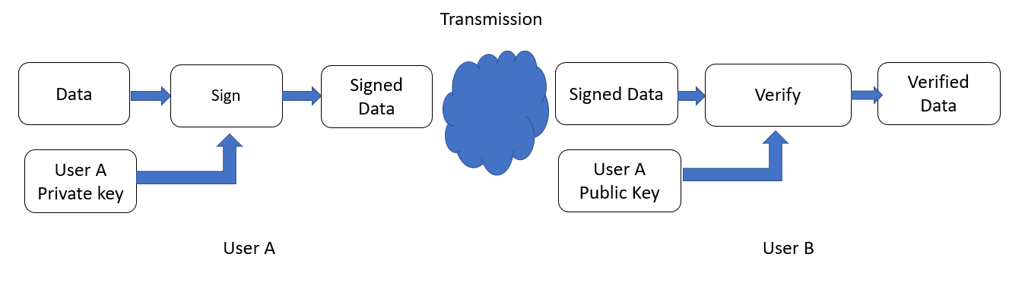
Secure Boot
Fig 2: Sign and Verification of the data
Notes:
Secure boot relies on the public key cryptography to verify image signatures before their execution [14]. A pair of public and private key is generated for image signing and verification. The private key is used to sign an image offline while the public key is used to verify the image signature before one image is executed. The whole secure boot process usually involves several images, originating outwards from the root of trust.

Slide 4
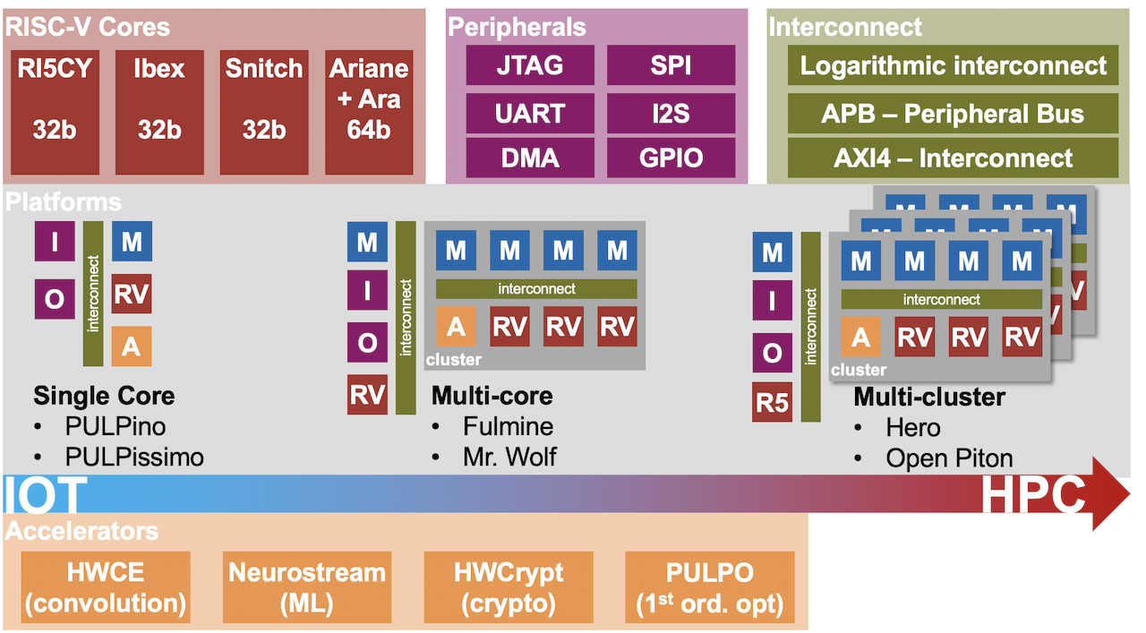
PULP platform
Fig 3: PULP platform family
Notes:
PULP is a silicon-proven Parallel Ultra Low Power platform targeting high energy efficiencies. With energy efficiency at the core of its design, it can lend itself readily to various kinds of embedded systems applications. With the omnipresent nature of embedded devices, ensuring device security is of even higher priority as malicious attackers might easily gain physical access to tamper with devices despite of the rapid growth of device number and market size, security has been overlooked for embedded systems due to the lagging security standards, inadequate investment in security development as well as the lack of security awareness.

Slide 5
Motivation
Lack of secure boot implementation for PULPissimo leaves it vulnerable to boot code injection at privileged levels which can cause sensitive information to be compromised.
Bootloader firmware units (like wolfBoot) might provide a false sense of security, as attackers might be able to compromise such units.
Notes:
In the Hack@DAC 2018 hardware security competition, it was exposed how the lack of secure boot implementation for PULPissimo leaves it vulnerable to boot code injection at privileged levels which can cause sensitive information to be compromised. [NJ2]
•while plug and play bootloaders like wolfboot exist, such Bootloader firmware units might provide a false sense of security. Work by L. Morel and D. Couroussé ,discusses how an attacker can be able to compromise such units can gain full control over the target system [NJ1]. It is up to the user to verify the security of the firmware and to ensure it does not contain any backdoors, which is impossible if the code is proprietary. the PULPissimo framework and other open-source RISC-V architectures do not have a secure boot implementation thereby making any applications developed on the platform vulnerable to a multitude of attacks primarily including data (including firmware) theft or firmware corruption. Since RISC-V architecture and the PULPissimo framework in particular are gaining popularity, we believe this is required for the reliability of any application^{[RMB1]} that uses the PULPissimo framework.

Slide 6
Objectives
Through this project we aim to provide the following deliverables:
Basic Secure Boot: A trusted application prior to execution of the user application that validates the user application before launching the application.
Procedure to test the functionality of the implemented secure boot.
A guide for the community aiming to implement secure boot onto the PULPissimo framework and for developing secure applications.
Notes:
Through this project we aim to provide the following deliverables:
· Basic Secure Boot – A trusted application prior to execution of the user application that validates the user application before launching the application.
· Validation – Procedure to test the functionality of the implemented secure boot.
· A guide for the community aiming to implement secure boot onto the PULPissimo framework and for developing secure applications.

Slide 7
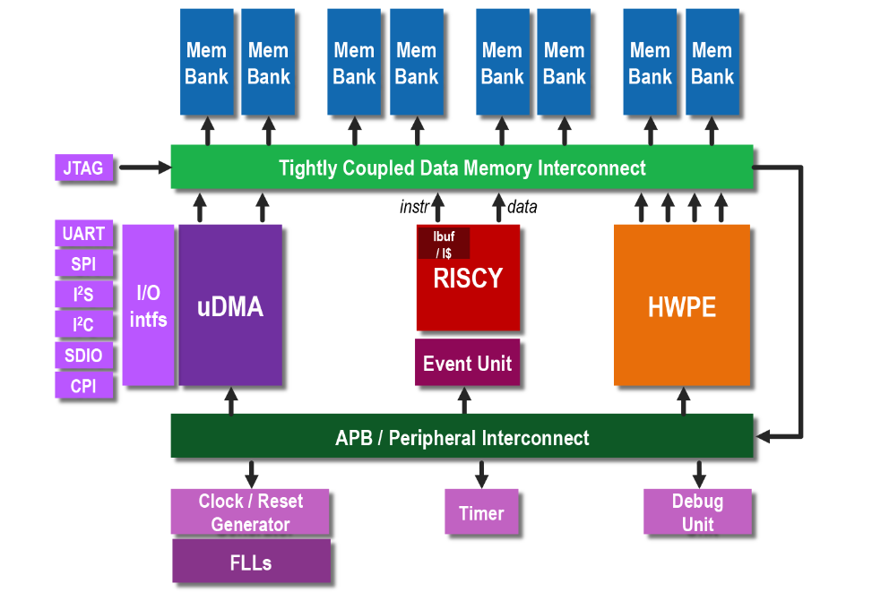
PULPissimo RISC-V Architecture
Fig 4: PULP RISC-V architecture

Slide 8
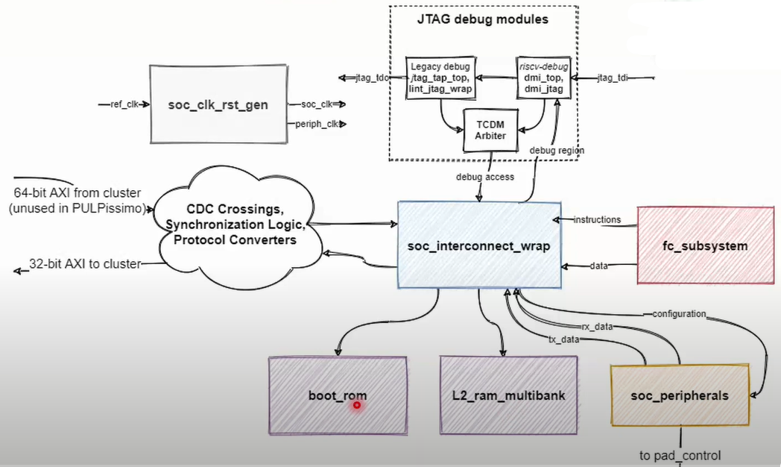
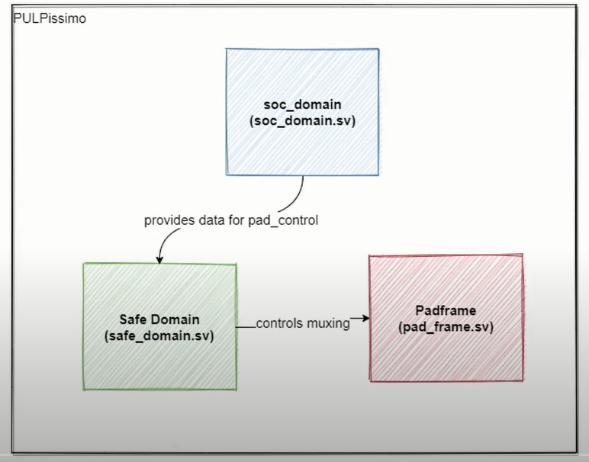
PULP Architecture
Fig 5: SoC Architecture

Slide 9
PULPissimo Setup
Vivado 2019.2 and QuestaSim tool were used.
Installation of PULP platform specific toolchain:
RISC-V GNU Compiler Toolchain
On Ubuntu, several packages that are required to build the toolchain.
Simple Runtime:
Export the PULP RISC-V toolchain to our toolchain path.
Update and use the pulp-runtime configuration.
The runtime simulation environment is setup.

Slide 10
PULPissimo Setup
Software Development Kit:
For a more complete runtime (drivers, tasks etc.)
Linux dependencies were built for the initialization of SDK
Use of virtual environment was essential for python packages.
After building the pulp-sdk, the necessary environment variables were set.
RTL simulation platform:
QuestaSim installation was required for the RTL simulation platform.
The latest version of the IP’s were checked out composing of the PULP system.
The required scripts were generated and updated. Dependencies were resolved.

Slide 11
FPGA setup for Pulp
Bitstream generation (generated for ZedBoard)
.bit the bitstream file for JTAG configuration
.bin the binary configuration file to flash to a non-volatile configuration memory
Bitstream Flashing
Programmed ZedBoard using Vivado.
GDB and OpenOCD:
The binary has to be loaded into PULPissimo’s L2 memory.
We need OpenOCD in parallel with GDB to setup communication with internal RISC-V debug module.
JTAG is used as a communication channel between OpenOCD and the Core

Slide 12
Data Hashing
Map data of any size to a fixed length ->Hash Digest
One way cryptographic function.
Common hashing algorithms include MD5, SHA-1, SHA-2, NTLM, and LANMAN
A good hash function must have 1. Irreversibility 2. Deterministic Property 3. Has an Avalanche effect

Slide 13
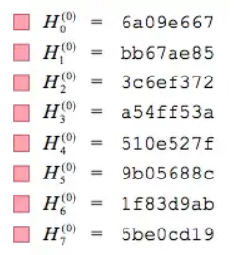
SHA256 : Pre-Processing
Padding
Blocks
Hash Initialisation
Fig 7: square roots of the first eight prime numbers
Fig 6: Pre-processing the input data
https://medium.com/

Slide 14
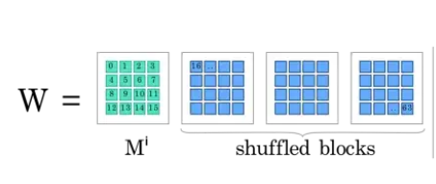
SHA256 : Algorithm
.
Message Schedule
Shuffle
Fig 9. Message schedule, Wi, 512-bits
New Hash
Fig 8: Generation of Hash Value
https://medium.com/

Slide 15
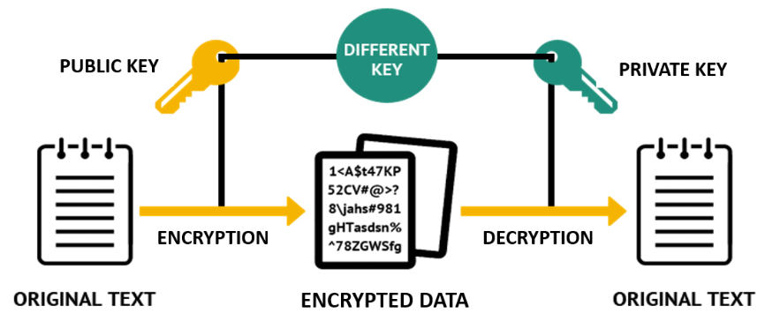
Encryption
Input data to cipher text.
Can only be decrypted by intended users.
Commonly used encryption algorithms AES, RSA, ECC
Fig 10: Encryption

Slide 16
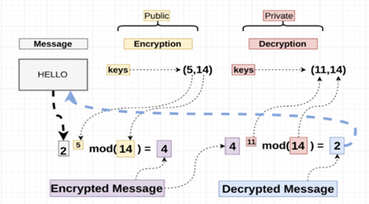
RSA Encryption
Two prime numbers
P and Q
n=p*q and ɸ=(p-1)*(q-1)
Public key(n,e)
Private key(d,e)
Fig 11: RSA Encryption
https://www.simplilearn.com/

Slide 17
Secure Boot Implementation

Slide 18
Boot Validation
Compute SHA256 hash of the device flash code
Software implementation of SHA256
Compare with the user hash stored in the device
Hash should match to launch the user code

Slide 19
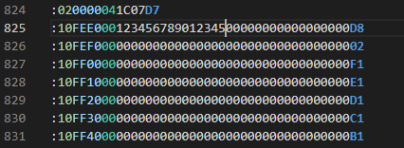
User Hash
Calculated using the original binary
riscv32-unknown-elf-objcopy tool is used
Convert executable -> elf -> hex
Add hash
Scripting
Manual - Intel HEX format
Convert edited hex -> executable
Linker script edits for custom section
Fig 12 - Intel Hex format editor

Slide 20
Secure Boot Flags
Version Number
Do not launch if incoming version number is smaller
Prevent exploitation of vulnerabilities in previous versions
Magic Number
Specific sequence of alternate 1s and 0s
To prevent unintended edits to boot flow
Is_Valid
Save the state of the validation

Slide 21
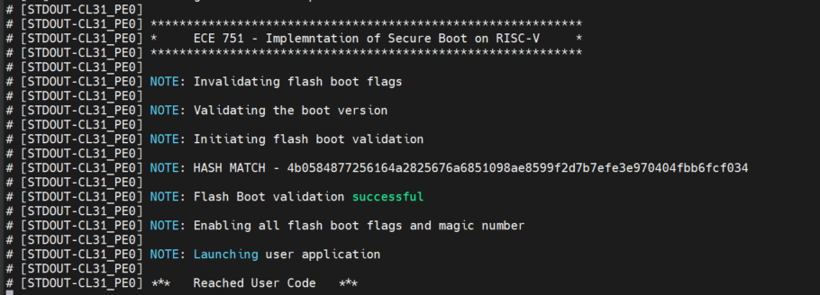
Verification - Regular Secure Boot Flow

Slide 22
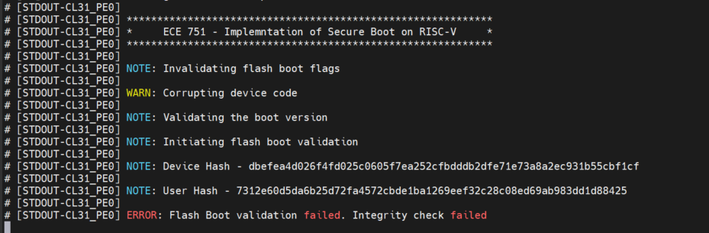
Verification - Manual Data Corruption

Slide 23
Conclusion
Basic secure boot for the PULPissimo RISC-V platform
Validation of the implemented secure boot
A guide for the community aiming to implement secure boot
Notes:
If a processor can use consecutive voltage, only a single voltage can minimize energy consumption satisfying the time constraint (Lemma-2).
Two voltages minimizes energy consumption under any time constraints(Theorem-1).
Two voltages which minimize energy consumption under a time constraint are immediate neighbors to the Videal (Theorem-2).

Slide 24
THANK YOU

