Slide 1

🎓 Elevate Labs – Online Internship Program
📊 Task 3 – Dashboard Design using Power BI
👩‍💻 Presented by: Rakshitha B M
🗓️ August 2025

Slide 2
Title: Dataset Overview – Call Center Agent Performance
- Source: CSV file (9,939 entries)
- Key Columns:
• AgentID, Agent_Name
• CallID, PickedUp (1/0)
• Duration (in seconds)
• ProductSold (1/0)

Slide 3
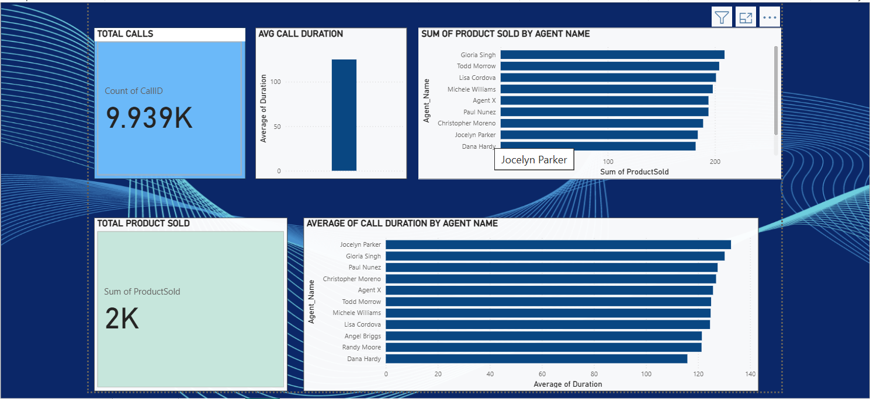
Title: Dashboard Layout – Power BI
Content:

Slide 4
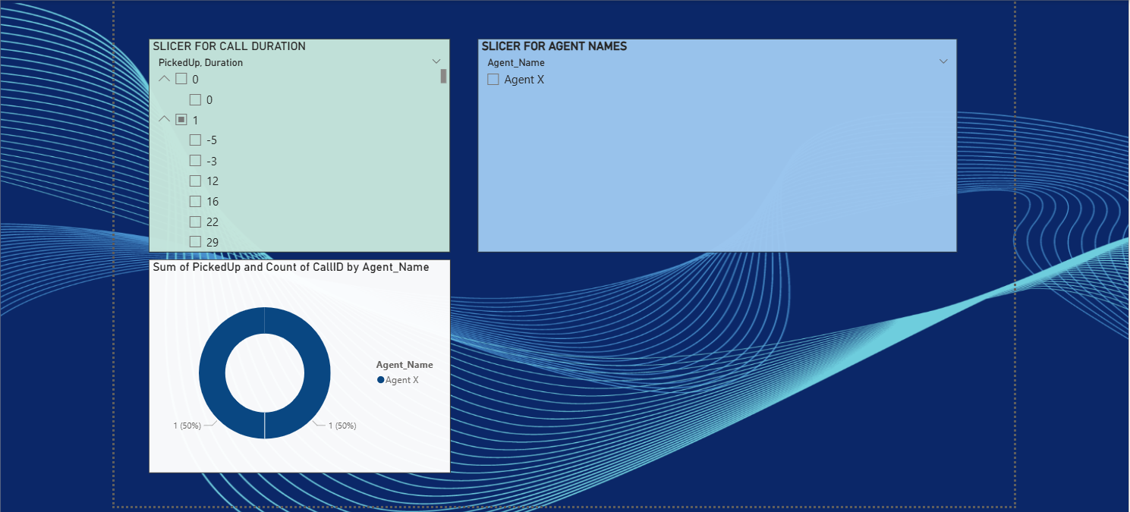

Slide 5
Title: Key Insights from the Dashboard
- Agent X had the highest number of picked calls
- Longer average call durations led to higher conversions
- Some agents missed more calls than others
- Product sales are related to pickup rates
- Call performance varies significantly across agents

Slide 6
Title: Tools Used & Learning Outcome
🛠️ Tools:
- Power BI Desktop
- Microsoft Excel (for data checking)
🎓 Learnings:
- Designed professional dashboards
- Applied slicers and filters effectively
- Discovered insights from call data
- Enhanced data storytelling skills
➡️ This project showed how simple call metrics can reveal strong business insights.

