Slide 1


K.RAMAKRISHNAN COLLEGE OF ENGINEERING
(AUTONOMOUS)
2048 GAME DEVELOPMENT
Presented by,
Name : RAKSHITHA R
Register No : 8115U25IT091
Roll No : F2549
Year & Section : I & B

Slide 2
Introduction
2048 is a popular single-player puzzle game created by Gabriele Cirulli in 2014. The game is played on a 4×4 grid where the player slides numbered tiles in four directions (up, down, left, and right). When two tiles with the same number collide, they merge into one tile with their combined value. The main objective is to create a tile with the number 2048. The game requires logical thinking, planning, and strategy to achieve higher scores and avoid filling up the grid. Due to its simple rules and challenging gameplay, 2048 has become one of the most popular puzzle games worldwide.

Slide 3
Abstract
The 2048 Game is a simple yet challenging puzzle game played on a 4×4 grid. The player combines tiles with the same numbers to create higher-value tiles, aiming to reach the number 2048. The game improves logical thinking, problem-solving skills, concentration, and strategic planning. Its easy-to-understand rules and engaging gameplay make it popular among people of all ages. The game continues until no more moves are possible or the player successfully creates the 2048 tile.
The 2048 Game is a simple yet challenging puzzle game played on a 4×4 grid. The player combines tiles with the same numbers to create higher-value tiles, aiming to reach the number 2048. The game improves logical thinking, problem-solving skills, concentration, and strategic planning. Its easy-to-understand rules and engaging gameplay make it popular among people of all ages. The game continues until no more moves are possible or the player successfully creates the 2048 tile.

Slide 4

OBJECTIVES
To create a tile with the value 2048 by merging identical numbered tiles.
To improve logical and strategic thinking skills.
To enhance problem-solving abilities through planning and decision-making.
To develop concentration and focus while playing.
To achieve the highest possible score by creating larger numbered tiles.
To efficiently manage the available grid space and avoid game over.
To provide an enjoyable and challenging puzzle gaming experience.
To improve analytical and cognitive skills through continuous gameplay.

Slide 5
PROJECT SUMMARIZATION
2048 is a number-based puzzle game played on a 4×4 grid.
The player combines tiles with the same numbers to create larger values.
The main objective is to reach the 2048 tile.
The game requires logical thinking and strategic planning.
It improves problem-solving and decision-making skills.
Players must manage grid space efficiently to continue the game.
The game has simple controls and an easy-to-use interface.
It provides both entertainment and educational benefits.
The project demonstrates game development and user interaction concepts.
Overall, the project enhances cognitive skills while offering an engaging gaming experience.

Slide 6


PYTHON USED
Variables – Store tile values and scores.
Lists (2D Lists) – Represent the 4×4 game board.
Functions – Handle movements, merging, and game logic.
Conditional Statements (if, else) – Check game rules and conditions.
Loops (for, while) – Update the board and continue gameplay.
Random Module – Generate random tiles (2 or 4).
Notes:
1.7.2013
8
‹#›

Slide 7
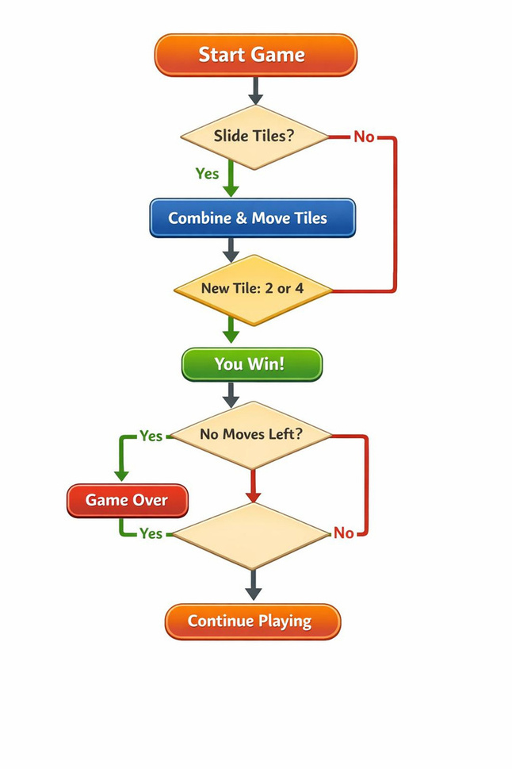
FLOW CHAT

Slide 8
System Module
Game Initialization
User Input and Movement Control
Tile Merging and Board Update
Win and Game Over Detection
.

Slide 9
Module 1:Game Initialization
Purpose:
Manages the initial setup of the 2048 game and prepares the game board for play.
Functions:
Create a 4×4 game board
Initialize the score to zero
Generate two random tiles (2 or 4)
Display the initial game board
Set game status and variables
Description:
Game Initialization is the first module of the 2048 game. It creates an empty 4×4 grid and places two random numbered tiles on the board. The player's score is set to zero, and all necessary variables are initialized. After the board is displayed, the game becomes ready to accept user input and begin gameplay.

Slide 10
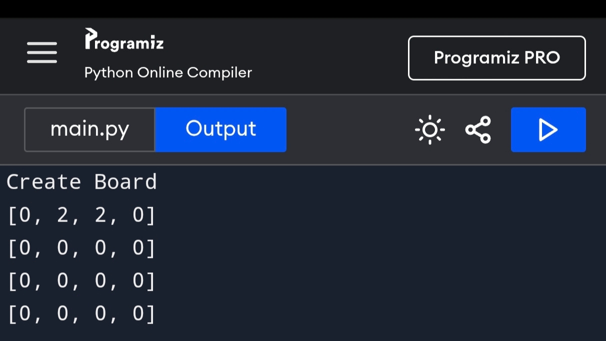
Output

Slide 11
Module 2 : User Input and Movement Control
Purpose:
Manages player input and controls the movement of tiles on the game board.
Functions:
Accept user input (Up, Down, Left, Right)
Move tiles in the selected direction
Validate player moves
Update tile positions on the board
Prevent invalid movements
Description:
This module handles all interactions between the player and the game. It receives movement commands from the user and moves the tiles accordingly. The module checks whether the move is valid and updates the board state. It ensures that tiles move correctly within the grid and prepares the board for tile merging and score updates.

Slide 12
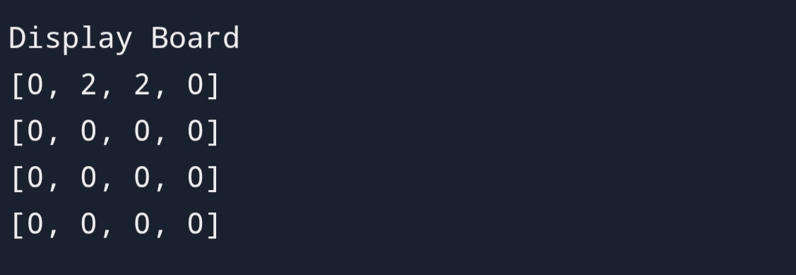
output
Notes:
1.7.2013
11
‹#›

Slide 13
Module 3: Tile Merging and Board Update
Purpose:
Manages the merging of tiles with the same value and updates the game board after each move.
Functions:
Identify adjacent tiles with the same value
Merge matching tiles into a single tile
Double the tile value after merging
Update the player's score
Add a new random tile after a valid move
Refresh the game board display
Description:
This module combines tiles with the same value when they are moved together. After merging, the board is updated, and a new tile is added to an empty position. It helps the player create larger-number tiles and continue the game.

Slide 14
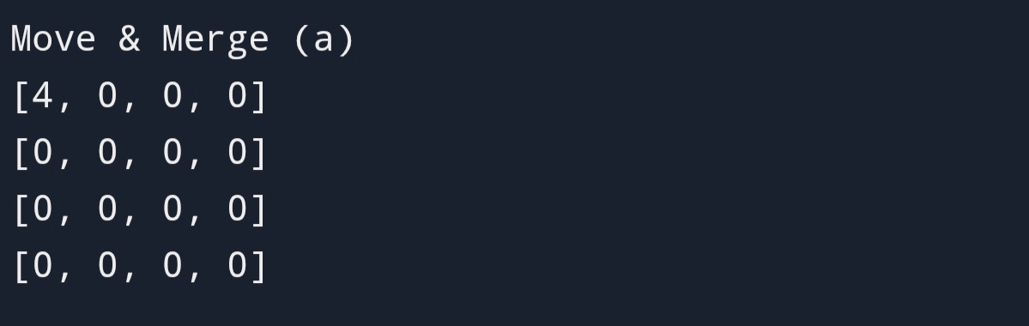
output
Notes:
1.7.2013
12
‹#›

Slide 15
Module 4: Win and Game Over Detection
Purpose:
Determines whether the player has won the game or if no more moves are available.
Functions:
Check for the 2048 tile
Detect winning condition
Check for available moves
Detect game over condition
Display win or game over message
Show the final score
Description:
This module checks whether the player has reached the 2048 tile and won the game. It also detects when no more moves are possible and displays the game-over message. This helps determine the final status of the game.

Slide 16
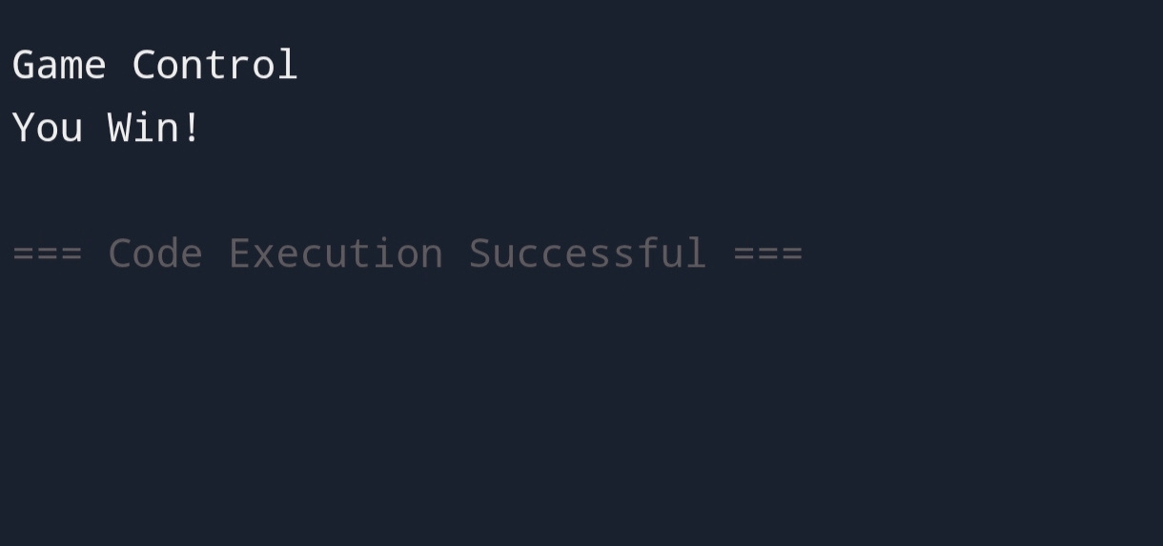
output

Slide 17
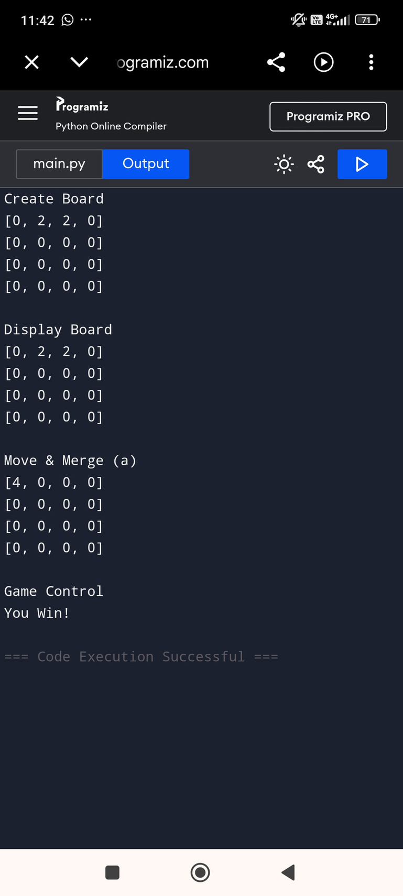
Final Output
Notes:
1.7.2013
14
‹#›

Slide 18
ADVANTAGE
Improves Logical Thinking – Helps players think logically and make smart decisions.
Enhances Problem-Solving Skills – Encourages finding the best moves to achieve the goal.
Develops Strategic Planning – Requires planning ahead to avoid losing.
Increases Concentration – Improves focus and attention during gameplay.
Easy to Learn – Simple rules make it accessible for beginners.
Provides Entertainment – Offers a fun and engaging gaming experience.
Boosts Memory Skills – Helps players remember patterns and strategies

Slide 19
DISADVANTAGES
Can Be Addictive – Players may spend excessive time trying to achieve higher scores.
Limited Gameplay Variety – The game follows the same rules and objectives throughout.
May Become Repetitive – Repeated moves can make the game feel monotonous over time.
Requires Continuous Attention – Losing focus can lead to mistakes and game over.
No Multiplayer Option – Standard 2048 is designed for a single player only.
Success Depends on Luck and Strategy – Random tile generation can sometimes make the game difficult.
May Cause Frustration – Reaching the 2048 tile can be challenging for some players

Slide 20
Conclusion
The 2048 Game is an engaging and educational puzzle game that combines entertainment with learning. It helps improve logical thinking, problem-solving skills, concentration, and strategic planning. The game is simple to understand but challenging to master, making it enjoyable for players of all ages. Through tile merging and careful decision-making, players work toward achieving the 2048 tile. Overall, the project successfully demonstrates game development concepts while providing a fun and mentally stimulating experience.

Slide 21
REFERENCE
python.org – Programming language used to develop the game.
jetbrains.com– Used for writing and debugging Python code.
code.visualstudio.com – Alternative code editor for development.
pygame.org– Python library used for creating the game interface and controls.
github.com– Used for source code storage and version control.

Slide 22
THANK YOU

