Slide 1
IPL Performance Analytics
Major Project — Data Analysis Internship
Nagella Rakshitha | ECE, Final Year, SPMVV | Avishkarana Andhra Summer Internship

Slide 2
Problem Statement
IPL ball-by-ball and match data analyzed to identify top-performing players
Understand team scoring patterns across different phases of an innings
Test statistically whether death-over scoring differs from middle-over scoring
Deliver insights via an end-to-end pipeline and interactive dashboard

Slide 3
KPIs Tracked
Total runs scored per team
Top 10 run scorers across all matches
Top 10 wicket-taking bowlers
Average run rate by over (powerplay / middle / death)
Match win counts by team
High-scoring overs (aggregate runs per over > 15)

Slide 4
Data Sources & Modeling
matches.csv
deliveries.csv
One row per match — teams, venue, toss, result, margin
One row per ball — batsman, bowler, runs, wicket, over
Joined on match_id → loaded into SQLite (ipl.db) for relational SQL analysis across both sources.

Slide 5
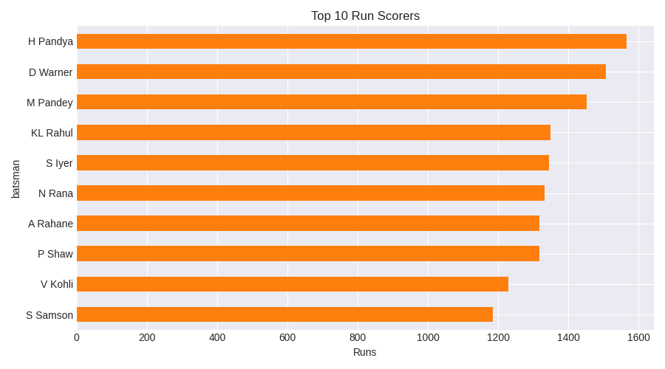
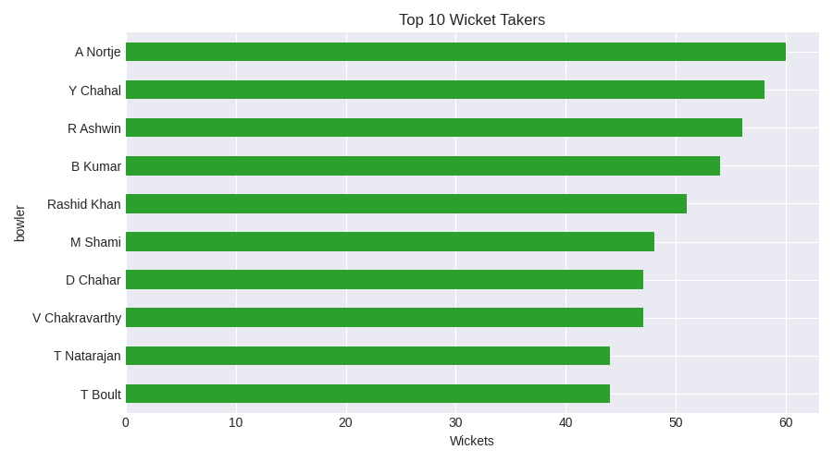
EDA — Top Performers
Both scoring and wicket-taking are concentrated among a small group of top players.

Slide 6
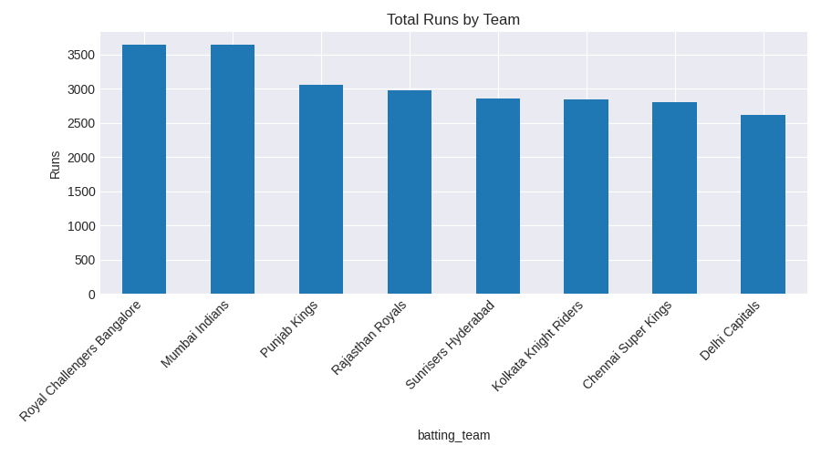
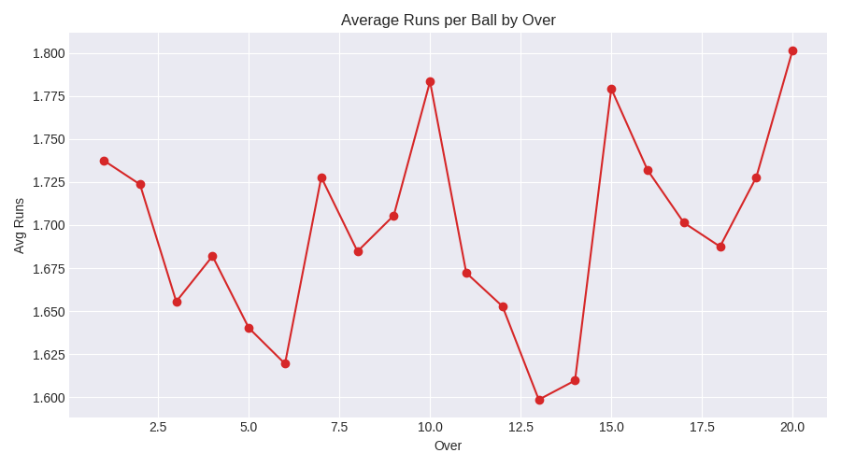
EDA — Team & Scoring Patterns

Slide 7
SQL Analysis — Top Run Scorers
Batsman | Total Runs
H Pandya | 1565
D Warner | 1506
M Pandey | 1451
KL Rahul | 1348
S Iyer | 1345
Query: SELECT batsman, SUM(total_runs) FROM deliveries GROUP BY batsman ORDER BY total_runs DESC LIMIT 5

Slide 8
Statistical Summary & Hypothesis Test
Mean runs/ball: 1.696 | Std Dev: 1.841 | Skewness: 1.063
Correlation (over vs runs): 0.007 — negligible linear relationship
t-test: Death overs (16-20) vs Middle overs (7-15)
Death mean = 1.730, Middle mean = 1.690, p-value = 0.306
Result: no statistically significant difference (p > 0.05)

Slide 9
Interactive Dashboard
Built with Streamlit + Plotly:
Live KPI cards — matches, total runs, wickets, avg runs/ball
Team filter for drill-down exploration
4 linked charts: top scorers, top wicket takers, run rate by over, wins by team
Run locally: https://machinelearning-cvw2fxqbwrgb8neq5pkndd.streamlit.app/

Slide 10
Insights & Conclusion
Scoring is concentrated among a core group of top batsmen, mirroring real IPL trends
Bowling impact is similarly concentrated among a handful of strike bowlers
Overs 10, 16 and 20 show aggregate scoring spikes — tactically relevant for bowling changes
Death-over vs middle-over scoring difference is not statistically significant in this dataset
Codebase and dashboard are reusable — swap in real IPL CSVs to re-run the full pipeline

