Slide 1



ELECTRICITY PRICE FORECASTING USING DEEP LEARNING
Channabasaveshwara Institute of Technology
ISO 9001:2015 Certified Institution)
(Affiliated to VTU, Belgaum & Approved by AICTE, New Delhi)
NH 206 (B.H. Road), Gubbi, Tumkur – 572 216. Karnataka
2022-23 .
PROJECT PHASE-1 PRESENTATION ON
TEAM MEMBERS
RAKSHITHA SHANKAR - 1CG19CS090
SOWMYASHREE O A - 1CG19CS105
POOJA M - 1CG19CS085
VARSHITHA T S - 1CG19CS114
GUIDED BY
Mrs. RASHMI C R
Asst. PROFESSOR
DEPT. OF COMPUTER SCIENCE
CIT,GUBBI

Slide 2

INTRODUCTION
Accurately predict
electricity consumption
minimize the production
storage
It influence factors such as
power supply
demand relationship
market participant influences
power generation costs
market structure
deep learning algorithms
LSTM methods
CNN
RNN

Slide 3
PROBLEM STATEMENT
Problems
Bidding
techniques
Decision by regulators
Changes in demand
interconnectors
Energy is transferred between several networks, there are numerous bidding techniques, the price of electricity is non-linear and extremely variable, and both supply and demand are always changing. Storage is therefore unprofitable.

Slide 4
OBJECTIVES
This study is to evaluate the peak performance of different ML Algorithms & Deep neural networks in predicting the price of electricity.
To provide an optimized scheduling process for an industrial loads to get an accurate electricity price.
Comparing ML & DL algorithms, the high accurated model for EPF is selected.

Slide 5
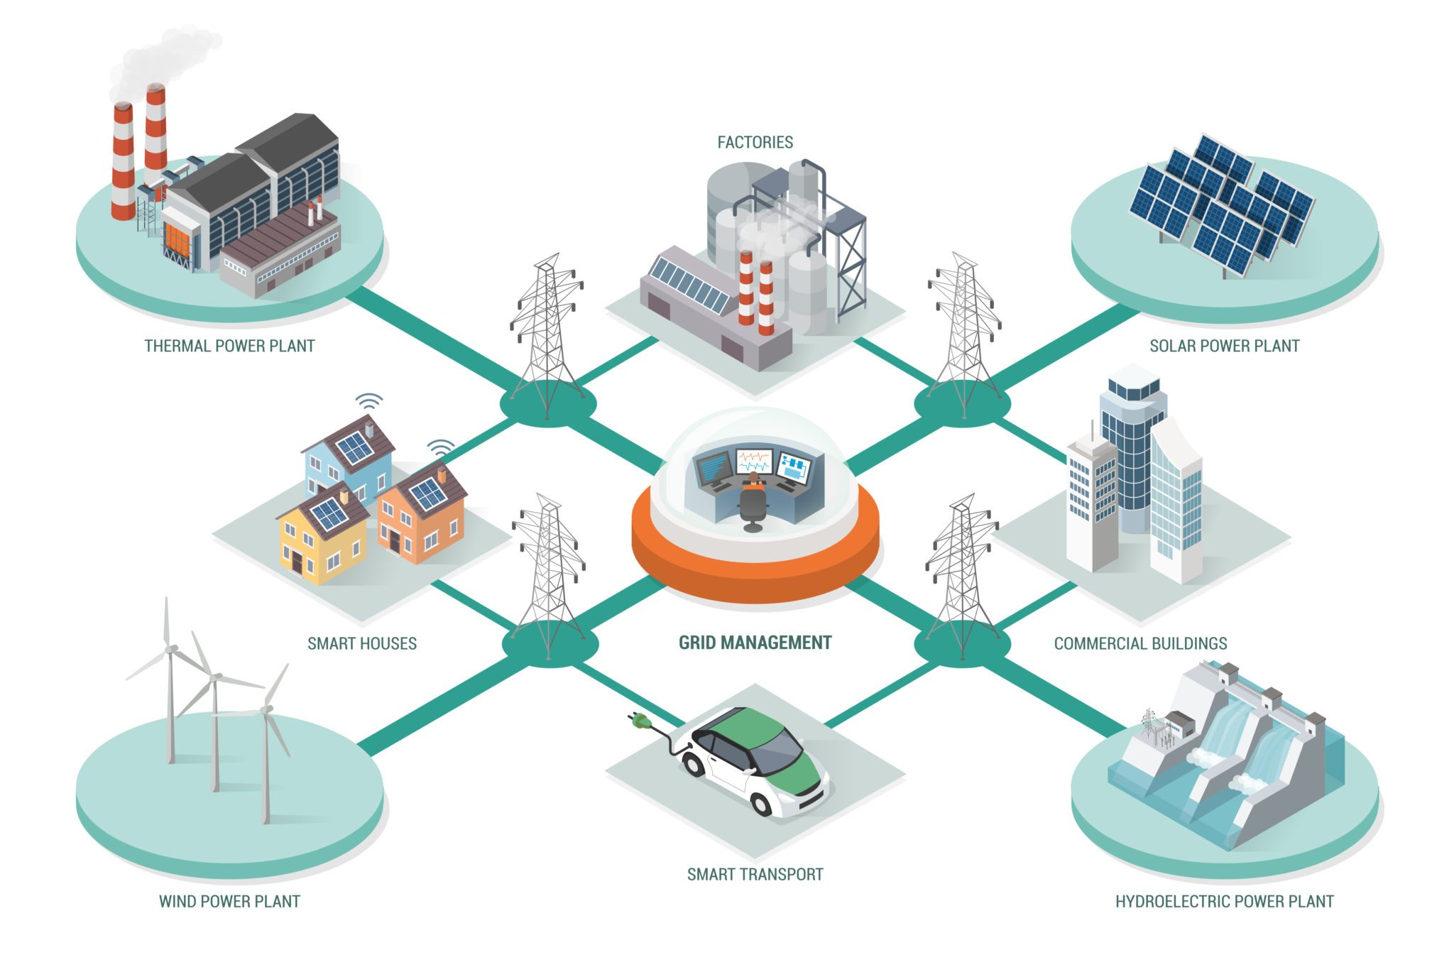
SCOPE OF THE PROJECT

Slide 6
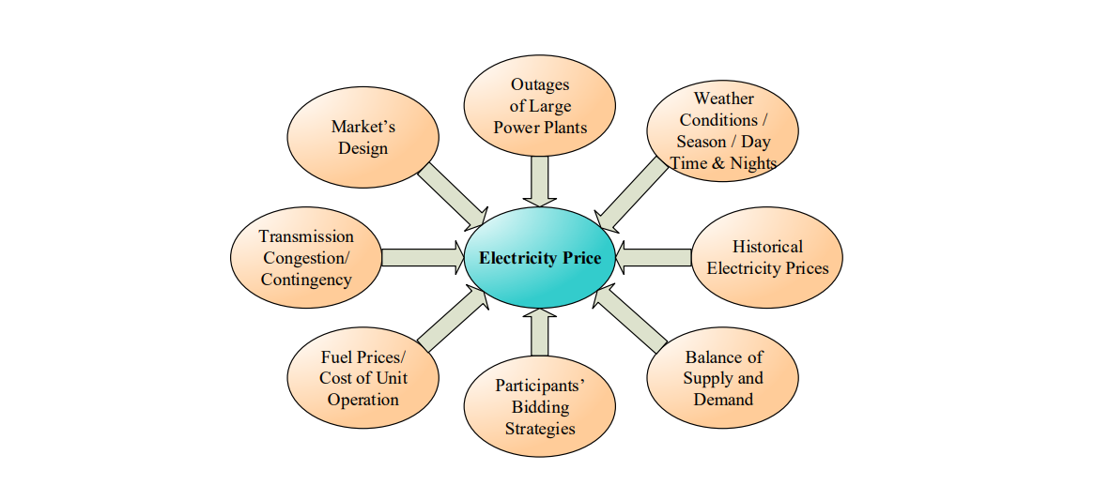
It can be seen that because of the various factors influences electricity prices

Slide 7
LITERATURE SURVEY
SI NO | PAPER TITLE | AUTHOR NAME | MODELS | CONCLUSION
01 | Electricity Consumption & Prediction using Machine Learning Models | Tapas Ranjan jean | CML | This Paper reviews the CML Models as well as the recent models, allowing predicting electricity consumption
02 | Day-ahead electricity price prediction applying hybrid models of LSTM-based deep learning methods and feature selection algorithms under consideration of market coupling | Denis Becker | LSTM | LSTM models have a good performance in handling nonlinear and complex problems and processing time series data

Slide 8
SI NO | PAPER NAME | AUTHOR NAME | MODELS | CONCLUSION
03 | Week Ahead Electricity Price Forecasting Using Artificial Bee Colony Optimized Extreme Learning Machine with Wavelet Decomposition | Udaiyakumar | ABC-ELM | using graph plots and error metrics and the proposed method is found to provide better accuracy.
04 | An Electricity Price Forecasting Model by Hybrid Structured Deep Neural Networks | Ping-Huan Kuo | CNN,LSTM | Experiment results show that compared with other traditional machine learning methods, the prediction performance of the estimating model proposed in this paper is proven to be the best

Slide 9
SI NO | PAPER NAME | AUTHOR NAME | MODELS | CONCLUSION
05 | Deep Learning Forecasts of the Electricity Price with special Consideration of the Electricity Supply | Stephan Schneider | deep learning artificial neural networks | This study primarily looks at the supply-side prediction of the electricity price with the help of deep learning artificial neural networks
06 | Short-Term Electricity Price Forecasting by Employing Ensemble Empirical Mode Decomposition and Extreme Learning Machine | Sajjad Khan | (ELM). | We conduct several experiments on real-time data obtained from three different states of the electricity market in Australia

Slide 10
Methodology
start
Train the model on Batches
Loading data
Finish
Training
NO
Data normalization
Select the Testing partition
Finish
NO
Split Training data and Testing data
Performance Evaluation
Shuffle Training data
End

Slide 11
EXPECTED OUTCOME
The literature survey concludes with better results for electricity consumption prediction with the hybrid approach of machine learning techniques.
Feature selection is essential to achieving accurate prediction, and features from integrated markets have an impact on prediction.
using graph plots and error metrics and the proposed method is found to provide better accuracy.

Slide 12
REFERENCES
Electricity Consumption & Prediction using Machine Learning Models”, Tapas Ranjan Jena, Swati SucharitaBarik, SasmitaKumariNayak, published an Article - June 2020
“Day-ahead electricity price prediction applying hybrid models of LSTM-based deep learning methods and feature selection algorithms under consideration of market coupling”, Wei Lia , Denis Beckera, published on 18 Jul 2021
. “Forecasting day-ahead spot electricity prices using deep neural networks with attention mechanism”, Adam Marszałek, TadeuszBurczyński,Published: 30 Mar 2021

Slide 13
“An Electricity Price Forecasting Model by Hybrid Structured Deep Neural Networks”,Ping-HuanKuo,Published: 21 April 2018.
Deep Learning Forecasts of the Electricity Price with special Consideration of the Electricity Supply”,Stephan Schneider.
Short-Term Electricity Price Forecasting by Employing Ensemble Empirical Mode Decomposition and Extreme Learning Machine”,Sajjad Khan

Slide 14
THANK YOU

