Slide 1

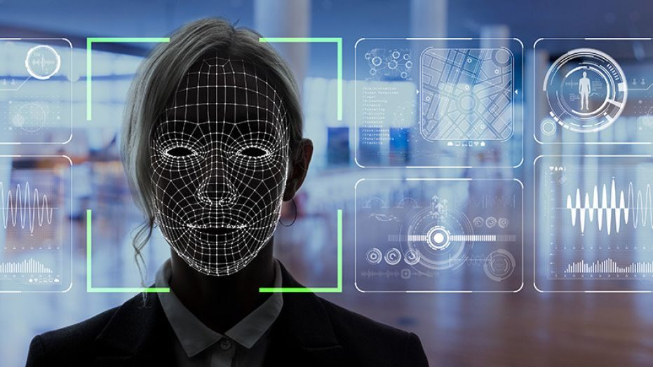



Biometrics Assignment 03 Design and Evaluation of a Face Recognition System
Presented by:
Urvi Chandreshkumar Sheth [A20430232]
Rakshith Churchagundi Amarnath [A20424771]
Aditya Yaji [A20426486]

Slide 2
Contents
Problem Statement
Approach
Implementation
Results
ROC and CMC Curves

Slide 3
Problem Statement
This Face Recognition System is developed using MATLAB Image Processing and Computer Vision tools for coding.
Objective is to design and evaluate a face recognition system using the data provided and the open source face recognition software.
A dataset is given in which 2D-face images taken from the different subjects.

Slide 4
Approach
Design Gallery and probes using given database.
Open Source Software for implementation of the system which is doing face matching and recognition.
Generate Genuine and Imposter Distributions.
Extract ROC and CMC curves from the results.

Slide 5
Files
Testmask.m (Code to create Eigen values for Gallery & Find Euclidean distance for Probe)
Face_recognition.pptx (The file containing findings and graphs)
Graph.ipynb (Code to generate ROC,CMC and Histogram)
Mmatrix_val.xlsx (All Euclidean distances for probe to Gallery)(Folder-wise)
Open Source code ( EigenfaceCore.m and Recognition.m)

Slide 6
Implementation Step-1:
In this assignment, we have used MATLAB Image Processing and Computer Vision tools for coding.
The dataset contains 144 subjects. We have used Gallery/Training set of all 144 subjects and probe for all 144 subjects. So each subject has image in gallery and probe subject is matched against all subjects from gallery.
The identification is achieved firstly by extracting features using Principal Component Analysis (PCA) and the resulting eigenfaces are matched with the probe to get Euclidean Distance (ED) between the 2 templates. The minimum ED confirms a match.

Slide 7
Implementation (contd.) Step-2:
The implementation for generating eigen values for the gallery
Taking the image from gallery
Convert it into grayscale
Reshape 2D image of the training database into 1D column vector named ‘T’ and merged it into 2D matrix.
Use EigenfaceCore function gets a 2D matrix, containing all training image-vectors and returns 3 outputs which are extracted from training database which are the values named m , A and eigenfaces.

Slide 8
Implementation (contd.)
Step-3:
Taking all the testing images from the probe, we took images from each folder and calculated the ED between each match.
An array named Euc_dist stores all the ED and is copied in an MS Excel sheet named Mmatrix_val.xlsx for plotting the ROC and CMC curves.

Slide 9

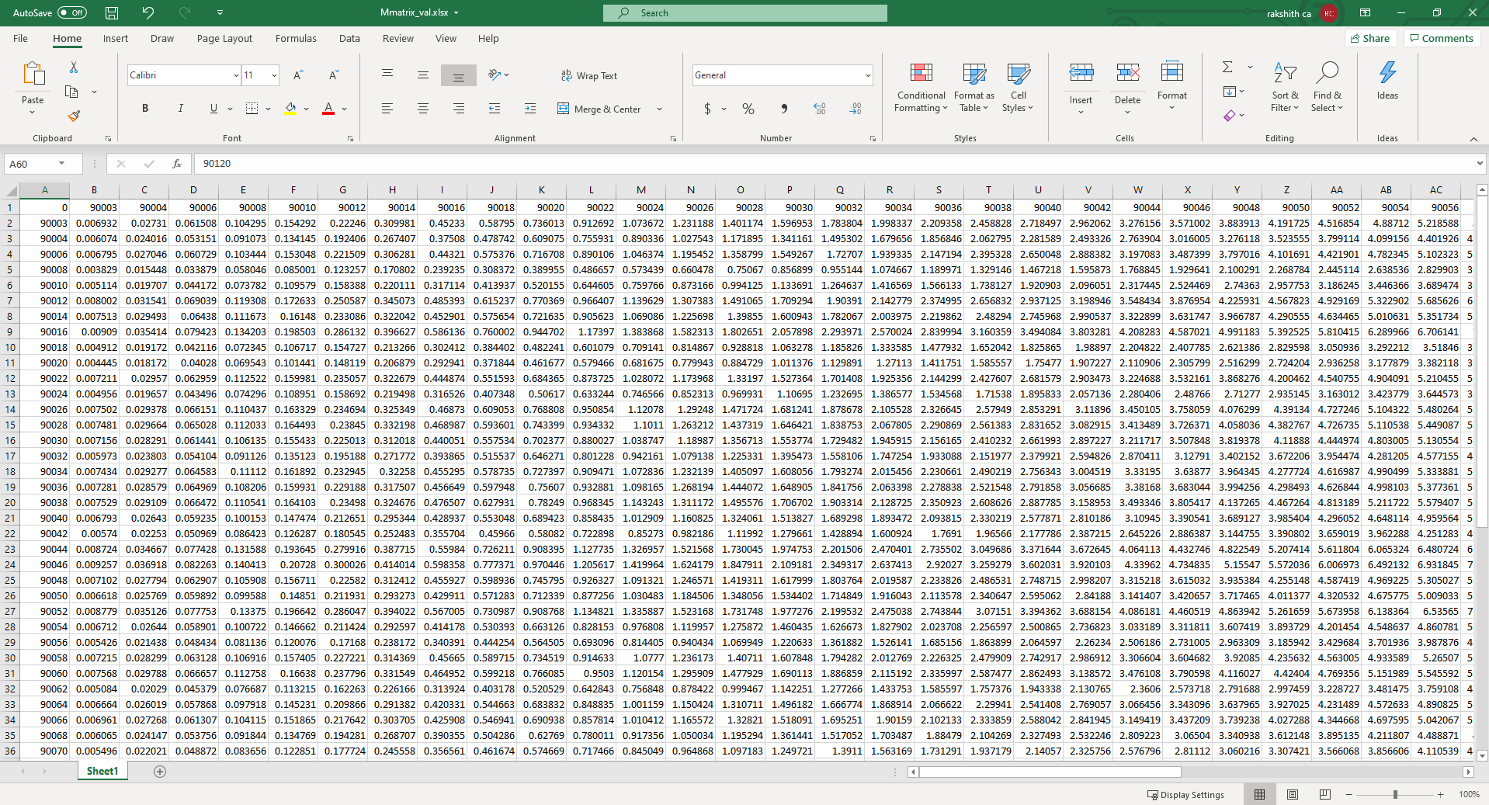
Results
Rows and Columns are highlighted in red are the folder names.
The other values are ED between the corresponding rows & cols.

Slide 10
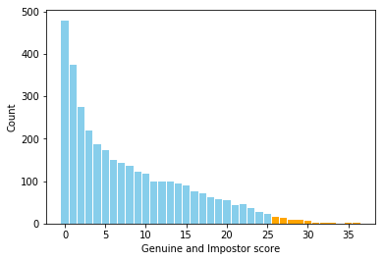
Imposter and Genuine Distribution
From the data of Euclidian Distance, we plot the Imposter and Genuine Distribution
We are taking a threshold value of 25 for Genuine and Imposter Distribution
Blue represents Imposters
Orange represents Genuine

Slide 11
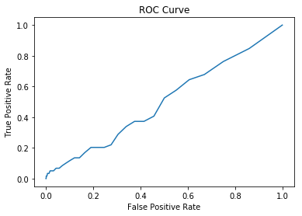
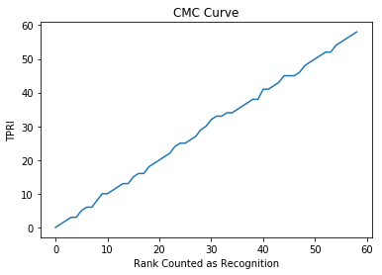
CMC and ROC Curves
For ROC, we calculated by considering the True match region and False match region from the distribution and the data table.
For CMC, Each probe image is sorted and ranked based on ED. Rank is allotted for the true matches. True Positive Identification Rate is calculated. The Curve is plot between TPRI and ranks

