Slide 1
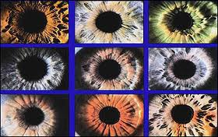
IRIS RECOGNITION SYSTEM
CS-559 – HW2 – FALL 2019
Presented by:
Aditya Yaji [A20426486]
Urvi Chandreshkumar Sheth [A20430232]
Rakshith Churchagundi Amarnath [A20424771]

Slide 2
Overview:
Introduction
Iris Recognition Diagram
Problem Statement
Files
Approach
ROC Curves for probe – 1 and 2
Histogram for probe – 1 and 2
CMC Curves for probe – 1 and 2

Slide 3
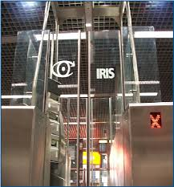
Introduction
Iris recognition is a method of biometric identification and authentication that use pattern-recognition techniques based on high resolution images of the irises of an individual's eyes .
It is the most accurate biometric technology available today.

Slide 4
Iris Recognition Diagram
Iris Segmentation
Image Acquisition
Normalization
Eye Image
Iris Region
Feature points in the iris region
Feature Matching
Feature Encoding
Identify or Reject Subject
Iris Template
Iris Templates Database

Slide 5
Problem Statement
The project is designed to develop an iris biometrics system that evaluates performance for verification based on ROC curve and recognition based on CMC curve.
To train the system and evaluate the performance iris datasets collected by LG2200 and LG4000 is being used.
The input to the system will be an eye image, and the output will be an iris template, which will provide a mathematical representation of the iris region.

Slide 6
Files
trial_4000.m (Code to create iris template and find hamming distance for LG4000 Probe)
trial_2200.m (Code to create iris template and find hamming distance for LG2200 Probe)
Report.pptx (The file containing findings and graphs)
Graph_2200.ipynb (Code to generate ROC,CMC and Histogram for LG2200 probe)
Graph_4000.ipynb (Code to generate ROC,CMC and Histogram for LG4000 probe)
Values_2200.xlsx (All Hamming distances for LG2200 probe to Gallery)(Folder-wise)
Values_4000.xlsx (Hamming distance for LG4000 probe to Gallery) (Folder-wise)
Open Source code (Libor Masek's open source iris matching code)

Slide 7
Approach
Iris Recognition system, we evaluate and design the Iris Recognition by using given databases.
From Database, we have used LG2200-2008 folder's images from all subjects as gallery, LG2200-2010 folder's images as probes and LG4000-2010 folder's images as probes (we took 1-1 images from all sub folders).
From Open Source Iris matching code, we have made one source code which is using functions from open source iris matching code. From that we can calculate Hamming Distance and we can do 1-n matching for iris system for all image set at a time. From Hamming distance result set, which is stored in a xlsx file.
After that we derive Histogram in ipynb file only. In that, we do code to derive threshold values, TMR and FMR by using array function so that we can derive ROC curve and CMC Curve.
Process:
Image Acquisition – capturing eye image
Segmentation – locating the iris region in an eye image
Normalization – creating a dimensionally consistent representation of the iris region
Feature Encoding – creating a template containing only the most discriminating features of the iris

Slide 8
Approach(Contd..)
In the initial phase, multiple distinct images from LG2200-2008 named Gallery2000 dataset are fetched to create the gallery (a collection of biometric templates that form search dataset) for the system. Once the database is ready, probe (collection of biometric templates that needs to be recognized or identified by matching against the gallery) is compared with the gallery to determine whether it is a true match or a false match. One image from each subfolder of LG2200-2010 (probe1) and LG4000-2010 (probe2) dataset is considered as probe while evaluating the performance of the system.
The functions of createiristemplate.m creates template (which creates a binary data) for each image fetched from existing dataset (LG2200-2008) and stores the template for matching.
When the probe image is given as input, using the createiristemplate.m a template is created and compared with the N templates from gallery that are already stored in the database. In this case, gallery comprises of 88 images, probe1 and probe2 comprises of number of images around 220 each.
After creating template for both gallery and probes, we try to find hamming distance for each probe against all the gallery values. After all the values are generated, we store it into a xlsx format to generate ROC, Histogram and CMC

Slide 9
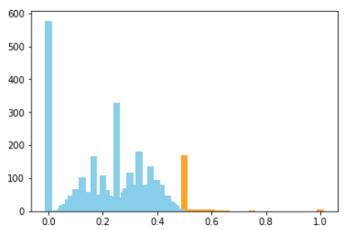
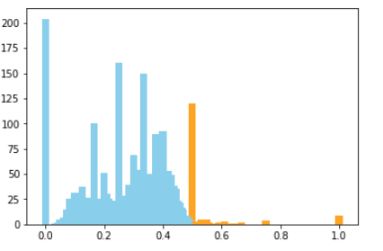
Histogram for Probe – 1 and 2
Histogram for Probe 1
Histogram for Probe 2
For the threshold value 0.5 we can see the clear distribution of Genuine by Blue color and Imposters as orange.
For the threshold value 0.5 we can see the clear distribution of Genuine by Blue color and Imposters as orange.

Slide 10
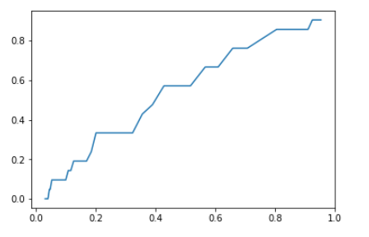
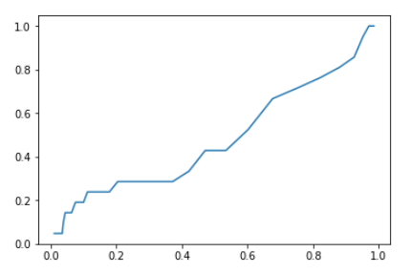
ROC Curve for probe - 1 and 2
ROC Curve for Probe 1
ROC Curve for Probe 2
In the given ROC Curve, all Gallery LG2200-20008 images are considered as gallery. For probe 1 we have taken images from each sub folder of LG2200-2010; after that we have evaluated the threshold value and array of TMR and FMR for ROC curve-probe 1.
In the given ROC Curve, all Gallery LG4000-20008 images are considered as gallery. For probe 2 we have taken images from each sub folder of LG4000-2010; after that we have evaluated the threshold value and array of TMR and FMR for ROC curve-probe 2.

Slide 11
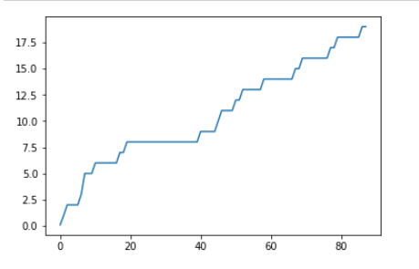
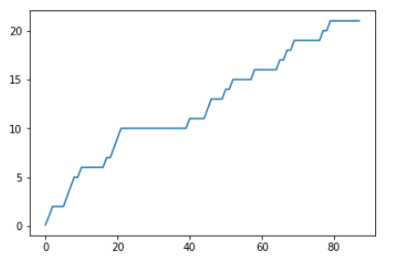
CMC Curves for probe – 1 and 2
CMC Curve for Probe 1
CMC Curve for Probe 2
In the given ROC Curve, all Gallery LG2200-20008 images are considered as gallery. For probe 1 we have taken images from each sub folder of LG2200-2010; after that we have evaluated rank and Recognition rate to create CMC Curve probe 1.
In the given ROC Curve, all Gallery LG2200-20008 images are considered as gallery. For probe 1 we have taken images from each sub folder of LG4000-2010; after that we have evaluated rank and Recognition rate to create CMC Curve probe 2.

