Slide 1
Welcome to
Git Session

Slide 2
Overview of Git
What is Git?
What is distributed version control?
How does Git Work?
How to install Git?
What is Github?
Sample project creation using Git.

Slide 3
What is Git?
Git started in 2005 by Linus Torvald aid in linux kernel development.
Git is a distributed version-control system for tracking changes in source code during software development.
Git is designed for coordinating work among programmers, but it can be used to track changes in any set of files.
Git goals include speed, data integrity, and support for distributed, non-linear workflows.
Git directory on every computer is a full-fledged repository with complete history and full version-tracking abilities, independent of network access or a central server.
Git is free and open-source software.

Slide 4
What is distributed version control?
It is a form of version control where the complete codebase,including its full history and it is mirrored on every developer's computer.
This allows branching and merging to be managed automatically, increases speeds of most operations (except for pushing and pulling).
Improves the ability to work offline, and does not rely on a single location for backups.
It is used to store different versions of a file in a remote or local repository.
It is used to track changes in the source code.
It allows multiple developers to work together.

Slide 5
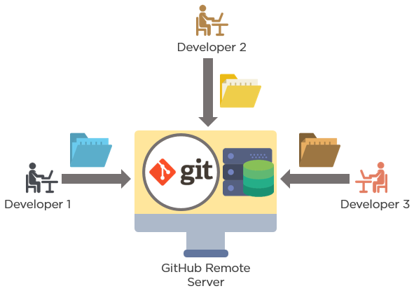

Slide 6
How does git work?
Git is an Open Source Distributed Version Control System.
Control System means it is is a content tracker.
Version Control System means code which is stored in Git keeps changing as more code is added and also many developers can add code in parallel so, it helps to maintain the history.
Git provides features like branches and merges.
Distributed Version Control System means it has a remote repository which is stored in a server and a local repository which is stored in the computer of each developer.

Slide 7
How to install git?
Download git
Command in the command prompt
Command Line : git --version
URL is as follows
URL : https://git-scm.com/book/en/v2/Getting-Started-Installing-Git

Slide 8
Create your local Git repository
In your computer, create a folder for your project : Eg:-- git_sample
Go into your project folder and add a local Git repository to the project using the commands:
1. cd git_sample
2. git init
Create a file called demo.txt in the project folder and add some text to it.(Eg:-- Hi my first git project)

Slide 9
Staging and Committing the code
Committing is the process in which the code is added to the local repository.
Before committing the code, it has to be in the staging area,is there to keep track of all the files which are to be committed.
Any file which is not added to the staging area will not be committed. This gives the developer control over which files need to be committed.
Use the following command for staging the file:
git add file_name
Or
git add file1 file2 file3
Or
git add .
Committing Use the following command to commit the file
git commit -m "Initial Commit"

Slide 10
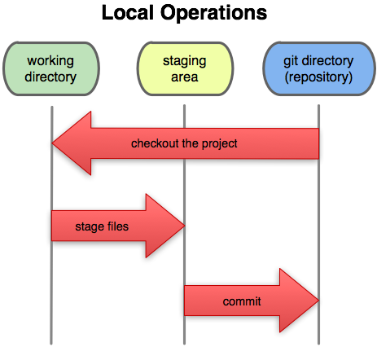

Slide 11
Git Status and Git Log
Now modify the demo.txt file.
Use git status to find out information regarding what files are modified and what files are there in the staging area.
demo.txt to the staging area and commit it using the following commands:
git add demo.txt
git commit -m "demo.txt file is modified"
Use git log to print out all the commits which have been done up until now.

Slide 12
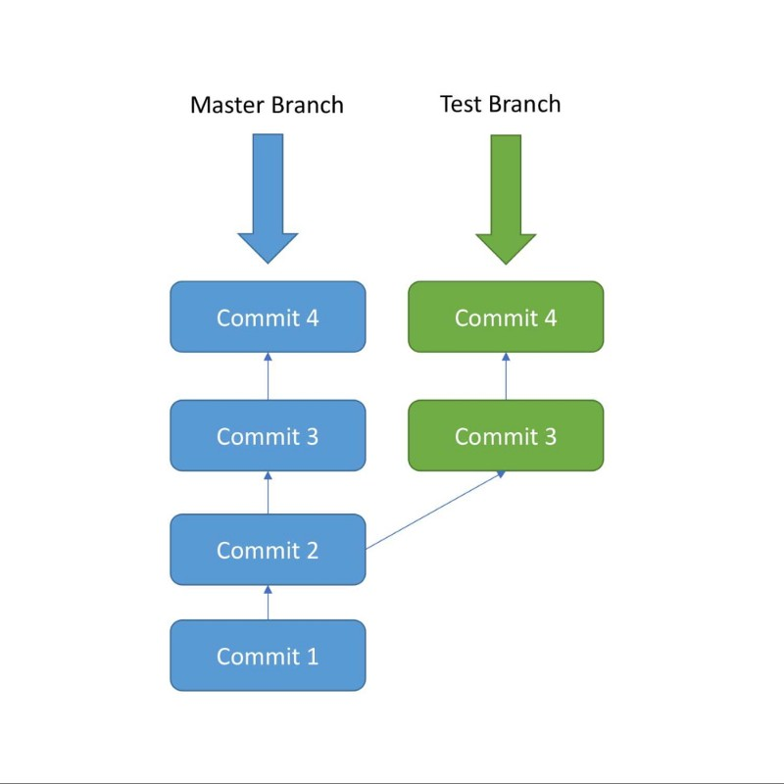
Branches
A branch is nothing but a pointer to the latest commit in the Git repository.
Multiple branches are needed to support multiple parallel developments. Image below will show how it works;

Slide 13
Create a new branch called test using the following command:
git branch test
We are still in the context of the master branch. In order to switch to the test branch. use the following command:
git checkout test
You can list out all the branches in local using the following command:
git branch
Do some commit in new branch by Modifying demo.txt and stage and commit the changes.
You can verify the commit history in Test Branch using: git log
we want all the code in the Test Branch to be brought back to the Master Branch git merge .(Merging)
In order to merge the code from the test branch into the master branch, follow these steps:
1. First go back to the master branch: git checkout master
2. Then run the merge command: git merge test

Slide 14
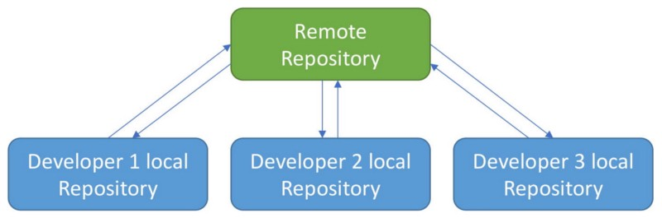
The Remote Git Repository
Each developer will work in their local repository but eventually, they will push the code into a remote repository.
Once the code is in the remote repository, other developers can see and modify that code.

Slide 15
What is github?
Github is a remote repository to store the project.
Go to https://github.com/ and create an account.
After registering in the GitHub homepage, click on Start a Project to create a new Git repository. Give the repository a name and click “Create Repository”.(ex: Git demo project)
Point your local repository to the remote repository, use the following command: git remote add origin [repository url]
push all the code from the local repository into the remote repository, use the following command: git push -u origin master
git pull is used to pull the latest changes from the remote repository into the local repository: git pull origin master
git clone is used to clone an existing remote repository into your computer. The command for this is: git clone [repository url]

Slide 16
Cmd | Description
git config | sets the author name and email address
git init | start a new repository
git clone | obtain a repository from an existing URL
git add | adds a file to the staging area
git commit | file permanently in the version history.
git diff | file differences which are not yet staged.
git reset | unstages the file
git status | lists all the files that have to be committed
git rm | deletes the file from your directory
git log | list the version history of current branch
Cmd | Description
git show | shows the metadata and content changes
git tag | Give tags to the specific commit
git branch | Lists all the local branches in repository
git checkout | switch from one branch to another
git merge | merges the branch’s history
git remote | Connect your local server to the remote server
git push | sends committed changes to remote server
git pull | fetches/merges changes on the remote server
git stash | temporarily stores all the modified tracked files

Slide 17
Links to know about Git
You can visit to https://medium.freecodecamp.org/what-is-git-and-how-to-use-it-c341b049ae61
to know more about git.
Visit https://www.siteground.com/tutorials/git/commands/ to know more about git commands.
To create account in github visit https://github.com/ .

Slide 18


