Slide 1
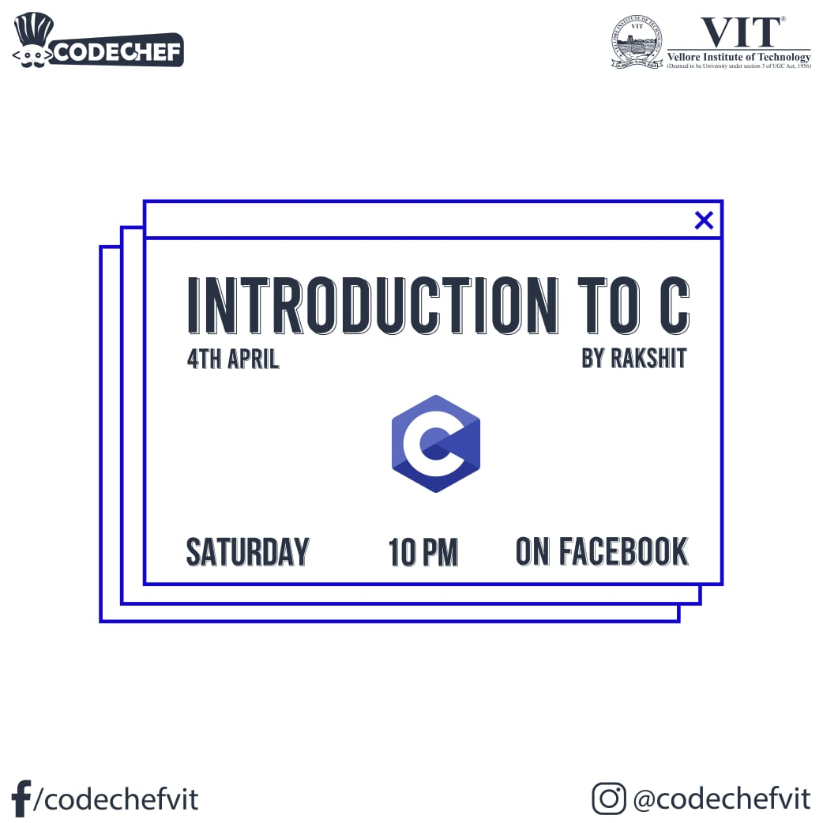

Slide 2
Reference Material :-
https://drive.google.com/drive/folders/1W1K8dbS7OzZFb2QUPOfFqUNcjojHa_Bo?usp=sharing

Slide 3
Definition :-
Dennis Ritchie (1969-1973)
C language is a general purpose ,high level ,compiler based function oriented programming language .
General purpose
High level
Compiler based
Function Oriented programming

Slide 4
Layout of a C program :-
pre-processor directives
global declarations
int main()
{
local variables to function main
statements associated with function main
Function invoking
}

Slide 5
NOTE:-
Every statement should end with ;
Program opens and closes using a parenthesis { }
Functions are defined in Header files and #include just paste the code from the header file
When the compiler encounters printf() function and doesn’t find stdio.h header file , compiler will show a error
Block of code in C need not be intended

Slide 6
Comments in C
Everything that is enclosed inside the comment is not executed by the compiler.
Single Line comments //
Multi Line comments
Multi line comment starts with /* and ends with */

Slide 7
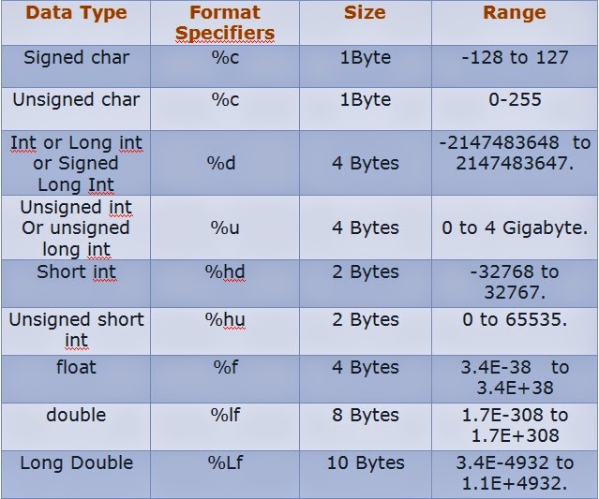
Data types and Format specifiers :-

Slide 8
INPUT &OUTPUT IN C

Slide 9
Pre-defined function :printf()
Display /Show message to the user on the screen :-
printf(“Codechef”);
Displaying values of variables to users
printf(“format_specifier”, variable_name);
Different datatypes have different format specifiers

Slide 10
Pre-defined function scanf()
Scanf() reads formatted input from the user ,When the user enter an value , it is stored in the assigned variable .
Note the ‘&’ sign before assigned variable gets the address of the variable and the value input by the user is stored in that address .
Syntax:-
scanf(“format_specifier”,&variable_name);
scanf(“%d” ,&age );

Slide 11
Identifiers :-
They are names given to different entities such as constants , variables, structures, functions etc.
Example: int corona ;
char vit ;
Corona and Vit are Identifiers and int and char are its datatypes respectively

Slide 12
Rules of Naming Identifiers in C
An identifier can have only alphanumeric characters (a-z , A-Z , 0-9) (i.e. letters & digits) and underscore( _ ) symbol.
The first character must be an alphabet or underscore.
Only first thirty-two (32) characters are significant.
Identifiers are case-sensitive.
Name Name30 Name_student | Name# 30Name Name.student

Slide 13
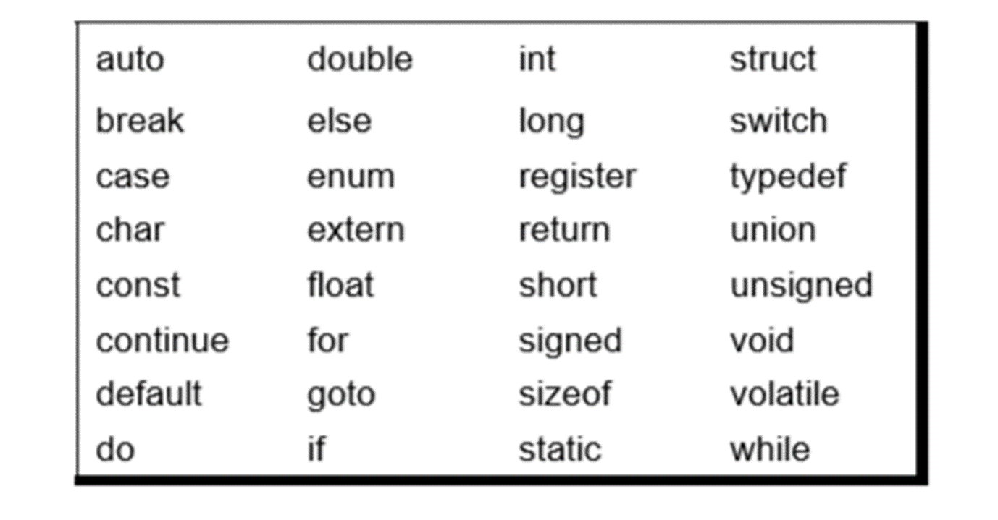
Keywords in C -

Slide 14
OPERATORS IN C
Arithmetic Operators
Relational Operators
Logical Operators
Assignment Operators
Increment and Decrement Operators

Slide 15
Arithmetic Operators-
OPERATOR | USE
+ | Addition
- | Subtraction
* | Multiplication
/ | Division 5/3=1 47/10=4
% | Modulus or Remainder after Division 5%3=2 47%10=7

Slide 16
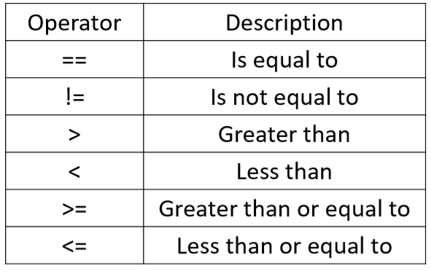
Relational Operators:-
Used to Compare two quantities or values .

Slide 17
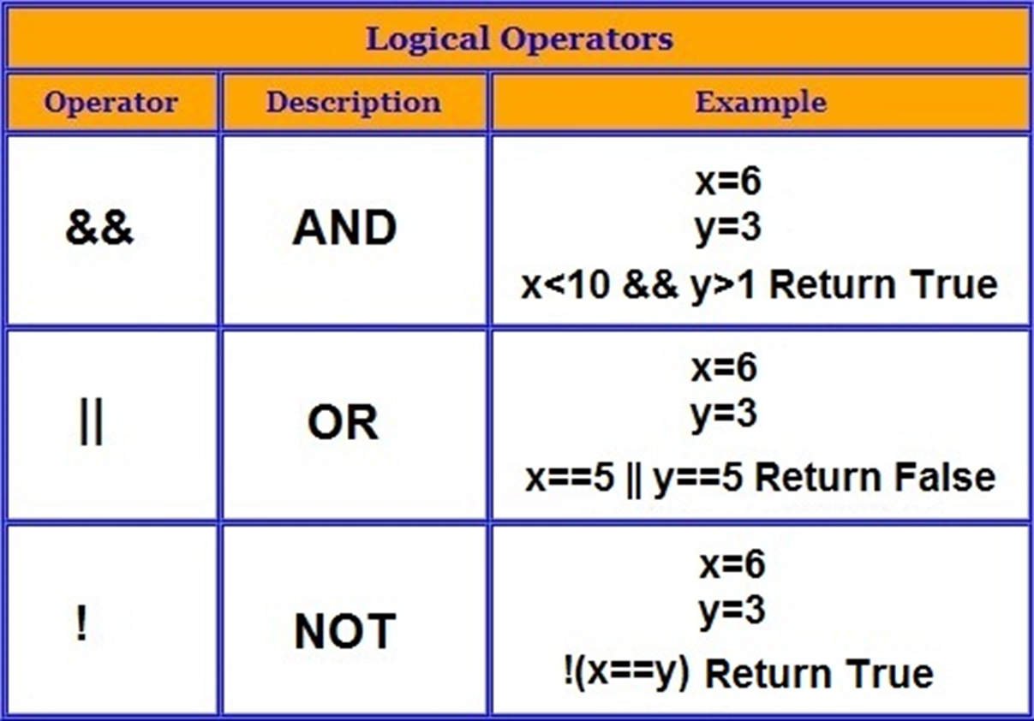
Logical Operators:-

Slide 18
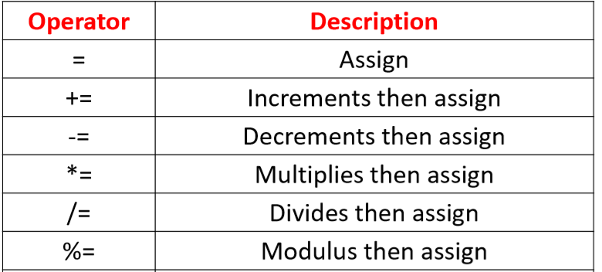
Assignment Operator
Assignment operators applied to assign the result of an expression to a variable.

Slide 19
Increment and Decrement Operator -
This Operator is used to increase or decrease the value of variable by one in c program .
Syntax:-
Increment : ++i; i++;
Decrement : --i; i--;
Difference between Post and Pre Increment /Decrement ??

Slide 20
Conditional statements
If Else
Nested If Else
Switch Case

Slide 21
If Syntax:-
if (test expression)
{
statements;
}
NOTE:-
Paranthesis is manadatory
; is not to placed after if statement
Example :-Greater of two numbers
If else Syntax:-
if (test expression)
{
statements of if body;
}
else
{
statements of else body;
}

Slide 22
Nested if else
When there are more than on if condition .
Example:- Display one if the user inputs 1
Display two if the user inputs 2
Display three if the user inputs 3
Display invalid if anything other is input

Slide 23
Switch Case Statements
Substitute for Nested if else loop, SC is faster and much more cleaner .
Syntax:-
switch(n) { case constant 1:
//code to be executed if n=constant 1
break ;
case constant 2:
// code to be executed if n=constant 2
break;
default:
//code to be executed if n doesn’t match }

Slide 24
ITERATION
For loop
Nested For loops
While loop
Do While loop

Slide 25
For loop
For loop Syntax:-
for( initialization statement ; test expression ;update statement)
{
//code
}
Initialization statement – Start point
Test expression – Condition to follow
Update statement –Increment or Decrement

Slide 26
Two variables can also be used in For loop
NOTE:- C will only consider the last condition in the test expression .
Example:- Display this “0011223344….99”.

Slide 27
While loop
In while loop we manually increment or Decrement .
Syntax:-
while (test expression )
{ //code;
Increment or Decrement ;
}

Slide 28
Do While loop
The body of the do while loop is executed once ,before even checking the test expression .
Syntax:-
do
{
//code;
Increment or Decrement ;
} while (test expression);

Slide 29
Nested loops
Nested loops are generally used to build patterns
Example:-
* 1
** 1 2
*** 1 2 3
**** 1 2 3 4

Slide 30
FUNCTIONS IN C

Slide 31
Set of statements that take inputs from the user , and do some specific computation and produce output .
Reduces the task of writing the same code again and again
Types of Functions :- Standard Library functions
User defined functions

Slide 32
Standard Library Functions :-
C has some Inbuilt functions for the users .
Examples :-
Input /Output functions, #include<stdio.h> – printf , scanf
String Handling function , #include<string.h> – strstr , strlen , strcat etc
Maths functions , #include<math.h> – pow , sqrt , ceil , floor etc

Slide 33
User defined Functions
Syntax:-
return_type function_name (type 1 argument 1 , type 2 argument 2);
Whenever the function are specified after the main( ) then a function prototype / function declaration is mandatory .
Example :-void add( );
int main( )
When the function only returns the value not prints it ??

Slide 34
ARRAYS IN C

Slide 35
An array is a collection of data that holds fixed number of values of the same type .
data_type array_name [array_size];
How to retrieve a particular element in an array??
int array[6];
array[0] =34 array[1] =90 array[0]=array[4]
How to take Input and Output in an array??
34 | 90 | 68 | 23 | 34 | 5
0 | 1 | 2 | 3 | 4 | 5

Slide 36
Search a element in array- Concept of Flag
Reverse of an array –
Temp=a[ 0]
a[ 0]=a[n-1-i] , (n-1-i) = (5-1-i) =4
=a[4]
a[n-1-i] = Temp
12 | 23 | 37 | 43 | -59
0 | 1 | 2 | 3 | 4
-59 | 43 | 37 | 23 | 12
0 | 1 | 2 | 3 | 4

Slide 37
STRINGS In c

Slide 38
Strings are character array terminated with a null character at the end .
char name[3]={ “c” , “a” ,“r” } ~Array
char name[4]={“c” , “a” , “r” ,”\0” } ~String
or
char name[4]=“car” ~String
What is a null character??

Slide 39
Always include #include<string.h> when working with strings ,it has all the special operations related to strings .
Syntax for Input and Output in strings .
Why & is not used while taking input of a string ??
Reading an entire sentence ,using gets and puts .

Slide 40
String handling functions
FUNCTIONS | USE
strlen() | Length of string
strcpy() | Copies string to another string
strcat() | Joins two strings
strcmp() | Compares two strings
strlwr() | Convert to lower case
strupr() | Convert to upper case
strrev() | Reverse a string

Slide 41
Strcmp( )
Takes two strings and returns an integer
strcmp( str1 , str2)
What is ASCII ??
Character by Character comparison is done.
0 | If both are identical
-ve | If ASCII of str1<str2
+ve | If ASCII of str1>str2

Slide 42
String in String or Character in String
Example:- Student is from electronics or computer science .
FUNCTION | USE
Strstr() | String in string
Strchr() | Character in string

Slide 43
Recursion in c
Factorial of a Number

Slide 44
Function calling itself from within the function
#include<stdio.h>
void test( )
{ test( );
}
Int main ( )
{
test( );
return 0;
}
Exit criteria is mandatory , return statement should be present based on a condition.

