Slide 1

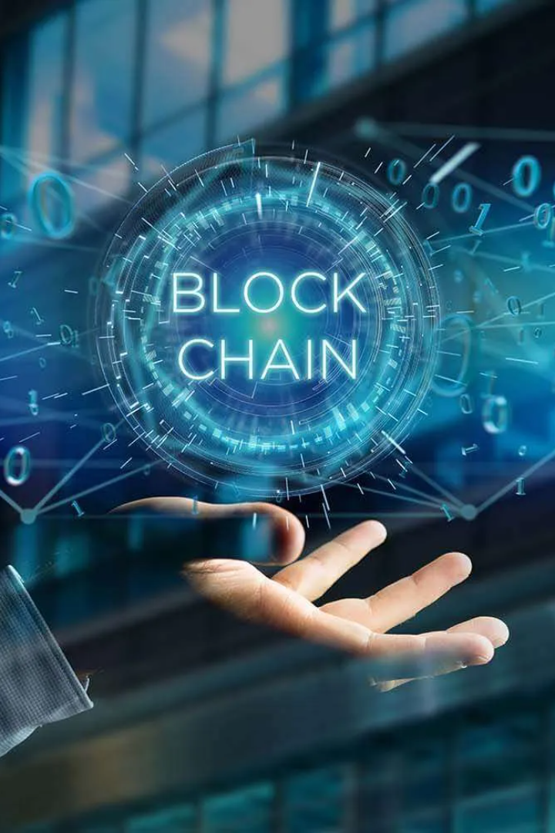

Blockchain and Cybersecurity
As the world grows more digitized, blockchain technology is becoming more valuable, but it's also crucial to protect it from cyber-attacks effectively. So, in this presentation, we will explore the correlation between Blockchain and Cybersecurity.
by Subroto Rakshit

Slide 2
What is Cybersecurity?
Creating a Secure Environment
Protecting Sensitive Data
Mitigating Risk
Cybersecurity plays a vital role in mitigating risks from malicious third parties that might damage a firm's reputation.
It ensures that only authorized parties can access sensitive data and prevent the unintended distribution of customer and proprietary information.
Cybersecurity is the practice of securing networks, devices, and applications from unscrupulous activities like theft, damage, or illegal access.

Slide 3

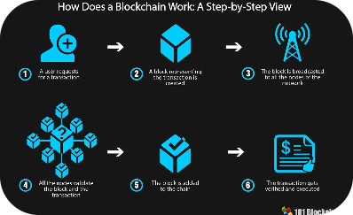
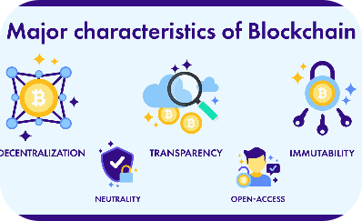
Introduction to Blockchain Technology
What is a Blockchain?
How Does it Work?
Characteristics of a Blockchain
It is a decentralized digital record-keeping system that records constant transactions and maintains their transparency.
A blockchain is a network of computers that validates transactions, these transactions are then recorded in a block, which is then linked to other blocks like a chain.
An immutable and secure peer-to-peer public record of transactions, maintained by a decentralized network of computers across the world.

Slide 4
The Importance of Cybersecurity in Blockchain Technology
1
Prevents Unauthorized Access
Cybersecurity ensures the privacy of transactions on a blockchain network from unwanted access.
Integrity of Data
2
It enables the smooth functioning of the transactional ecosystem while upholding the integrity of data and maintaining transparency.
3
Builds Trust
Cybersecurity will help build trust among stakeholders to invest in blockchain technology as a means of transfer of value.

Slide 5


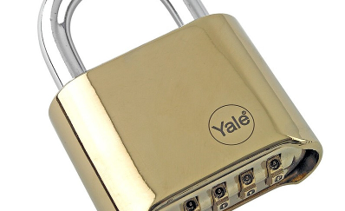
Blockchain Attacks
Common Blockchain Attacks
51% Attack
Denial of Service Attack (DoS)
When an entity or organization gains control over 51% of the computing power of a blockchain and is successful in writing incendiary transactions to the network's history to gain control of the blockchain network.
Blockchain is vulnerable to different types of attacks that put private information and systems at risk.
An attack that's made to websites, applications, or devices to hinder or forbid a client's access to a network resource by overwhelming it with fake traffic.

Slide 6
Use Cases for Blockchain in Cybersecurity
Securing Digital Identities
Cyber Threat Prediction
Supply Chain Traceability
Blockchain technology can provide secure verification and management of digital identities by offering a more decentralized approach to identity verification, which is difficult to manipulate.
The technology can track the network's consistency, warning of upcoming threats in advance, thereby facilitating a quick response to cyber externalities.
It facilitates supply chain governance by offering a shared data set that tracks information from product origin to receipt and provides greater transparency and consistency in supply chain management.

Slide 7
Challenges of Implementing Cybersecurity on a Blockchain Network
1
Complexity
The intricacies of blockchain technology and cybersecurity necessitate an in-depth understanding of the technology.
Blockchain-Ecosystem Interdependence
2
The security of the blockchain system is directly dependent on the security of the ecosystem supporting it, and the data it's handling.
3
Scalability
Blockchain networks must develop safe and scalable cybersecurity measures as blockchain's computational complexity increases.

Slide 8

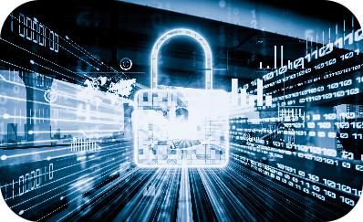
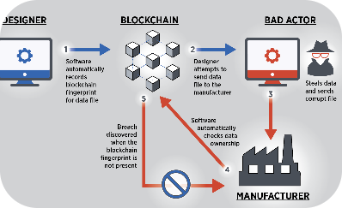
Problems and Solutions
Problems
Solutions
Future Plans
The drawback of blockchain technology is that it is vulnerable to a variety of cyber risks.
One solution to boost blockchain's cybersecurity is to establish decentralized data storage and leverage AI and machine learning technologies to assist in blocking malicious actors.
The growth of blockchain technology and the proliferation of cyber-attacks are expected to spark a surge in research and re-evaluation of how blockchain technology can address cybersecurity vulnerabilities.

Slide 9

Conclusion and Future of Blockchain and Cybersecurity
1
Blockchain technology offers a secure and immutable file-keeping record.
Cybersecurity and blockchain technology work hand in glove to create a secure ecosystem.
2
To combat and prevent cyber threats, blockchain's cybersecurity measures require collective engagement from its users.
Futuristically, blockchain technology holds immense potential to transform cybersecurity by providing security along with transparency and accountability.

