Slide 1
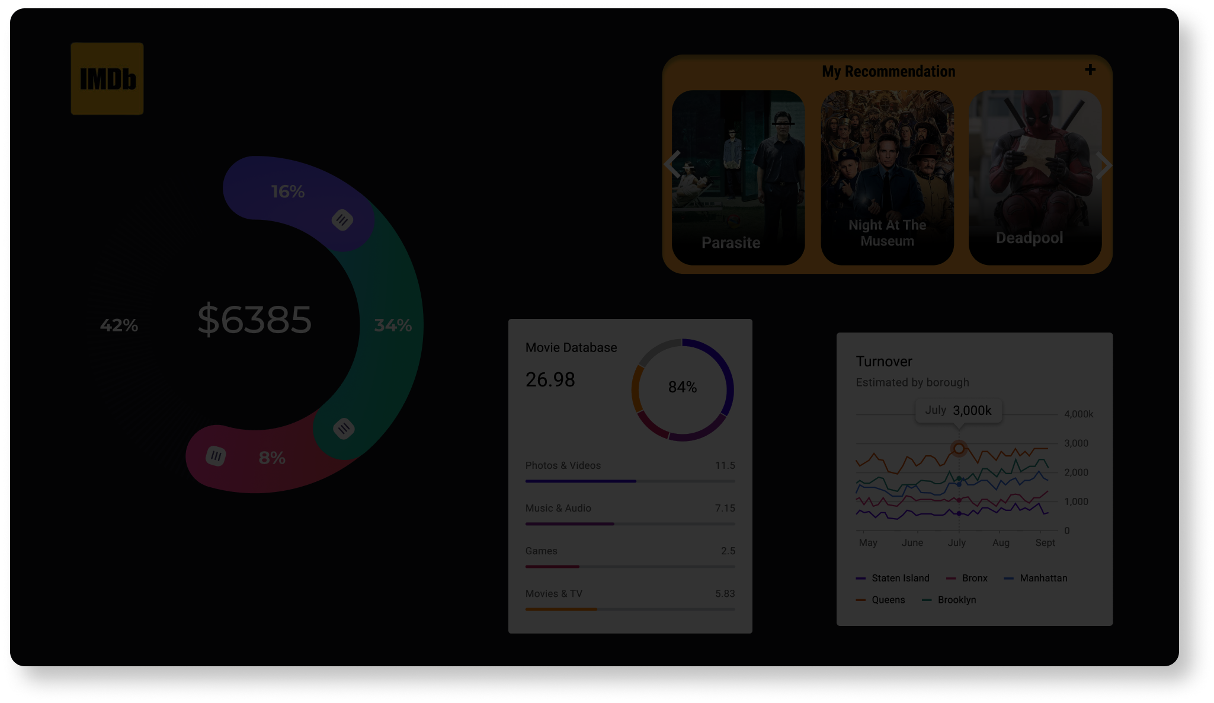
IMDB MOVIE ANALYSIS FINAL PROJECT-1
PROJECT BY- RAKSHITA SADANSHIVE

Slide 2

Project Overview
The project aimed to analyse factors influencing the success of movies on IMDB. Success was defined by high IMDB ratings. The objective was to provide insights for stakeholders in the movie industry to make informed decisions for future projects. The project covered genres, movie durations, languages, directors, and budgets as potential factors affecting movie ratings.
Excel File Link: IMDB Movie Analysis Excel Sheet

Slide 3
Approach
1. Data Collection and Cleaning: The IMDB movie dataset was obtained and pre-processed. Missing values were handled, duplicates removed, and removing unwanted attributes.
2. Data Analysis Tasks: The project followed a structured sequence of tasks:
Movie Genre Analysis: Genre distribution and impact on IMDB scores were analysed.
Movie Duration Analysis: Movie durations distribution and its relationship with IMDB scores were explored.
Language Analysis: Distribution of movies by language and its impact on IMDB scores were examined.
Director Analysis: Top directors' influence on IMDB scores and their contribution to movie success were studied.
Budget Analysis: Correlation between budgets and gross earnings, along with movies with high profit margins, were investigated.
3. Five 'Whys' Approach: This technique was applied to delve deeper into findings, seeking to understand the underlying reasons behind observed trends.

Slide 4

Tech-Stack Used
Microsoft Excel 2019: Used for data preprocessing, calculations, and analysis.
Excel Functions: Utilized functions like COUNTIF, AVERAGE, MEDIAN, MODE, MAX, MIN, VAR, STDEV, and PERCENTILE for data manipulation and statistical analysis.
Scatter Plots and Trendlines: Excel's visualization tools were used to create scatter plots with trendlines for understanding relationships.

Slide 5
Insights
Genres Influence on Ratings: Certain genres consistently yielded higher IMDB scores, indicating genre's impact on viewer preferences.
Action and Comedy genres are the most common genres of movies people prefer to watch.
Genre | Genre Count
Action | 955
Adventure | 371
Animation | 46
Biography | 207
Comedy | 995
Crime | 256
Documentary | 31
Drama | 676
Family | 3
Fantasy | 37
Horror | 160
Musical | 2
Mystery | 23
Romance | 2
Sci-Fi | 8
Thriller | 1
Western | 3
Grand Total | 3776
AVERAGE | 222.12
MEDIAN | 37
MODE | 3
MAX | 995
MIN | 1
VAR | 112312.61
STD DEV | 335.13

Slide 6
Insights
Duration and IMDB Scores: Movies with varying durations were present in the dataset, but no strong correlation was found between movie duration and IMDB scores.
Movie duration and IMDB score has a linear relationship.
Maximum movies fall under the range of duration of approx. 75 minutes to 200 minutes and IMDB scores ranges between 2 to 9.5.
AVERAGE | 110.16
MEDIAN | 106
STD DEV | 22.76

Slide 7
Insights
Language's Role: Movies in English and a few other languages dominated the dataset. However, language didn't exhibit a significant impact on IMDB scores.
Language | Language Count
Aboriginal | 2
Arabic | 1
Aramaic | 1
Bosnian | 1
Cantonese | 8
Czech | 1
Danish | 3
Dari | 2
Dutch | 3
Dzongkha | 1
English | 3604
Filipino | 1
French | 36
German | 13
Hebrew | 2
Hindi | 8
Hungarian | 1
Icelandic | 1
Indonesian | 2
Italian | 7
Japanese | 12
Kazakh | 1
Korean | 5
Mandarin | 14
Maya | 1
Mongolian | 1
Norwegian | 4
Persian | 3
Portuguese | 5
Romanian | 1
Russian | 1
Spanish | 23
Swedish | 1
Telugu | 1
Thai | 3
Vietnamese | 1
Zulu | 1
(blank)
Grand Total | 3776
MEAN | MEDIAN | STD DEV
6.95 | 6.6 | 1.1
7.2 | 6.6 | 1.1
7.1 | 6.6 | 1.1
4.3 | 6.6 | 1.1
7.24 | 6.6 | 1.1
7.4 | 6.6 | 1.1
7.9 | 6.6 | 1.1
7.5 | 6.6 | 1.1
7.57 | 6.6 | 1.1
7.5 | 6.6 | 1.1
6.43 | 6.6 | 1.1
6.7 | 6.6 | 1.1
7.3 | 6.6 | 1.1
7.69 | 6.6 | 1.1
7.6 | 6.6 | 1.1
7.18 | 6.6 | 1.1
7.1 | 6.6 | 1.1
6.9 | 6.6 | 1.1
7.9 | 6.6 | 1.1
7.19 | 6.6 | 1.1
7.63 | 6.6 | 1.1
6 | 6.6 | 1.1
7.7 | 6.6 | 1.1
7.02 | 6.6 | 1.1
7.8 | 6.6 | 1.1
7.3 | 6.6 | 1.1
7.15 | 6.6 | 1.1
8.13 | 6.6 | 1.1
7.76 | 6.6 | 1.1
7.9 | 6.6 | 1.1
6.5 | 6.6 | 1.1
7.08 | 6.6 | 1.1
7.6 | 6.6 | 1.1
8.4 | 6.6 | 1.1
6.63 | 6.6 | 1.1
7.4 | 6.6 | 1.1
7.3 | 6.6 | 1.1

Slide 8
Insights
Director's Impact: Top directors consistently achieved higher IMDB scores, suggesting their influence on movie success.
List of top 15 directors shows that Tony Kaye and Charles Chaplin are the directors whose movies success rate is consistently 93%.
Top 15 Directors | Average IMDB Score
Tony Kaye | 8.6
Charles Chaplin | 8.6
Alfred Hitchcock | 8.5
Damien Chazelle | 8.5
Majid Majidi | 8.5
Christopher Nolan | 8.43
Sergio Leone | 8.43
S.S. Rajamouli | 8.4
Richard Marquand | 8.4
Asghar Farhadi | 8.4
Lee Unkrich | 8.3
Fritz Lang | 8.3
Lenny Abrahamson | 8.3
Billy Wilder | 8.3
Charles Ferguson | 8.3
LARGE | 8.6
RANK | 0.928
PERCENTILE | 8.6

Slide 9
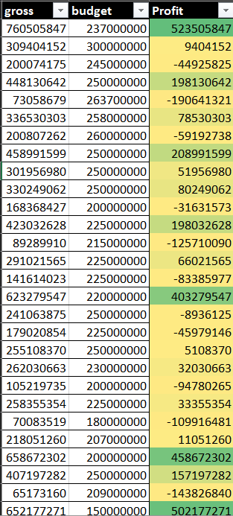
Insights
Budget and Success: While a positive correlation between budget and gross earnings existed, it wasn't a guarantee of high IMDB ratings. Some lower-budget movies achieved remarkable success.
CORRELATION
0.099226689
HIGH PROFIT MARGIN
523505847

Slide 10
Results
The project successfully analysed multiple aspects influencing movie success on IMDB, providing valuable insights into factors like genres, director influence, and budget correlations.
The approach utilized statistical analyses, visualizations, and the 'Five Whys' technique to dig deeper into findings, resulting in a comprehensive understanding of the dataset.
The project contributed to a nuanced understanding of the complexities surrounding movie success, highlighting that multiple factors play a role, and that success isn't solely determined by budget or genre.
In conclusion, the project's approach of analysing various factors influencing IMDB movie ratings provided valuable insights for stakeholders, enabling them to make informed decisions for future movie projects.

