Slide 1
EVENT MANAGEMENT SYSTEM
PRESENTED BY UNDER THE GUIDENCE
RAKSHITHA K N Of
LAVANYA L B Mr. Murthy P G
ABHISHEK GANESH

Slide 2
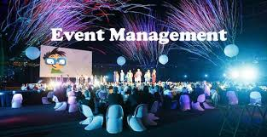
INTRODUCTION
Traditional event management system often manual, time-consuming and prone to errors.
There is a growing need for a digitial platform to streamline event planning and execution.
Our project is a web-based Event Management System designed to simplify the organization of various events.
The System supports multiple roles like Admin, Organizer and Users.

Slide 3
OBJECTIVES
To build a centralized plaform for managing different types of events.
To implement role-based access for Admins, Organizers and Users
To Simplify the event creation, registration and participation process
To improve user experience with a clean and responsive interface
To automate event-related tasks and reduce manual work.

Slide 4
ROLES IN THE SYSTEM
Admin :
Manages users and organizers.
Monitors system activity and event approvals.
Organizer :
creates, updates and manages event details.
Views participant lists and registrations.
User :
Registers and participates in events.
Views upcoming events.

Slide 5
SERVICES
Wedding Events
Corporate Events
Private Parties
Schools and College Fests
Birthday Parties
Music and Entertainments

Slide 6
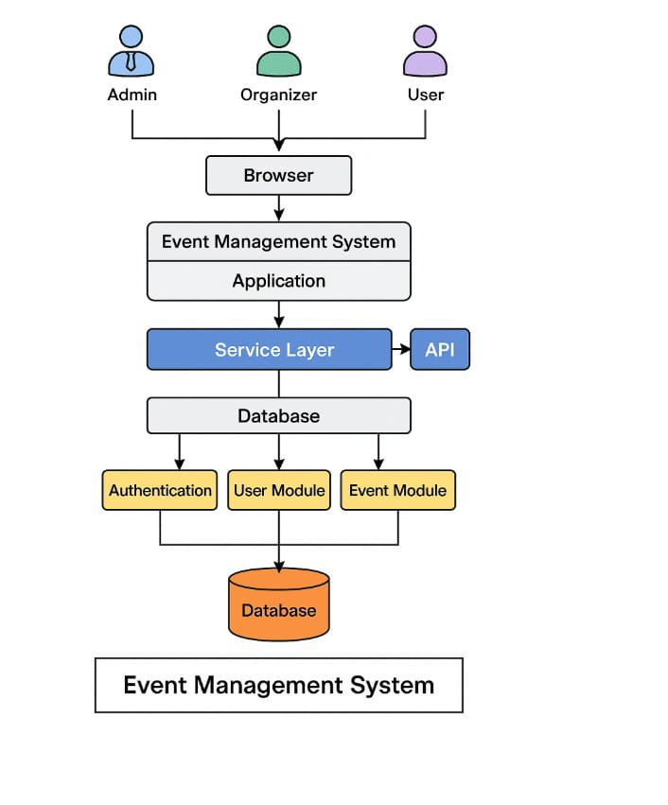
SYSTEM ARCHITECTURE

Slide 7
Frontend :
User interface for Admin, Organizer and User
Backend:
Business logic and API handling using (Spring Boot)
Database:
Stores user data, event details, registration(MySQL)
Role-based access ensures secure operations.

Slide 8
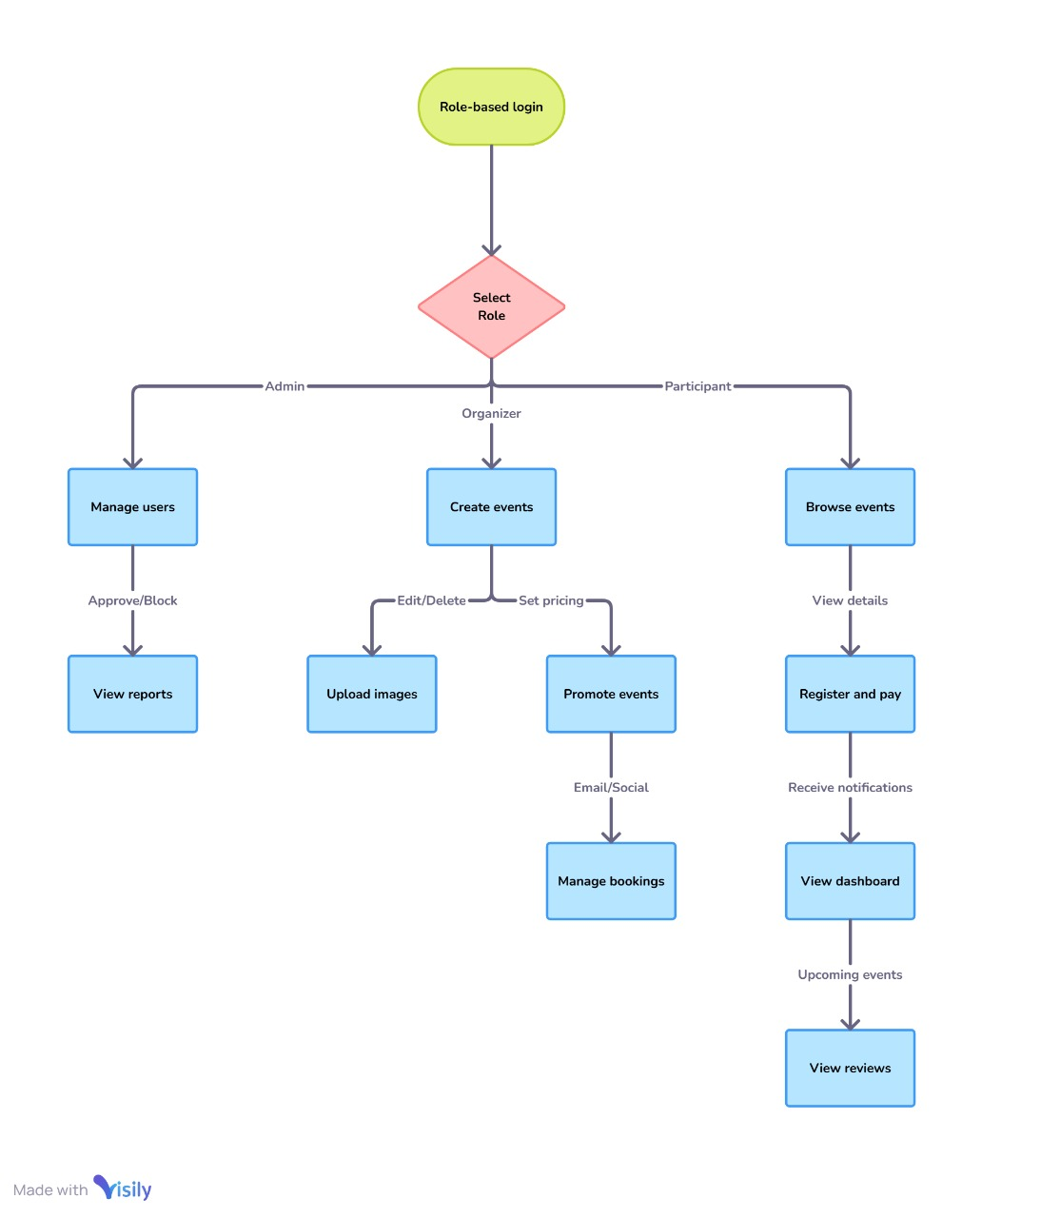
FLOWCHART

Slide 9
The system uses a Role-Based Login, where users choose a specific role after logging in.
Admins: Manage user accounts (approve/block) and Access and view system reports.
Organizers:Create, edit, and delete events also Manage event bookings.
Organizer Promote events via email or social platforms and Upload event images and set pricing.

Slide 10
Participants:Browse and view event details by Registering for events and make payments.
Participant access their dashboard to track activities and View and submit event reviews.
The flow ensures role-specific access to maintain security and organized functionality within the Event Management System.

Slide 11
KEY FEATURES
Secure login system with role-based dashboards
Event creation, editing and deletion by organizers.
Users can browse, register and participate in events.
Admin for managing users, events and monitoring system activity.
Search and filter events by category/date.

Slide 12
CONCLUSION
The Event Management System streamlines the process of planning, organizing, and managing various events. By offering role-based access the system ensures smooth coordination and secure operations. It enhances user experience through a centralized platform for event registration, booking, and feedback. The integration of backend modules and a service layer supports efficient data handling and real-time updates. Overall, the system reduces manual efforts, increases productivity, and ensures successful event execution.

Slide 13


